Slide 1
Clinical Test Maintenance
IOS Batch -
Gourishanker
Sinchana R G
Tufail Ahmad
Nandan R
Nagarajupalli Dinesh Kumar

Slide 2
The problem
Clinical Test Maintenance
Create a screen with Login Id and Password for XDiagnostics labs. Check for the distinct roles and restrict access to perform the specified operations. (I.e., User cannot Modify/Delete values.). User types are Admin and User.
Tests are of two types 1. Pathology, 2. Radiology
Sample types like blood,urine,lipid etc.
Department information too to be maintained as a static table.

Slide 3
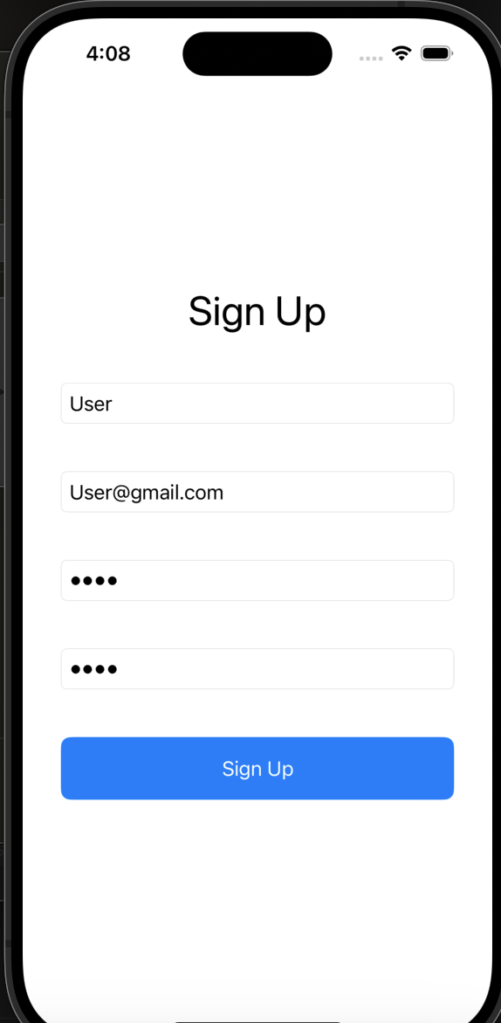
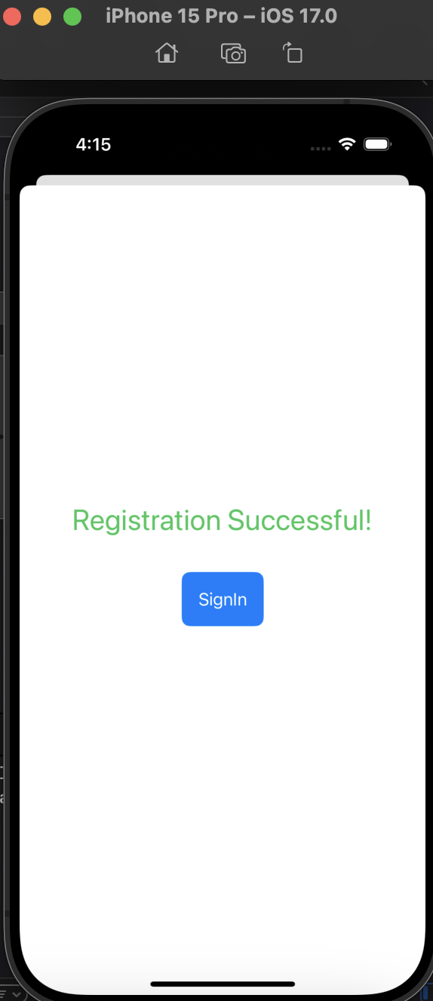
SignUp and Registration
Clinical Test Maintenance

Slide 4
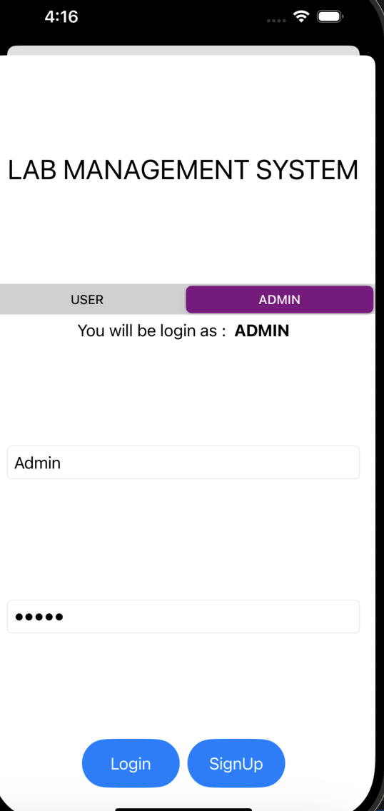
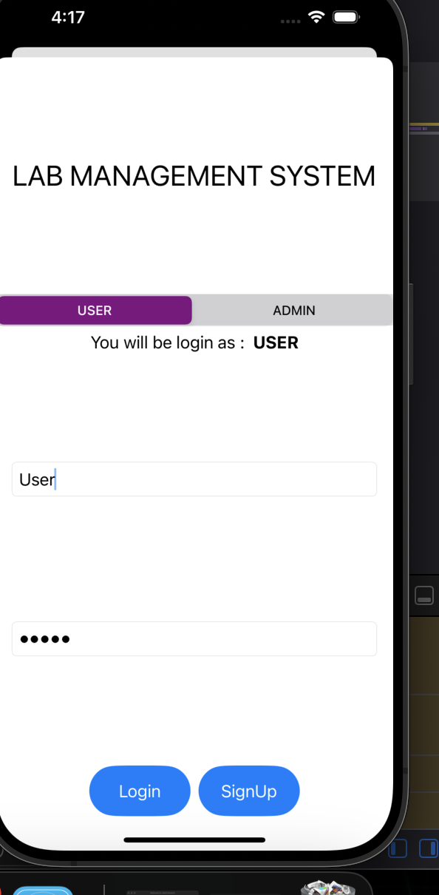
Signin Page
Clinical Test Maintenance

Slide 5
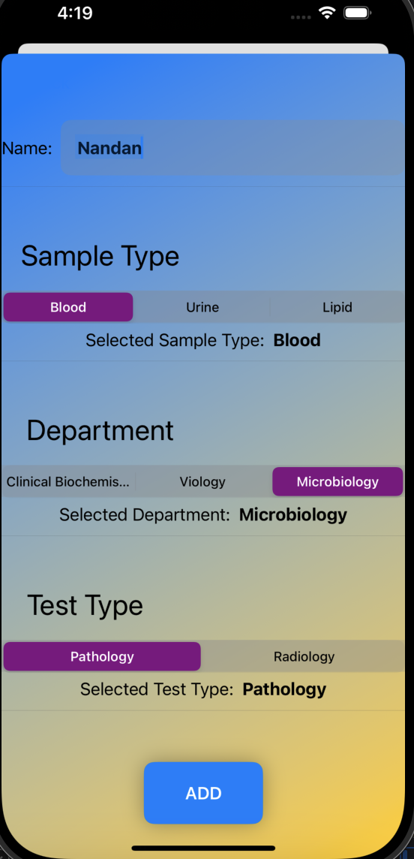
Main Page - to add Data
Clinical Test Maintenance

Slide 6
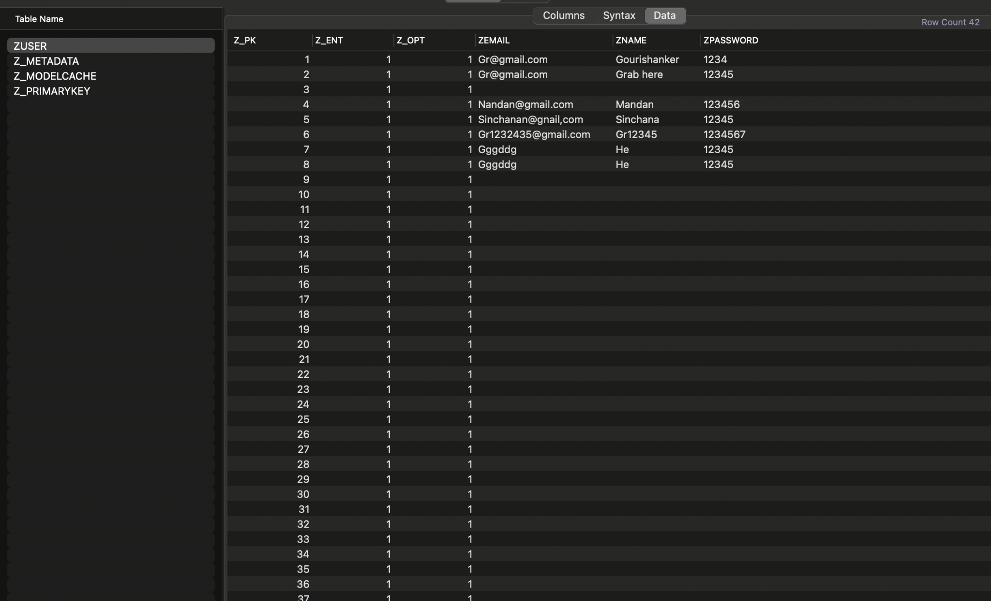
Core Data

Slide 7
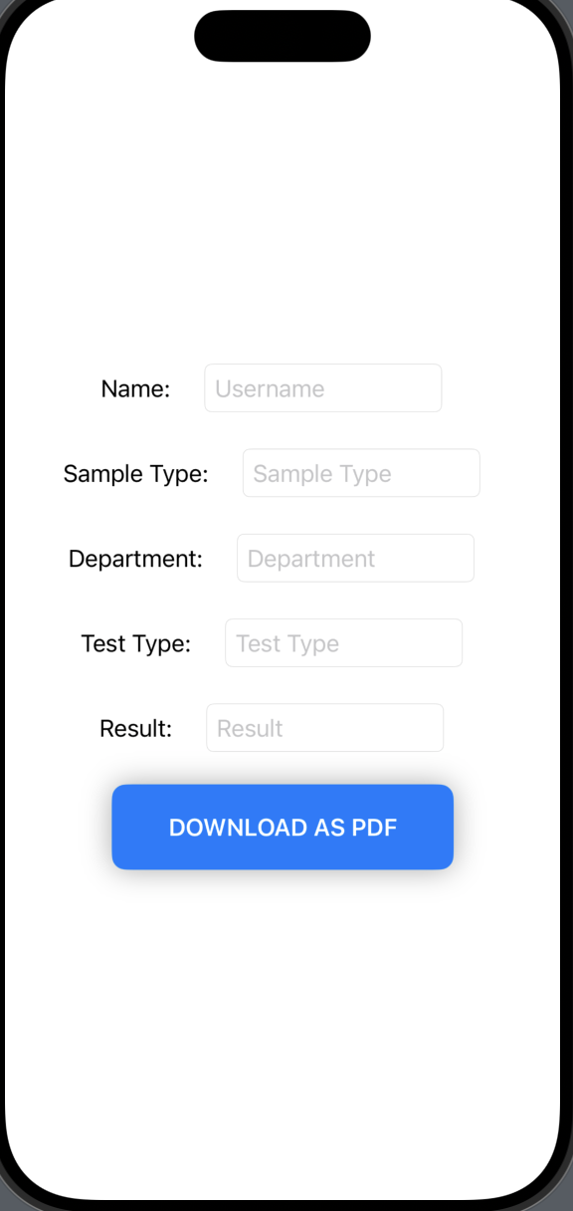
View Page
Clinical Test Maintenance

Slide 8
Thank You

