Slide 1
Sports Data Analytics
Tyler Gourley

Slide 2

The Question…
Can we predict the outcome of soccer matches based on team chemistry?

Slide 3
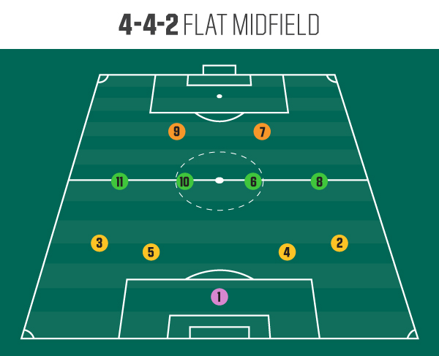
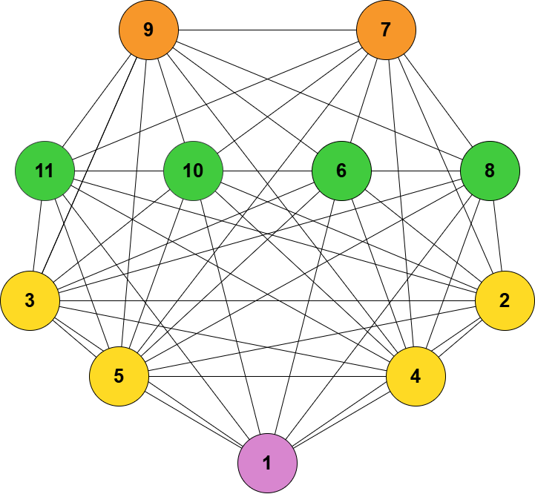
Graphical Representation
Each match will have 2 Complete, Weighted Graphs (one for each team)

Slide 4
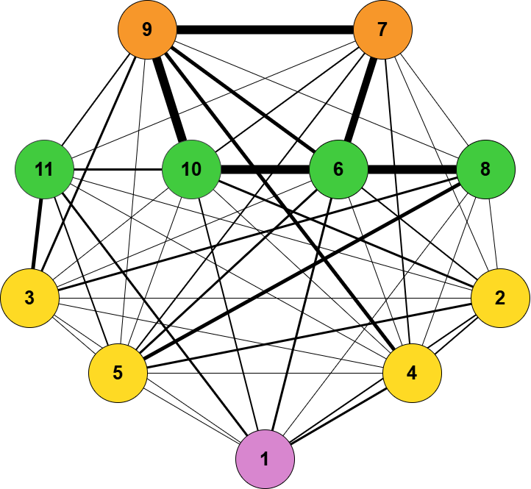
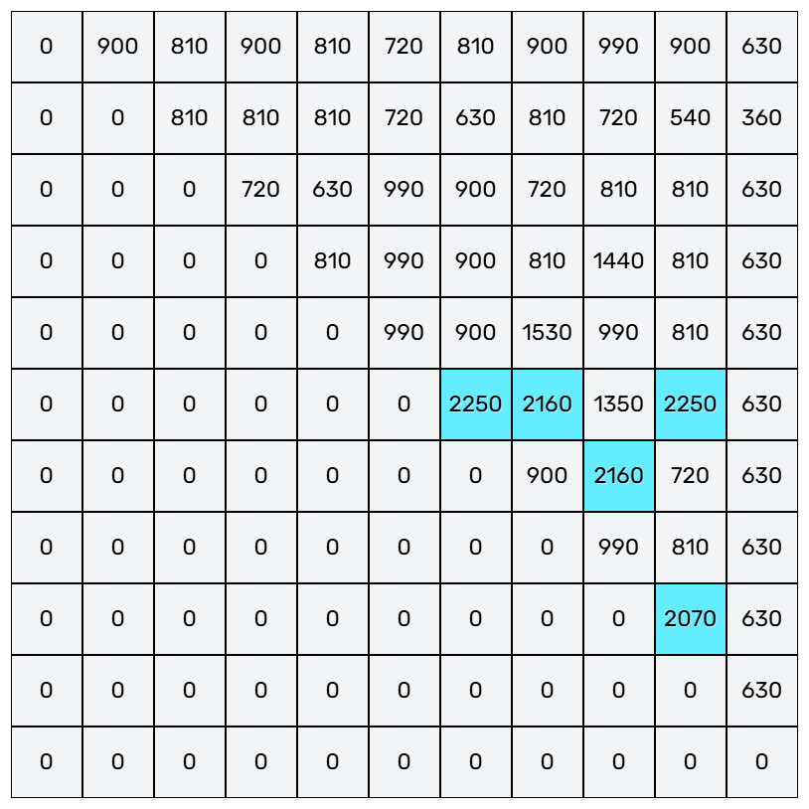
Numerical Representation
Convert the Weighted Graphs to Numpy Arrays
**These arrays will be the
input to our machine
learning models

Slide 5
Process
Compile the Data
Data Preprocessing
Machine Learning
Results

Slide 6
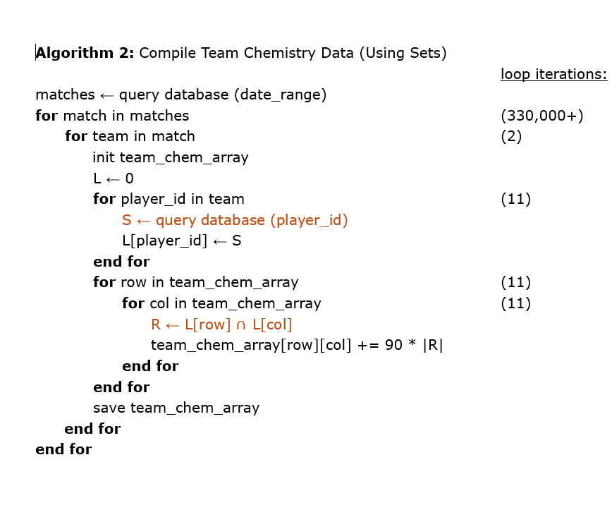
Data Compilation Algorithm
Algorithm 1:
Our database contains the playing time data for over 330,000 soccer matches
We iterate over every cell in the upper triangular array (representing the 55 player combinations possible)
For every cell, we need to query the database again to determine how many game minutes the players played together

Slide 7
Motivation for Data Preprocessing
We have a 55-feature input, but some models only work well with few features of the input data
Normalize our data to make the samples easily comparable
Maybe we only want to analyze data from certain teams/leagues (filtering)
What about matchup advantages? Can we use playing time data from the other team to aid in predictions

Slide 8
Data Preprocessing Techniques
Simple Average
Box and Whisker
Group by Player Position
PCA
Euclidean Normalization
Standard Scaler
Log Transform
…and more

Slide 9
Machine Learning Algorithms
K Nearest Neighbors (k-NN)
Decision Trees

Slide 10
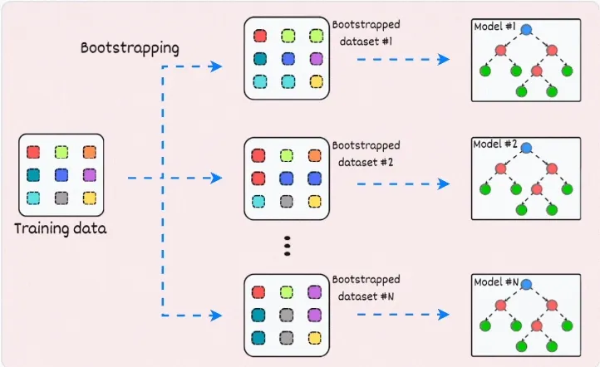
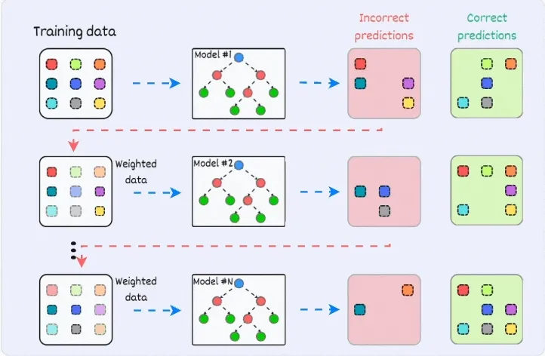
More ML Algorithms
Linear Regression
Least Squares
Bagging and Boosting Techniques
Clustering Algorithm

Slide 11
Convolutional Neural Networks (CNNs)
Classification
Cluster Algorithms

Slide 12
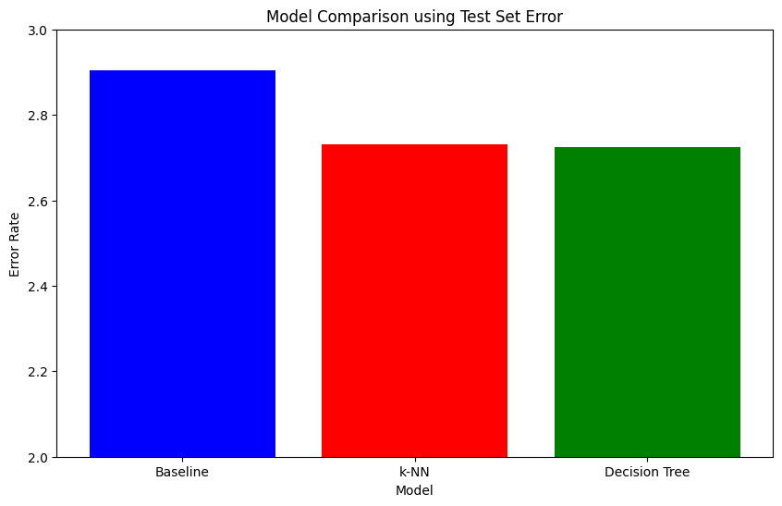
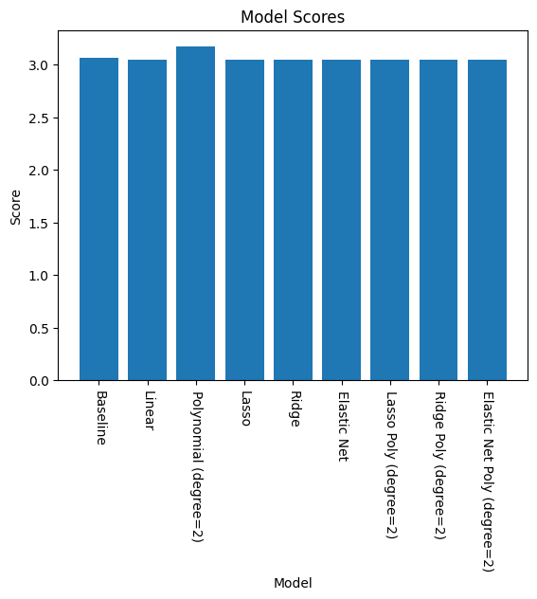
Preliminary Results
The performance metrics were run on a representative 200 match portion of the overall database (330,000+ matches)

Slide 13
What’s Next?

Slide 14
Questions?

