Slide 1
REVOLUTIONIZING COMMUNICATION: EXPLORING ANDROID CHATBOT APPLICATIONS WITH GENERATIVE AI

Slide 2

INTRODUCTION
An overview of Android chatbot applications and their impact on communication. Exploring the potential of generative AI in revolutionizing the way we interact and engage with technology.

Slide 3
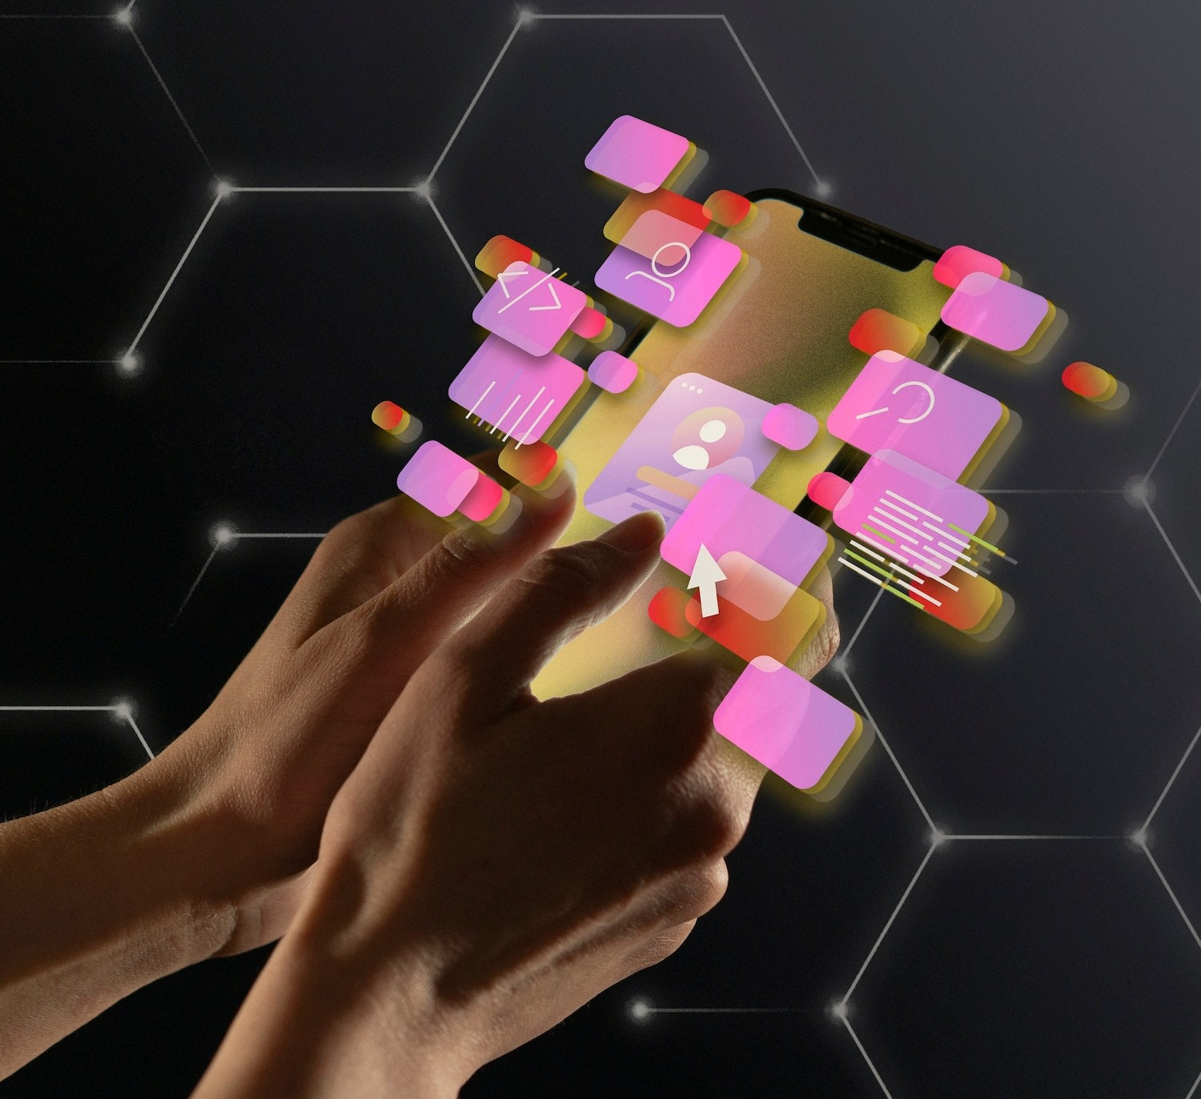
UNDERSTANDING CHATBOTS
The role of chatbots in modern communication, their ability to interpret natural language and provide personalized responses. Exploring the evolution of chatbot technology and its impact on user experience.

Slide 4

GENERATIVE AI IN CHATBOTS
Unleashing the power of generative AI in chatbot applications. Understanding how machine learning enables chatbots to generate human-like responses and enhance conversational experiences.

Slide 5
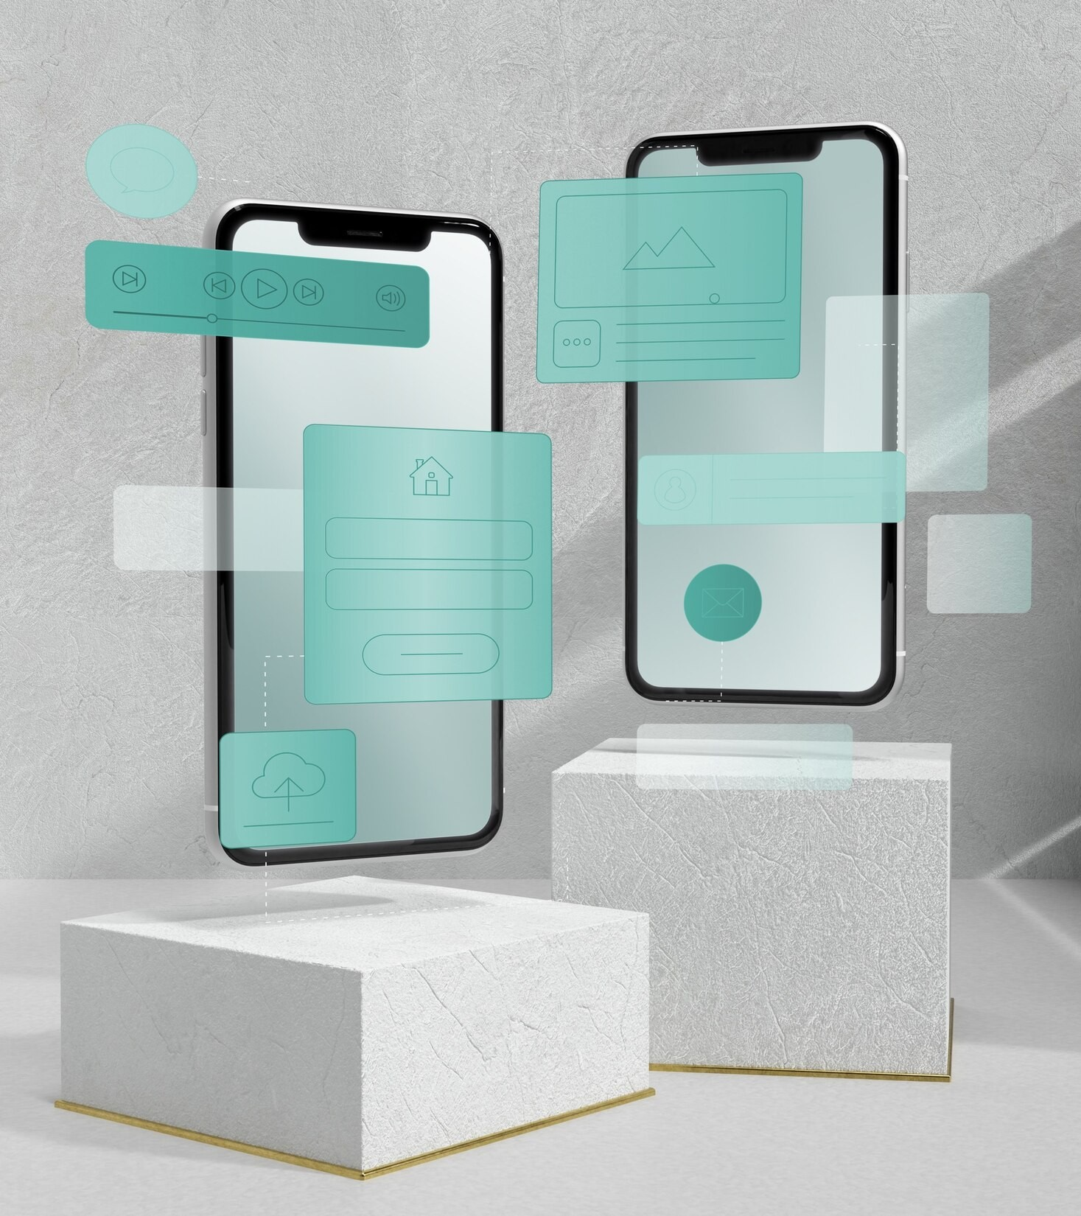
ANDROID CHATBOT APPLICATIONS
Exploring the diverse range of Android chatbot applications and their impact on various industries. Examples of successful integration of chatbots in Android platforms and their beneﬁts.

Slide 6
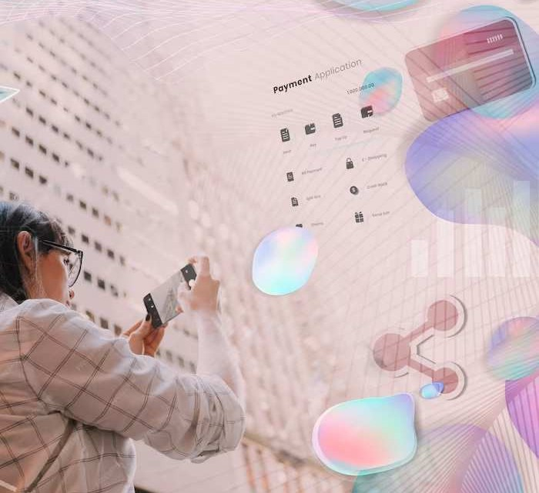
ENHANCING USER EXPERIENCE
The role of Android chatbot applications in enhancing user experience through personalized interactions and e cient problem-solving. Exploring the potential of chatbots in streamlining communication processes.

Slide 7
CONCLUSION
Reﬂecting on the transformative potential of Android chatbot applications with generative AI. Emphasizing the signiﬁcance of innovation in communication technology and its implications for the future.

Slide 8




Thanks!
Do you have any questions? youremail@email.com
+91 620 421 838
www.yourwebsite.com @yourusername

