Slide 1


Cricket Tournament
SUPERVISEE
Gourove Roy
ID : 2105017
&
Sadrul Islam Faysal
ID : 2105018
Supervisor
Ishrat jahan
Lecturer in Computer Science & Engineering, BUET ishrat@teacher.cse.buet.ac.bd , ishratjahan039@gmail.com

Slide 2
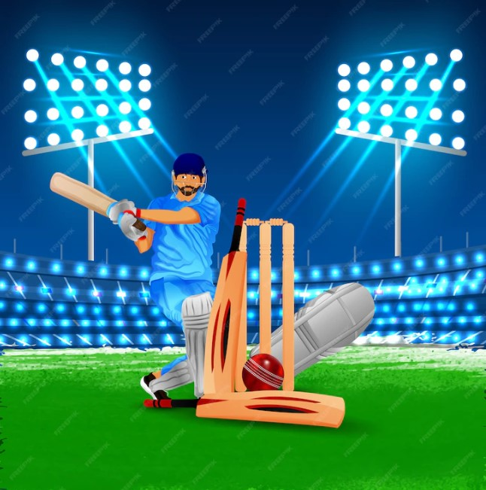
Project Objectives
Relationships between entities (e.g., players, teams, matches) are defined and maintained, allowing for efficient data retrieval and minimizing the risk of inconsistencies.
Streamlining and centralizing data related to cricket leagues.
Enhancing data accuracy and accessibility for stakeholders.
Facilitating easy retrieval of statistical information and efficient querying.
Through optimized queries and indexing, users can quickly obtain specific data such as player performance metrics, team rankings, and historical match outcomes.

Slide 3

Data Model
Entities: Players, Teams, Matches, Point table, match history, tournament, awards, venues.
Relationships: Player-team associations, match-player relationships, match-history relationships etc.
Attributes: Player statistics, team details, match outcomes, awards winning, venue details etc.

Slide 4
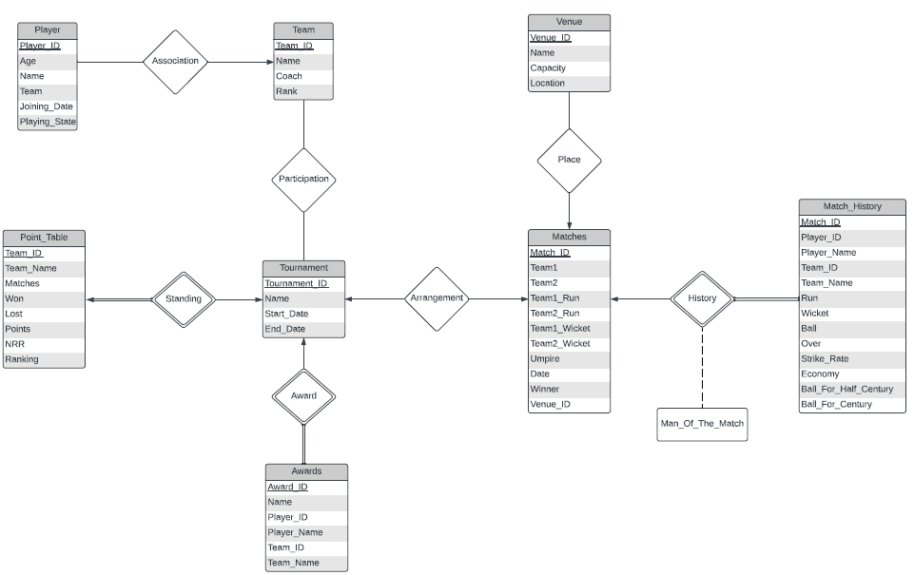
RELATIONSHIP
One to one : tournament – point_table(standing), tournament – matches(arrangement)
One to many : tournament – awards(award), team – player(association), matches – venue(place), matches – match_history(history)
Many to many : team – tournament(participation)

Slide 5
ER DIAGRAM
HJ

Slide 6

PROJECT’S BASIC STRUCTURE
THIS PROJECT CONTAIN A TOURNAMENT ENTITY WHICH HAS SOME EVENTS WHERE SOME TEAM CAN PARTICIPATE.
EVERY TEAM CONTAINS PLAYER ENTITY WHERE PLAYERS HAVE THEIR INFORMATIONS.
ALSO EVERY EVENT HAS A POINT TABLE WHICH CONTAIN EVERY TEAMS RANKING, WIN-LOSS, NRR
THERE ARE SOME AWARDS IN EACH TOURNAMENT.
EVERY TOURNAMENT HAVE SOME MATCHES ENTITY WHICH CONTAIN EVERY MATCH WITH THERE DETAILS INFORMATION.
THERE ALSO A VENUE ENTITY.
THERE IS STATS SECTION IN WHICH SOME STATS OF THE TOURNAMENT WILL BE SHOWN SUCH AS MOST RUN SCORERS, MOST WICKET-TAKER, MOST SIXES ETC.
THERE IS A NEWS SECTION WHERE NEWS OF THE TOURNAMENT WILL BE PROVIDED

Slide 7

MATCHES
EVERY MATCH HAS BATTING AND BOWLING PERFORMANCE OF TWO INNINGS OF A MATCH
EVERY MATH HAS A DESCRIPTIVE ATTRIBUTE (Man of the match).

Slide 8
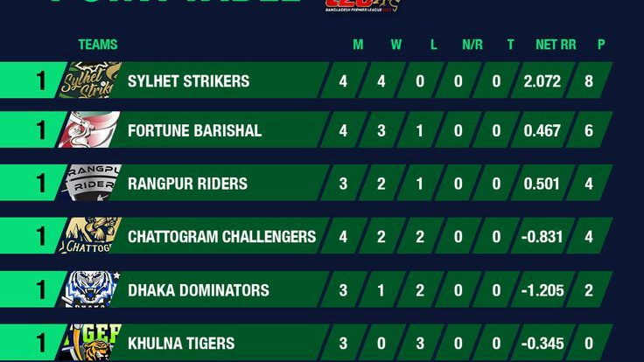
POINTS TABLE
THIS PART CONTAINS THE STANDING OF THE TOURNAMENT
WHERE VIEWERS CAN SEE EACH TEAM’S RANKING IN THE TOURNAMENT,WINNING PERCENTAGE , LOSS PERCENTAGE, NET RUN RATE, AND POINTS

Slide 9

STATS
THIS SECTION WILL SHOW THE STATS OF THE TOURNAMENT
STATS SUCH AS MOST SIXES, MOST RUN SCORER, MOST WICKET TAKER, BEST ECONOMY RATE, BEST AVERAGE ETC

Slide 10

AWARDS
IN THIS SECTION, DIFFERENT AWARDS WITH THEIR WINNER WILL BE SHOWN.
WINNERS DETAILS WILL ALSO BE AVAILABLE IN THIS SECTION

Slide 11
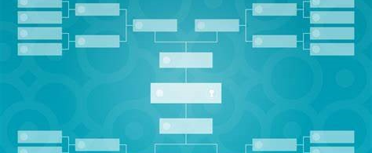




MATCH SCHEDULE
MACH SCHEDULE OF THE TOURNAMENT WILL BE SHOWN IN THIS PART

Slide 12

NEWS IN THIS SECTION, NEWS OF THE TOURNAMENT WILL BE SHOWN

Slide 13
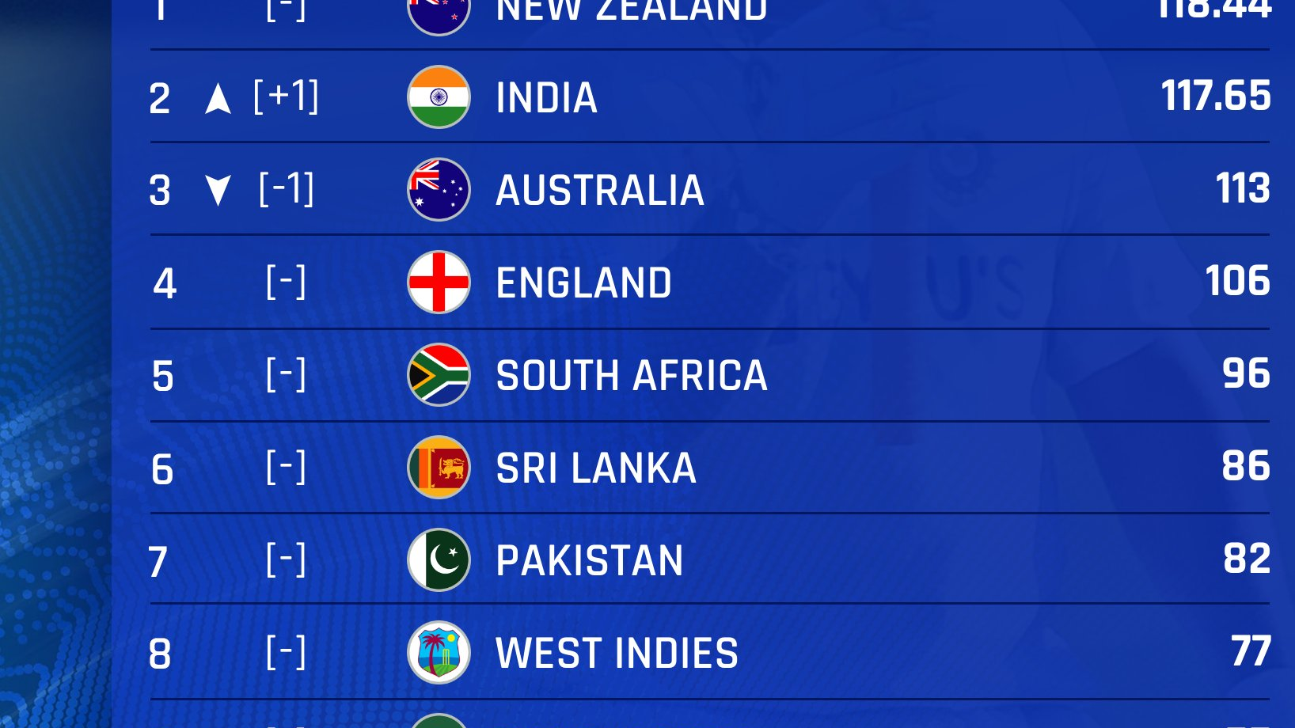
RANKING
TEAMS RANKING AND PLAYER RANKING WILL BE SHOWN HERE

Slide 14
SUMMARY
The Cricket League Database Management System (DBMS) project is designed to revolutionize the management and analysis of cricket-related data within a league context.
This project aims to enhance the overall efficiency, accuracy, and accessibility of cricket league management by leveraging database management principles to organize, secure, and present cricket-related data in a meaningful and user-friendly manner. The project's features cater to the diverse needs of stakeholders, from league administrators and team managers to players and fans, fostering a data-driven approach to decision-making and league operations.

