Slide 1
WSWE
Team Name: </Scorpion>
G. Srinivas
Avinassh Bharadhwaj
P. Durga Prasad

Slide 2
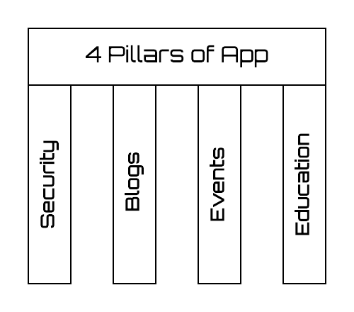
Problem Statement
Women Safety and Women Empowerment
Solution
Our main moto is to develop a mobile application based on the four key stones of Women Empowerment and Safety.
Security
Education
Blogs
Events

Slide 3
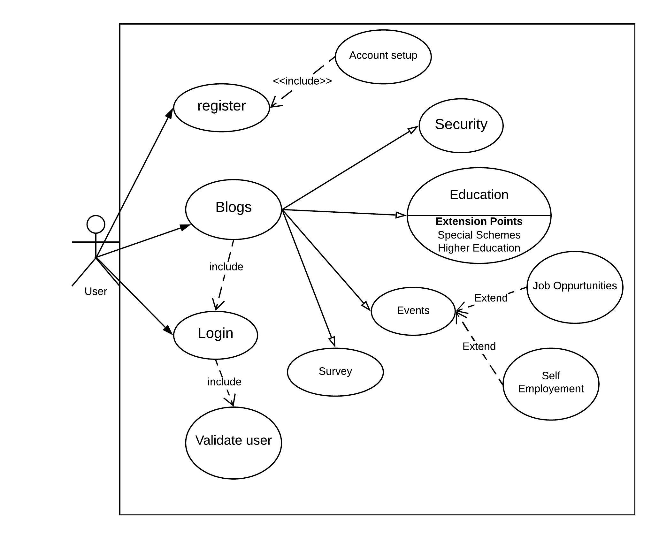
Use case

Slide 4
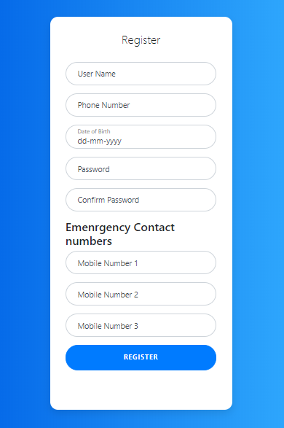
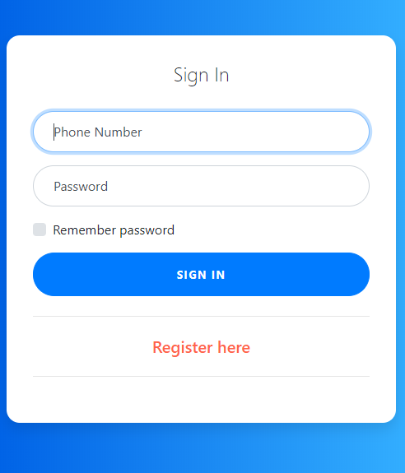

Slide 5
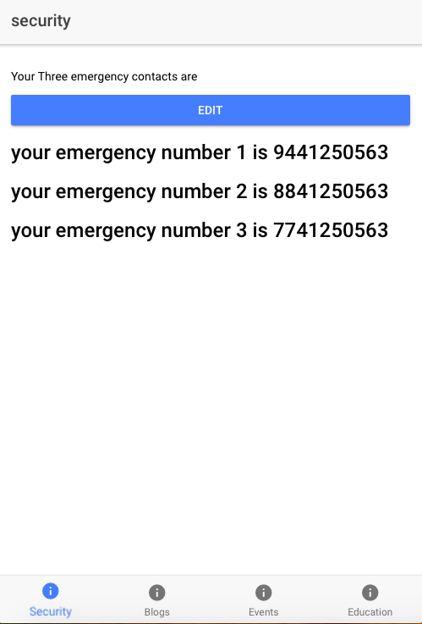
Security
Security is achieved using alert messaging and geo tagging.
App sends recent location of user to near by police stations in emergency cases.

Slide 6
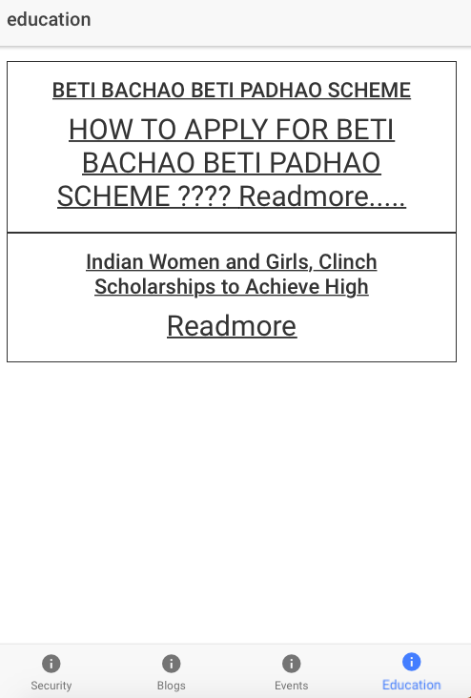
Education
Special schemes by government and private sectors.
Provides information about Educational institutes and Universities that provides special opportunities for women.

Slide 7
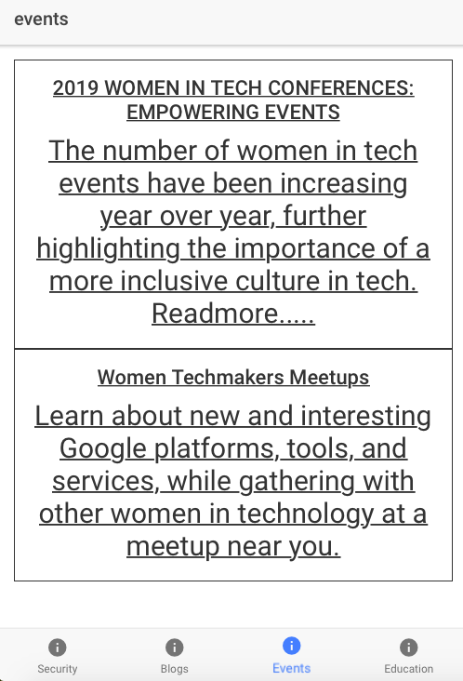
Events
Events that are special conducted for women
Events will be shown based on users choice.

Slide 8
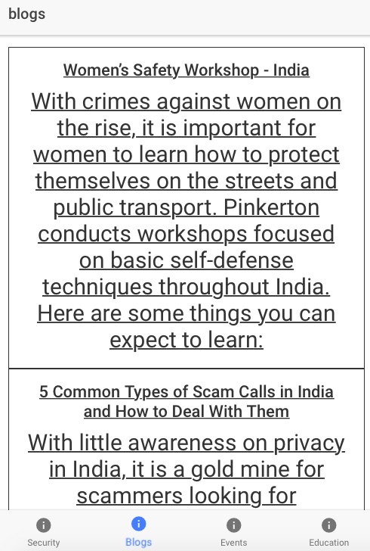
Blogs
Here we share stories related latest issues.
It helps them to get aware of Frauds, Health Issues etc.

Slide 9
Future Scope
Personalise the app to monitor the daily events using ML .
Include the survey component to take individual opinion on the query.

Slide 10
Thank you

