Slide 1
Team Name: </Scorpion>
G. Srinivas
Avinassh Bharadhwaj
P. Durga Prasad

Slide 2
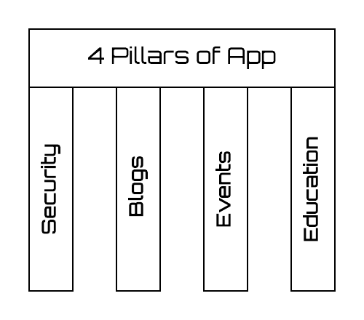
Problem Statement
Women Safety and Women Empowerment
Solution
Our main moto is to develop a mobile application based on the four key stones of Women Empowerment and Safety.
Security
Education
Blogs
Events

Slide 3
Use Case

Slide 4
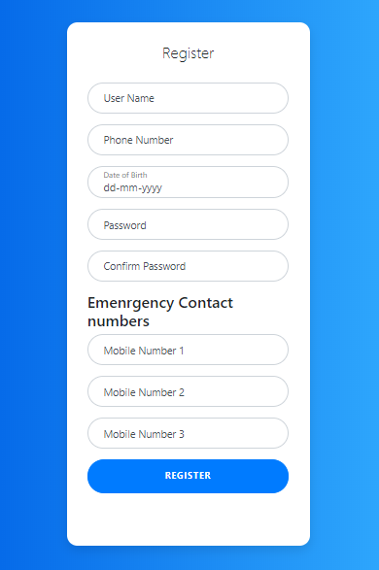
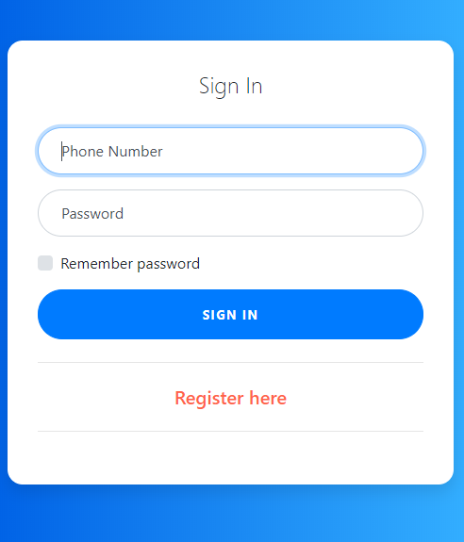

Slide 5
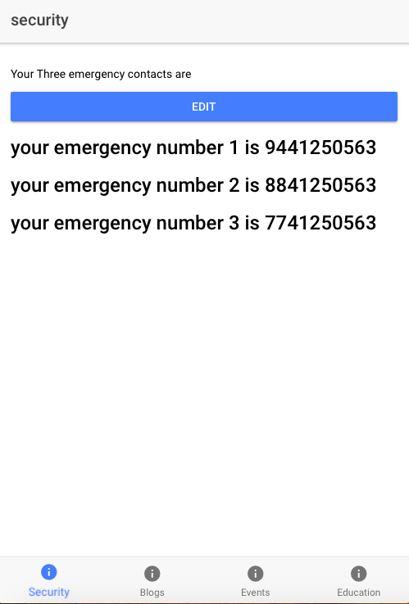
Security
Security is achieved using alert messaging and geo tagging.
App sends recent location of user to near by police stations

Slide 6
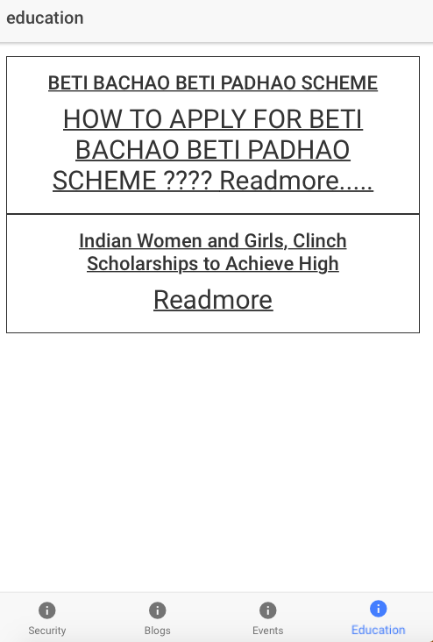
Education
Special schemes by government and private sectors.
Provides information about Educational institutes and Universities that provides special opportunities for women.

Slide 7
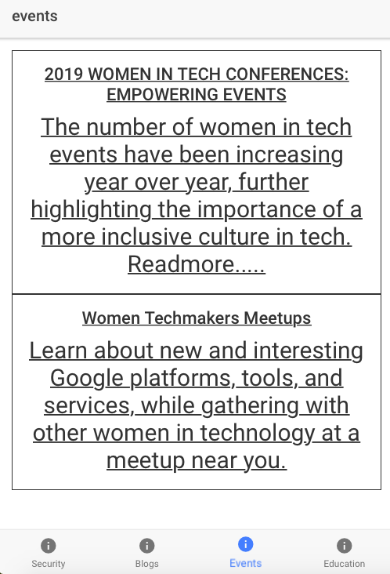
Events
Events that are conducted special conducted for women
Events will be shown based on users choice.

