Slide 1
Customer Churn Analysis for Telecom Industry
Elevate Labs – Data Analyst Internship
Prepared by: Goury Surendran
College of Engineering Kottarakkara
Tools: Python • SQL • Pandas • Scikit-learn • SHAP • Matplotlib • Seaborn

Slide 2
Problem Statement
• Customer churn impacts telecom revenue and customer retention.
• Analyze customer behaviour using historical data.
• Identify key churn factors and provide actionable insights.

Slide 3
Objectives
• Clean and preprocess telecom data
• Perform exploratory data analysis
• Build and evaluate machine learning models
• Use SQL for business analysis
• Generate customer segments and recommendations

Slide 4
Dataset Overview
• IBM Telco Customer Churn Dataset
• 7043 records and 21 features
• Target variable: Churn

Slide 5
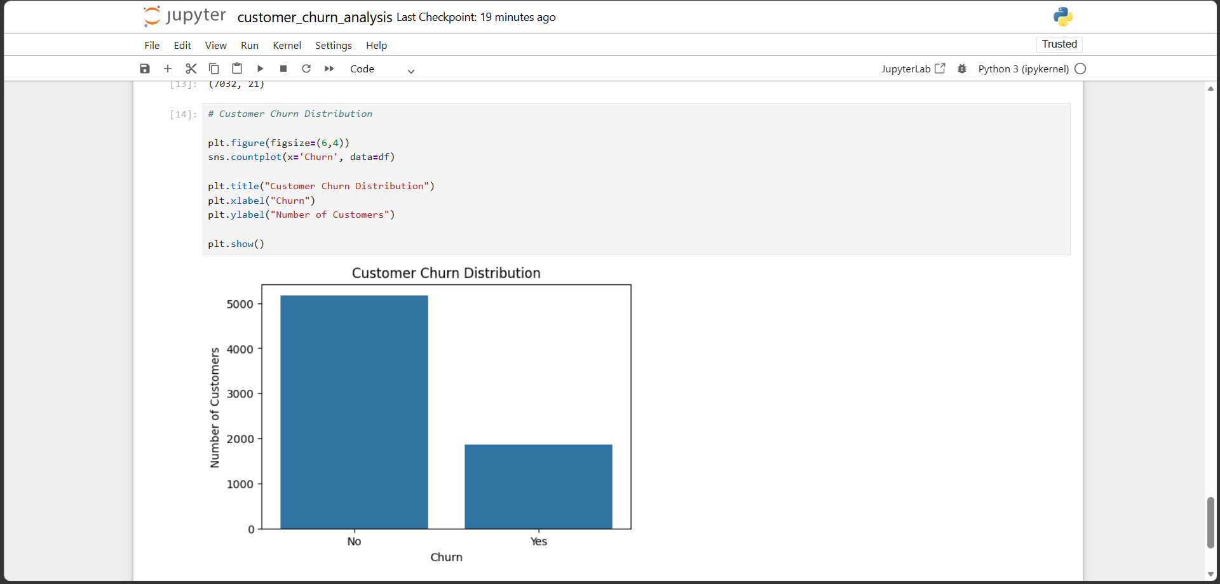
Churn Distribution
Key Insight
Most customers remained with the company.

Slide 6
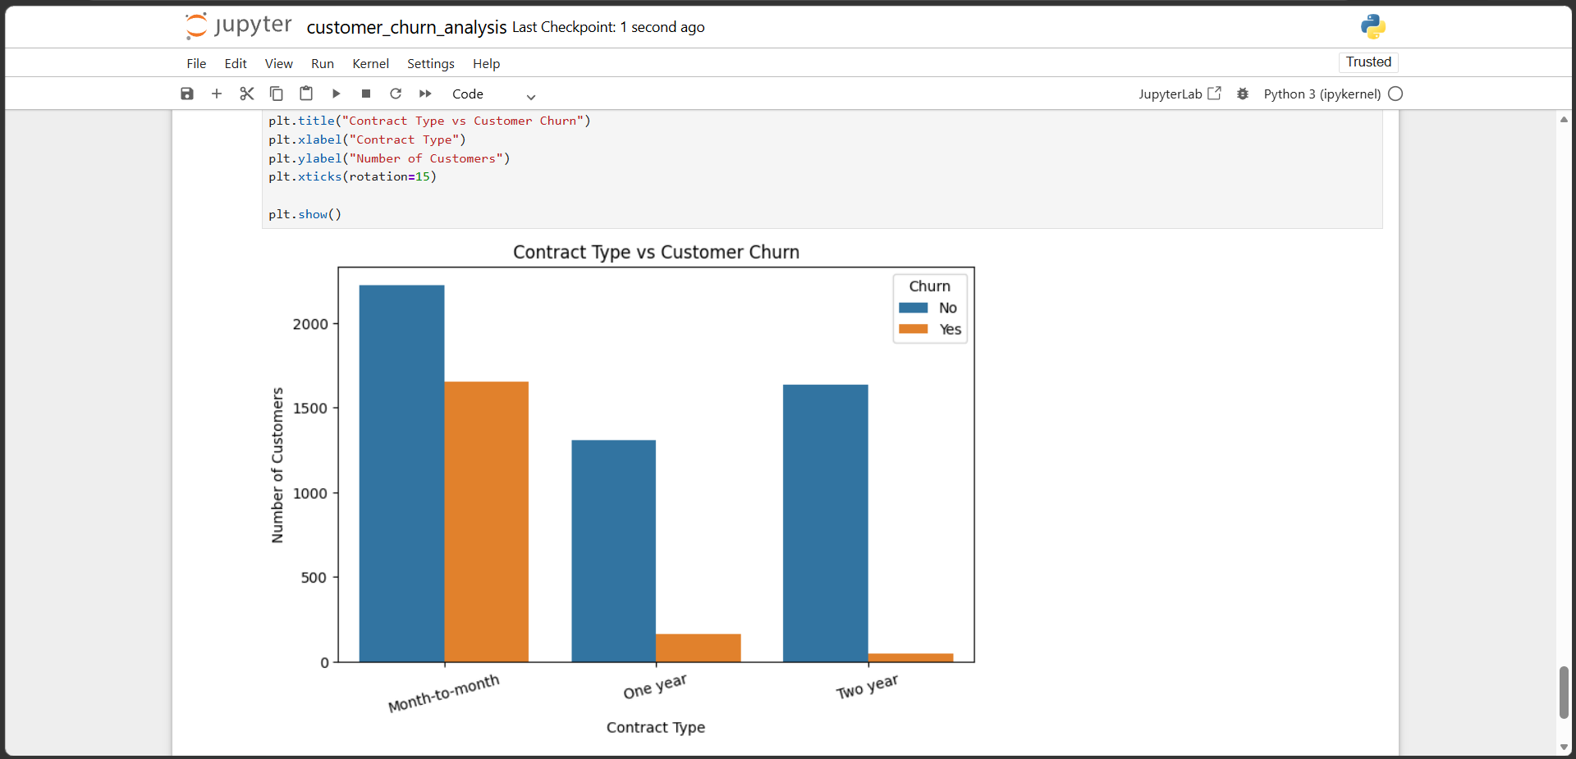
Contract vs Churn
Key Insight
Month-to-month customers have the highest churn.

Slide 7
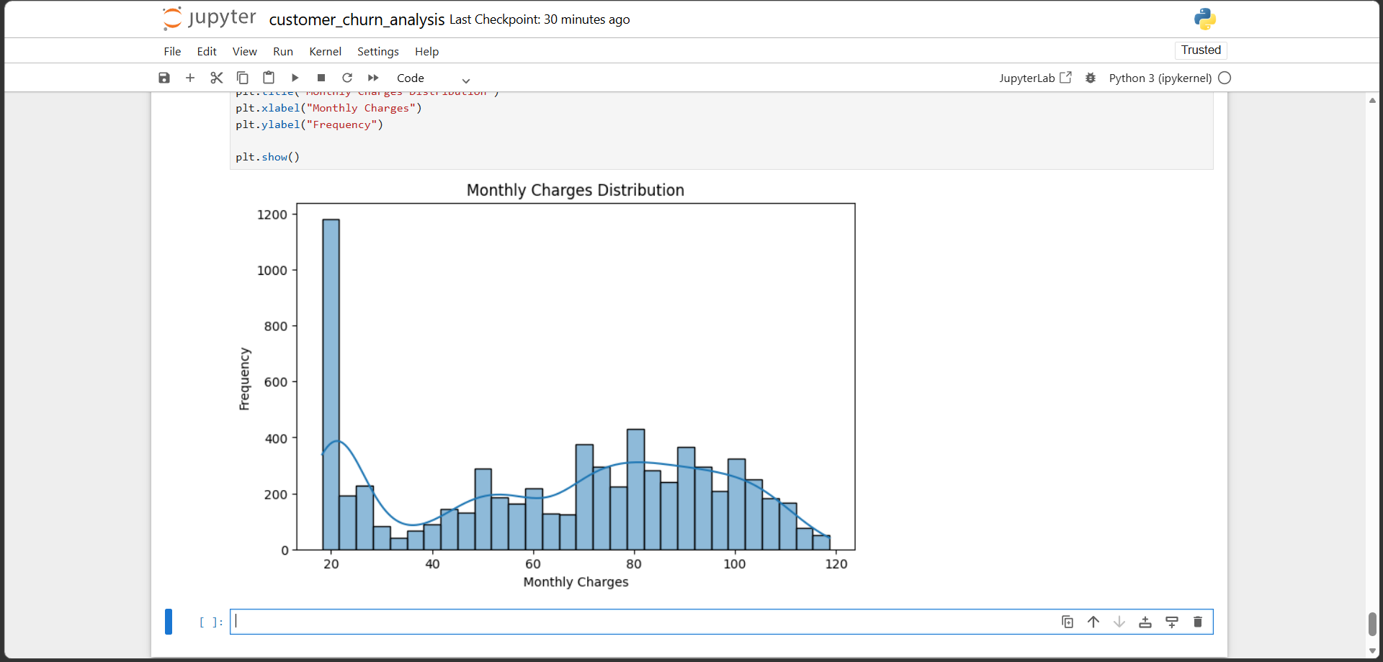
Monthly Charges Distribution
Key Insight
Subscription charges vary widely.

Slide 8
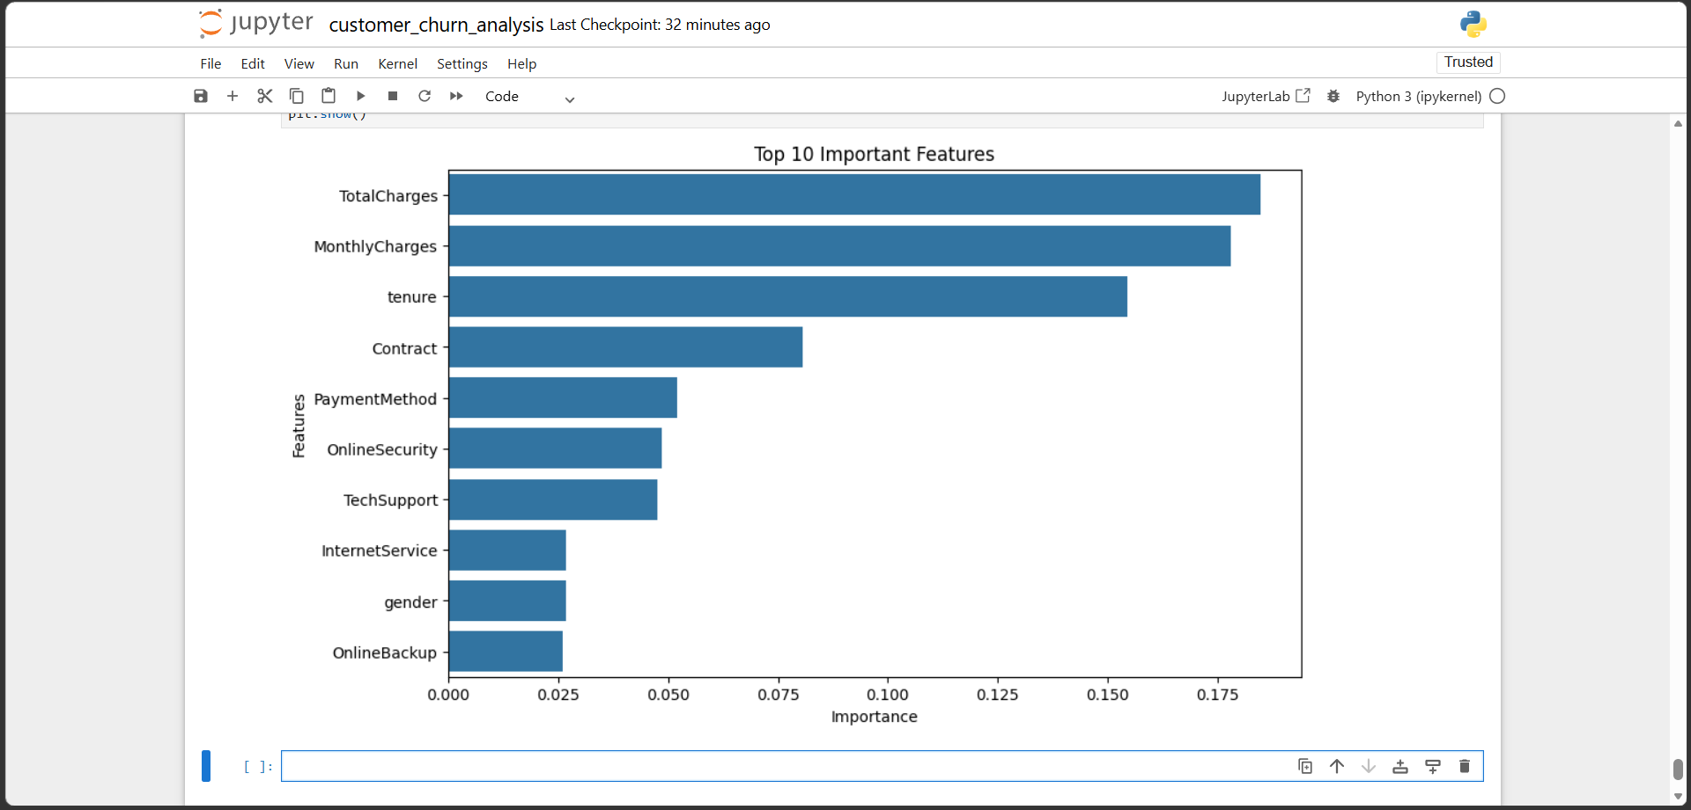
Feature Importance
Key Insight
Contract and tenure are the strongest predictors.

Slide 9
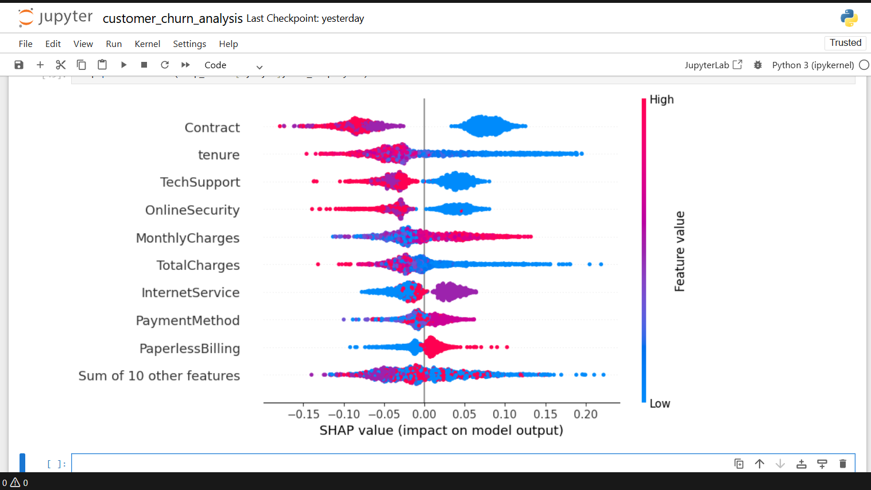
SHAP Explainability
Key Insight
SHAP explains how features influence predictions.

Slide 10
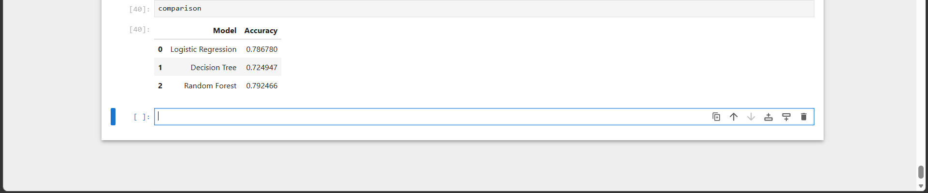
Model Comparison
Key Insight
Random Forest achieved the best performance.

Slide 11
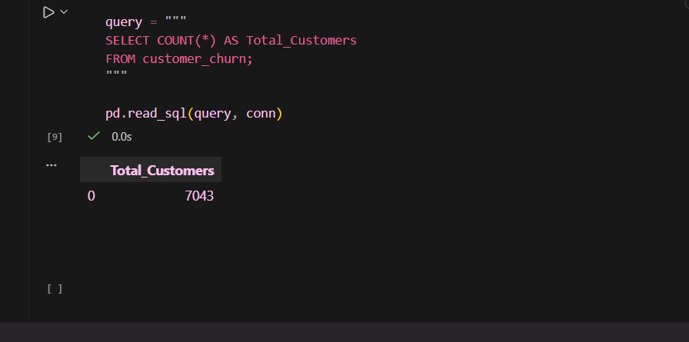
SQL Analysis
Key Insight
SQL validated key business metrics.

Slide 12
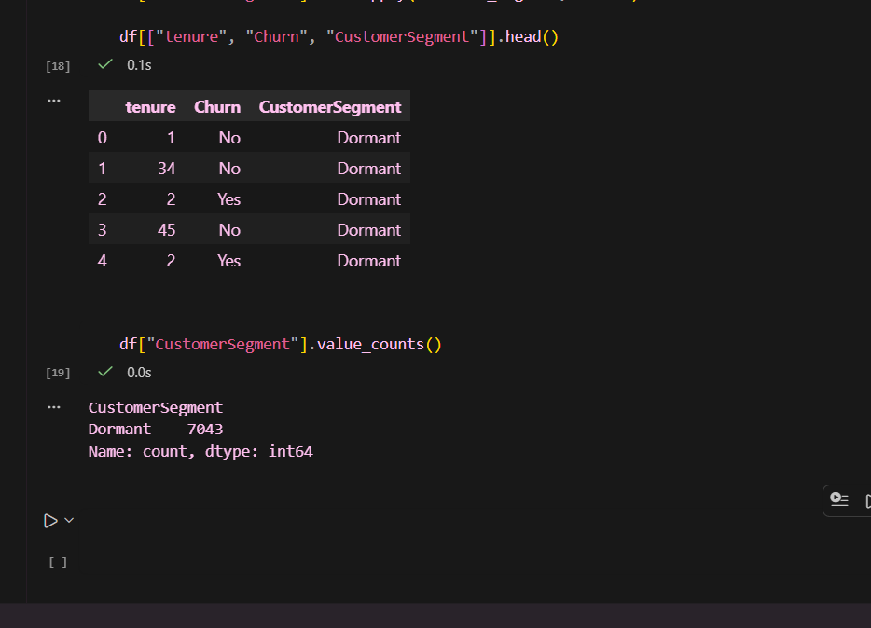
Customer Segmentation
Key Insight
Customers segmented into Loyal, At Risk and Dormant.

Slide 13
Business Recommendations
• Promote long-term contracts.
• Target at-risk customers with retention offers.
• Strengthen technical support services.
• Monitor churn continuously using predictive analytics.

Slide 14
Conclusion
• Combined Python, SQL and machine learning to analyze churn.
• Generated business insights and customer segments.
• Project demonstrates practical data analytics skills.

Slide 15
Thank You
• Questions?

