Slide 1
Task 4 - Dashboard Design
Elevate Labs Data Analyst Internship
Prepared by: Goury S

Slide 2
Objective
Design an interactive Power BI dashboard to analyze Superstore sales data using KPIs and visualizations.

Slide 3
Dashboard Overview
• Total Sales, Profit and Quantity KPIs • Sales Trend (Order Date) • Sales by Category • Sales by Region • Sales by Segment • Profit by Category • Interactive Region Slicer Insert the dashboard screenshot on this slide before submission.

Slide 4
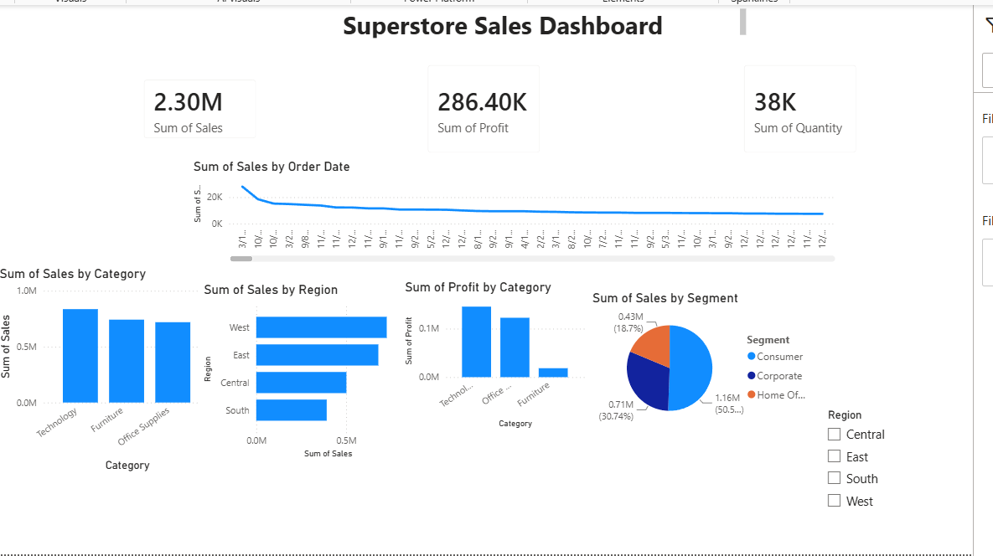
Dashboard

Slide 5
Key Insights
• Total Sales: 2.30M • Total Profit: 286.40K • Total Quantity: 38K • Technology recorded the highest sales. • West region showed the highest sales. • Consumer segment contributed the largest share of sales.

Slide 6
Conclusion
The dashboard provides an interactive overview of business performance. It enables users to monitor KPIs, analyze sales trends, compare categories and regions, and support data-driven decision-making.

