Slide 1
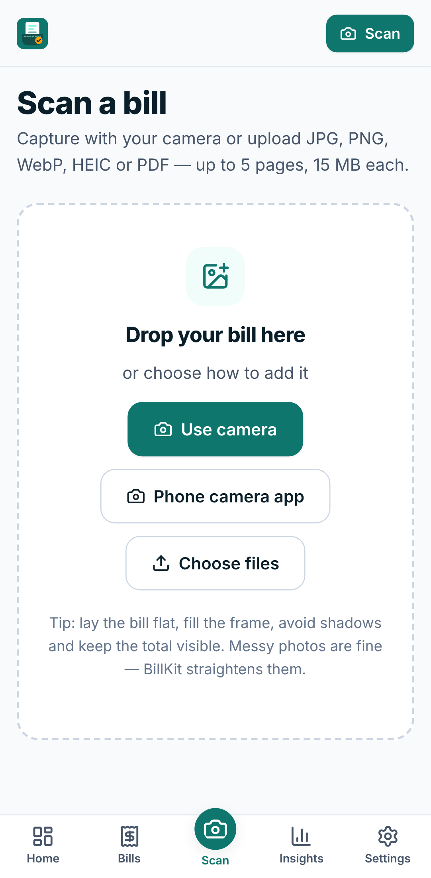
BillKit
Every bill, in your pocket.
Evidence-aware bill scanning: detect, read, verify, and only then save
Created and developed by Shaik Gouse Kareem · November 2026
Notes:
BillKit turns a photo of a bill into a verified expense record. Its core idea: accuracy, evidence and user trust matter more than pretending AI is always right.

Slide 2
Paper bills are easy to lose and slow to record
Manual entry
Messy photos
Typing merchant, date and total for every receipt is slow and error-prone.
Real receipts are crumpled, faded, tilted, shadowed or photographed in poor light.
Confusing numbers
Silent AI errors
Subtotal, tax, discount, amount paid and total all look alike to software.
Scanners that auto-fill fields without showing uncertainty let mistakes slip into records.
Notes:
The problem is not only reading text. It is knowing which number is the total, and being honest when the system is unsure.

Slide 3
BillKit checks its own work before you save
1
2
3
4
5
6
Capture or upload
Is it a bill?
Read and extract
Check the maths
Highlight doubt
You approve
What makes it different
Every value links to the line of the photo it came from
Uncertain and missing fields are flagged with text labels, not only colour
Arithmetic is verified, allowing for inclusive tax, discounts and round-off
Non-bills (selfies, ID cards, chat screenshots) are politely rejected with reasons
Nothing is saved until a person approves it; corrections are tracked
Notes:
Differentiation: evidence-aware extraction, uncertainty highlighting, mathematical verification and human correction before saving.

Slide 4
One codebase: a PWA, an API and a shared AI pipeline
Browser / PWA
Fastify API
AI pipeline
Storage
React 19 · TypeScript
Camera, review, history
Offline copies (IndexedDB)
Auth · CSRF · rate limits
Uploads · processing queue
Bills · analytics · export
Quality → preprocess → OCR
→ classify → extract
→ categorise → validate
SQLite (users, bills,
corrections, metrics)
Images on disk (UUID paths)
packages/shared: zod schemas and validation used by the browser, the server and the evaluation harness, so all three run the same checks
Optional cloud vision model (Anthropic) — only for uncertain bills, only if enabled
Full diagram: diagrams/rendered/png/D01_overall_architecture.png
Notes:
The backend and the evaluation harness call the same processDocument() function, so evaluation measures exactly what users get.

Slide 5
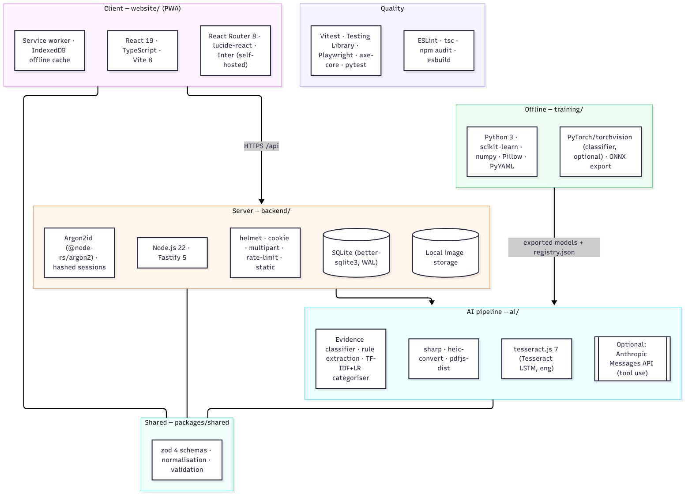
Technology stack: private, low-cost, testable
Key decisions
PWA, not React Native: one codebase, installable, testable here
Tesseract (tesseract.js): runs on our server, Apache-2.0, no per-page fee
SQLite: zero-ops; PostgreSQL path documented
Argon2id + hashed sessions
Cloud vision model optional and opt-in
Notes:
Each choice is justified in docs/architecture.md and docs/model_selection.md.

Slide 6
Twelve stages from photo to checked record
01
02
03
04
05
06
Decode
Quality
Preprocess
OCR
Classify
Layout
07
08
09
10
11
12
Extract
Vision model
(optional)
Categorise
Validate
Confidence
Review
Cheap path first: OCR + transparent rules handle clear bills. The vision model is called only when the classification is ambiguous or required fields are weak, and one call does both classification and extraction.
Notes:
These stage names are the same ones the app shows while processing.

Slide 7
Bill or not? A transparent evidence scorer
Evidence for a bill
Evidence against
Decision
Bill words: total, invoice, GSTIN, CGST/SGST
Rows ending in amounts
A date on the page
ID-card, certificate, letter and newspaper patterns
Chat timestamps; screenshot traits
Almost no text + skin tones or colour → photo
Score ≥ 0.5 → bill (with subtype)
Score ≤ 0.22 → polite rejection
In between → ambiguous: vision model or ask the user
User can always override
Not a trained CNN: there was no licensed training data, and the 20 HR images must stay a test set. A MobileNetV3 transfer-learning pipeline is ready for when data exists. Detecting a bill-like document does not prove a transaction happened.
Notes:
Method billkit-evidence-v1. The score is a heuristic, not a probability.

Slide 8
OCR: Tesseract LSTM, tuned for receipts
1
Preprocess
What we learned
Find the page, fix perspective, deskew, flatten shadows, boost contrast
Auto page segmentation dropped the right-hand amount column on receipts; single-column mode (PSM 4) fixed it
Forcing 300 DPI made results worse, so it is left unset
Born-digital PDFs skip OCR and use their own text layer
OCR confidence describes the characters, not whether the right line was chosen
2
Recognise
tesseract.js 7, English model from npm, PSM 4 (single column)
3
Rotate if needed
Few solid words → retry at 90°, 180°, 270° and keep the best
4
Rebuild rows
Group words into visual rows with boxes and confidences
Notes:
Alternatives considered: Google ML Kit (native SDK only), PaddleOCR (Python runtime), cloud OCR (cost, privacy).

Slide 9
Extraction: labels decide what a number means
Label on the bill | Rule score | Field
Grand total | 0.95 | Total
Net amount / payable | 0.90 | Total
Total (not sub/qty/tax) | 0.80 | Total
Sub total | 0.90 | Subtotal
CGST + SGST | sum | Tax
Largest unlabelled amount | last resort | Total (inferred, flagged)
Every field carries evidence
The OCR row text and its box on the page
Dates, times, phone numbers and IDs are masked before amounts are read
Ambiguous dates such as 03/04/2026 are flagged unless the bill reveals the order
Competing candidates become one-tap alternatives
Missing means null, never a guess
Notes:
Twenty-one fields, including invoice number, payment method, GSTIN and line items.

Slide 10
Confidence is a ranked heuristic, and labelled as one
OCR confidence
Rule strength
Model self-report
Validation
How sure Tesseract is about the characters
How strong the label rule was
Recorded, never used as a probability
Pass, warn or fail from deterministic checks
Review states shown in the app (icon + text, not colour alone)
High confidence
Needs review
Missing
Validation warning
User corrected
Review threshold 0.85 by default (configurable). Calibration by histogram binning is implemented but needs a labelled real validation set, so scores stay marked "heuristic" for now.
Notes:
The system abstains (Missing or Unknown) when evidence is insufficient.

Slide 11
The maths must add up, in any legitimate format
A total is accepted if any interpretation matches within max(1, 0.5 %)
Other checks
1
subtotal + tax + service + tip − discount + round-off
Missing merchant, date or total
Negative, zero or implausible totals
Tax > total; discount > subtotal
Line items vs subtotal; qty × price
Paid + balance vs total
Impossible, future or ancient dates
Currency codes
2
discount already deducted from the subtotal
3
prices include tax
4
prices include tax and the discount is already deducted
5
without the round-off line
Notes:
The same validateBill() runs live as the user edits and again on the server before saving.

Slide 12
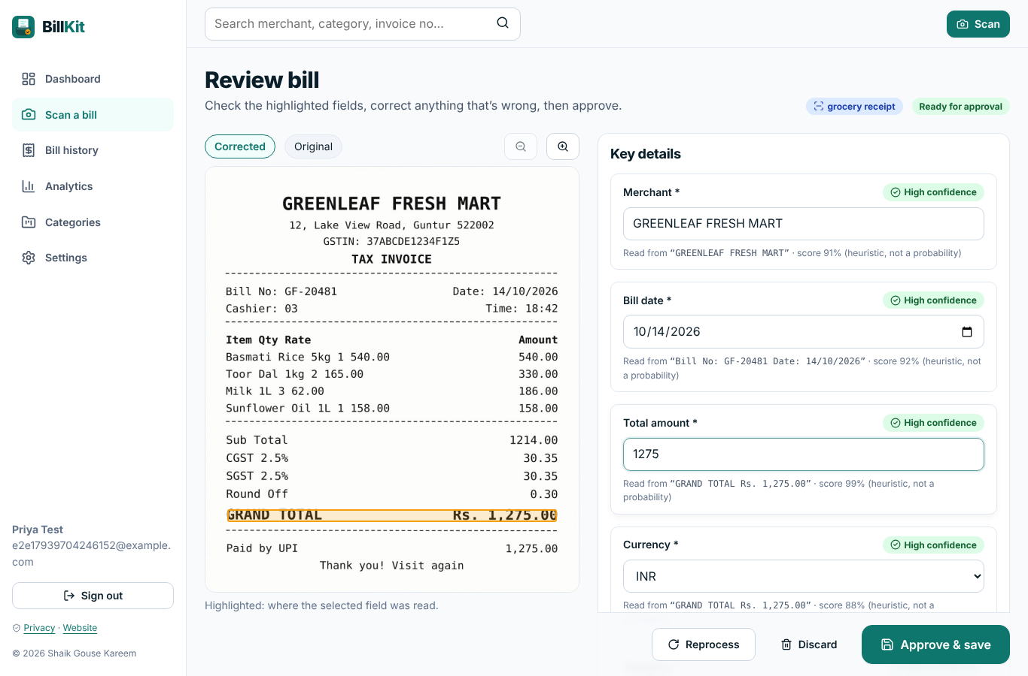
The human makes the final call
Review screen
Evidence box drawn on the photo
Edit any field; badge turns "User corrected"
Flagged fields need a tick or an edit
Validation updates live
Corrections saved with the AI value, versions and consent flag
Nothing retrains automatically
Notes:
Screenshot of the running app with a synthetic, fictional sample receipt.

Slide 13
Dataset framework: built for real phone photos
26
9
70/15/15
0
bill condition/type folders
non-bill folders
grouped split, seed 20261106
real images included
Separation and leakage control
Responsible collection
Train / validation / test / HR 15 bills / HR 5 non-bills never mix
Photos of one bill share a group id
Duplicate and near-duplicate checks
Training code refuses to read the HR folder
Consent records and redaction guide
Licences of CORD, SROIE, FUNSD, XFUND, RVL-CDIP and DocVQA documented; nothing downloaded
Synthetic images only for tests, always labelled
Notes:
No third-party dataset files and no real bill photographs are shipped.

Slide 14
Train only where it is justified
Model | Status | Note
Categoriser (TF-IDF + logistic regression) | Trained, registered | Synthetic seed data (324 examples); grouped CV macro-F1 0.990 vs rules 0.976 (optimistic)
Confidence calibration | Code ready | Needs a labelled real validation set
Bill/non-bill image classifier (MobileNetV3-Small) | Not trained | No licensed labelled images; pipeline, configs and ONNX export ready
OCR and extraction models | Not trained | Established engine and rules; fine-tuning not justified at this size
Training is offline Python with fixed seeds; inference is TypeScript that reads only registered artefacts. A JSON registry supports rollback. See TRAINING_GUIDE.md.
Notes:
The 25-item training record for each model is in TRAINING_GUIDE.md.

Slide 15
Evaluation: what is measured, and how
Per image (20 images)
Rules and metrics
Expected vs predicted class, merchant, date, total, category
Correct / incorrect per field
Uncertainty status and failure reason
Processing time, vision calls, cost
Merchant: normalised, contained or ≥ 0.85 similar
Date: ISO equal · Total: within 0.01
Accuracy, precision, recall, F1, confusion matrix
Wilson 95 % intervals (15/15 still ≈ 80 % lower bound)
Were wrong values flagged for review?
Notes:
npm run eval:hr writes predictions.csv, results.json, metrics.json and report.md.

Slide 16
Results: the real 20-image evaluation is pending
HR set (15 real bills + 5 non-bills): PENDING. The images have not been supplied yet, so there are no real-world accuracy figures.
Pipeline check on 15 synthetic, computer-generated images (NOT real-world accuracy)
15 / 15
10 / 10
1.65 s
0
classifications correct
merchant, date and total correct
mean time per image
wrong values; 4 of 40 correct ones flagged
Tests: 136 unit/integration, 11 end-to-end (incl. accessibility), 10 Python — all passing on 6 Nov 2026.
Notes:
Synthetic images are much cleaner and more uniform than real phone photos. Replace this slide with the HR results after running npm run eval:hr.

Slide 17
Expected failure cases, to be confirmed on real bills
These are anticipated failure modes, not measured results. The HR run will show which actually occur.
Wrong total line
Faded thermal paper
Merchant from a slogan
Several totals with unusual labels
Digits misread (8→3), decimals lost
Or a name that appears only in a logo
Ambiguous dates
Bill-like non-bills
Mixed-store categories
Day/month order; two-digit years
Order confirmations, price lists
Groceries vs shopping
Notes:
Failure reasons in the evaluation report come from evidence: for example, was the expected total present in the OCR text?

Slide 18
Privacy and security, stated honestly
Implemented
Honest limits
Argon2id; hashed HttpOnly sessions; CSRF header + Origin check
Rate limits; strict CSP; magic-byte upload checks
Every query scoped to the user
Receipt text treated as untrusted in prompts
Delete bills or the whole account; unsaved scans expire
No analytics or third-party scripts
Images are processed on the server, and by Anthropic only if cloud vision is enabled
No MFA or e-mail verification yet
No encryption at rest by the app
No penetration test
No compliance claimed (GDPR, DPDP); legal pages are drafts
Notes:
Details in docs/privacy_security.md.

Slide 19
What comes next
1
Run the HR evaluation and analyse every failure
5
Train the image classifier and compare it with the rules
2
Collect a consented, redacted set of ~300 Indian receipts
6
Indian-language OCR; on-device OCR in the browser
3
Fit calibration so scores mean what they say
7
MFA, e-mail verification and encryption at rest
4
Add PaddleOCR as a second engine and compare
Notes:
Priorities are ordered by what improves trust in the numbers first.

Slide 20
Every bill, in your pocket.
Evidence-aware extraction · uncertainty highlighting · mathematical verification · human approval
Thank you. Questions?
Shaik Gouse Kareem
Notes:
Close by restating the principle: accuracy, evidence, transparency and user trust over pretending AI is always correct.

