Slide 1
Accelerating CPU-based Distributed DNN Training on Modern HPC Clusters using BlueField-2 DPUs
Gousepeer Arella
Poornesh Chaganti
Akhil
Dhanvi Medha
Vaibhav

Slide 2
Introduction
DL training process consists of multiple phases – data augmentation, training and validation of trained model.
Mellanox/NVIDIA has introduced the BlueField-2 DPUs which combine the advanced capabilities of traditional ASIC based network adapters with an array of ARM processors.
In this paper, we characterize and explore how one can take advantage of the additional ARM cores on the BlueField-2 DPUs to intelligently accelerate different phases of DL training.
Propose multiple novel designs to efﬁciently ofﬂoad the phases of DL training to the DPUs.

Slide 3
Contributions
We optimize parameters like No of Processes per Node(PPN), batch size, and OMP_NUM_THREADS to get good performance on CPU and DPU.
We present performance evaluation results on 16 nodes, each with 32 CPU cores and 8 ARM cores.
We use DPUs to accelerate DL training on a multi-node heterogeneous CPU+DPU cluster.

Slide 4
Contributions
The contributions made in this paper are:
Performance characterization of Data Parallelism on CPU and DPU using multi-process per node conﬁguration.
Proposing multiple novel designs for ofﬂoading different phases of DL training to the BlueField-2 DPUs.
Performance evaluations of the proposed designs with multiple DL models (ResNet-20, ResNet-56, and Shufﬂe Net) on three datasets.
Obtained speedup improvements up to 15%, 12.5%, and 11.2% for training the ResNet-20 model on the CIFAR-10 dataset, Shufﬂe Net model on the Tiny ImageNet dataset, and ResNet-56 model on the SVHN dataset respectively.
Scaled proposed designs to 16 nodes and achieved consistent improvement for multi-node experiments.

Slide 5
Background – DPUs
A Data Processing Units(DPU) is a specialized processing unit designed to accelerate data-intensive workloads such as data analytics, artificial intelligence, and machine learning at the network edge or within the data center.
DPUs offload processing tasks from the CPU, enabling more efficient data processing and improving overall system performance.
They often incorporate features like hardware acceleration, optimized data movement, and advanced networking capabilities.

Slide 6
Background – BlueField-2 DPU
BlueField-2 DPU is a system-on-chip architecture which comes with ARMv8 A72 cores (64-bit), DDR4 DRAM controller, ethernet, InﬁniBand, and PCI interfaces.
BlueField-2 DPUs are used to ofﬂoad I/O intensive tasks from CPU taking the role of a trafﬁc controller with greater performance.
Furthermore, BlueField-2 DPUs may be used to ofﬂoad encryption and compression workload from the CPU.

Slide 7
Exploiting DPUs for DNN training
To train a neural network we have several phases such as fetching the data, data augmentation, forward pass, backward pass and validation of data.
So, some of these phases can be offloaded to blue-field DPU's.
there are different methods used to offload set of these tasks to the DPU.

Slide 8
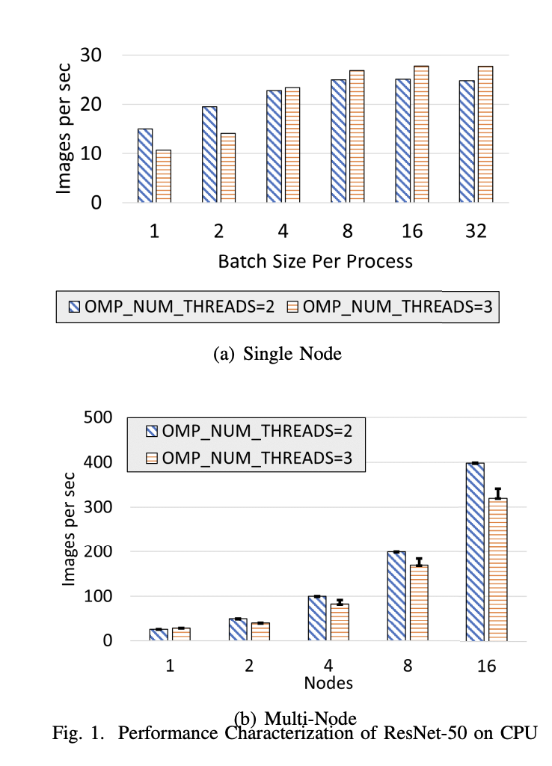
CPU performance
Recent studies recommend multiple processes per CPU for optimal DL training. We found peak performance with a batch size of 16 per process. For multi-node setups, we chose a batch size of 16 per process and OMP NUM THREADS=2 for CPU+DPU experiments after observing performance variations with OMP NUM THREADS=3.

Slide 9
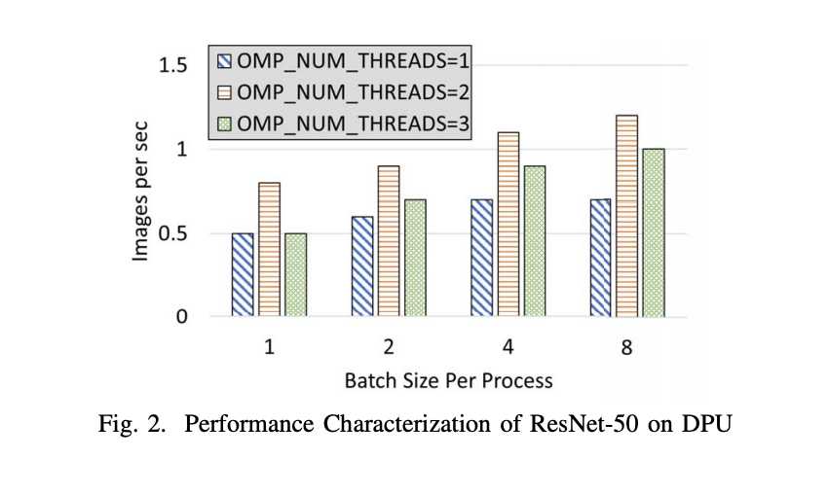
DPU Performance
Using DPUs using batch size of 8 gives peak performance on DPUs, image rate is very low because DPU 's hardware is designed to handle small tasks.

Slide 10
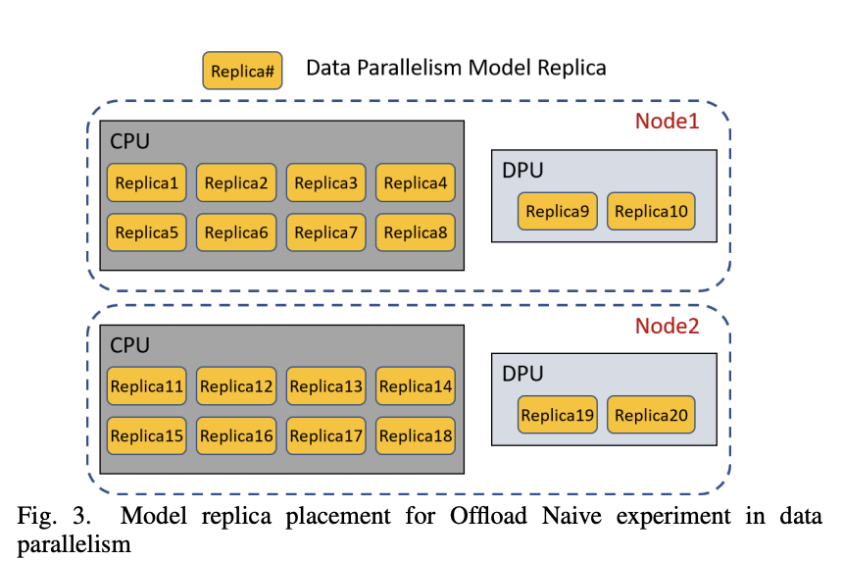
Offload-naive
Using data parallelism to off-load training to DPU's , every core (cpu's + DPU) will get a model replica. Forward and backward pass will be done on each replica and then we use allreduce to get the gradients.

Slide 11
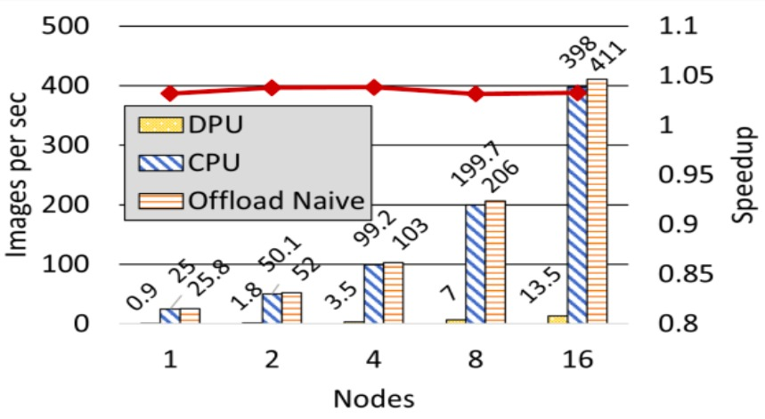
Offload Naive
Time per iteration can be used To distribute batch size between CPU'S and dpu's
Speed-up upto 1.03x
And maximum speed up is about 1.04x
Because Arm processors in DPU's are not as powerful as host CPU's

Slide 12
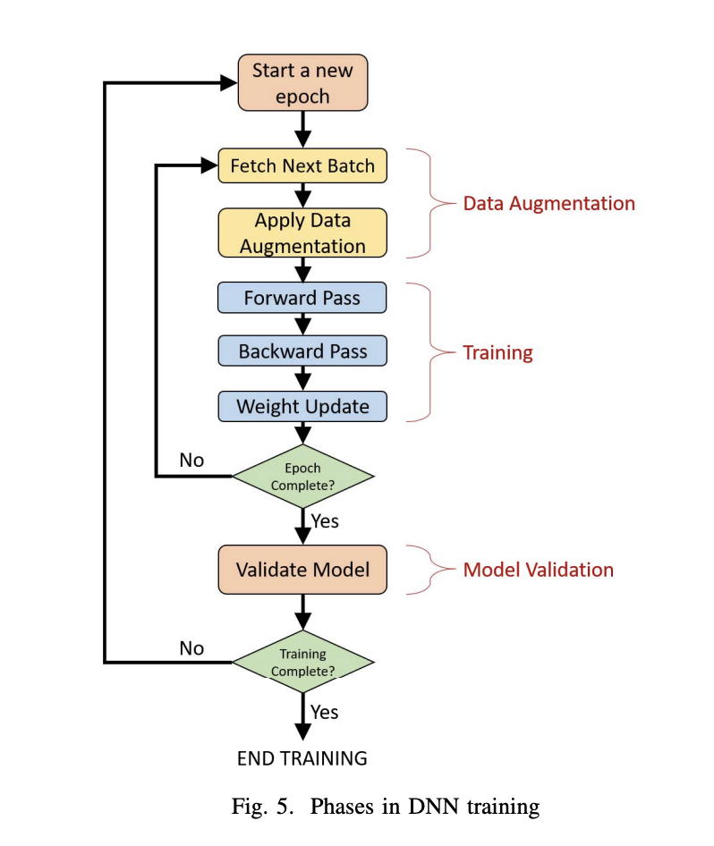
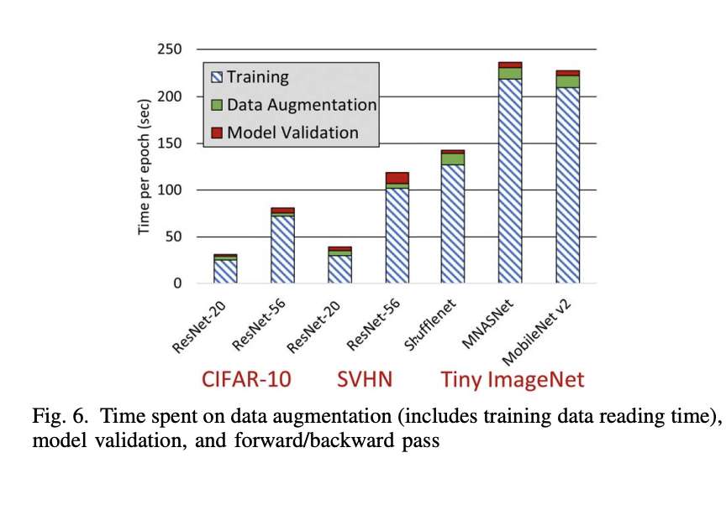
Offloading Data Augmentation and Model Validation

Slide 13
Proposed Advance Offloading Designs
We investigate several designs to offload different phases of DNN training to DPUs and reduce the time per epoch.
strategies to offload data augmentation and model validation to DPUs and overlap these phases with forward and backward pass on CPUs.
MPI4py for the communication between processes on CPUs and DPUs.
Horovod is used to train the model with data parallelism on CPUs.
There are three designs
Offload Data Augmentation
Offload Model Validation
Hybrid Offloading

Slide 14
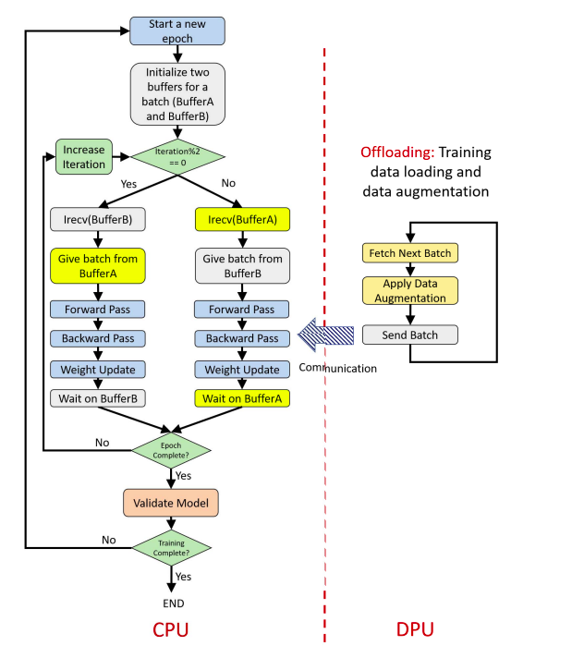
Offload Data Augmentation
Training Process:
Two buffers overlap communication and computation during DNN training.
One buffer receives batches from data augmentation, while the other handles forward and backward passes.
Initiation of irecv before the forward pass synchronizes communication with computation.
Data Augmentation Process:
PyTorch's DistributedSampler divides training data among DPUs.
Circular buffers manage communication and computation overlap on DPUs.
If a buffer is free, the next batch undergoes augmentation and send to the training process; otherwise, it waits for availability.

Slide 15
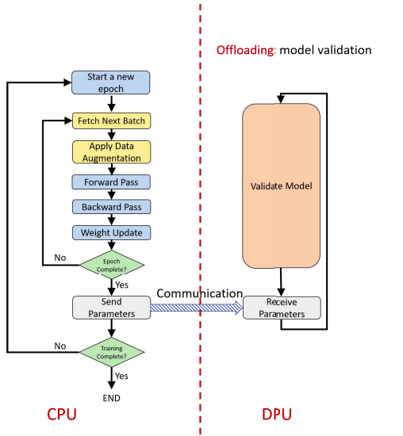
Offload Model Validation
Instead of offloading data augmentation to DPU, we offload model validation to the DPUs.
Model validation is a less compute-intensive task compared to training.It is similar to inference using a trained model.
Overlap the calculation of validation loss and accuracy for epoch i with the training of epoch i+1.
So we will have two process
1)Training process on CPU
2)Testing process on DPU

Slide 16
Offload Model Validation
Training Process:
Training process fetches data, applies augmentation, and conducts forward/backward passes and weight updates.
Parameters are sent to corresponding DPU processes after training on all samples, advancing to the next epoch after sending weights.
Testing Process:
Each CPU training process has a corresponding DPU testing process.
DPU testing process waits for weights from the CPU training process for each epoch.
Despite DPUs being slower, model validation time on DPUs should ideally match or be faster than CPU training time.
Evaluation Finding:
Model validation on DPUs can sometimes exceed CPU training time, leading to overall degradation in epoch time.
To address this, testing data is split between CPU and DPU to balance time and maximize overlap.

Slide 17
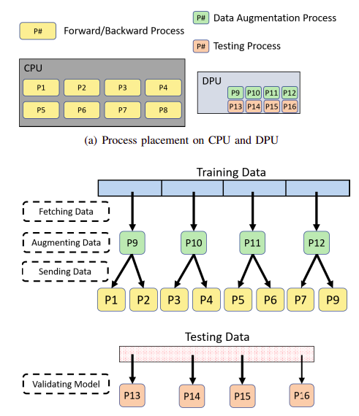
Hybrid Offloading
Combines data augmentation and model validation offloading to improve speedup for models with lengthy forward/backward passes.
Three process types: CPU for forward/backward, DPU for data augmentation, and DPU for testing.
Process placement: CPU processes utilize 4 cores each, while DPU processes use one core each.
Since CPU has 32 cores, each process runs on four cores. Likewise, each DPU process runs on one core.

Slide 18
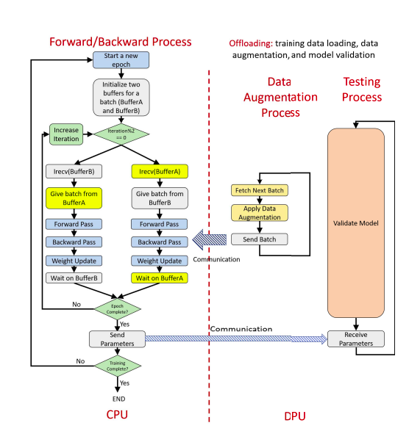
Hybrid Offloading

Slide 19
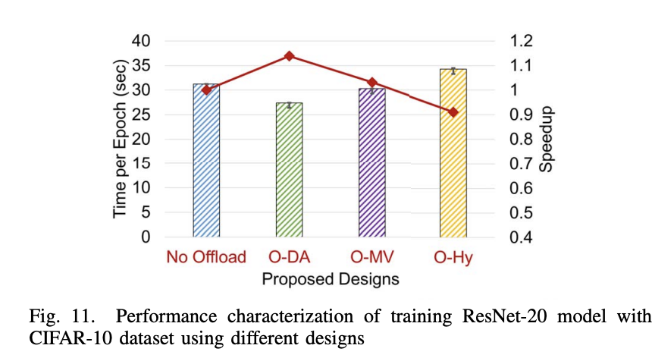
Performances of proposed offloading approaches
Training ResNet-20 with the CIFAR-10 Dataset:
O-DA and O-MV, achieve 13.8% and 3.1% speedups, respectively. In this experiment, the O-Hy design results in a slow down. In this case, performing data augmentation on DPU cores produced best overall results.

Slide 20
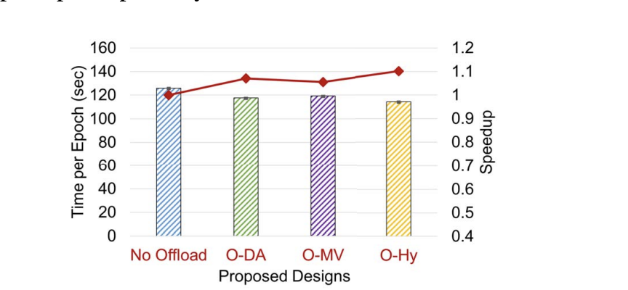
Training ResNet-56 with the Street View House Numbers (SVHN) Dataset:
O-DA, O-MV, and O-Hy result in 7%, 5.5%, and 10.1% speedups, respectively.

Slide 21
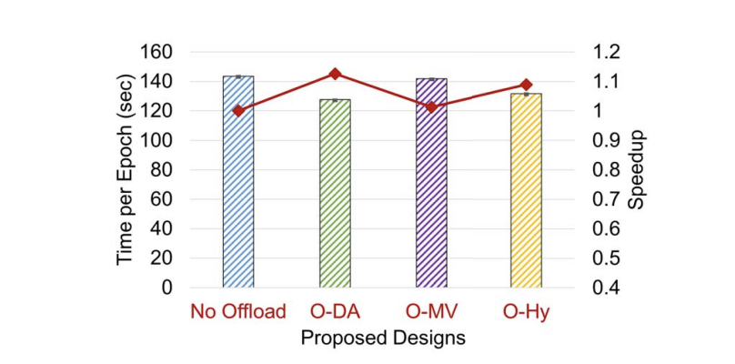
Training ShuffleNet with the Tiny ImageNet Dataset:
each epoch during training for no offload and proposed designs. O-DA, O-MV, and O-Hy result in 12.5%, 1.2%, and 8.9% speedups, respectively.

Slide 22
Future Aspects
Exploring Scaling capabilities of Bluefield-2 DPUs in large HPC clusters to accommodate growing DNN model sizes and training datasets.
Further optimize computation and communication overlap to maximize DPU utilization
Develop adaptive strategies to dynamically adjust DPU utilization based on workload and cluster conditions for better resource utilization.

Slide 23
Conclusion
Innovative Designs: Introduced four designs namely Offload Naive, Offload Data Augmentation, Offload Model Validation, and Offload Hybrid, leveraging Bluefield DPUs for DL training acceleration.
Significant Speedup: Achieved speedup improvements ranging from 11.2% to 15% across different DL models and datasets
This also sets the groundwork for future advancements in optimizing DL workflows with novel hardware architectures.

Slide 24
Conclusion
Looking ahead, we can extend the research to encompass offloading schemes for a broader range of Machine Learning and Data Analytics algorithms, further harnessing the power of DPUs to enhance performance.
In conclusion, the effectiveness of employing Bluefield DPUs for optimizing DL training processes, offering valuable insights for future advancements in this rapidly evolving field.

