Slide 1




Manufacturing Analysis
Comparative Study using Excel, Power BI, Tableau & MySQL
“Turning 10K rows of raw data into real manufacturing insights.”
Group Members Names :
Anushree Ramachandran
Palagara Tejaswani
Penumula Srilatha
Tupili Lekhasri
Shaik Arshiya
Shaik Gouse Peera
Vijay Kumar Dhanasekaran
Date : 29/10/2025
Group Number : 1

Slide 2

Introduction & Objective
“Analyzed 2015 manufacturing data to identify rejection patterns and improve process efficiency.”
“Turning production data into process improvement insights.”
What We Analyzed | Why It Matters
2015 manufacturing data (10 K rows) | To find relation between manufactured and rejected quantities
Machine & product performance | Identify bottlenecks and improve efficiency
KPIs – Manufactured Qty, Rejected Qty, Wastage % | Support data-driven decisions
Project Overview / Workflow
Raw Data
Excel
Power BI / Tableau
Insights

Slide 3
Comparative Manufacturing Data Analysis – Multi-Tool Approach
This project helped us to:
Track production vs. rejection rate
Identify which products or machines have higher defect rates
Measure efficiency of manufacturing processes
Analyze 10K+ records of 2015 manufacturing data to generate insights
Evaluate key KPIs: Manufactured Qty, Rejected Qty, Wastage %, Processed Qty

Slide 4
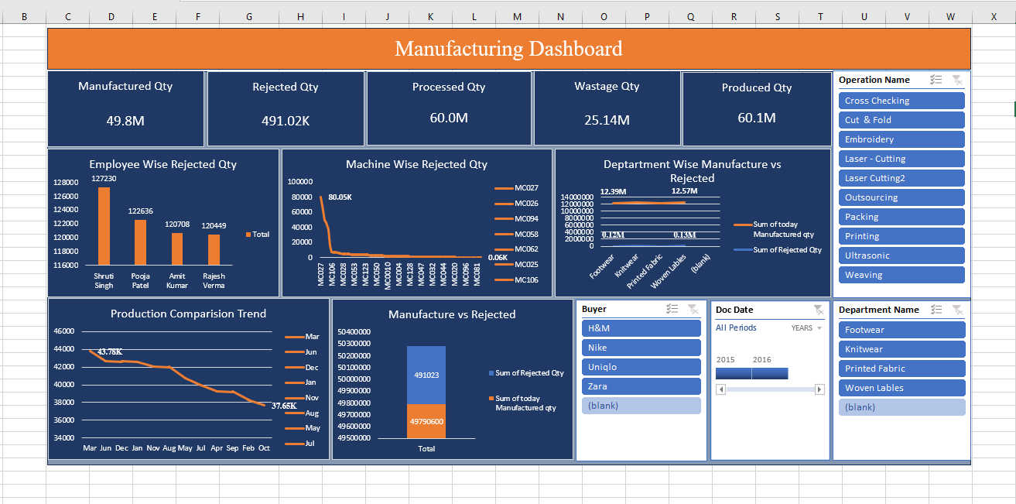
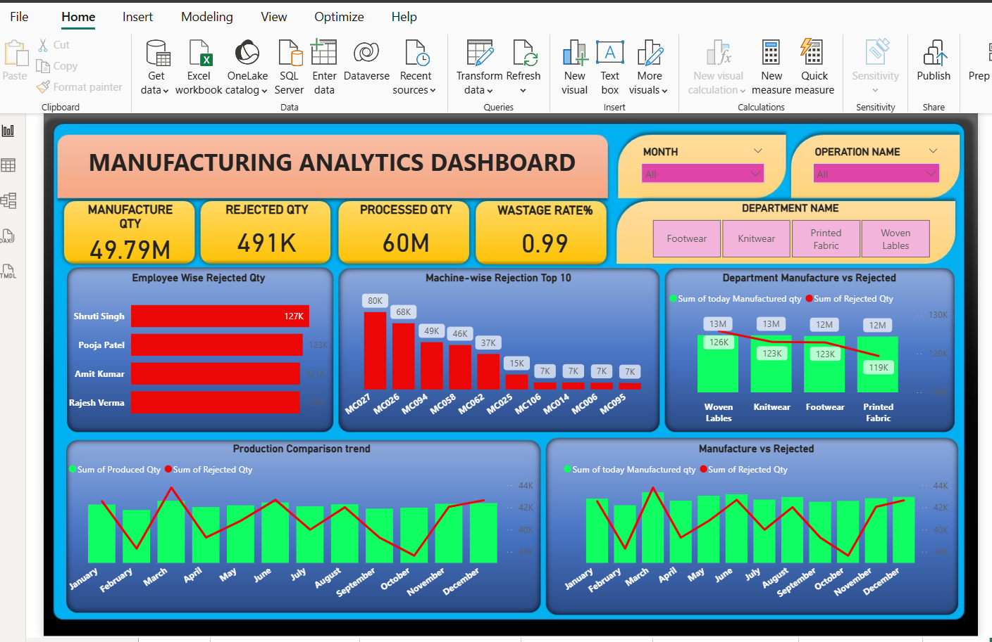
Dashboard Visuals – Excel | Power BI
“Excel Dashboard”
Built KPI dashboards using charts, slicers, and pivot tables. Learned data cleaning & interactivity.
“Power BI Dashboard”
Created dynamic visuals with filters, & cards. Learned modeling, relationships, automation.

Slide 5
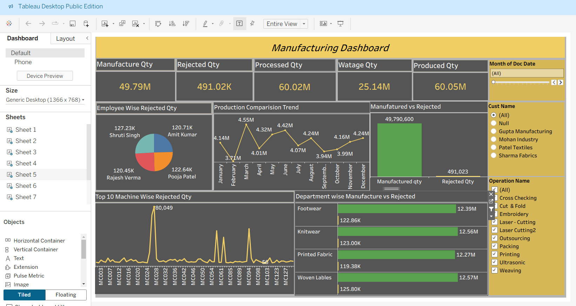
Dashboard Visuals –Tableau |
My SQL
“Tableau Dashboard”
Designed interactive dashboards with hierarchy and story-telling visuals.
MySQL – Queried KPIs & trends. Strengthened data querying and aggregation logic

Slide 6
Challenges Faced
Challenges | Description / Impact
Data inconsistency | Some data had missing or incorrect values
Understanding relationships | Hard to find direct cause for rejection
.Visualization errors | Initially graphs didn’t reflect correct KPIs
“We encountered both technical and coordination challenges while ensuring accuracy across tools.”

Slide 7
Advantages:
        Helps improve production efficiency
        Reduces waste and cost
        Supports data-driven decision making
        Identifies bottlenecks in the process quickly
Limitations:
  Accuracy depends on the quality of input data
  Analysis may not consider external factors (like human error or raw material quality)
  Time-consuming to clean and prepare data

Slide 8
Learnings:
  • Excel → Simplicity and Quick Analysis
  Learned basic KPI visuals and data organization.
  • Power BI → Automation and Dynamic Reports
  Learned data relationships and real-time updates.
  • Tableau → Storytelling and Interactivity
  Learned to present data creatively with filters and narratives.
  • MySQL → Foundation for Analytics
  Learned to write queries and derive KPIs logically.
Conclusion:
The manufacturing analysis project successfully provided insights into the production process.
It showed where improvements were needed and how data visualization can help in making smart manufacturing decisions.
Future improvements could include real-time dashboards and predictive maintenance analytics.

Slide 9
Teamwork & Challenges Faced
Challenges:
• Data cleaning and tool integration
• Standardizing KPIs across platforms
• Time management and coordination
How We Solved It:
• Weekly catch-ups and shared progress
• Divided tasks by strength (SQL, BI tools, formatting)
• Peer review to maintain consistency
This project taught us coordination, adaptability, and patience — skills as important as technical knowledge.

Slide 10
THANK YOU

