Slide 1

Internship:-DATA ENGNEERING Name:- SHAIK GOUSE BASHA Report On:- Railway Info Platforms:- Tableau, MS PP
INTERNSHIP REPORT
REPORTING

Slide 2
INTRODUCTION
Overview This report presents a comprehensive analysis of the Indian Railways dataset, focusing on operational trends, route popularity, and station frequency. The goal is to extract actionable insights that can aid in strategic planning, resource allocation, and service optimization.
Data Description
Source: Railway operational schedule dataset
Total Records: 11,113 train entries
Key Fields:
Train Number & Name
Source & Destination Stations
Operating Days
Objective To identify patterns and insights in railway operations, including:
Peak operational days
Major source and destination stations
High-frequency routes

Slide 3
Tasks Level:-1 Data Exploration and Basic Operations
1: Load and Inspect Data
Loaded the dataset with 11,113 train records.
Displayed the first 10 rows to understand the format.
Key fields:
Train_No, Train_Name, Source_Station_Name, Destination_Station_Name, days.
1.2: Basic Statistics
Total Number of Trains: 11,113
Unique Source Stations: 921
Unique Destination Stations: 924
Most Common Source Station: CST-MUMBAI
Most Common Destination Station: CST-MUMBAI
1.3: Data Cleaning
Missing Values: No missing values found across all columns.
Standardizing Station Names: Will convert all station names to uppercase in the next step for consistency.

Slide 4
Tasks Level:-2 Data Transformation and Aggregation
Task 2.1: Data Filtering
Saturday Trains: Filtered dataset to show only trains running on Saturdays (e.g., SAWANTWADI ROAD ➝ MADGOAN JN.).
Trains from "NEW DELHI": Extracted all trains originating from NEW DELHI (e.g., NEW DELHI ➝ SHMATA VD KATRA).
Task 2.2: Grouping and Aggregation
Top Stations by Outbound Trains:
CST-MUMBAI: 513 trains
SEALDAH, CHENNAI BEACH, HOWRAH JN. follow closely.
Average Trains per Day:
Most smaller stations operate 1 train per day on average.
Larger stations average higher (to be visualized next).
Task 2.3: Data Enrichment
Day Type Categorization:
Weekdays: Monday–Friday
Weekend: Saturday & Sunday
Added new column Day_Type for analysis

Slide 5
Tasks Level:-3 Advanced Data Analysis
Task 3.1: Pattern Analysis
Day-wise Distribution:
Most trains operate on Friday and Saturday.
Monday and Tuesday see the fewest scheduled trains.
Top Source Stations:
CST-MUMBAI, SEALDAH, and HOWRAH JN. are consistently dominant origin points.
Task 3.2: Correlation & Insights
Weekday vs Weekend:
Approximately 70% of trains operate on weekdays.
Suggests that rail traffic is higher for commuter or work-related travel.
Insight: Optimize maintenance or resource scheduling on low-demand days (Monday–Tuesday).

Slide 6
Tasks Level:-4 Data Visualization and Reporting
Heatmap Analysis: Train Frequency by Day for Top 15 Source Stations
The heatmap visualizes how frequently trains depart from top stations across each day of the week.
Key Insights:
CST-MUMBAI, SEALDAH, and HOWRAH JN. show consistent activity across all days.
Some stations, like CHENNAI BEACH, have spikes mid-week, while others peak over weekends.
Useful for operational planning, platform allocation, and resource deployment.
Conclusion and Recommendations
Peak Travel Days: Friday and Saturday; ideal for introducing new services or adjusting timetables.
High-Traffic Hubs: CST-MUMBAI and SEALDAH demand priority in scheduling and resource allocation.
Weekday Dominance: Focus on improving efficiency for workday commuters.
Low-Demand Opportunities: Use Monday/Tuesday for maintenance windows or test operations.

Slide 7
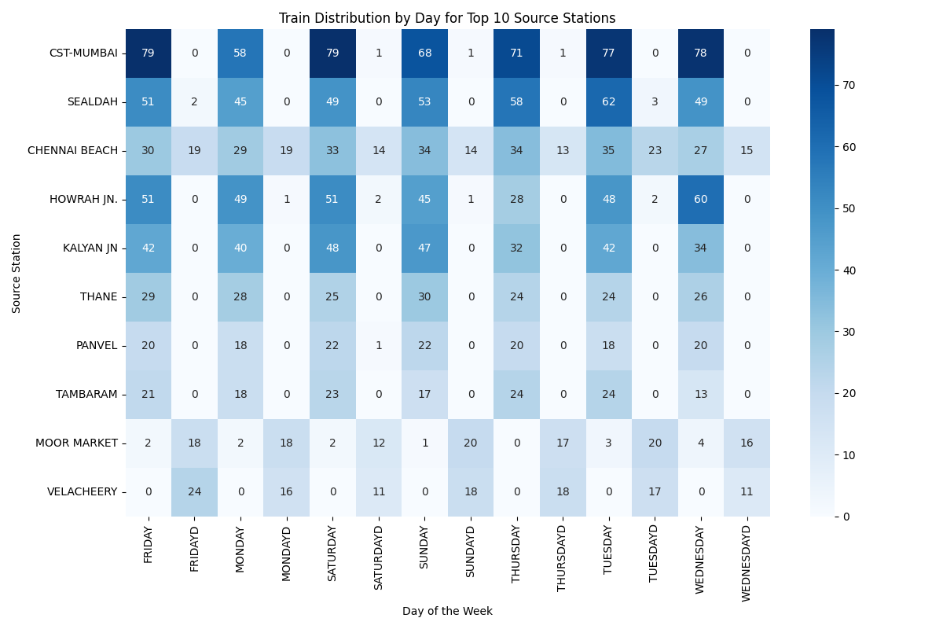
Tasks Level:-4 Data Visualization and Reporting

Slide 8
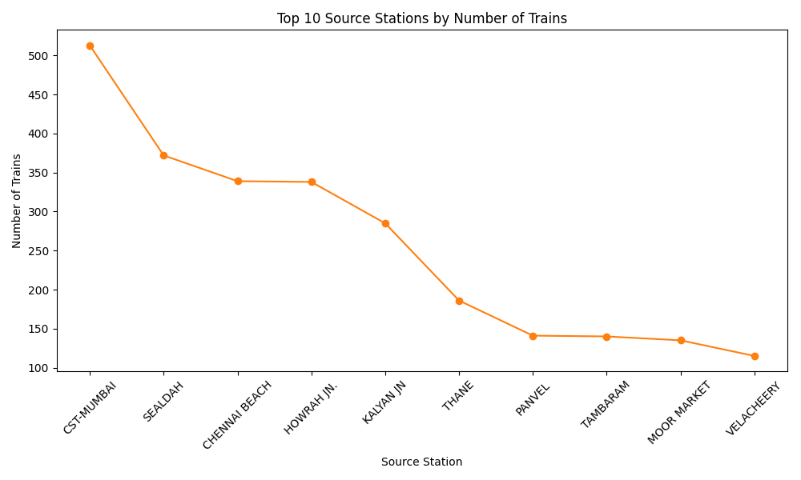
Tasks Level:-4 Data Visualization and Reporting

Slide 9
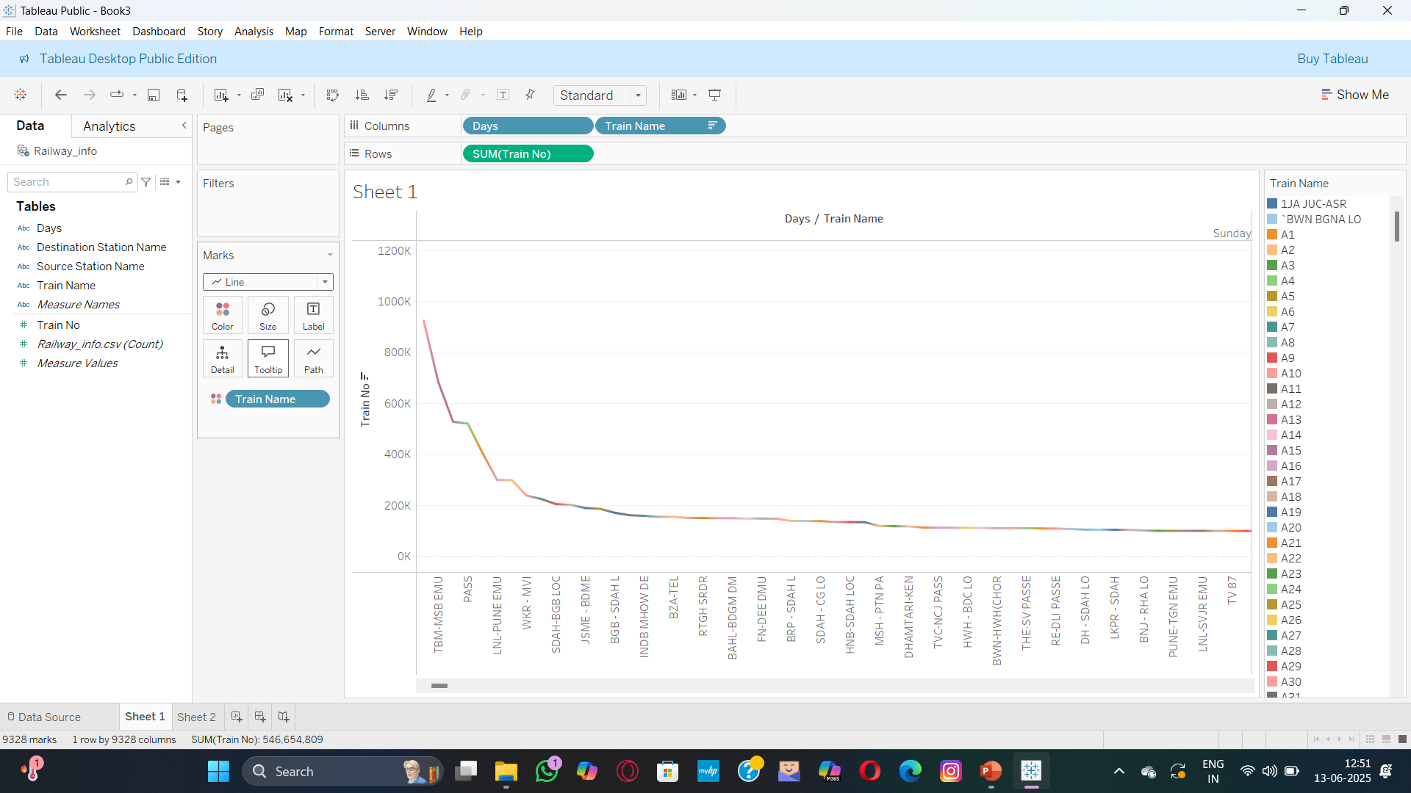
Tasks Level:-4 Data Visualization and Reporting

Slide 10
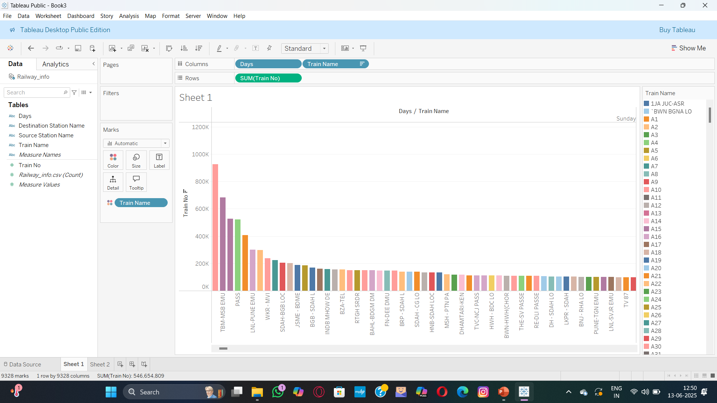
Tasks Level:-4 Data Visualization and Reporting

