Slide 1

railora.
COMPUTATIONAL THINKING
AND PROGRAMMING
SMART TRAVELLING SHORTEST PATH BOOKING PLATFOEM
Methods. Implementation. Evidence.
1
Decomposition
2
Abstraction
3
Pattern Recognition
4
Algorithm Design
SHAIK GOUSE BASHA • 2601150020
Python-authored UI / PostgreSQL CTPDB
AI&DS • K L UNIVERSITY
DR. G. Syam Prasad • 2026
Swiss scenic inspiration • Pexels 32548690 • Academic simulation
Notes:
OPENING
Introduce Railora as an academic Python-authored railway reservation project. The first four content slides are Decomposition, Abstraction, Pattern Recognition and Algorithm Design, in that order.
DISCLOSURE
Sample trains, dates, passengers and fares; simulated payments/refunds; demo PDFs are not valid for travel. Student name, roll number, department, institution, guide and year are placeholders, not invented identities.
VISUAL CREDITS
Train hero: https://images.pexels.com/photos/32548690/pexels-photo-32548690.jpeg — Swiss Landwasser viaduct, scenic inspiration, not an Indian booked route. Pexels licence: https://www.pexels.com/license/ . Actual UI captures originate from the isolated PostgreSQL report replica documented in railora-report/assets/capture_manifest.json. Other cached screen assets: Goa 32262464, Kerala 13045091 and Jaipur 19149600. Source: docs/ASSET_CREDITS.md.
EVIDENCE
Source and saved tests from Railora-Project.zip; Railora_Project_Report.pdf. All diagrams are editable source-based illustrations. Typeface: Arial / Consolas for common Office compatibility. No new complete test suite was run to make this presentation.

Slide 2
01 / COMPUTATIONAL THINKING
Decomposition: one problem, eight parts
METHOD
Break a complex booking request into focused responsibilities and explicit contracts.
REAL-WORLD QUESTION Who owns the final seat when several travelers click “Book”?
1
Identity
2
Discovery
3
Pricing
4
Allocation
Account, session and role
Route, date and class
Exact fare and service fee
Free, unique group seats
AuthService
RailService.search
FarePolicy / fare_quote
allocate_seats
5
Persistence
6
Lifecycle
7
Observation
8
Validation
Booking + seats + event
Confirm / cancel / expire
Admin register and charts
Properties, races and E2E
Database.transaction
RailService
AuditEvent / AdminUI
tests/ + reports/
IN RAILORA
A two-passenger request crosses identity, search, fare, seats and atomic persistence—not one giant UI handler.
RAILORA / ACADEMIC DEMO
SPECIFICATION.md • services.py • schemas.py
02 / 35
Notes:
SLIDE 2 — Decomposition: one problem, eight parts
METHOD
Break a complex booking request into focused responsibilities and explicit contracts.
USE IN RAILORA
A two-passenger request crosses identity, search, fare, seats and atomic persistence—not one giant UI handler.
EXPLANATION / TECHNICAL DEFENCE
The real-world problem is consistent ownership of scarce seats when requests race or are retried. A search page shows only a snapshot. Decomposition separates authentication, discovery, exact pricing, allocation, persistence, lifecycle, observation and validation. Each has typed inputs, outputs and an invariant. For example, allocation returns free unique seat numbers but does not charge or write a booking. The service owns the atomic transaction. Explain that tests are an engineering responsibility, not a step that executes for every passenger click. Group size is 1–6, holds last 15 minutes and requested dates span today through 60 days ahead.
EVIDENCE
SPECIFICATION.md • services.py • schemas.py
DISCLOSURE
Academic simulation; synthetic services and passenger data, simulated payments. Recorded validation is not a new run on the student's machine.

Slide 3
02 / COMPUTATIONAL THINKING
Abstraction: keep only what matters
METHOD
Model essential booking facts; deliberately leave unrelated detail outside the model.
KEEP IN THE MODEL
OMIT / SIMPLIFY
Train number and endpoints
Journey date and travel class
Passengers, price and status
Seat identity and owner
Deadline and request key
FILTER
Engine and maintenance details
Live national inventory
Operating calendars
Transfer feasibility
Real payment settlement
LESS
DETAIL
CLEARER
CONTRACT
IN RAILORA
Train + date + class define inventory; station edges support teaching routes, not connection-valid tickets.
RAILORA / ACADEMIC DEMO
models.py • algorithms.py • ARCHITECTURE.md
03 / 35
Notes:
SLIDE 3 — Abstraction: keep only what matters
METHOD
Model essential booking facts; deliberately leave unrelated detail outside the model.
USE IN RAILORA
Train + date + class define inventory; station edges support teaching routes, not connection-valid tickets.
EXPLANATION / TECHNICAL DEFENCE
Train has number, endpoints, displayed times, duration, base fare, capacity and active status. Inventory identity is train/date/class. Booking stores account owner, passenger JSON, fare, state and request identity. SeatAssignment is separate from Booking. The graph abstraction uses stations and non-negative base-fare/minute edges. Engine mechanics, maintenance, real railway class configurations, operating calendars and transfer feasibility are omitted. Those omissions simplify learning but limit what results mean. The UI is Python-authored through NiceGUI but renders Vue/Quasar/JavaScript in the browser. Do not claim native Python runs in the browser.
EVIDENCE
models.py • algorithms.py • ARCHITECTURE.md
DISCLOSURE
Academic simulation; synthetic services and passenger data, simulated payments. Recorded validation is not a new run on the student's machine.

Slide 4
03 / COMPUTATIONAL THINKING
Pattern recognition: reusable solutions
METHOD
Recognise familiar structures before choosing code: paths, queues, ordering and shared resources.
Weighted path
Stable ordering
FIFO fairness
Retry identity
Scarce resource
100
B
595
KEY: same-request
A
1
2
3
01
780
C
950
oldest first
ONE PNR
unique DB key
Station → service → station
Fare / duration / departure
Oldest group stays first
Same key → same PNR
One seat → one owner
IN RAILORA
A weighted graph finds paths; FIFO preserves fairness; idempotent commands make retries safe.
RAILORA / ACADEMIC DEMO
ALGORITHMS.md • services.py • models.py
04 / 35
Notes:
SLIDE 4 — Pattern recognition: reusable solutions
METHOD
Recognise familiar structures before choosing code: paths, queues, ordering and shared resources.
USE IN RAILORA
A weighted graph finds paths; FIFO preserves fairness; idempotent commands make retries safe.
EXPLANATION / TECHNICAL DEFENCE
These patterns recur outside railway booking: hospital appointments share scarce-slot consistency; distributed APIs need idempotent commands; logistics networks use weighted paths. In Railora, train ranking is stable sorting, network routing is weighted path search, waitlist handling is FIFO, retry handling is command identity and seat ownership is a transactionally protected shared resource. A pattern is not an excuse to force the same algorithm into every function. Explain that the database queue is ordered by created_at and traversed with deque; the browser itself does not own fairness.
EVIDENCE
ALGORITHMS.md • services.py • models.py
DISCLOSURE
Academic simulation; synthetic services and passenger data, simulated payments. Recorded validation is not a new run on the student's machine.

Slide 5
04 / COMPUTATIONAL THINKING
Algorithm design: match method to need
METHOD
Select by objective, constraints and worst-case cost—not by using every method everywhere.
METHOD
OBJECTIVE
FUNCTION
WHERE
Divide & conquer
Stable train ranking
merge_sort
Search
Greedy
Cheapest non-negative route
greedy_route
Planner
Dynamic programming
Cheapest route with ≤H edges
dynamic_route
Lab
Backtracking
Find contiguous group seats
allocate_seats
Booking
Branch & bound
Fastest simple path within budget
branch_bound_route
Lab
IN RAILORA
Merge sort and seat allocation are in search/booking; graph optimisers live in the educational planner.
RAILORA / ACADEMIC DEMO
algorithms.py • ALGORITHMS.md
05 / 35
Notes:
SLIDE 5 — Algorithm design: match method to need
METHOD
Select by objective, constraints and worst-case cost—not by using every method everywhere.
USE IN RAILORA
Merge sort and seat allocation are in search/booking; graph optimisers live in the educational planner.
EXPLANATION / TECHNICAL DEFENCE
Selection is driven by a subproblem. Stable merge sort makes divide-and-conquer inspectable in train ordering. Dijkstra minimises non-negative base fare. Bounded DP adds an at-most-H-edge constraint. Bounded backtracking seeks contiguous six-seat-row groups. Branch-and-bound minimises minutes under a fare budget over simple paths. The last three route routines do not validate real connections or issue multi-leg bookings. Booking transactions must remain short; never run a national-network branch search under a seat lock. Native sorted() is faster but custom sort is intentionally pedagogical.
EVIDENCE
algorithms.py • ALGORITHMS.md
DISCLOSURE
Academic simulation; synthetic services and passenger data, simulated payments. Recorded validation is not a new run on the student's machine.

Slide 6
SOFTWARE DESIGN / MODULAR ARCHITECTURE
Architecture: two adapters, one rulebook
METHOD
Use layered modules and shared services to avoid duplicated business rules.
Traveler / Admin UI
REST clients
NiceGUI • Python-authored
FastAPI • bearer token
UI adapters
API adapters
AuthService + RailService
Strategies
Pure algorithms
Database
FarePolicy / DemoPayment
Sort / seats / routes
SQLAlchemy → PostgreSQL
IN RAILORA
NiceGUI UI and FastAPI call the same AuthService / RailService; PostgreSQL commits durable state.
RAILORA / ACADEMIC DEMO
web.py • admin_ui.py • api.py • services.py • db.py
06 / 35
Notes:
SLIDE 6 — Architecture: two adapters, one rulebook
METHOD
Use layered modules and shared services to avoid duplicated business rules.
USE IN RAILORA
NiceGUI UI and FastAPI call the same AuthService / RailService; PostgreSQL commits durable state.
EXPLANATION / TECHNICAL DEFENCE
The Python-authored browser UI is built with NiceGUI. Browser rendering uses Vue/Quasar/JavaScript. API clients use FastAPI routes and validated Pydantic inputs with bearer tokens. Both enter the same services. The services compose pricing/payment strategies, pure algorithms and SQLAlchemy sessions. PostgreSQL CTPDB handles persistence and cross-process locks. UI code and REST endpoints are adapters, not separate owners of validation. The application uses one web process; multi-worker UI deployment needs shared session/state changes. Database create_all is first-version bootstrap, not a migration system.
EVIDENCE
web.py • admin_ui.py • api.py • services.py • db.py
DISCLOSURE
Academic simulation; synthetic services and passenger data, simulated payments. Recorded validation is not a new run on the student's machine.

Slide 7
SOFTWARE DESIGN / RELATIONAL DATA
Database: model ownership, not counters
METHOD
Use related entities, composite identities and database constraints to preserve invariants.
User
1 : N
Booking
N : 1
Train
id • email • role
password_hash
PNR • user • train
class • fare • state
number • route
times • capacity
Other tables
SeatAssignment
Inventory
Station • Session
AuditEvent
train + date + class
+ seat → owner
train + date + class
capacity
Solid: selected foreign keys • Dashed: logical inventory grouping, not a composite FK
IN RAILORA
SeatAssignment PK = (train, date, class, seat); no second committed row can own that same seat identity.
RAILORA / ACADEMIC DEMO
models.py • db.py • CTPDB
07 / 35
Notes:
SLIDE 7 — Database: model ownership, not counters
METHOD
Use related entities, composite identities and database constraints to preserve invariants.
USE IN RAILORA
SeatAssignment PK = (train, date, class, seat); no second committed row can own that same seat identity.
EXPLANATION / TECHNICAL DEFENCE
There are eight concrete tables: users, login_sessions, stations, trains, inventory, bookings, seat_assignments and audit_events. Base is not a ninth table. Train references origin/destination stations. Inventory identity is train/date/class. Booking has user/train foreign keys, passenger JSON, fare/status/deadline and a unique user/idempotency key. SeatAssignment references Train and Booking and has a four-part primary key; there is no declared full composite FK to Inventory. Audit booking_pnr is a logical string link, not a declared Booking FK. Selected connections are shown, not every FK. Constraints protect identity but service logic still checks capacity, validity, authorization and lifecycle.
EVIDENCE
models.py • db.py • CTPDB
DISCLOSURE
Academic simulation; synthetic services and passenger data, simulated payments. Recorded validation is not a new run on the student's machine.

Slide 8
ALGORITHM 01 / DIVIDE-AND-CONQUER
Divide & conquer: split, sort, merge
METHOD
Recursively split a list, then stably merge sorted halves.
TIME O(n log n)
[950, 595, 450, 780]
SPACE O(n)
[950, 595]
[450, 780]
950
595
450
780
[595, 950]
[450, 780]
[450, 595, 780, 950]
IN RAILORA
merge_sort ranks train results by fare, duration or departure; equal keys keep their original order.
RAILORA / ACADEMIC DEMO
algorithms.py: merge_sort • search() • test_algorithms.py
08 / 35
Notes:
SLIDE 8 — Divide & conquer: split, sort, merge
METHOD
Recursively split a list, then stably merge sorted halves.
USE IN RAILORA
merge_sort ranks train results by fare, duration or departure; equal keys keep their original order.
EXPLANATION / TECHNICAL DEFENCE
Use the illustrative train-key values 950, 595, 450, 780. Split halves recursively, sort each and merge by choosing the smaller next item. The <= comparison selects the left item on ties, so stability holds. A higher-order key chooses fare, duration or departure without duplicating the algorithm. Time is O(n log n), peak auxiliary space O(n) with O(log n) recursion. Slices and merge output allocate cumulative O(n log n) elements even though peak storage is linear. This is inspectable teaching code; measured native sorted() is faster and is a production replacement candidate.
EVIDENCE
algorithms.py: merge_sort • search() • test_algorithms.py
DISCLOSURE
Academic simulation; synthetic services and passenger data, simulated payments. Recorded validation is not a new run on the student's machine.

Slide 9
ALGORITHM 02 / GREEDY
Greedy: settle the cheapest frontier
METHOD
Dijkstra expands the lowest cumulative base-fare candidate; all edge costs must be non-negative.
UNIT-TEST GRAPH / BASE FARE (INR)
Cheapest route
B
A → B → C → D
100
500
A
100
D
300
170
total base fare
travel minutes
250
100
C
Not “cheapest next edge”
Compare cumulative costs; reject negative weights.
IN RAILORA
greedy_route uses heapq + distances + predecessors in the Route Explorer; it does not book connections.
RAILORA / ACADEMIC DEMO
algorithms.py: greedy_route • example_graph() tests
09 / 35
Notes:
SLIDE 9 — Greedy: settle the cheapest frontier
METHOD
Dijkstra expands the lowest cumulative base-fare candidate; all edge costs must be non-negative.
USE IN RAILORA
greedy_route uses heapq + distances + predecessors in the Route Explorer; it does not book connections.
EXPLANATION / TECHNICAL DEFENCE
The diagram is the actual small unit-test graph: A→B fare100/minutes90; A→C250/30; B→C100/40; B→D500/20; C→D100/40. Greedy_route minimises fare, not minutes. It settles cumulative costs A0, B100, C200, D300. A→C250 loses to A→B→C200. Choosing an individually cheap outgoing edge is not the correctness argument; settling the minimum cumulative non-negative frontier is. heapq stores possible duplicates and stale entries are skipped. A predecessor dictionary reconstructs the path once. Conservative lazy-heap time is O((V+E) log(V+E)), space O(V+E); simple-graph textbook logV is a common special case.
EVIDENCE
algorithms.py: greedy_route • example_graph() tests
DISCLOSURE
Academic simulation; synthetic services and passenger data, simulated payments. Recorded validation is not a new run on the student's machine.

Slide 10
ALGORITHM 03 / DYNAMIC PROGRAMMING
Dynamic programming: bound the legs
METHOD
Reuse the previous layer to minimise cost with at most H edges.
H = 0
H = 1
H = 2
H = 3
A : 0
B : 100
C : 250
C : 200
D : 350
D : 300
At most 2 edges
At most 3 edges
A
C
D
fare 350
A
B
C
D
fare 300
IN RAILORA
dynamic_route uses previous/current dictionaries; the lab compares ≤4 edges, while tests vary H.
RAILORA / ACADEMIC DEMO
algorithms.py: dynamic_route • test_algorithms.py
10 / 35
Notes:
SLIDE 10 — Dynamic programming: bound the legs
METHOD
Reuse the previous layer to minimise cost with at most H edges.
USE IN RAILORA
dynamic_route uses previous/current dictionaries; the lab compares ≤4 edges, while tests vary H.
EXPLANATION / TECHNICAL DEFENCE
D[h][v] is the minimum cost to v with at most h edges. Recurrence D[h][v]=min(D[h-1][v], min_(u→v)(D[h-1][u]+fare)). current starts as previous.copy(); relax only from previous, never current. This enforces the edge bound. In the unit-test graph, H=2 produces A→C→D cost350, whereas H=3 permits A→B→C→D cost300. B→D exists but is expensive (600 from A), so it does not change these outcomes. The lab chooses H=4. This source stores full path tuples, so analysis must include path-copy overhead: O(H(V+E)) relax/copy work plus up to O(H²E) path copying, with O(HV) peak stored-path auxiliary space. The function does not create a flattened-edge list.
EVIDENCE
algorithms.py: dynamic_route • test_algorithms.py
DISCLOSURE
Academic simulation; synthetic services and passenger data, simulated payments. Recorded validation is not a new run on the student's machine.

Slide 11
ALGORITHM 04 / BACKTRACKING
Backtracking: find seats together
METHOD
Explore row candidates, prune infeasible prefixes, then use a deterministic fallback.
Example: available {1, 3, 4, 5, 6}; group size = 3
Bound the hard search
Fixed row width = 6
1
2
3
4
5
6
If no row group fits
free
taken
chosen
chosen
chosen
free
Choose earliest free seats
1 → 2 fails
Backtrack
3 → 4 → 5 succeeds
Return unique free seats
Availability is the invariant
Together is a preference—not a promise.
IN RAILORA
allocate_seats searches six-seat rows for a 1–6 person group; together/window remain preferences.
RAILORA / ACADEMIC DEMO
algorithms.py: allocate_seats • test_together_row_backtracking
11 / 35
Notes:
SLIDE 11 — Backtracking: find seats together
METHOD
Explore row candidates, prune infeasible prefixes, then use a deterministic fallback.
USE IN RAILORA
allocate_seats searches six-seat rows for a 1–6 person group; together/window remain preferences.
EXPLANATION / TECHNICAL DEFENCE
Available seats are [1,3,4,5,6], group size3. Seat2 is unavailable, so a contiguous group cannot extend seat1 to seat2. The search then finds seats3,4,5. Rows have exactly six simulated positions; global coach-wide unconstrained combinations are not enumerated. Prefixes are pruned when remaining positions cannot fill the group. If no contiguous row group exists but enough seats are free, the earliest deterministic seats are returned. A window request prioritises row-edge numbers. Time includes normalisation sorting O(nlogn+n·2^6), auxiliary O(n), depth≤6. This is not the real layout of every train/class and no preference is guaranteed.
EVIDENCE
algorithms.py: allocate_seats • test_together_row_backtracking
DISCLOSURE
Academic simulation; synthetic services and passenger data, simulated payments. Recorded validation is not a new run on the student's machine.

Slide 12
ALGORITHM 05 / BRANCH-AND-BOUND
Branch & bound: fastest within a budget
METHOD
Search simple paths; reject over-budget branches and prune by an admissible remaining-time bound.
FARE BUDGET = 350
Lower the budget to 300
A
A → B → C → D
fare 300 • 170 minutes
Reject cycles
A → C → D
A → B → …
Only simple paths are explored
fare 350
70 minutes: incumbent
90 + 20 ≥ 70
Cannot beat incumbent
Safety cap ≠ optimum
20,000 states → error if exceeded.
Lower bound helps typical cases; worst-case growth still matters.
IN RAILORA
branch_bound_route minimises minutes under a fare budget; a 20,000-state cap raises an explicit error.
RAILORA / ACADEMIC DEMO
algorithms.py: branch_bound_route • budgeted path tests
12 / 35
Notes:
SLIDE 12 — Branch & bound: fastest within a budget
METHOD
Search simple paths; reject over-budget branches and prune by an admissible remaining-time bound.
USE IN RAILORA
branch_bound_route minimises minutes under a fare budget; a 20,000-state cap raises an explicit error.
EXPLANATION / TECHNICAL DEFENCE
Use the same unit-test graph, budget350. A→C→D costs350 and takes70 minutes, establishing incumbent70. For the branch starting A→B, elapsed90 + optimistic remaining20 =110, already no better than70, so it can be pruned. The lower bound ignores fare budget and is still admissible: actual feasible remaining time cannot be smaller. At budget300 the fast350 path is rejected, leaving A→B→C→D at300 fare and170 minutes. Precompute remaining-time bounds by reverse relaxation O(VE). Enumerating simple paths can still be exponential/factorial; outgoing sort, tuple membership and copying add costs. Depth is O(V), but concurrently live immutable path-prefix tuples can total O(V²). The safety cap is not a claim of optimality when reached.
EVIDENCE
algorithms.py: branch_bound_route • budgeted path tests
DISCLOSURE
Academic simulation; synthetic services and passenger data, simulated payments. Recorded validation is not a new run on the student's machine.

Slide 13
ALGORITHM ANALYSIS / TIME AND SPACE
Complexity: analyse the actual code
METHOD
Distinguish worst-case bounds, expected hashing and amortized resizing from measured latency.
ROUTINE
TIME / QUALIFICATION
AUXILIARY SPACE
Merge sort
n log n
n peak + log n stack
Dijkstra
(V+E) log(V+E); lazy heap
V+E
Bounded DP
H(V+E) + up to H²E path-copy work
HV stored paths
Seat backtracking
n log n + n·64; fixed 6-seat rows
n; depth ≤6
Branch & bound
Exponential/factorial; VE bound prep
V² copied prefixes + E
EXPECTED
Set/dict lookup: O(1) expected, not guaranteed.
AMORTIZED
List append: O(1) averaged across resize costs.
IN RAILORA
Path-tuple copies count: DP stores full paths, and branch recursion retains several copied prefixes.
RAILORA / ACADEMIC DEMO
ALGORITHMS.md • algorithms.py • benchmark.py
13 / 35
Notes:
SLIDE 13 — Complexity: analyse the actual code
METHOD
Distinguish worst-case bounds, expected hashing and amortized resizing from measured latency.
USE IN RAILORA
Path-tuple copies count: DP stores full paths, and branch recursion retains several copied prefixes.
EXPLANATION / TECHNICAL DEFENCE
Let n be items/free seats, V/E graph vertices/edges and H the edge bound. Merge sort O(nlogn), O(n) peak. Dijkstra conservative lazy-heap time O((V+E)log(V+E)), O(V+E) space; simple graph logV is usual. DP relax/layer copies O(H(V+E)), with up to O(H²E) extra path-copying and O(HV) stored-path space. Seat allocator is O(nlogn+n·2^6), O(n); six-seat fixed row and k≤6 keep backtracking bounded. Branch bound preprocessing O(VE) plus exponential/factorial path count; path prefixes can require O(V²) simultaneously, plus graph/outgoing-edge storage. Expected hash lookup O(1) has pathological worst cases; list append amortized O(1) averages resize costs over operations. Neither promises every transaction is fast: waiting for a DB lock is a separate cost.
EVIDENCE
ALGORITHMS.md • algorithms.py • benchmark.py
DISCLOSURE
Academic simulation; synthetic services and passenger data, simulated payments. Recorded validation is not a new run on the student's machine.

Slide 14
PYTHON / DATA STRUCTURES
Data structures: choose for the operation
METHOD
Use ordered sequences, membership sets, priority heaps, FIFO queues and immutable values purposefully.
List
Set + dict
Heap
Ordered passengers / results
Free-seat membership / distances
Lowest-cost route frontier
[p1, p2, …]
{1, 3, 4} best[A]=0
100 → 200 → 300
Deque
Frozen values
DB key + index
Oldest waitlist group first
Edges / paths as value objects
Cross-process seat identity
head → group → group
Edge • RouteResult
train + date + class + seat
IN RAILORA
Free seats use sets; Dijkstra uses heapq; waitlist traversal uses deque; PostgreSQL keys enforce ownership.
RAILORA / ACADEMIC DEMO
algorithms.py • services.py • models.py
14 / 35
Notes:
SLIDE 14 — Data structures: choose for the operation
METHOD
Use ordered sequences, membership sets, priority heaps, FIFO queues and immutable values purposefully.
USE IN RAILORA
Free seats use sets; Dijkstra uses heapq; waitlist traversal uses deque; PostgreSQL keys enforce ownership.
EXPLANATION / TECHNICAL DEFENCE
List indexes are O(1), append amortized O(1) and middle deletion O(n). Sets and dictionaries support expected O(1) membership/mapping; they also have worst cases. Heap push/pop is O(log m) and min peek O(1). deque popleft is O(1), unlike list pop(0). Tuples and frozen dataclasses support immutable value semantics, but copying a path tuple costs its length. A B-tree index is typically simplified as O(log N+result size); planner, I/O, caching and locks matter. Database uniqueness works across web processes; a Python set of currently known seats is only a snapshot. Explain which choice would change if input sizes grew.
EVIDENCE
algorithms.py • services.py • models.py
DISCLOSURE
Academic simulation; synthetic services and passenger data, simulated payments. Recorded validation is not a new run on the student's machine.

Slide 15
PYTHON / LANGUAGE CONSTRUCTS
Pythonic programming: concise, not cryptic
METHOD
Use generators, comprehensions, decorators and context managers without hiding side effects.
ITERATOR / GENERATOR
COMPREHENSION
labels = seat_labels([1, 37])
next(labels) # C1-01
next(labels) # C2-01
free = [seat for seat in pool
if seat not in taken]
DECORATOR
CONTEXT MANAGER
@timed
def quote(base, cls, people):
return fare_quote(
base, cls, people)
with db.transaction() as session:
session.add(booking)
# success: commit
# exception: rollback
IN RAILORA
seat_labels is lazy; timed preserves the callable; Database.transaction commits or rolls back reliably.
RAILORA / ACADEMIC DEMO
algorithms.py: seat_labels, timed • db.py • services.py
15 / 35
Notes:
SLIDE 15 — Pythonic programming: concise, not cryptic
METHOD
Use generators, comprehensions, decorators and context managers without hiding side effects.
USE IN RAILORA
seat_labels is lazy; timed preserves the callable; Database.transaction commits or rolls back reliably.
EXPLANATION / TECHNICAL DEFENCE
seat_labels accepts any Iterable[int] and yields strings. Creating the iterator does not format all outputs; next() consumes work on demand. A comprehension builds free-seat values from membership tests. The actual timed decorator uses wraps and ParamSpec, logs elapsed milliseconds in finally and returns the original R—it does not change the result into a tuple. Database.transaction uses a context manager around SQLAlchemy sessions.begin; commit happens on success and rollback on error. The short snippets are illustrative uses of source constructs, not complete runnable modules. Iterable input, iterator semantics and output materialisation must be distinguished in space analysis.
EVIDENCE
algorithms.py: seat_labels, timed • db.py • services.py
DISCLOSURE
Academic simulation; synthetic services and passenger data, simulated payments. Recorded validation is not a new run on the student's machine.

Slide 16
SOFTWARE DESIGN / OOP AND PATTERNS
OOP: compose replaceable responsibilities
METHOD
Define abstract contracts, inherit concrete policies and inject collaborators by composition.
RailService
Database
FarePolicy (ABC)
PaymentGateway
transaction()
Repository[T]
quote() contract
Protocol contract
Strategy + composition
+ unit of work
StandardFare
DemoPayment
Implements the fare strategy
Simulates charge / refund
IN RAILORA
RailService composes Database, FarePolicy and PaymentGateway; UI/API consume its shared behavior.
RAILORA / ACADEMIC DEMO
services.py • db.py: Repository[T] • models.py
16 / 35
Notes:
SLIDE 16 — OOP: compose replaceable responsibilities
METHOD
Define abstract contracts, inherit concrete policies and inject collaborators by composition.
USE IN RAILORA
RailService composes Database, FarePolicy and PaymentGateway; UI/API consume its shared behavior.
EXPLANATION / TECHNICAL DEFENCE
FarePolicy is an ABC with quote(); StandardFare implements it. PaymentGateway is a Protocol with DemoPayment as the current simulation. RailService composes these dependencies and Database. Database.transaction is a unit-of-work context; Repository[T] supplies a generic persistence wrapper. The ORM models inherit declarative Base. This demonstrates Strategy, adapter separation and unit of work without unnecessary class proliferation. Inject BrokenPayment in tests to verify rollback. There is no implemented age concession; adding one requires appropriate passenger-age inputs/contract changes and new integer-rounding tests, not inheritance alone.
EVIDENCE
services.py • db.py: Repository[T] • models.py
DISCLOSURE
Academic simulation; synthetic services and passenger data, simulated payments. Recorded validation is not a new run on the student's machine.

Slide 17
SOFTWARE DESIGN / TYPING AND MAINTAINABILITY
Types and generics: make contracts visible
METHOD
Express reusable types, structural protocols and immutable values; validate runtime inputs separately.
REUSABLE GENERIC REPOSITORY
SIGNATURE-PRESERVING DECORATOR
class Repository(Generic[T]):
def add(self, entity: T) -> T: ...
def all(self) -> list[T]: ...
def timed(
fn: Callable[P, R]
) -> Callable[P, R]: ...
# P = ParamSpec; R = TypeVar
Static checking
Runtime validation
Immutable values
Mypy: 7 core modules
Pydantic + service invariants
Frozen Edge / RouteResult
Typed boundaries: UI / API → schemas → services → models / pure algorithms
IN RAILORA
Mypy checks seven core modules; Pydantic validates passenger and train commands at runtime.
RAILORA / ACADEMIC DEMO
schemas.py • db.py • algorithms.py • pyproject.toml
17 / 35
Notes:
SLIDE 17 — Types and generics: make contracts visible
METHOD
Express reusable types, structural protocols and immutable values; validate runtime inputs separately.
USE IN RAILORA
Mypy checks seven core modules; Pydantic validates passenger and train commands at runtime.
EXPLANATION / TECHNICAL DEFENCE
Repository uses Generic[T] with T bound to declarative Base; add returns T and all returns list[T]. merge_sort is generic over T with a Callable key. timed uses ParamSpec P and TypeVar R to preserve arguments/return type. PaymentGateway is structurally typed, and frozen Edge/RouteResult are typed value objects. Mypy is configured for seven core modules, not every dynamic NiceGUI handler. Annotations do not enforce runtime security; Pydantic plus service checks validate actual inputs and permissions. Modular boundaries support changing a policy or sorting key without duplicating allocation/locks. The fragments are abbreviated source contracts, not full import-complete modules.
EVIDENCE
schemas.py • db.py • algorithms.py • pyproject.toml
DISCLOSURE
Academic simulation; synthetic services and passenger data, simulated payments. Recorded validation is not a new run on the student's machine.

Slide 18
FUNCTIONAL PROGRAMMING / PURE AND HIGHER-ORDER FUNCTIONS
Functional design: separate values from effects
METHOD
Use pure calculations and higher-order functions; isolate database and payment effects.
Input values
Output value
base = 595
class = CC, people = 2
fare_quote()
subtotal 1,190 + fee 40
TOTAL 1,230
HIGHER-ORDER KEY FUNCTION
Effects stay in services
ranked = merge_sort(
trains, key=lambda t: t["fare"])
Persist booking + seats + audit.
Simulated payment is not a pure calculation.
IN RAILORA
fare_quote, sort, allocation and route functions are testable values; services own state transitions.
RAILORA / ACADEMIC DEMO
algorithms.py • FarePolicy • services.py
18 / 35
Notes:
SLIDE 18 — Functional design: separate values from effects
METHOD
Use pure calculations and higher-order functions; isolate database and payment effects.
USE IN RAILORA
fare_quote, sort, allocation and route functions are testable values; services own state transitions.
EXPLANATION / TECHNICAL DEFENCE
fare_quote(595,CC,2) deterministically returns ticket595, subtotal1190, fee40 and total1230 in integer rupees. CC multiplier1; 3A6/5 and SL3/5 round upward using integer arithmetic. No global mutation, database access or real payment occurs in fare_quote. merge_sort accepts a key callback, so sorting criteria are behavior passed as a value. Frozen Edge and RouteResult discourage accidental mutation. Logging in a decorated function is a side effect even if the underlying calculation is pure. The service layer necessarily writes state; functional design means confining and testing these effects, not declaring the whole app pure.
EVIDENCE
algorithms.py • FarePolicy • services.py
DISCLOSURE
Academic simulation; synthetic services and passenger data, simulated payments. Recorded validation is not a new run on the student's machine.

Slide 19
CONCURRENCY / THREADS, PROCESSES, ASYNC AND GIL
Concurrency: select by workload
METHOD
Threads overlap blocking I/O; async coordinates tasks; processes run pure Python CPU work.
I/O
AWAIT
CPU
THREADS
ASYNC
PROCESSES
Blocking DB / service I/O
Coordinate independent reads
Pure graph / CPU computation
run.io_bound(...)
asyncio.gather(...)
run.cpu_bound(...)
GIL insight
Pure Python CPU loops → processes. Blocking I/O → threads. Async ≠ a lock on scarce seats.
IN RAILORA
DB calls use run.io_bound; dashboard reads use asyncio.gather; algorithm lab uses run.cpu_bound.
RAILORA / ACADEMIC DEMO
web.py • admin_ui.py • lab_ui.py • main.py
19 / 35
Notes:
SLIDE 19 — Concurrency: select by workload
METHOD
Threads overlap blocking I/O; async coordinates tasks; processes run pure Python CPU work.
USE IN RAILORA
DB calls use run.io_bound; dashboard reads use asyncio.gather; algorithm lab uses run.cpu_bound.
EXPLANATION / TECHNICAL DEFENCE
Synchronous SQL/service work is offloaded to the NiceGUI thread pool to keep the event loop responsive. asyncio.gather coordinates independent dashboard reads; the expiry task schedules its 15-second sweep and offloads the transaction. The lab calls a top-level picklable benchmark_lab in a process pool; never pass a live SQL session across processes. Under the conventional CPython build used for recorded validation, pure Python CPU loops generally do not parallelise in threads because of the GIL. Native Argon2 is CPU work and may release the GIL; thread offloading still preserves UI responsiveness. Process startup and serialization can cost more than tiny graph work. Concurrency does not replace DB row locks; async alone cannot prevent overselling.
EVIDENCE
web.py • admin_ui.py • lab_ui.py • main.py
DISCLOSURE
Academic simulation; synthetic services and passenger data, simulated payments. Recorded validation is not a new run on the student's machine.

Slide 20
CONCURRENCY / DATABASE CONSISTENCY
Atomic booking: protect the final seat
METHOD
Combine row locks, command identity and unique constraints inside one transaction.
ILLUSTRATIVE TIMELINE / ONE SEAT REMAINS
Idempotency
same key + same payload
→ same PNR
Buyer 1
LOCK
ASSIGN
COMMIT
Final DB guard
Buyer 2
WAIT FOR LOCK
RECHECK → WAITLIST
one composite seat key
→ one assignment
Booking + SeatAssignment + AuditEvent
Exception → rollback all three
IN RAILORA
Lock order is Train → Inventory → Booking; booking, seats and audit commit or roll back together.
RAILORA / ACADEMIC DEMO
services.py: create_booking • models.py • test_concurrency.py
20 / 35
Notes:
SLIDE 20 — Atomic booking: protect the final seat
METHOD
Combine row locks, command identity and unique constraints inside one transaction.
USE IN RAILORA
Lock order is Train → Inventory → Booking; booking, seats and audit commit or roll back together.
EXPLANATION / TECHNICAL DEFENCE
The figure is an illustrative two-buyer/one-seat timeline, not a freshly run experiment. Buyer1 locks train then inventory, creates records and commits. Buyer2 waits, then rechecks availability and cannot own the same composite seat identity. Related commands use Train→Inventory→Booking order. Coarse train lock protects lazy inventory creation and serializes even different dates/classes for a train; finer locks are a future improvement. The command fingerprint is checked before and after locking. Identical retries return the same PNR; changed data with the same key is rejected. Recorded race tests:18 simultaneous requests for6 seats produce6 confirmed/12 waitlisted;20 requests using2 independent PostgreSQL service pools also produce6 confirmed;12 identical retries produce1 booking/2 seats. Provider-failure injection leaves no partial booking/assignment/event. Never put a real network payment under the current SQL lock.
EVIDENCE
services.py: create_booking • models.py • test_concurrency.py
DISCLOSURE
Academic simulation; synthetic services and passenger data, simulated payments. Recorded validation is not a new run on the student's machine.

Slide 21
CONCURRENCY / LIFECYCLE AND QUEUES
Lifecycle: holds, expiry and fair promotion
METHOD
Model explicit states; release seats safely and serve the oldest feasible queue head first.
Waitlisted
promote
Reserved
confirm
Confirmed
No assigned seats
15-minute hold
Demo receipt + seats
Expired → release seats
FIFO EXAMPLE 2 free seats; the oldest group needs 3
HEAD: 3 PEOPLE
NEXT: 1 PERSON
2 FREE SEATS
Head blocks younger groups: fairness over throughput.
IN RAILORA
A promoted waitlist group becomes reserved for 15 minutes—not automatically paid or confirmed.
RAILORA / ACADEMIC DEMO
services.py: confirm, cancel, expire_holds, promotion
21 / 35
Notes:
SLIDE 21 — Lifecycle: holds, expiry and fair promotion
METHOD
Model explicit states; release seats safely and serve the oldest feasible queue head first.
USE IN RAILORA
A promoted waitlist group becomes reserved for 15 minutes—not automatically paid or confirmed.
EXPLANATION / TECHNICAL DEFENCE
Five stored statuses:confirmed,reserved,waitlisted,cancelled,expired. A reservation assigns seats for15 minutes; confirm independently checks its deadline. The sweeper runs every15 seconds, so expiration enforcement is not reliant only on UI display or sweep scheduling. Cancellation and expiry release assignments in the transaction and attempt FIFO promotion. If the head group needs3 seats and only2 are free, a later1-person group does not bypass it. This fairness choice can leave seats idle. When enough are free, the head becomes reserved with a new15-minute deadline, not automatically confirmed. Admin polling about every3 seconds is separate from the expiry sweep. Cancellation of eligible reserved/waitlisted entries is also allowed; not every edge is shown in this simplified diagram.
EVIDENCE
services.py: confirm, cancel, expire_holds, promotion
DISCLOSURE
Academic simulation; synthetic services and passenger data, simulated payments. Recorded validation is not a new run on the student's machine.

Slide 22
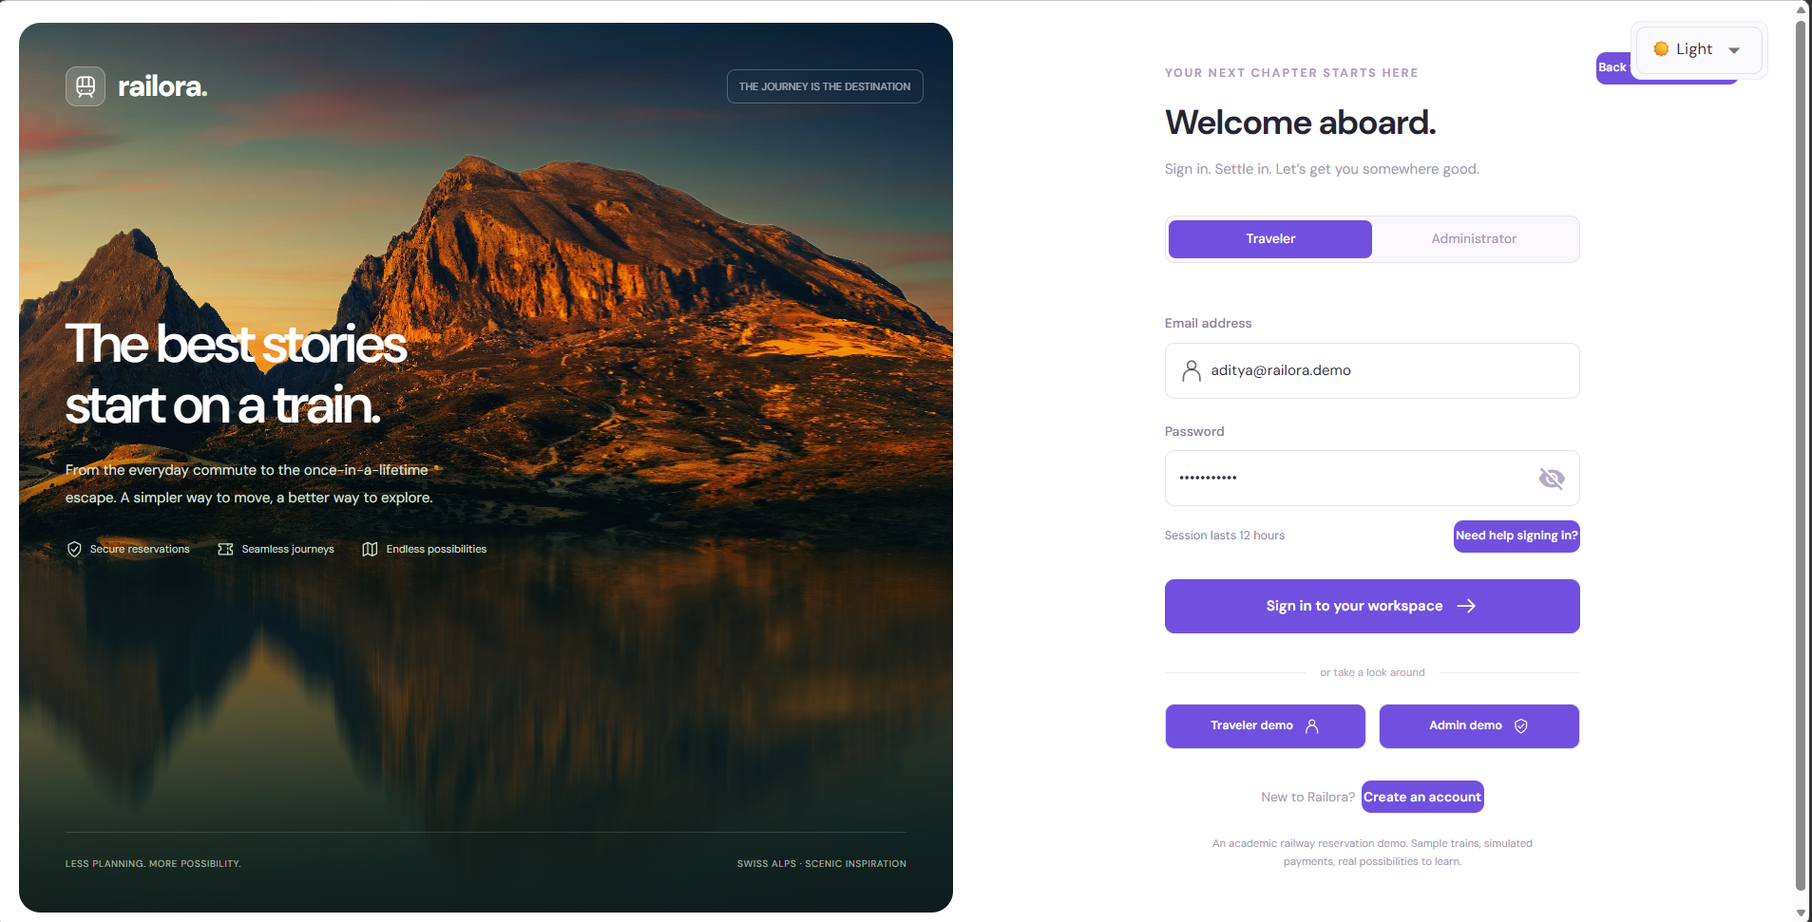
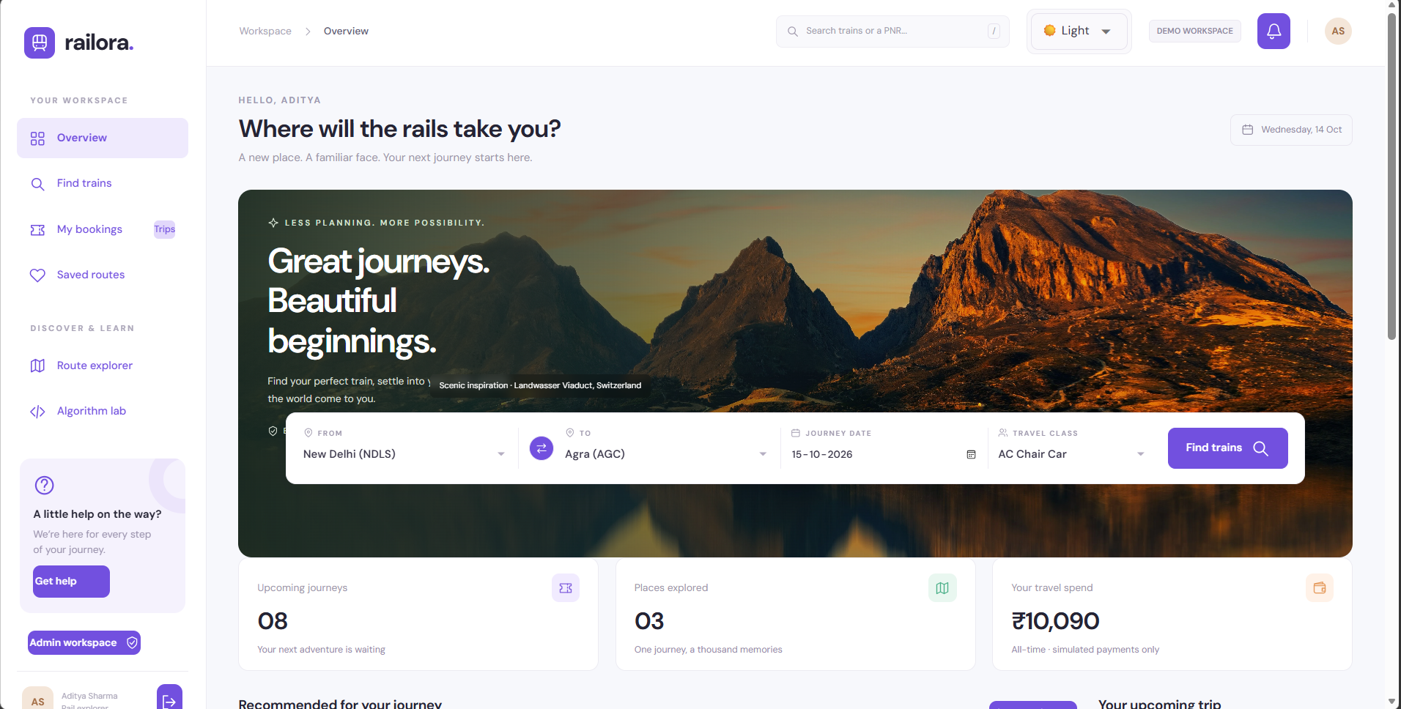
IMPLEMENTATION / ACTUAL SCREENSHOTS
Traveler UI: make the method observable
METHOD
Use clear feedback, responsive layout and shared validated commands at the presentation boundary.
Role-aware sign-in • local real photography
Direct train discovery • passenger booking
IN RAILORA
Login → search → passenger modal → PNR/demo ticket; the service rechecks inventory at submit time.
RAILORA / ACADEMIC DEMO
web.py • web_components.py • capture_manifest.json
22 / 35
Notes:
SLIDE 22 — Traveler UI: make the method observable
METHOD
Use clear feedback, responsive layout and shared validated commands at the presentation boundary.
USE IN RAILORA
Login → search → passenger modal → PNR/demo ticket; the service rechecks inventory at submit time.
EXPLANATION / TECHNICAL DEFENCE
These are actual browser screenshots captured during report creation from an isolated PostgreSQL CTPDB replica of the unchanged delivered source, using only environment overrides. They are not fictional designs and not a new full-suite run. The login supports traveler/admin entry; registration only creates a traveler. The dashboard exposes direct route/date/class search, availability and booking entry. Modal validates1–6 passengers, class/preference/mode and displays exact fare. A search count is staleable; only service validation plus SQL transaction allocates. NiceGUI internally uses Vue/Quasar/JS/CSS despite Python authoring. Cached real scenic images are credited, not live Google Images scraping. Demo ticket is explicitly NOT VALID FOR TRAVEL.
EVIDENCE
web.py • web_components.py • capture_manifest.json
DISCLOSURE
Academic simulation; synthetic services and passenger data, simulated payments. Recorded validation is not a new run on the student's machine.

Slide 23
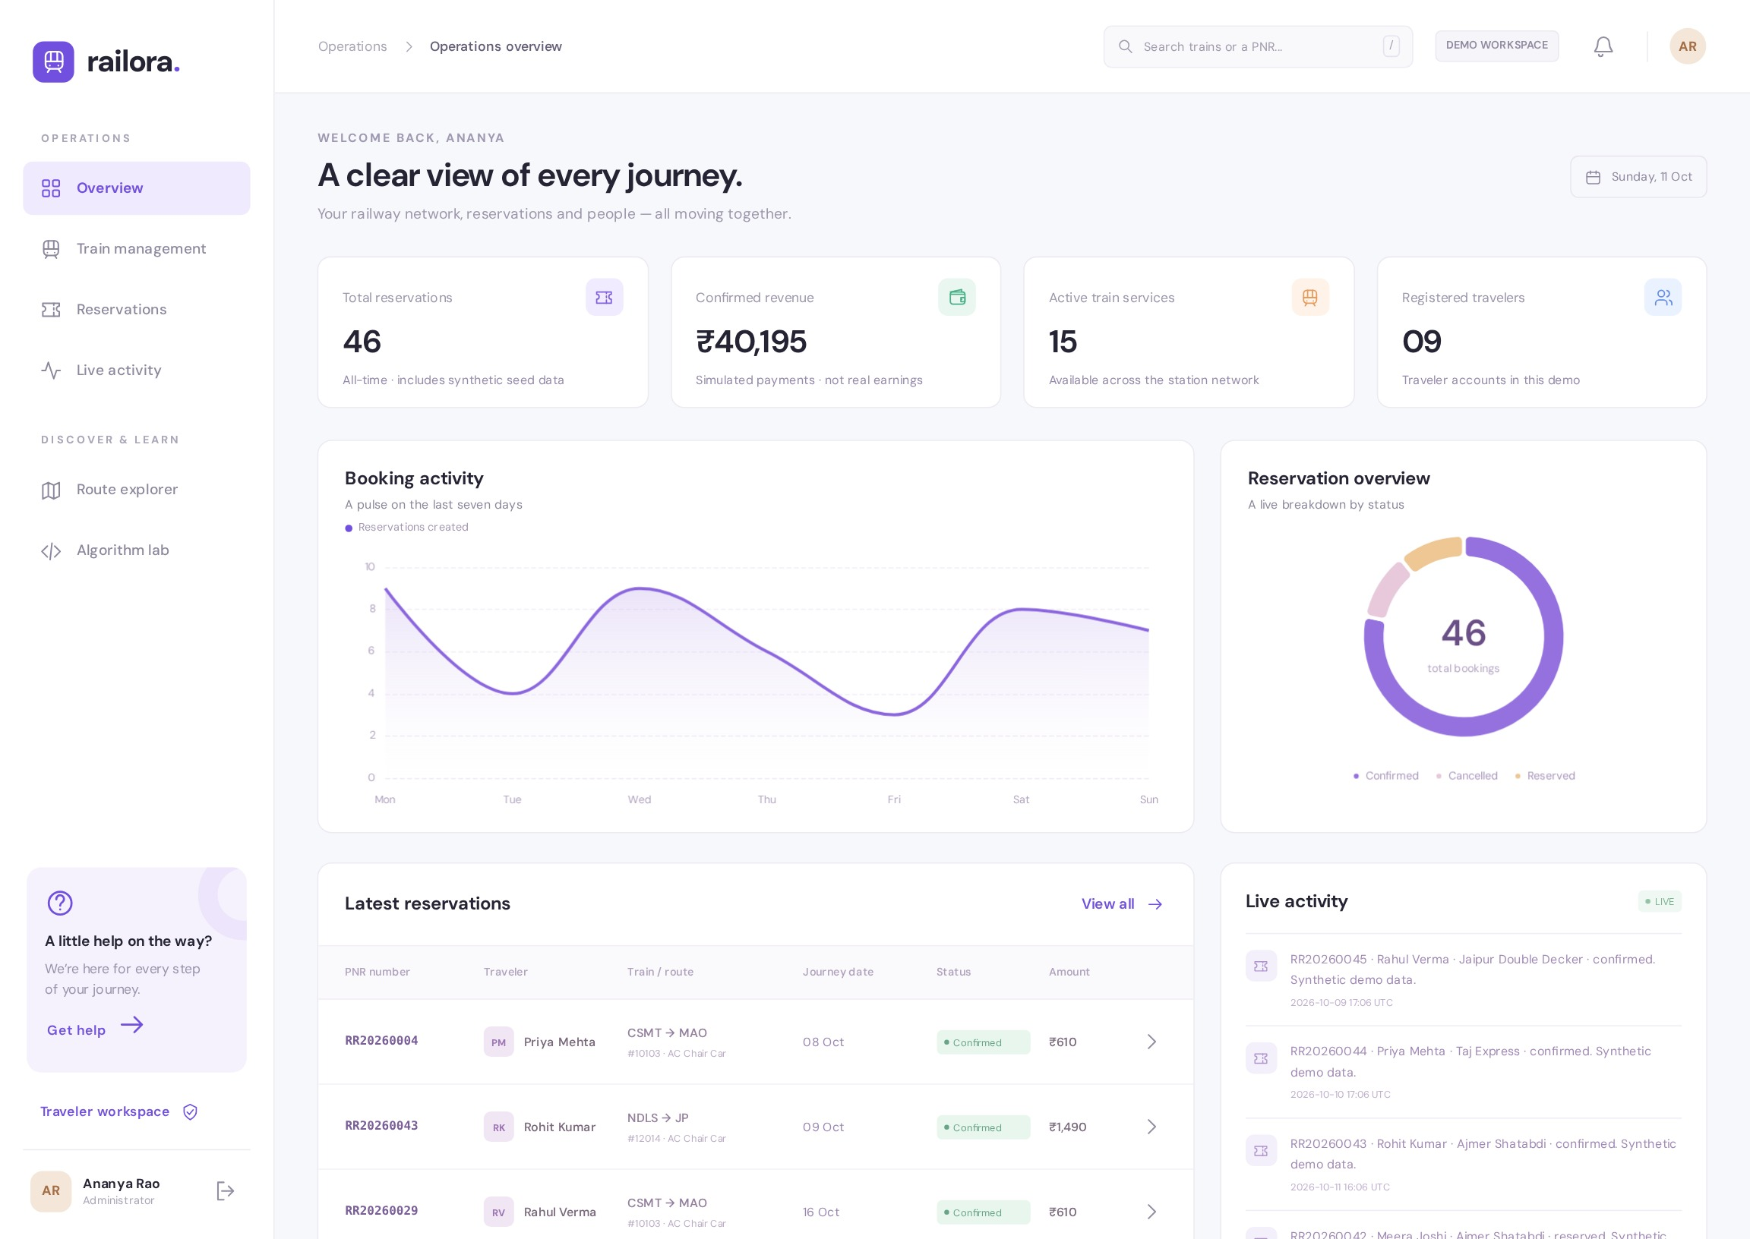
IMPLEMENTATION / ACTUAL SCREENSHOTS
Admin UI: observe committed changes
METHOD
Combine role-based access with periodic reads of durable statistics and audit events.
Role checks
UI and services enforce admin
Persistent updates
Booking + audit commit first
Polling + WebSocket
Refresh about every 3 seconds
IN RAILORA
AdminUI polls about every 3 seconds; charts/register reflect synthetic CTPDB data, not browser-only counters.
RAILORA / ACADEMIC DEMO
admin_ui.py • admin_stats() • events() • capture_manifest.json
23 / 35
Notes:
SLIDE 23 — Admin UI: observe committed changes
METHOD
Combine role-based access with periodic reads of durable statistics and audit events.
USE IN RAILORA
AdminUI polls about every 3 seconds; charts/register reflect synthetic CTPDB data, not browser-only counters.
EXPLANATION / TECHNICAL DEFENCE
Screenshot is actual isolated synthetic demo state:46 initial sample bookings,15 active services and9 traveler accounts plus1 admin. Confirmed revenue is simulated, not real money. Administrators can add validated trains, pause/resume new booking, inspect reservations/events and export CSV. Service-level authorization is retained even if UI buttons are hidden. Pause does not silently cancel existing tickets. Audit events commit with reservation changes; polling observes them and NiceGUI sends updated components through WebSocket. It is not direct push from PostgreSQL or real railway data. Register has12 rows per UI page but currently loads/serializes all bookings with extra per-booking queries; SQL pagination and batched loading are future improvements.
EVIDENCE
admin_ui.py • admin_stats() • events() • capture_manifest.json
DISCLOSURE
Academic simulation; synthetic services and passenger data, simulated payments. Recorded validation is not a new run on the student's machine.

Slide 24
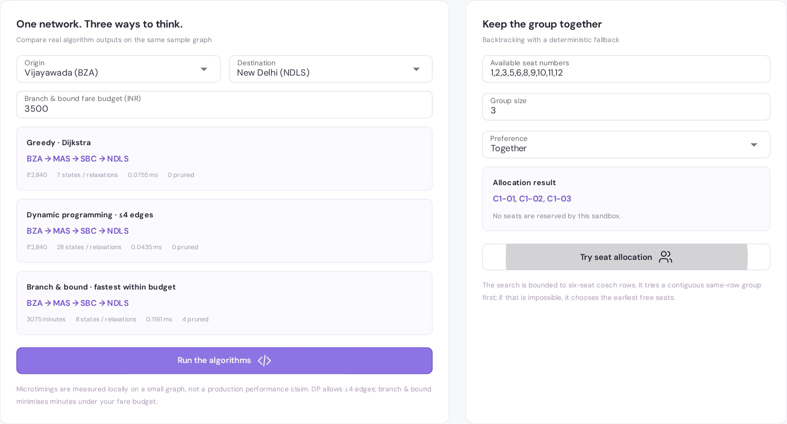
IMPLEMENTATION / ALGORITHM LABORATORY
Algorithm Lab: compare the same network
METHOD
Run pure graph computations in a process pool and compare their different objectives and constraints.
GREEDY
Lowest base fare
DYNAMIC PROGRAMMING
Lowest fare, ≤4 edges
BRANCH & BOUND
Fastest within budget
IN RAILORA
Dijkstra / DP return base-fare cost; branch-and-bound returns minutes. The seat sandbox reserves nothing.
RAILORA / ACADEMIC DEMO
lab_ui.py • benchmark_lab() • capture_manifest.json
24 / 35
Notes:
SLIDE 24 — Algorithm Lab: compare the same network
METHOD
Run pure graph computations in a process pool and compare their different objectives and constraints.
USE IN RAILORA
Dijkstra / DP return base-fare cost; branch-and-bound returns minutes. The seat sandbox reserves nothing.
EXPLANATION / TECHNICAL DEFENCE
This is an actual screenshot from the isolated synthetic PostgreSQL report replica, not an invented design. The default graph uses sample stations and services. Default BZA→MAS→SBC→NDLS costs2840 base fare. Dijkstra is cheapest without a leg bound; DP is cheapest with≤4 edges; branch-and-bound is fastest within the selected farebudget and returnsminutes rather thanfare as RouteResult.cost. Matching paths in one example do not make the objectives equivalent. The toy unit-test graph on earlier slides exposes their differences. Native CPU worker keeps the UI responsive; individual microtimings here are noisy and do not replace the five-repeat benchmark evidence. The seat sandbox only computes labels; it does not lock or allocate actual booking inventory. The graph ignores service calendars and transfer feasibility.
EVIDENCE
lab_ui.py • benchmark_lab() • capture_manifest.json
DISCLOSURE
Academic simulation; synthetic services and passenger data, simulated payments. Recorded validation is not a new run on the student's machine.

Slide 25
QUALITY ENGINEERING / SYSTEMATIC TESTING
Testing: examples plus independent oracles
METHOD
Layer unit, service, API, database-race and browser tests; generate boundary inputs with Hypothesis.
BROWSER E2E
Hypothesis generates
Seat lists, group sizes and graphs
POSTGRESQL RACES
API / SERVICE INTEGRATION
Check invariants
unique ∧ free ∧ valid result count
UNIT + PROPERTY TESTS
Small graphs → independent brute force
Failing examples → shrink and inspect
IN RAILORA
Allocation properties check free/unique seats; route properties compare against independent brute-force results.
RAILORA / ACADEMIC DEMO
tests/test_algorithms.py • test_services.py • test_api.py • test_e2e.py
25 / 35
Notes:
SLIDE 25 — Testing: examples plus independent oracles
METHOD
Layer unit, service, API, database-race and browser tests; generate boundary inputs with Hypothesis.
USE IN RAILORA
Allocation properties check free/unique seats; route properties compare against independent brute-force results.
EXPLANATION / TECHNICAL DEFENCE
Unit tests cover ordering/stability, labels, integer fares and graph objective examples. Service integration covers ownership, roles, idempotency, holds, release/FIFO and injected-provider rollback. HTTP integration exercises schemas and endpoints. PostgreSQL tests use independent pools and true SQL row locks. E2E covers login, booking, separate admin observation, PDF download/cancel, mobile layout and CPU lab. Hypothesis generates lists/groups and small graphs, shrinking failures to useful counterexamples. Dijkstra agrees with DP when enough edges are allowed; branch search agrees with a separate brute-force oracle. Do not validate an implementation merely by rewriting the same algorithm in the test. Destructive fixtures must target an isolated *_test database, never CTPDB.
EVIDENCE
tests/test_algorithms.py • test_services.py • test_api.py • test_e2e.py
DISCLOSURE
Academic simulation; synthetic services and passenger data, simulated payments. Recorded validation is not a new run on the student's machine.

Slide 26
QUALITY ENGINEERING / RECORDED RESULTS
Quality evidence: show the scope
METHOD
Report executed checks accurately; coverage supports review but is not a correctness proof.
49
4
98.49%
PostgreSQL cases passed
Browser E2E cases passed
Core statement coverage
4 browser cases skipped here
Separate browser invocation
846 / 859 • UI and seed excluded
Ruff lint
Formatting
Mypy
Compilation
PASSED
PASSED
7 core modules
PASSED
Scope matters
SQLite repeats the core cases. Coverage is not full-UI or branch coverage; a deprecation warning remains.
IN RAILORA
49 PostgreSQL cases + 4 browser cases = 53 distinct cases; scoped core statement coverage is 98.49%.
RAILORA / ACADEMIC DEMO
reports/validation.json • coverage-postgres.json • VALIDATION.md
26 / 35
Notes:
SLIDE 26 — Quality evidence: show the scope
METHOD
Report executed checks accurately; coverage supports review but is not a correctness proof.
USE IN RAILORA
49 PostgreSQL cases + 4 browser cases = 53 distinct cases; scoped core statement coverage is 98.49%.
EXPLANATION / TECHNICAL DEFENCE
Recorded on2026-10-11 with Python3.13.16/PostgreSQL17. PostgreSQL49 passed/4 skipped/0failures; browser separately4 passed/0skip/0failures; SQLite48 passed/5skip repeats core cases and is not48 extra distinct tests. PostgreSQL core statement coverage846/859=98.49%, excludes dynamic UI modules and seed. It is not branch coverage, full UI coverage, penetration testing or accessibility certification. Mypy passed7 configured core modules; Ruff lint and formatting and compileall passed. A Starlette/httpx TestClient deprecation warning remains. Configuration YAML was structurally checked, but container and remote CI execution were not reported. These are stored project artefacts, not new tests performed to make the PPT.
EVIDENCE
reports/validation.json • coverage-postgres.json • VALIDATION.md
DISCLOSURE
Academic simulation; synthetic services and passenger data, simulated payments. Recorded validation is not a new run on the student's machine.

Slide 27
DEVOPS / CI AND CONTAINERISATION
DevOps: configured gates, honest status
METHOD
Automate repeatable checks and container configuration; do not confuse configuration with execution.
Commit / PR
Lint + format
Mypy
PG tests / coverage
Container build
PARALLEL JOB: Chromium browser E2E
Application container
PostgreSQL container
Non-root Python / NiceGUI
Health check + persistent volume
STATUS: configured + structurally checked; not remotely executed or automatically deployed.
IN RAILORA
CI defines quality/PostgreSQL and browser jobs; Dockerfile + Compose are included, but remote/container runs are unverified.
RAILORA / ACADEMIC DEMO
ci.yml • Dockerfile • docker-compose.yml • VALIDATION.md
27 / 35
Notes:
SLIDE 27 — DevOps: configured gates, honest status
METHOD
Automate repeatable checks and container configuration; do not confuse configuration with execution.
USE IN RAILORA
CI defines quality/PostgreSQL and browser jobs; Dockerfile + Compose are included, but remote/container runs are unverified.
EXPLANATION / TECHNICAL DEFENCE
The included CI validate job runs Ruff, format, Mypy, pytest coverage against a PostgreSQL17 test service and a Docker build. Browser job runs a separate disposable seeded application and Playwright. Coverage fail threshold is85. Non-root Dockerfile and Compose with PostgreSQL healthcheck and persistent volume are supplied. YAML structural parsing passed, but Docker build, Compose launch, remote Actions execution and production deployment were not executed in recorded delivery. No automatic CD is claimed. In Compose the app connects to host db inside the container network; the browser talks to the web app using valid relative URLs, never container-local localhost. Root password/public demo credentials are development-only.
EVIDENCE
ci.yml • Dockerfile • docker-compose.yml • VALIDATION.md
DISCLOSURE
Academic simulation; synthetic services and passenger data, simulated payments. Recorded validation is not a new run on the student's machine.

Slide 28
AI-ASSISTED ENGINEERING / PROMPTING AND CONTEXT
AI-assisted: specify before generating
METHOD
Supply narrow context, explicit invariants and falsifiable tests; treat generated code as a draft.
EXAMPLE PROMPT TEMPLATE • NOT A TRANSCRIPT
Narrow context
TASK: implement one booking command
CONTEXT: schema + service + relevant tests
MUST PRESERVE:
unique seat ownership
atomic booking / seats / event
retry identity + FIFO + role checks
DELIVER: plan, code, edge cases, tests
Contracts, not blind rewrites
Generate a draft
Explain assumptions first
Validate critically
Run independent checks
IN RAILORA
Use schemas + lock order + constraints to request a bounded change, then inspect and validate it.
RAILORA / ACADEMIC DEMO
AI_REVIEW.md • SPECIFICATION.md • schemas.py
28 / 35
Notes:
SLIDE 28 — AI-assisted: specify before generating
METHOD
Supply narrow context, explicit invariants and falsifiable tests; treat generated code as a draft.
USE IN RAILORA
Use schemas + lock order + constraints to request a bounded change, then inspect and validate it.
EXPLANATION / TECHNICAL DEFENCE
This is a reusable prompting template, not an invented historical conversation. Ask for a plan before code. Give BookingInput, seat primary key, service contract and relevant tests rather than the entire repository. State non-negotiable invariants:unique seat ownership, atomic booking/seat/event, idempotent retries, FIFO fairness, roles, exact money and simulation. Ask for race/failure tests and independent oracles, not only happy-path demonstrations. Do not include real secrets, payment card data or personal bookings. AI was used to interpret specification, generate Python/UI and tests and review. Tool execution and regression checks validate drafts. Student must independently understand and acknowledge assistance under institutional policy.
EVIDENCE
AI_REVIEW.md • SPECIFICATION.md • schemas.py
DISCLOSURE
Academic simulation; synthetic services and passenger data, simulated payments. Recorded validation is not a new run on the student's machine.

Slide 29
AI-ASSISTED ENGINEERING / CRITICAL REVIEW AND VALIDATION
AI review: defects found, not hidden
METHOD
Inspect actual behavior, identify counterexamples, fix the cause and rerun checks.
UI state
CSS collision
PostgreSQL
Committed booking;
success dialog invisible
Admin rows collapse
into table-like layout
Fixture IDs do not
advance sequences
Browser workflow
+ DB/API inspection
Visual layout
+ computed style
First PG run:
4 failing cases
Root dialog outside
closed parent
Rename table-row
to data-row
Use DB-generated IDs;
rerun succeeds
IN RAILORA
Browser inspection and PostgreSQL tests caught UI-state, CSS and fixture defects in generated drafts.
RAILORA / ACADEMIC DEMO
AI_REVIEW.md • tests-postgres.xml • ui-smoke.json
29 / 35
Notes:
SLIDE 29 — AI review: defects found, not hidden
METHOD
Inspect actual behavior, identify counterexamples, fix the cause and rerun checks.
USE IN RAILORA
Browser inspection and PostgreSQL tests caught UI-state, CSS and fixture defects in generated drafts.
EXPLANATION / TECHNICAL DEFENCE
Actual review record: booking committed but success dialog was hidden because it was nested inside a closed parent modal; root the dialog in client content. Admin table-row collided with a Tailwind utility causing rows to collapse; rename data-row and enforce grid. PostgreSQL fixtures assigned manual IDs without advancing sequences, causing4 initial failures invisible on SQLite; let database allocate IDs and rerun PostgreSQL suite. Further actual corrections include wraps/typing details, bound row variable, Dijkstra predecessor storage, whitespace/time validation, timezone bucketing, mobile layout and real quick-search key handler. Do not say AI independently certified itself; execution and independent properties are evidence. Do not weaken tests or suppress failing rules to obtain a pass. No independent human production-security audit is claimed.
EVIDENCE
AI_REVIEW.md • tests-postgres.xml • ui-smoke.json
DISCLOSURE
Academic simulation; synthetic services and passenger data, simulated payments. Recorded validation is not a new run on the student's machine.

Slide 30
PERFORMANCE-AWARE PROGRAMMING / EVALUATION
Performance: measure, then improve
METHOD
Benchmark reproducibly and disclose input size, repeats, memory scope and excluded costs.
Same 5,000 items
Median per call over 5 repeats
3.54711 ms
DB search: 15 services
Merge sort
12.50938 ms / 159.10 KiB
89.62213 ms
Admin: 46 bookings
Python sorted()
0.58121 ms / 58.51 KiB
Next: SQL pagination,
joined/batched loading,
indexed aggregates.
Warm local calls; no browser / network / worker transport.
IN RAILORA
Use native sorted() as a reference; prioritise SQL pagination/batched loading for the current admin bottleneck.
RAILORA / ACADEMIC DEMO
reports/performance.csv • benchmark.py • VALIDATION.md
30 / 35
Notes:
SLIDE 30 — Performance: measure, then improve
METHOD
Benchmark reproducibly and disclose input size, repeats, memory scope and excluded costs.
USE IN RAILORA
Use native sorted() as a reference; prioritise SQL pagination/batched loading for the current admin bottleneck.
EXPLANATION / TECHNICAL DEFENCE
Recorded benchmarks use seed42 and median per call over5 repeats. Sort uses5 calls/repeat; graph/seat10; warm local DB search/admin5/3. Peak KiB is one-call tracemalloc Python allocation, not whole-process RSS/native or PostgreSQL memory. Browser/network proxy and CPU process-pool transport are excluded. At5000 items custommerge12.50938ms/159.10KiB, sorted0.58121ms/58.51KiB. Search15 services3.54711ms; admin46 bookings89.62213ms/309.77KiB. Native Timsort is a production candidate, while current custom sort is inspectable coursework. Admin serialization fetches complete register plus per-booking queries; UI pagination is not SQL pagination. Dijkstra500 nodes0.76966ms; tiny branch test pruning is not worst-case proof. Do not extrapolate microtimings to production throughput or claim process-pool speedup.
EVIDENCE
reports/performance.csv • benchmark.py • VALIDATION.md
DISCLOSURE
Academic simulation; synthetic services and passenger data, simulated payments. Recorded validation is not a new run on the student's machine.

Slide 31
OVERALL PROJECT DEMONSTRATION / COMPLETE WORKFLOW
The complete Computational Thinking workflow
METHOD
Trace decisions from a real-world invariant to validated code, measured behavior and defence.
1
Real-world
problem
2
Computational
thinking
3
Decomposition
+ abstraction
4
Algorithm +
data selection
8
Tests +
quality gates
7
Concurrency +
transactions
6
OOP /
functional design
5
Python
implementation
9
CI / containers
(configured)
10
AI review +
revalidation
11
Performance
evaluation
12
Live
demonstration
Iteration is the method:
review ↔ tests ↔ measured improvement
13
Student
technical defence
IN RAILORA
AI review and testing repeat throughout; CI/containerisation is configured, while student defence remains required.
RAILORA / ACADEMIC DEMO
ASSESSMENT_MAP.md • SPECIFICATION.md • VALIDATION.md
31 / 35
Notes:
SLIDE 31 — The complete Computational Thinking workflow
METHOD
Trace decisions from a real-world invariant to validated code, measured behavior and defence.
USE IN RAILORA
AI review and testing repeat throughout; CI/containerisation is configured, while student defence remains required.
EXPLANATION / TECHNICAL DEFENCE
Explain the whole course workflow:real scarce-seat problem→computational thinking→decomposition/abstraction→algorithm/data selection→Python→OOP/functional boundaries→appropriate concurrency and database consistency→tests/quality→configured CI/container→AI review/revalidation→performance→live demonstration→technical defence. It is iterative:AI generation/review and testing appear earlier as well, not a single late stage. The slide shows13 milestones in four rows; gray studentdefence means the implementation/report does not prove mastery or a passed viva. Amber CI/container means configuration exists but remote build/launch/deploy was not executed in the recorded environment. Run a useful regression after a small extension to produce student-owned evidence.
EVIDENCE
ASSESSMENT_MAP.md • SPECIFICATION.md • VALIDATION.md
DISCLOSURE
Academic simulation; synthetic services and passenger data, simulated payments. Recorded validation is not a new run on the student's machine.

Slide 32
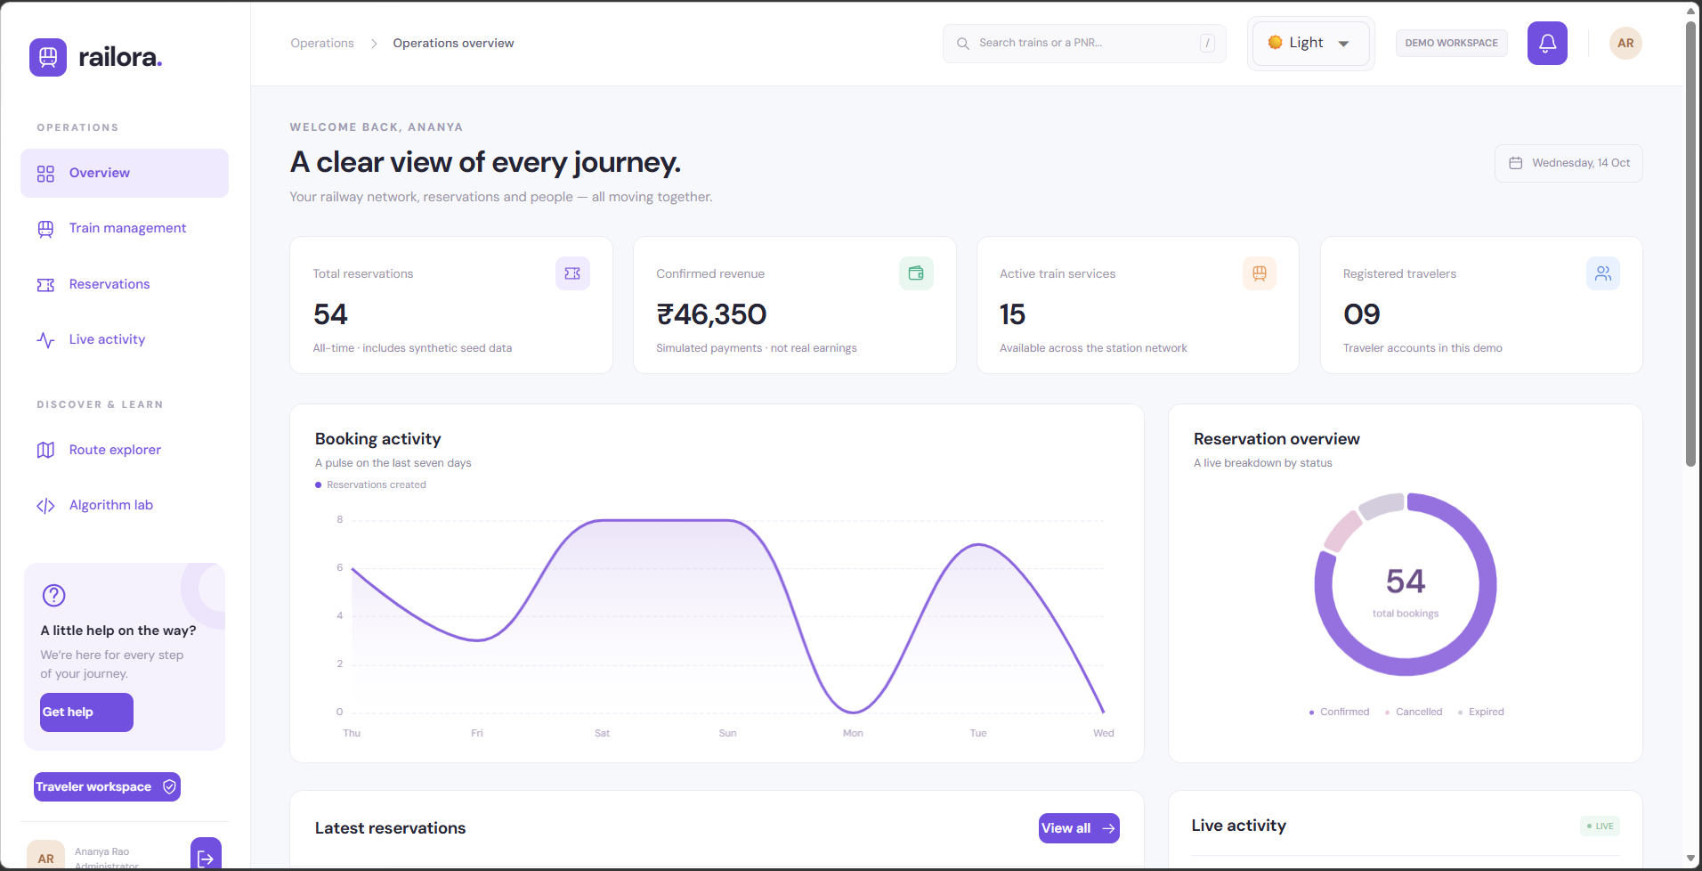
OVERALL PROJECT DEMONSTRATION / LIVE EXECUTION
Live demo: one journey, two sessions
METHOD
Demonstrate observable state changes with separate traveler and administrator profiles.
TRAVELER: BOOK / CANCEL
ADMIN: OBSERVE COMMITTED DATA
Search
Book 2
PNR / PDF
Admin update
Cancel
Run lab
IN RAILORA
Search → book two passengers → PNR/demo PDF → admin update → cancel → algorithm lab.
RAILORA / ACADEMIC DEMO
TECHNICAL_DEFENCE.md • tests/test_e2e.py • README.md
32 / 35
Notes:
SLIDE 32 — Live demo: one journey, two sessions
METHOD
Demonstrate observable state changes with separate traveler and administrator profiles.
USE IN RAILORA
Search → book two passengers → PNR/demo PDF → admin update → cancel → algorithm lab.
EXPLANATION / TECHNICAL DEFENCE
Use a clean development PostgreSQL CTPDB and two browser profiles or incognito contexts. Traveler aditya@railora.demo / Railora@123; admin admin@railora.demo / Admin@123. Website passwords differ from PostgreSQL root. Existing populated DB may not contain demo accounts because seed_demo earlyreturns when any User exists; never blindly delete existing user data. Pick tomorrow so departure-time guard will not reject today. Search direct service, book2, show finalfare/seats/PNR and visibly markedPDF. In admin profile wait about3seconds and inspect durable event/register. Cancel from traveler and explain seatrelease/promotion. Run lab and changebudget; do not call it connection-feasible booking. For FIFO/races use isolated *_test tests, not destructive actions on user data. Recorded E2E evidence exists but student should rehearse on their own installation.
EVIDENCE
TECHNICAL_DEFENCE.md • tests/test_e2e.py • README.md
DISCLOSURE
Academic simulation; synthetic services and passenger data, simulated payments. Recorded validation is not a new run on the student's machine.

Slide 33
ENGINEERING / LIMITATIONS AND IMPROVEMENT
Limitations: turn honesty into a roadmap
METHOD
Evaluate abstraction gaps and bottlenecks before proposing targeted, tested improvements.
ACADEMIC NOW
ENGINEERING NEXT
AUTHORISED RAIL
Direct sample routes
Simulated fares/payment
One web process
SQL pagination + batching
Migrations + safe seeding
TLS, secrets, recovery
Segment + calendar inventory
Feasible transfers
Payment reconciliation
Measure → change one boundary → add counterexamples → revalidate
IN RAILORA
Railora is an academic simulation—not official booking, real payment settlement or a production deployment.
RAILORA / ACADEMIC DEMO
SPECIFICATION.md • ALGORITHMS.md • AI_REVIEW.md
33 / 35
Notes:
SLIDE 33 — Limitations: turn honesty into a roadmap
METHOD
Evaluate abstraction gaps and bottlenecks before proposing targeted, tested improvements.
USE IN RAILORA
Railora is an academic simulation—not official booking, real payment settlement or a production deployment.
EXPLANATION / TECHNICAL DEFENCE
Current design has direct service booking, synthetic schedules/three-class availability, simulated funds, local demo sessions and graph paths without transfer feasibility. No official ticket, live national inventory, real payment/refund, SMS/email, production certification or live Google image feed exists. Safe seeding and migrations are important: create_all is bootstrap and nonempty users stops seed. Coarse train lock and N+1-style serialization limit throughput. Prioritise SQL pagination/loading and finer inventory locks with race tests; operational work adds TLS, rate limiting, secret rotation, backups, recovery and accessibility. Real provider integration needs permission and segment/calendar/transfer modeling, plus holds, outbox/webhook verification and payment reconciliation. Never add network charge directly under SQL lock. Future items are not presented as already implemented.
EVIDENCE
SPECIFICATION.md • ALGORITHMS.md • AI_REVIEW.md
DISCLOSURE
Academic simulation; synthetic services and passenger data, simulated payments. Recorded validation is not a new run on the student's machine.

Slide 34
OVERALL PROJECT DEMONSTRATION / TECHNICAL DEFENCE
Technical defence: explain the decision
METHOD
Answer with invariants, algorithm preconditions, source contracts and executed evidence.
Why not trust availability?
Why can DP cost differ?
Why bounded seat search?
Snapshot ≠ ownership.
Lock + unique key at commit.
The allowed edge count changes
which paths are feasible.
Six-seat rows; k≤6.
Preferences can fall back.
Why processes for the lab?
Does 98.49% prove safety?
What proves mastery?
Pure Python CPU work and GIL.
Measure process overhead.
No: scoped statement coverage.
Review failures and properties.
A new regression + small change
+ explanation of its invariants.
IN RAILORA
A student should defend these choices and make one meaningful, tested extension—not merely show the UI.
RAILORA / ACADEMIC DEMO
TECHNICAL_DEFENCE.md • ASSESSMENT_MAP.md
34 / 35
Notes:
SLIDE 34 — Technical defence: explain the decision
METHOD
Answer with invariants, algorithm preconditions, source contracts and executed evidence.
USE IN RAILORA
A student should defend these choices and make one meaningful, tested extension—not merely show the UI.
EXPLANATION / TECHNICAL DEFENCE
Suggested answers:1 Availability is a snapshot; SQL row locks plus seatuniquePK prevent a secondowner atcommit.2 DP imposes atmostHedges, Dijkstra is unconstrained and non-negative.3 Together is a bounded preference; fallback remains available/free/unique.4 Conventional GIL prevents broad purePython CPU threading speedup; I/O threads and CPU processes fit different work.5 High statementcoverage measures execution, not correctness, branchcompleteness or security, and UI/seed are outsidecorepercentage.6 Idempotent retries use fullcommandfingerprint and keyrecheckafterlock; failed providers rollback. Student extension: add a well-specified sort rule or farepolicy, first create meaningfulfailingtest, implement minimally and rerunchecks. Agepolicy needs appropriateageinputcontract, not inheritance alone. No passed viva or personal independentauthorship is claimed.
EVIDENCE
TECHNICAL_DEFENCE.md • ASSESSMENT_MAP.md
DISCLOSURE
Academic simulation; synthetic services and passenger data, simulated payments. Recorded validation is not a new run on the student's machine.

Slide 35
ASSESSMENT MAP / EVIDENCE AND CLOSING
Every course outcome has inspectable evidence
METHOD
Link each claim to code, test artefacts or a demonstration; distinguish completed from proposed work.
01 Computational thinking
02 Python and data
03 Software design
Decomposition → five patterns
Time / space complexity
Expected and amortized
Generators + comprehensions
Decorators + contexts
Measure Python performance
ABC / inheritance / Protocol
Composition + design patterns
Type hints + generics
algorithms.py / ALGORITHMS.md
algorithms.py / db.py / benchmark.py
services.py / schemas.py / db.py
04 Functional / concurrency
05 Quality / DevOps
06 Responsible AI
Pure + higher-order functions
Threads / processes / async
CPU vs I/O and the GIL
Pytest + Hypothesis + E2E
Ruff + Mypy + coverage
CI / containers: configured
Specification-first prompts
Scoped context + generation
Review → tests → improve
algorithms.py / UI modules
tests/ / reports/ / ci.yml
AI_REVIEW.md / regression evidence
IN RAILORA
Use the source ZIP + project report + this deck together; fill the cover details and rehearse the defence.
RAILORA / ACADEMIC DEMO
ASSESSMENT_MAP.md • reports/ • ASSET_CREDITS.md
35 / 35
Notes:
SLIDE 35 — Every course outcome has inspectable evidence
METHOD
Link each claim to code, test artefacts or a demonstration; distinguish completed from proposed work.
USE IN RAILORA
Use the source ZIP + project report + this deck together; fill the cover details and rehearse the defence.
EXPLANATION / TECHNICAL DEFENCE
Six assessment pillars are covered. Computational thinking:decomposition, abstraction, patterns and all fivealgorithmfamilies plusimplementation-awarecomplexity. Python/data:structures, iterators/generators/comprehensions/decorator/contextmanager andperformance. Design:classes, ABCinheritance, composition, Protocol,generics,typehints, modularadapters/strategies/unitofwork. Functional/concurrency:purefunctions/higher-orderkeys/frozenvalues/threads/processes/async/GIL. Quality/DevOps:pytest,Hypothesis,unit/integration/race/browser,scopedcoverage,Mypy,Ruff,format,configuredCI/container. AI:prompting,context,specfirst,drafts,criticalreview,actualcorrections,revalidation. Primaryreferences:README andSPECIFICATION;sourcealgorithms/models/services;reportsvalidation/coverage/performance;AI_REVIEW,TECHNICAL_DEFENCE andASSET_CREDITS. Visualcredits:actualUIfromcapturemanifest, SwissheroPexels32548690 andcachedGoa32262464/Kerala13045091/Jaipur19149600; pexels.com/license. PhotosarelocalcreditableassetsnotliveGooglefeed. StudentmustfillcoverandacknowledgeAIappropriately. Originalresultsdated11Oct2026. Presentationcreatedfromevidence,notnewfulltests orstudentviva.
EVIDENCE
ASSESSMENT_MAP.md • reports/ • ASSET_CREDITS.md
DISCLOSURE
Academic simulation; synthetic services and passenger data, simulated payments. Recorded validation is not a new run on the student's machine.

