Slide 1
S&P GLOBAL & CRISIL CAMPUS HACKATHON 2026
AI/NLP Risk Engine +
Tactical Index Rebalancer +
Portfolio Stress Testing
Financial text
news headlines · stock tweets
NLP risk signals
FinBERT · BART-MNLI · impact score
Financial NLP, tactical portfolio rebalancing and scenario stress testing in one explainable decision-support prototype
Module A: index weights
Candidate Name: Boppana Goutam
sentiment-driven tilts
College Email ID: goutam.b23@iiits.in
College / Campus: Indian Institute of Information Technology, Sri City
Module B: stress tests
Demo Video Link: https://youtu.be/91JTRFemLJA
hypothetical shock scenarios
Slide Deck Link: Not hosted externally
Notes:
Title slide. Candidate details follow the requested hackathon submission format. The demo video is hosted on YouTube as an unlisted video.

Slide 2
From unstructured text to explainable signals
Financial news and social commentary carry risk information, but turning noisy, unstructured text into consistent, explainable portfolio signals is hard.
Unstructured text
NLP analysis
Structured risk signals
Decision support
news headlines · stock tweets
sentiment · event type · impact
ticker · sentiment · event · impact 1–10
rebalancing + stress testing
What the prototype demonstrates
Why two modules complement each other
Text becomes structured, searchable signals
Signals tilt a mock index by transparent rules
Resulting weights face hypothetical shocks
A asks: how should news shift weights?
B asks: how fragile is the resulting portfolio?
B stress-tests A's final rebalanced weights
A prototype for analyst decision support, not an autonomous trading system
Notes:
Workflow: unstructured text -> NLP analysis -> structured signals -> Module A rebalancing and Module B stress testing. The stress tab runs on the final rebalanced weights.

Slide 3
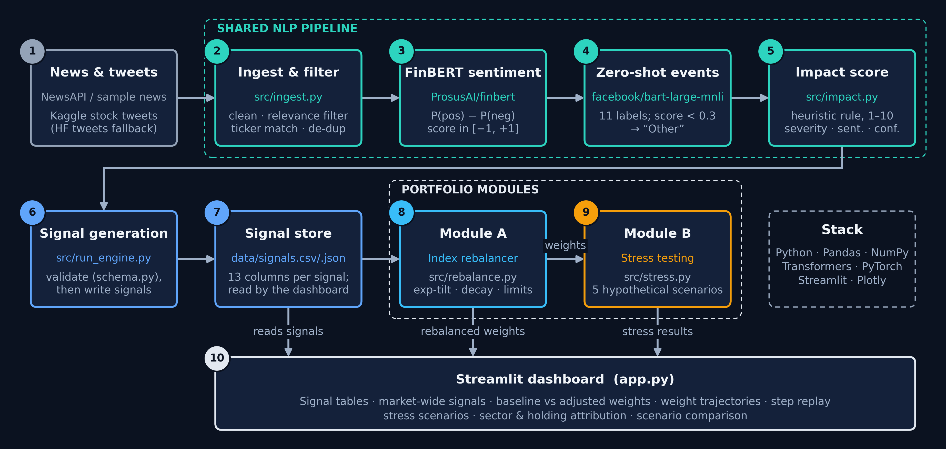
Architecture: one NLP pipeline, two modules
Notes:
Diagram generated from the project architecture: src/ingest.py -> src/engine.py -> src/impact.py -> src/run_engine.py and src/schema.py -> data/signals.csv -> src/rebalance.py and src/stress.py -> app.py.

Slide 4
Engineering highlights: signals to weights
1
Sentiment + event, together
Signal → weight (Module A)
FinBERT direction and BART-MNLI category in one record
IMPACT, 1–10
2
Transparent impact score
severity × (0.5 + 0.5·|sent|)
× (0.5 + 0.5·conf)
Hand-set severity × sentiment × confidence; inspectable
3
Confidence-aware tickers
Exchange tag > cashtag > name + finance; multi-ticker kept
NET SIGNAL, PER STOCK/STEP
Σ sentiment × impact / 10
clipped to ±2
4
Clean inputs
Relevance filter and >85% near-duplicate drop cut noise
5
One expansion, two views
TILT
Replay display and rebalancer share signal expansion
w ← w · exp(1.5 × net signal)
then normalise to 100%
6
Auto time buckets, tunable knobs
Day to year closest to 20 steps; sensitivity, decay, caps
DECAY + LIMITS
Validated and tested
0.95·tilt + 0.05·w₀
clip each weight to 1%–15%
7
Schema check before write; 87 offline unit tests pass
Defaults shown (sensitivity 1.5, decay 0.05); sliders adjust them.
Notes:
Formulas reflect src/impact.py and src/rebalance.py. Dashboard defaults: sensitivity 1.5, decay 0.05, maximum weight 0.15 and minimum weight 0.01. Five network-dependent tests require Hugging Face access.

Slide 5
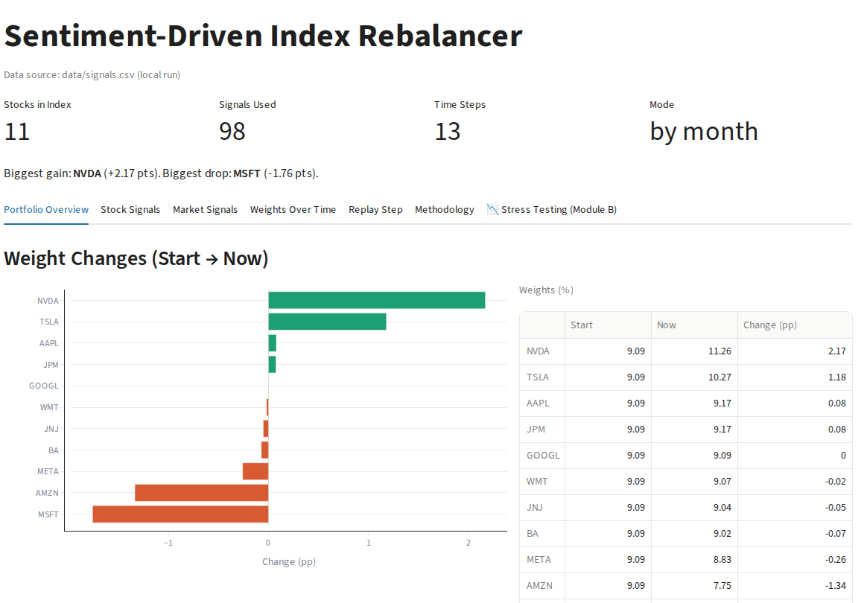
Results: verifiable prototype outputs
70%
FinBERT accuracy, 0.63 macro-F1
off-the-shelf model, 300 validation tweets
129
signals in the committed dataset
76 tweets (Oct 2021–Sep 2022) + 53 headlines (9 Oct 2026)
13
monthly replay steps
98 signals move 11 stocks: NVDA +2.17 pp, MSFT −1.76 pp
87
unit tests pass offline
5 more tests need network access to load data
Streamlit dashboard, Portfolio Overview. Committed data/signals.csv, default parameters. Weight changes are simulated tilts, not returns.
Notes:
Committed data/signals.csv has 129 rows: 76 tweets from 2021–2022 and 53 news headlines from 9 October 2026. The default dashboard produces 13 replay steps and 11 index stocks. NVDA changes by +2.17 percentage points and MSFT by -1.76 percentage points. These are simulated allocations, not returns.

Slide 6
Domain impact: explainable decision support
1
Structured, searchable signals
Simulated portfolio impact by scenario
Text becomes ticker, sentiment, event and impact fields
2
Explainable by design
Analysts trace each weight move to its source signals
3
News-aware mock index
Rules-based tilts show how sentiment could shift weights
4
Shock sensitivity testing
Hypothetical scenarios run on the rebalanced portfolio
5
Where the risk sits
Scenario comparison, sector and holding attribution
Before real deployment
Stronger validation, reliable data feeds, risk controls, market-data calibration
Hypothetical sector shocks applied to Module A's final weights (11 stocks). Not historical losses, forecasts or calibrated estimates.
Notes:
Chart values are hypothetical sector shocks applied to Module A's final weights: market sell-off -18.00%, rate/inflation -20.15%, geopolitical/energy -17.16%, credit -28.26%, and technology -26.42%. They are arithmetic scenario estimates, not historical backtests or forecasts.

Slide 7
Engineering boundaries and roadmap
Engineering boundary | Next step
Sentiment checked on 300 tweets; event labels not scored against ground truth | Larger labeled evaluation for sentiment and event classes
Impact weights are hand-chosen heuristics | Calibrate impact to observed market reactions
Ticker matching is keyword-based and can misattribute | Stronger entity resolution and ticker attribution
Module A has no historical price backtest | Market-data integration and walk-forward backtesting
Module B shocks are hypothetical, with no volatility or correlation calibration | Calibrate risk parameters on historical market data
Sparse, gapped data: tweets Oct 2021–Sep 2022, then 53 headlines from one 45-minute window in Oct 2026 | Continuous multi-source feed, data-quality monitoring, reproducible evaluation
TAKEAWAY
A working prototype that connects financial NLP to explainable portfolio decision-support workflows.
Notes:
The dataset contains tweets from October 2021 to September 2022 and a batch of 53 news headlines from 9 October 2026. Event labels have not been scored against ground truth. The impact score is heuristic, Module A has no historical price backtest, and Module B uses hypothetical shocks.

