Slide 1
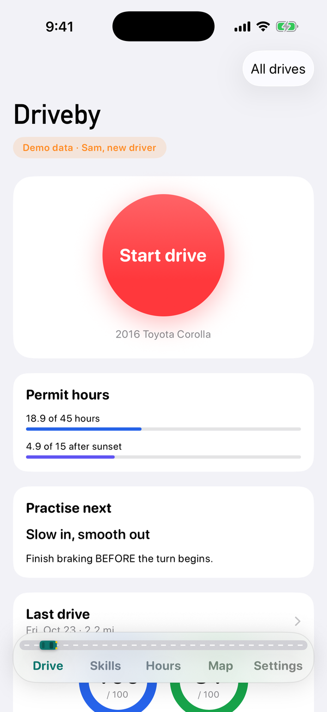
Driveby
Congressional App Challenge 2026
Your co-pilot for safer driving
Start drive
Every drive counts
Notes:
Title card.

Slide 2
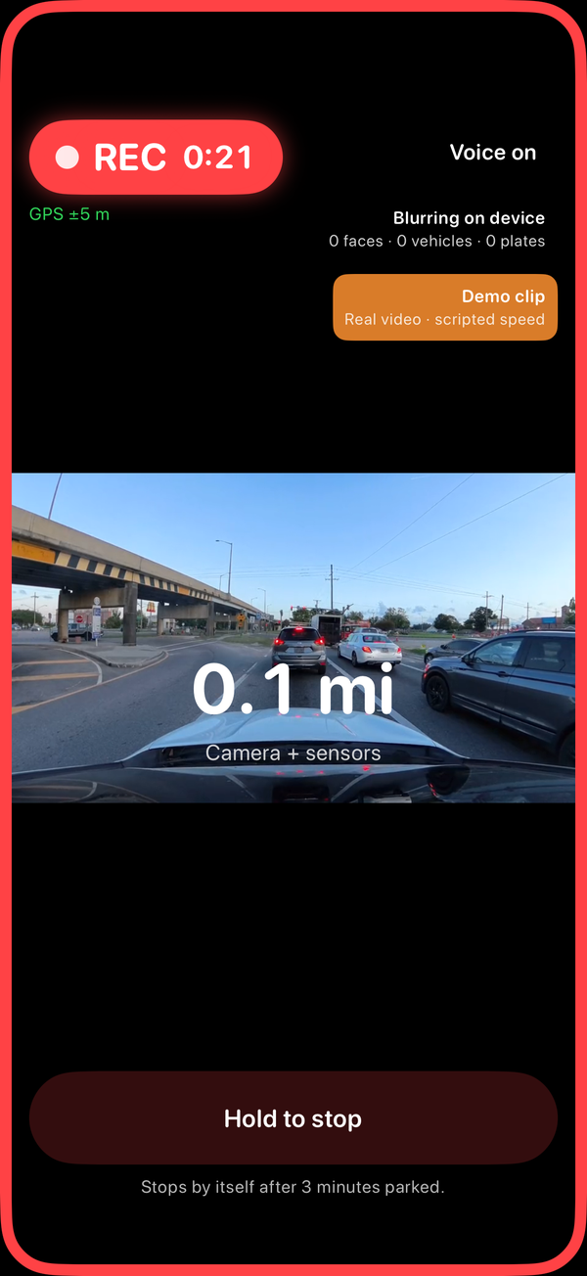
Purpose
Ideology
Help every new driver in Virginia get safer, one drive at a time.
Why it's needed
Teens only hear feedback after a mistake
Parents can't see every drive clearly
The 45-hour log is still kept on paper
No one tracks which skills need practice
Notes:
Purpose. Driveby exists to help every new driver in Virginia get safer, one drive at a time. Today teens only hear feedback after a mistake, parents cannot see every drive clearly, the 45-hour log is kept on paper, and nobody tracks which skills need practice.

Slide 3
Virginia Statistics
Ideology
33
4.5 min
45 h
teen drivers ages 15 to 19 killed on Virginia roads in 2025
between crashes in Virginia, 115,858 crashes in 2025
of supervised driving Virginia requires for a license, 15 of them after sunset
Sources: Virginia DMV, 2025 Virginia Traffic Crash Facts. Virginia Department of Education, parent/teen driving guide.
Notes:
Virginia statistics. In 2025, 33 teen drivers were killed on Virginia roads. Virginia had 115,858 crashes, one every 4.5 minutes. And every Virginia teen needs 45 supervised hours, 15 after sunset, before getting a license.

Slide 4
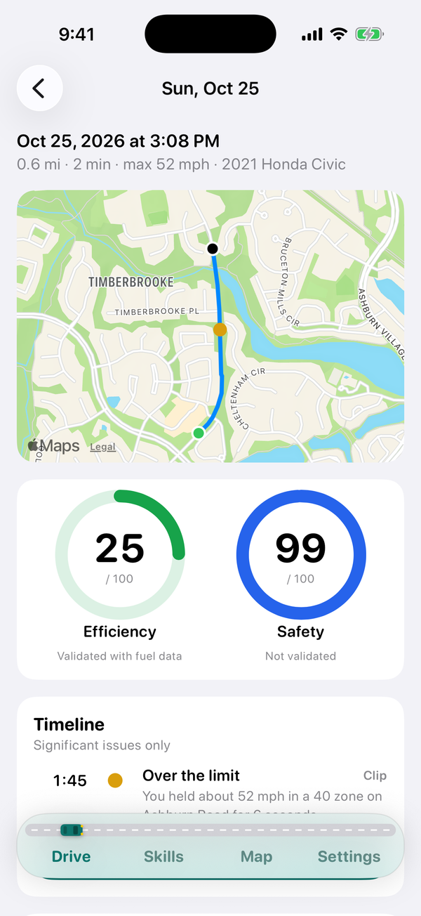
Impact
Impact
Who it helps
Teens get feedback the moment it matters
Parents coach from data, not arguments
The 45-hour log fills itself in
Hazard map shows VDOT and counties risky spots
99
/ 100
81
/ 100
Safety
Efficiency
Notes:
Impact. Teens get feedback the moment it matters, parents coach from data instead of arguments, the 45-hour log fills itself in, and the anonymous hazard map shows VDOT and counties where drivers brake hardest.

Slide 5
Highlights
Function
Live voice coach
Drive scores
Stop sign checks
Speaks up the moment you speed, brake hard or follow too close
Safety and efficiency scores after every drive
Every stop graded: full stop, rolling or missed
Permit hours
Paper log scan
Privacy first
Logs supervised and night hours, exports a PDF to sign
Snap a photo of an old paper log to add those hours
Faces and plates are blurred on the phone before saving
Notes:
Highlights. A live voice coach, safety and efficiency scores, stop sign checks, automatic permit and night hours with a PDF to sign, paper log scanning, and privacy blurring on the phone.

Slide 6
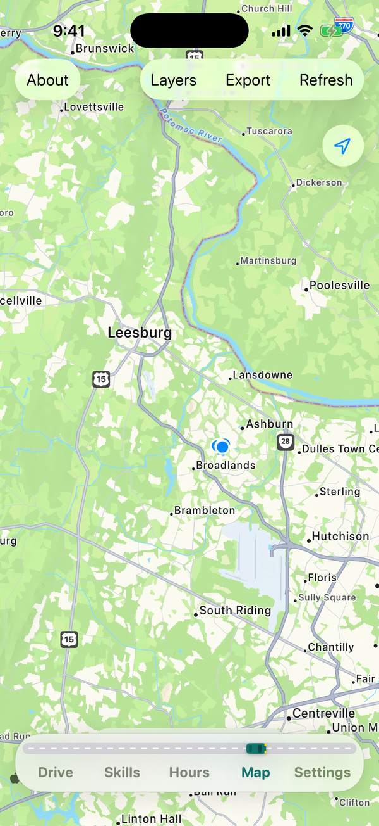
Map
Function
On the map
Every drive drawn with its moments
Hazard map: where drivers brake hardest
A spot publishes after 5 events from 3 drivers
Your own contributions stay private
Export GeoJSON for VDOT and county GIS
Notes:
Map. Every drive is drawn on the map with its moments. The hazard map shows where drivers brake hardest, pooled anonymously. A spot only publishes after 5 events from 3 different drivers, your own contributions stay private, and the data exports as GeoJSON for VDOT and county planners.

Slide 7
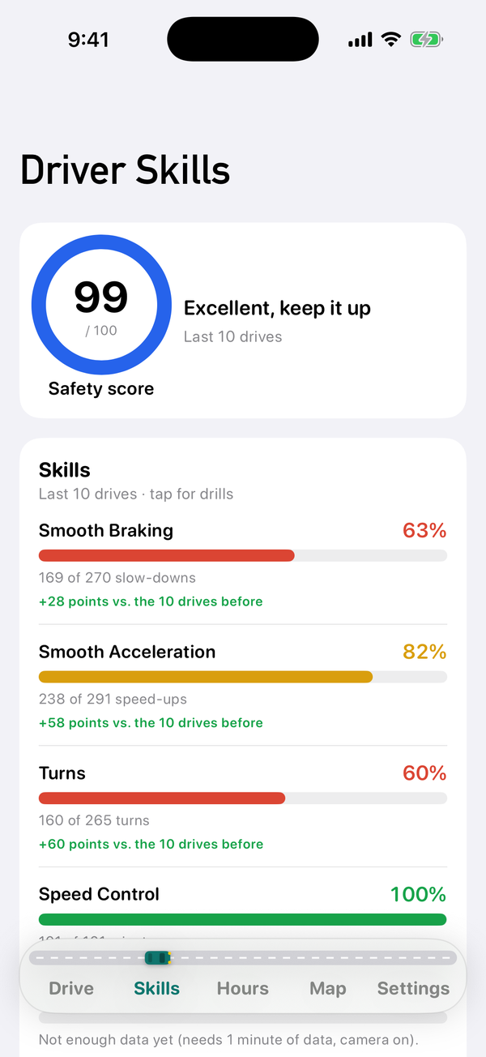
Design
UI
Built to glance at
One big Start drive button
Road-sign font, easy at a glance
Tab bar with a car that drives
Light and dark mode
Quick start walkthrough each launch
Notes:
Design. One big Start drive button, a road-sign font you can read at a glance, a tab bar with a little car that drives between tabs, light and dark mode, and a quick start walkthrough every time you open the app.

Slide 8
How it's built
Function
Swift + SwiftUI
Core ML
Vision
Native iPhone app, iOS 17
YOLOv8 runs on the phone
Reads paper logs, finds faces
Location + Motion
OpenStreetMap
99 tests
GPS and motion sensors
Speed limits and stop signs
Automated tests, all passing
Notes:
How it's built. Driveby is a native Swift and SwiftUI app. Core ML runs YOLOv8 on the phone, Vision reads paper logs and finds faces, Core Location and Core Motion read the sensors, and OpenStreetMap supplies speed limits and stop signs. 99 automated tests check the scoring.

Slide 9
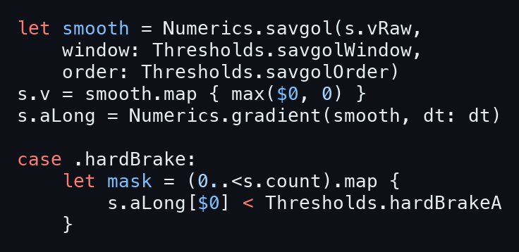
Drive Score
Code
The code
What it does
GPS 1x a second, motion 50x a second
Smooths speed with a Savitzky-Golay filter
Flags hard brakes, sharp turns, speeding
OpenStreetMap limits feed the safety score
Notes:
1:25 to 1:46. When you drive, Driveby records GPS once a second and motion fifty times a second. We smooth the speed with a Savitzky-Golay filter, then flag hard braking, sharp turns, speeding and tailgating. Speed limits come from OpenStreetMap. Each event lowers your safety score, and your speed trace sets your efficiency score.

Slide 10
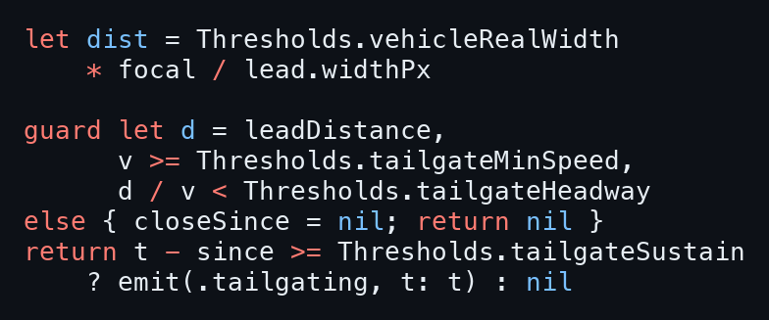
Live Coach
Code
The code
What it does
YOLOv8 runs on the phone, 15 fps
Distance from the car's width in pixels
Following time under 1 s for 3 s: "Back off"
Faces and plates blurred on the phone
Notes:
1:46 to 2:07. The live coach runs a YOLOv8 model on the phone fifteen times a second. It finds the car ahead and estimates the distance from how wide it looks. Divide by your speed and you get your following time. Under one second for three seconds, and Driveby tells you to back off. Faces and plates are blurred on the phone.

Slide 11
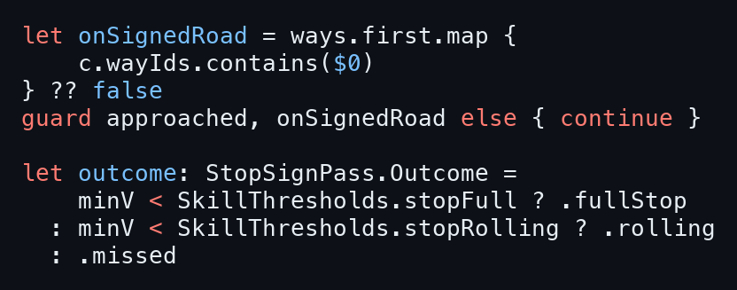
Stop Signs and Skills
Code
The code
What it does
GPS trace matched to the road you're on
Stop signs from OpenStreetMap
Under 0.7 m/s counts as a full stop
Skill scores pick what to practice next
Notes:
2:07 to 2:28. For stop signs, we match your GPS trace to the road, pull that street's stop signs from OpenStreetMap, and find your slowest speed as you pass. Under 0.7 meters per second counts as a full stop. Every stop, turn and brake feeds your skill scores, and Driveby picks what to practice next.

Slide 12
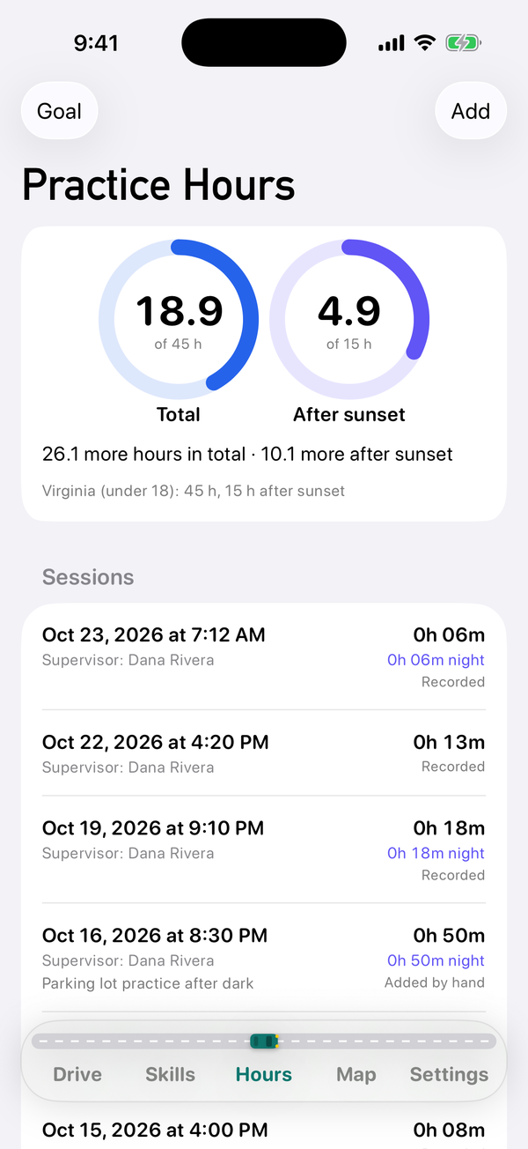
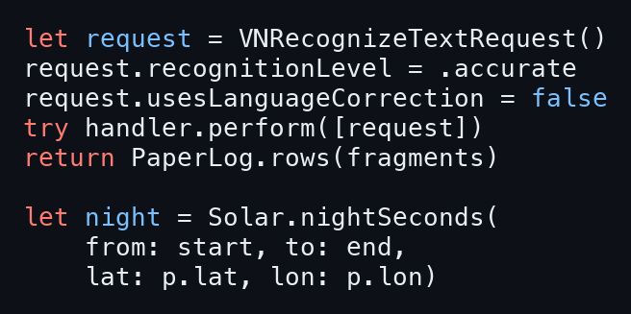
Permit Hours
Code
The code
What it does
Supervised drives logged automatically
Night hours from the sun's position
Paper log photos read with Apple Vision
PDF export, ready for a parent to sign
Notes:
2:28 to 2:49. Supervised drives go straight into your permit log, and night hours are worked out from the sun's position where you drove. Have a paper log? Snap a photo. Apple's Vision framework reads it and our parser adds up the hours. When you hit your goal, export a PDF for your parent to sign.

Slide 13
Every drive counts.
Driveby
Last drive
99
/ 100
81
/ 100
Safety
Efficiency
Notes:
2:49 to 3:00. Back at the DMV. FRIEND: So what changed? DRIVER: I could finally see what I was doing wrong. End card: Driveby. Every drive counts.

