Slide 1
EMR HEALTHCARE
DATA ANALYTICS PROJECT
SQL • Excel • Tableau • Power BI
PATIENTS
VISITS
DOCTORS
SUCCESS RATE
REVENUE
10K
10K
1K
33.01%
25.41M
Final Presentation | Executive Overview & Patient Analytics

Slide 2
Executive Summary
A complete analytics workflow from raw healthcare records to decision-ready dashboards.
PATIENTS
VISITS
DOCTORS
SUCCESS RATE
REVENUE
10,000
10,000
1,000
33.01%
$25.41M
Displayed portfolio
Visit activity
Provider base
Treatment KPI
Amount billed
PROJECT STORY
• Integrated SQL-based data preparation with Excel/Tableau/Power BI visualization.
• Built executive KPIs for patients, visits, treatment outcomes, chronic conditions and revenue.
• Added patient-level analytics for diagnosis, allergy, gender, state and insurance-provider views.
• Used interactive filters to support department, gender, date, specialist and treatment-status analysis.
EMR Healthcare Data Analytics | Final Project Presentation
2

Slide 3
Project Objectives & Business Questions
01
Measure activity
02
Understand patients
03
Monitor treatment
How many patients, visits,
doctors and tests are represented?
What diagnoses, chronic conditions,
allergies and gender patterns appear?
How are treatment outcomes
distributed and what is the success
rate?
04
Analyze claims
05
Understand revenue
06
Track trends
How many claims are approved,
pending, partially approved or denied?
Which departments/specialties
contribute most to billed revenue?
How does visit volume change
month-to-month?
EMR Healthcare Data Analytics | Final Project Presentation
3

Slide 4
Data Model & KPI Layer
Recommended analytical structure for the SQL-to-dashboard pipeline.
SOURCE DATA
SQL LAYER
ANALYTICAL MODEL
BI LAYER
DECISION LAYER
Patient / Visit
Doctor / Department
Claims / Treatment
Billing / Lab
Cleaning
Joins
Aggregations
KPI calculations
Fact Visit
Fact Claim
Fact Treatment
Dimensions
Excel / Tableau
Power BI
Interactive filters
Executive KPIs
Patient insights
Operational trends
CORE KPIS
Total Patients
10K
Total Visits
10K
Success Rate
33.01%
COUNT(DISTINCT Patient_ID)
COUNT(DISTINCT Visit_ID)
Successful Treatments / Total Treatments
Completion Rate
66.49%
Chronic Rate
80.35%
Revenue
$25.41M
Completed / Total Treatment Status
Chronic Patients / Total Patients
SUM(Amount Billed)
EMR Healthcare Data Analytics | Final Project Presentation
4

Slide 5
SQL Data Preparation & Analysis
Use SQL as the reproducible analytical layer before visualization.
01
02
03
04
05
Profile
Clean
Join
Aggregate
Validate
Check row counts, nulls, duplicates and distinct keys.
Standardize dates, categories, statuses and missing values.
Connect patient, visit, provider, department, claim and treatment data.
Create monthly, department, diagnosis and status summaries.
Reconcile SQL totals with dashboard KPI cards.
EMR Healthcare Data Analytics | Final Project Presentation
5

Slide 6
SQL Examples — Core KPIs
Illustrative templates: replace table/column names with those in your actual dataset.
QUERY 01
QUERY 02
-- 1. Core patient / visit KPIs
SELECT
COUNT(DISTINCT patient_id) AS total_patients,
COUNT(DISTINCT visit_id) AS total_visits,
COUNT(DISTINCT doctor_id) AS total_doctors
FROM emr_visits;
-- 2. Treatment success & completion
SELECT
100.0 * SUM(CASE WHEN treatment_status = 'Successful' THEN 1 ELSE 0 END)
/ COUNT(*) AS success_rate,
100.0 * SUM(CASE WHEN treatment_status = 'Completed' THEN 1 ELSE 0 END)
/ COUNT(*) AS completion_rate
FROM emr_treatments;
DASHBOARD OUTPUT
DASHBOARD OUTPUT
DASHBOARD OUTPUT
10K
10K
33.01%
Total patients shown
Total visits shown
Treatment success rate
EMR Healthcare Data Analytics | Final Project Presentation
6

Slide 7
SQL Examples — Claims, Revenue & Trends
-- Claims status distribution
SELECT claim_status,
COUNT(*) AS patient_count
FROM insurance_claims
GROUP BY claim_status
ORDER BY patient_count DESC;
-- Revenue by department
SELECT department_name,
SUM(amount_billed) AS revenue
FROM billing
GROUP BY department_name
ORDER BY revenue DESC;
-- Monthly visit trend
SELECT EXTRACT(YEAR FROM visit_date) AS yr,
EXTRACT(MONTH FROM visit_date) AS mn,
COUNT(DISTINCT visit_id) AS visits
FROM emr_visits
GROUP BY 1,2
ORDER BY 1,2;
APPROVED CLAIMS
PENDING CLAIMS
REVENUE
MONTHLY PEAK
6,075
1,211
$25.41M
~898
Largest claim-status count
Claim workflow view
Total amount shown
Highest displayed monthly visits
EMR Healthcare Data Analytics | Final Project Presentation
7

Slide 8
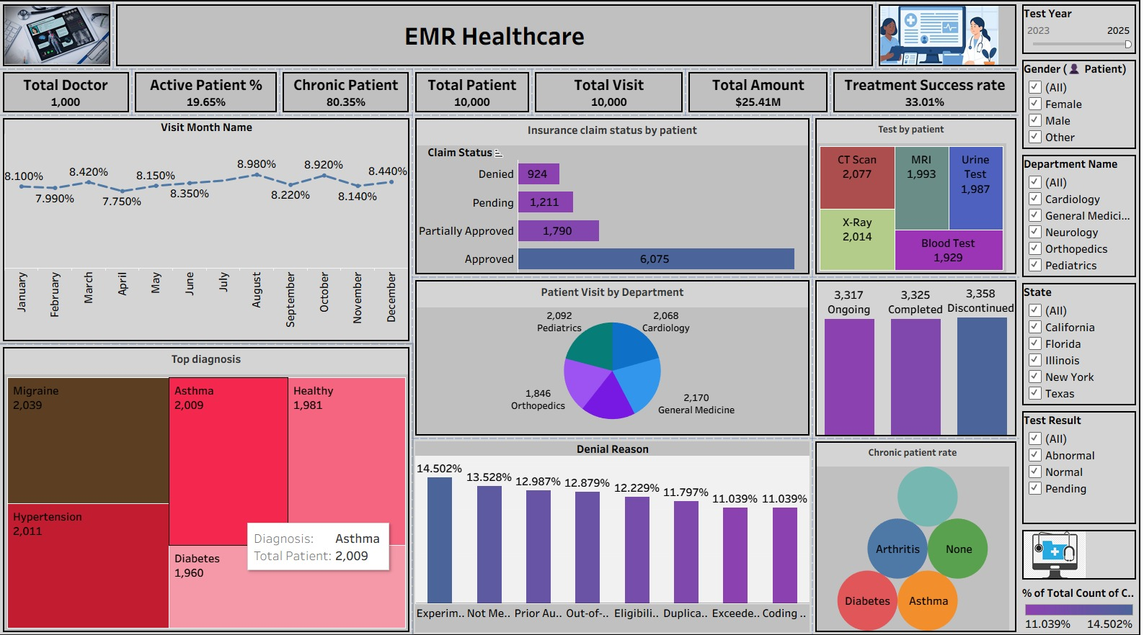
Dashboard 1 — EMR Healthcare Overview
Executive KPI and operational monitoring view.
EMR Healthcare Data Analytics | Final Project Presentation
8

Slide 9
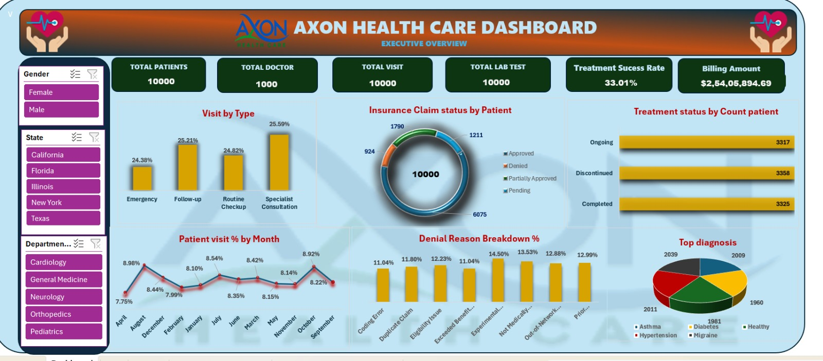
Dashboard 2 — Executive Overview
Alternative visual design showing visit type, claims, treatment status and diagnosis.
EMR Healthcare Data Analytics | Final Project Presentation
9

Slide 10
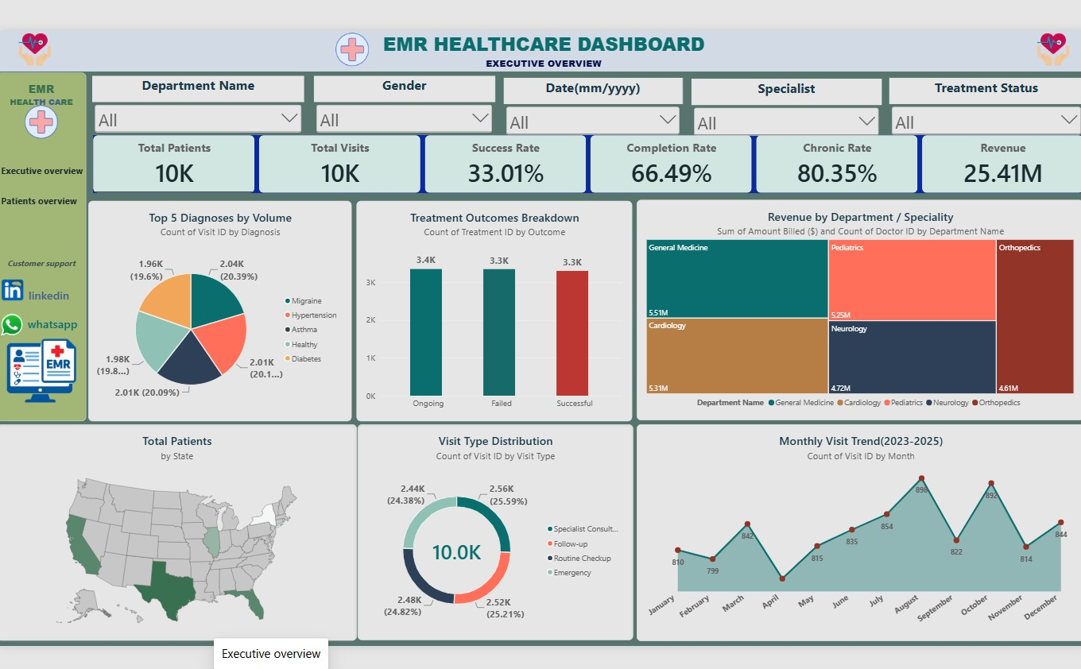
Dashboard 3 — Executive Overview
Power BI-style executive dashboard with KPI cards, diagnosis, revenue, geography and monthly trends.
EMR Healthcare Data Analytics | Final Project Presentation
10

Slide 11
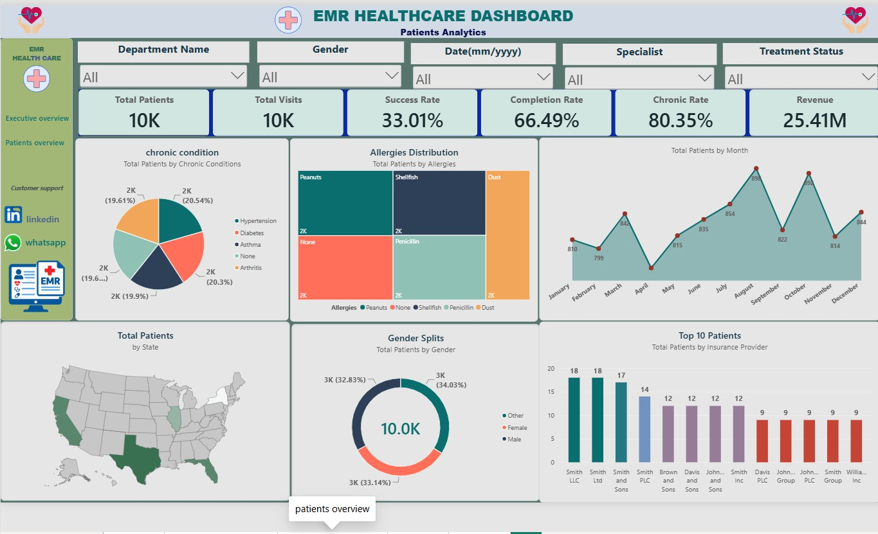
Dashboard 4 — Patient Analytics
Patient-focused view covering chronic conditions, allergies, gender, state and insurance-provider distribution.
EMR Healthcare Data Analytics | Final Project Presentation
11

Slide 12
Key Findings from the Dashboards
Descriptive observations from the displayed dashboard values.
Claim status
Treatment
Approved claims are the largest category at 6,075, followed by partially approved
(1,790), pending (1,211) and denied (924).
The displayed treatment success rate is 33.01%, with a completion rate of 66.49%.
Diagnosis
Visit mix
The leading displayed diagnosis count is Migraine (2,039), followed by
Hypertension (2,011), Asthma (2,009), Healthy (1,981) and Diabetes (1,960).
Specialist Consultation is the largest visit type at 25.59%; Emergency is the
smallest displayed category at 24.38%.
Revenue
Trend
Total billed revenue is shown as $25.41M. Department-level visuals show
General Medicine and Cardiology as major revenue contributors.
Monthly visits fluctuate around the 800–900 range, with the highest
displayed point around August (~898) and another high point around October (~892).
EMR Healthcare Data Analytics | Final Project Presentation
12

Slide 13
Dashboard Design & Interactivity
Designed to move from high-level KPIs to drill-down analysis.
EXECUTIVE LAYER
KPI cards: Patients • Visits • Doctors • Success • Completion • Chronic • Revenue
ANALYTICAL LAYER
Diagnosis • Treatment outcomes • Claim status • Revenue by department • Visit trend
FILTER LAYER
Department • Gender • Date • Specialist • Treatment status • State • Test result
DETAIL LAYER
Patient attributes • Allergies • Chronic conditions • Insurance provider • Monthly activity
EMR Healthcare Data Analytics | Final Project Presentation
13

Slide 14
Data Quality & Validation Checklist
✓
Completeness
✓
Uniqueness
✓
Consistency
Check missing patient IDs, visit IDs, dates,
departments and treatment statuses.
Confirm patient/visit/claim identifiers and prevent
duplicate joins.
Standardize spelling/case for departments, diagnoses,
claim status and outcomes.
✓
KPI reconciliation
✓
Date validation
✓
Filter validation
SQL totals must reconcile with
Excel/Tableau/Power BI KPI cards.
Use one consistent calendar definition for monthly
trend calculations.
Verify slicers affect every intended visual
and do not create conflicting totals.
EMR Healthcare Data Analytics | Final Project Presentation
14

Slide 15
Final Takeaway
The project demonstrates an end-to-end analytics workflow: SQL transforms the data,
BI tools communicate the KPIs, and interactive dashboards make the analysis accessible
to decision-makers.
DATA
SQL
DASHBOARDS
INSIGHTS
Structured healthcare records
Reproducible calculations
Interactive visual analytics
Clear operational story

