Slide 1

Highcloud
Airlines
Airline Performance & Passenger Trends Analysis
SQL | Excel | Power BI | Tableau
Group 6

Slide 2
Project Objective
The objective of this project is to analyse airline operational performance and passenger trends using SQL, Excel, Tableau and Power BI.
The dashboard helps stakeholders understand:
Load Factor
Passenger Trends
Airline Performance
Route Analysis
Distance Group Analysis
Weekday vs Weekend Performance

Slide 3
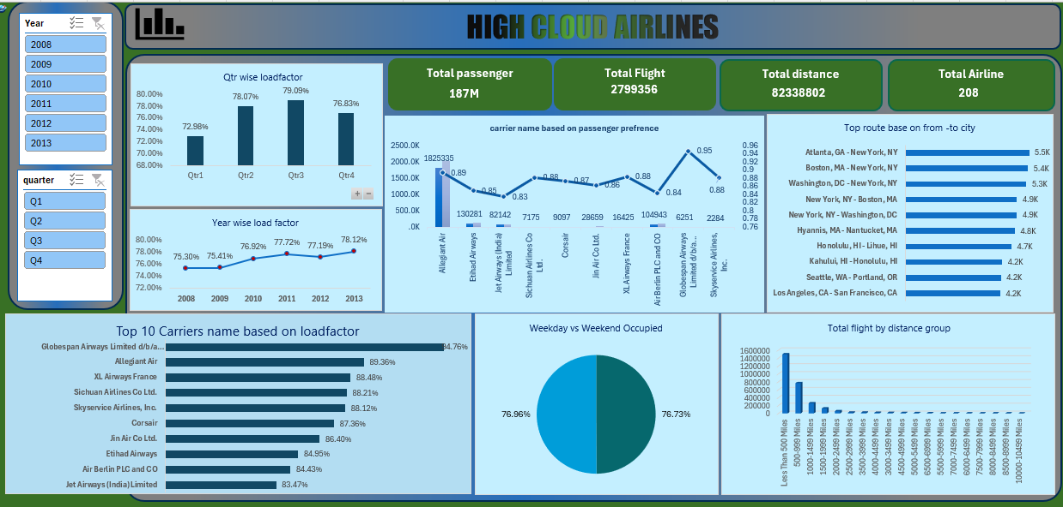
Excel Dashboard

Slide 4
Excel Dashboard
Key Insights
187 million passengers were transported during the analysis period.
Airlines operated approximately 3 million flights covering 82 million miles.
Data includes operations across 200+ airlines and more than
100 countries.
Overall Load Factor remained above 75%, indicating efficient seat utilization.
Passenger traffic is concentrated among a few major airlines, while several smaller carriers contribute comparatively less.

Slide 5
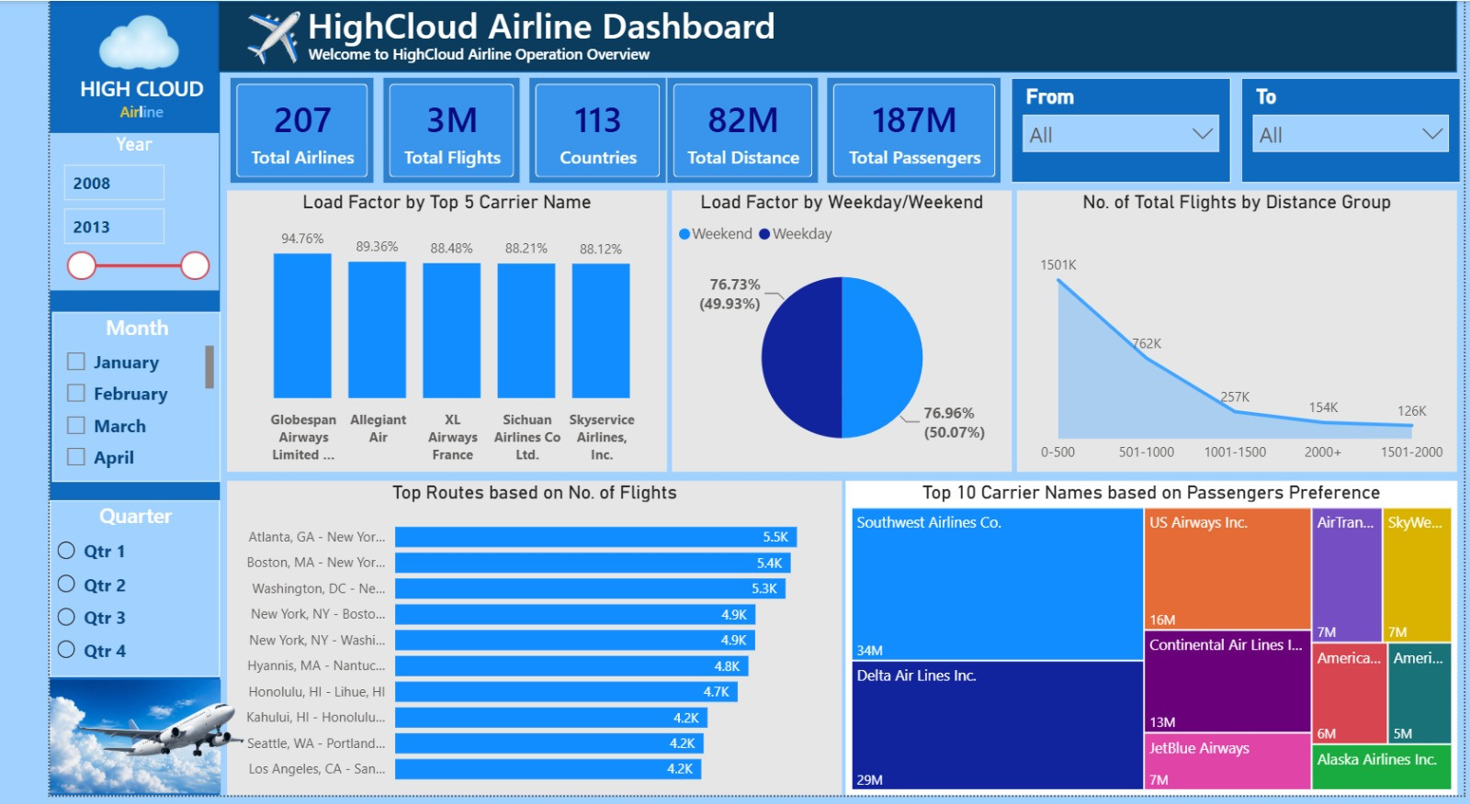
Power BI Dashboard

Slide 6
Power BI Dashboard
Key Insights
Atlanta, GA – New York, NY recorded the highest number of departures
Other high-demand routes include:
  Boston – New York
  Washington DC – New York
  New York – Boston
Most flights fall within the 0–500 mile distance group.
Flight volume decreases progressively as travel distance increases.
Short-distance routes contribute the largest share of airline operations.

Slide 7
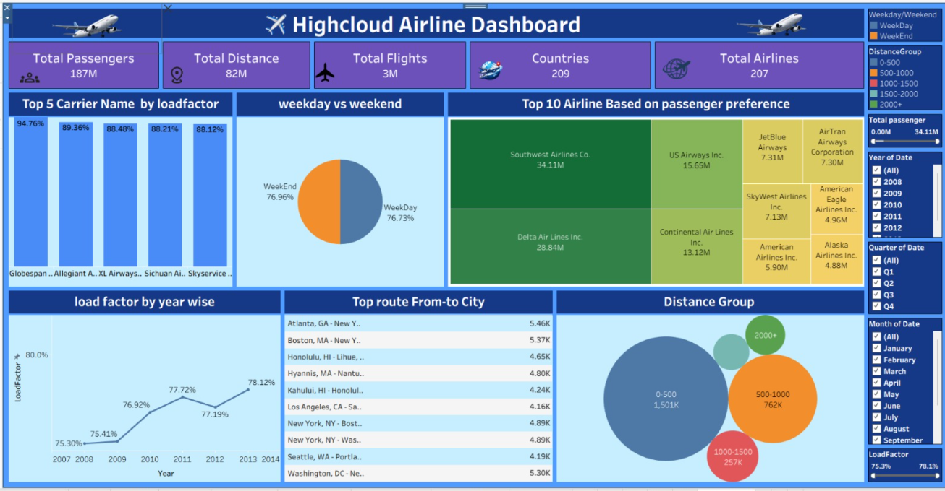
Tableau Dashboard

Slide 8
Tableau Dashboard
Key Insights
Southwest Airlines carried the highest number of passengers (around 34 million).
Delta Air Lines ranked second with approximately 29 million passengers.
The Top 10 airlines accounted for a significant share of the total passenger traffic.
Load factors among the top carriers remained consistently high, ranging from approximately 88% to 95%.
Higher load factors indicate better utilization of available seating capacity.

Slide 9
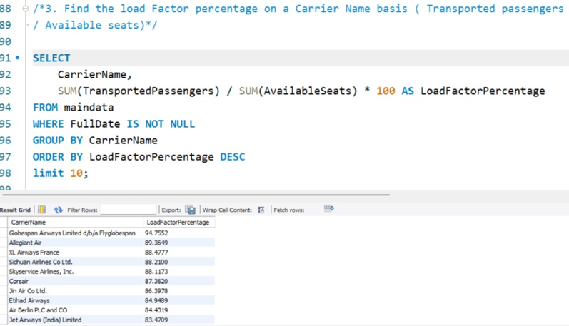
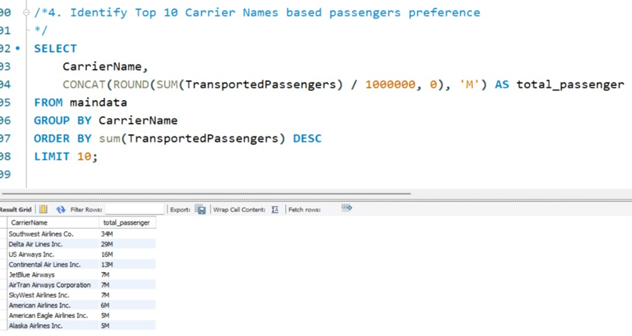
SQL Queries

Slide 10
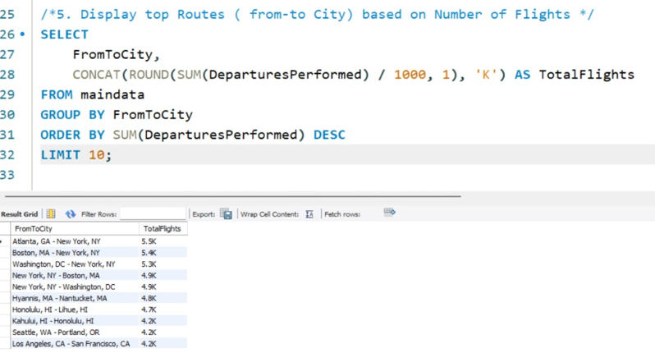
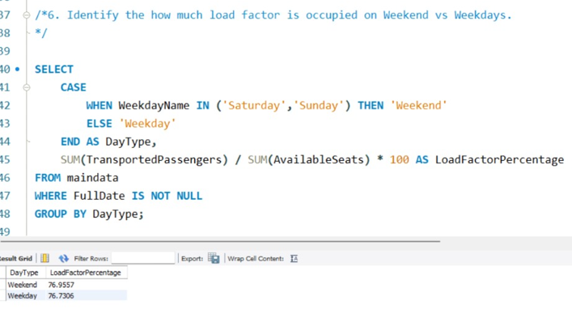
SQL Queries

Slide 11
02.
Load Factor year wise remained consistently high, ranging from approximately 75% to 78% .
Quarter wise its between 72% to 76%.

Slide 12
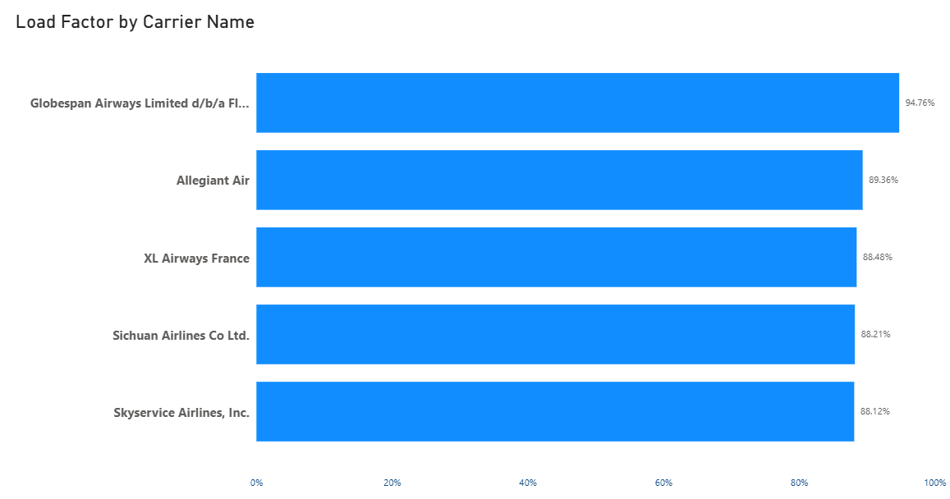
03.
A higher Load Factor indicates better seat utilization and operational efficiency.
A lower Load Factor suggests that flights are operating with many empty seats.

Slide 13
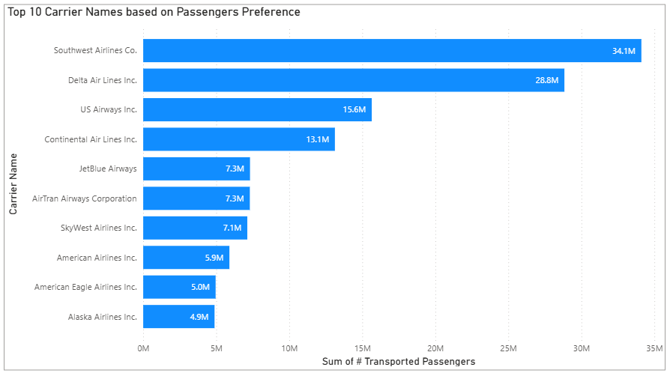
04.
Southwest Airlines has the highest passenger preference (34M).
Passenger traffic is concentrated among major airlines.
Useful for capacity and route planning.

Slide 14
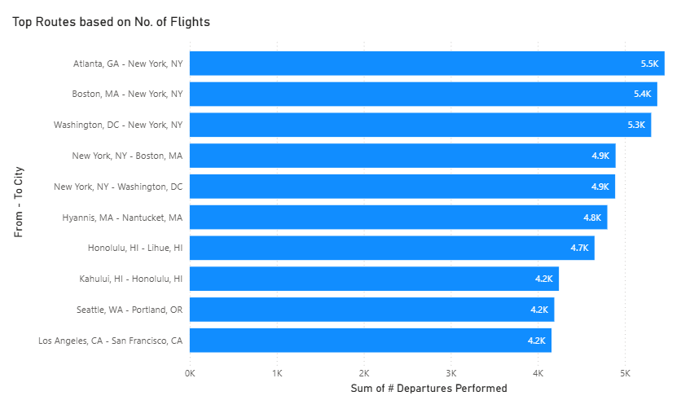
05.
Number of flights from Atlanta to New York is the highest.
Closely followed by Boston to New York and Washington DC to New York.

Slide 15
06.
Load factor for all days is almost same.
Airlines should use strategies to increase occupancy for weekends.
Prospective passengers are more likely to travel for leisure in weekends.

Slide 16
07
Flights operating on routes less than 500 miles shows strong demand.
Company should also focus on flights routes more than 500 miles by giving discounts and other benefits.

Slide 17
Insights
High Load Factor indicates better seat utilization and operational efficiency.
Passenger demand varies across different airlines, highlighting customer preferences.
Chicago–Detroit is the busiest route, with major hubs including Chicago, Atlanta, and Washington DC.
Passenger traffic on weekdays and weekends is almost same.
Most flights operate on routes less than 500 miles, showing strong demand for short-haul travel.
Monthly, quarterly, and yearly analysis helps identify seasonal trends in airline performance.
The analysis supports better route planning, resource allocation, and data-driven decision-making.

Slide 18
What We Learned
Visualization Skills
Tableau Dashboard Design
Power BI KPIs
Interactive Filters
Charts
Business Storytelling
Technical Skills
SQL Joins
Aggregate Functions
GROUP BY
CASE Statements
Date Functions
Load Factor Calculation
Business Skills
Airline Performance Analysis
Route Optimization
Capacity Utilization
Trend Analysis

Slide 19
Challenges Faced
Dashboard Challenges
Sorting
KPI Formatting
Filters
Route Analysis
Data Challenges
CSV Import Issues
Passenger Data Import
Date Conversion
Duplicate Columns
SQL Challenges
Load Factor Calculation
Financial Quarter
Weekday Calculations

Slide 20
How we tackled the challenges
Solution
Used functions to calculate the data - years, month and day
Analyzed airline seat utilization.
Compared yearly Load Factor (%).
Evaluated overall performance trend.
We used load factor field to evaluate week day/ weekend occupancy
Power query and power bi tools were very helpful in our analysis.

Slide 21
KPIs
187M
Total Passengers
3M
Total Flights
208
Total Airlines
82M
Total Distance (miles)
76%
Overall Load Factor

Slide 22
Recommendations
Business Suggestions
Increase flights on high-demand routes.
Improve occupancy on low load-factor routes.
Expand profitable routes.
Monitor seasonal demand.
Improve seat utilization.
Focus marketing on underperforming routes.

Slide 23
Conclusion
This project demonstrates how SQL, Excel, Tableau, and Power BI can be used together to transform raw airline operational data into meaningful business insights.
The airline dataset provided valuable insights into passenger traffic and airline performance.
Data analysis identified key trends, patterns, and performance indicators.
The insights support better decision-making in route planning and operational efficiency.
Interactive dashboards and visualizations simplified data interpretation.
This project demonstrates how data analytics converts raw data into meaningful business insights.

Slide 24
Thank You

