Slide 1
PREDICTION OF LOAN DEFAULT BY FIRST TIME BORROWERS
PROJECT BY
Sowndarya Saini
Goutham Yallapu

Slide 2

01
02
03
04
05
06
INTRODUCTION
EXPLORATORY DATA ANALYSIS
MODELS
RESULTS
CONCLUSIONS
RECOMMENDATIONS
OVERVIEW

Slide 3

INTRODUCTION
The challenges and methodologies associated with predicting loan defaults among first-time borrowers. This demographic, lacking an extensive credit history, presents a unique risk profile that complicates traditional risk assessment methods. Our focus will be on leveraging advanced analytical techniques to accurately predict which first-time borrowers are likely to default.
This analysis not only aims to reduce financial risks but also to refine lending practices, ensuring that loans are extended more judiciously to this underserved segment.

Slide 4
MOTIVATION
Loan providers face difficulties in assessing loan applications due to insufficient credit history, leading to potential losses from defaulters. Utilize EDA to analyze applicant profiles to ensure loan approval for capable individuals while minimizing the risk of default.
Approving a loan for an unreliable applicant increases the risk of financial loss for the company.
OBJECTIVE
Implementing a data-driven approach to predict and identify key factors influencing payment difficulties, empowering financial institutions with actionable insights for strategic decision-making in loan approvals and risk management.

Slide 5




BUSINESS VALUE
Decrease Financial Loss
Reduce Processing Time
Decrease Human Resource Cost

Slide 6
DATA DICTIONARY
SOURCE: KAGGLE.COM, OBSERVATIONS: 307505, VARIABLES: 122
Characteristics of Borrower
Characteristics of Bank
Characteristics of Economy
Gender
Income
Education
Age
No of days employed
Occupation
No of credit enquires in last 12 months
Count of default 60 days - Social Circle
Type of Loan (Cash or Revolving loan)
Credit Amount
Region Population
Region Rating

Slide 7






DATA PREPROCESSING
Handling Missing Values
Handling Correlated Variables
Data Partitioning
Handling Outliers
Cleaned Dataset
Omitted highly correlated variables
Training Dataset - 70%
Testing Dataset - 30%
78,580 missing observations
Removed extreme outliers. Transformation of variables to achieve normality.
Observations: 188,851
Variables: 27

Slide 8
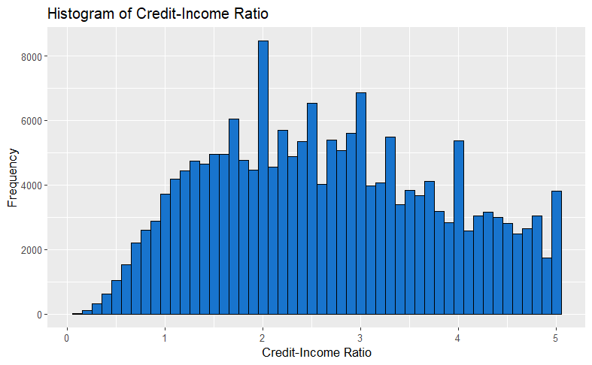
NEW VARIABLES
CREDIT TO INCOME RATIO
OCCUPATION TYPE
CREDIT INCOME RATIO =
Credit Amount
Annual Income
Histogram of Credit to Income Ratio
High Skill
Medium Skill
Low Skill
Managers
Accountants
High skill tech staff
Medicine staff
IT staff
Sales staff
Core staff
Private service staff
Drivers
Cooking staff
Secretaries
Realty agents
HR staff
Laborers
Security staff
Cleaning staff
Low-skill Laborers
Waiters
Barmen staff

Slide 9
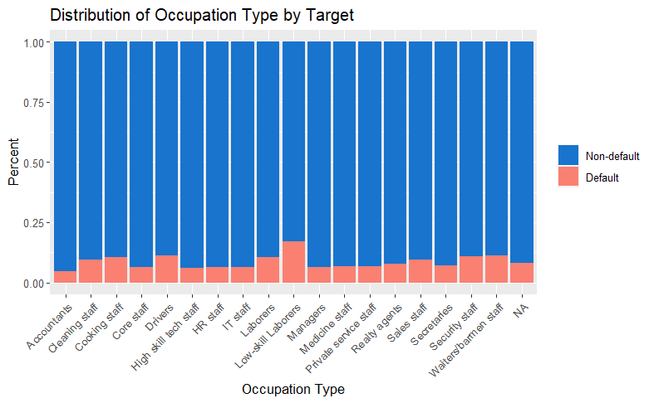
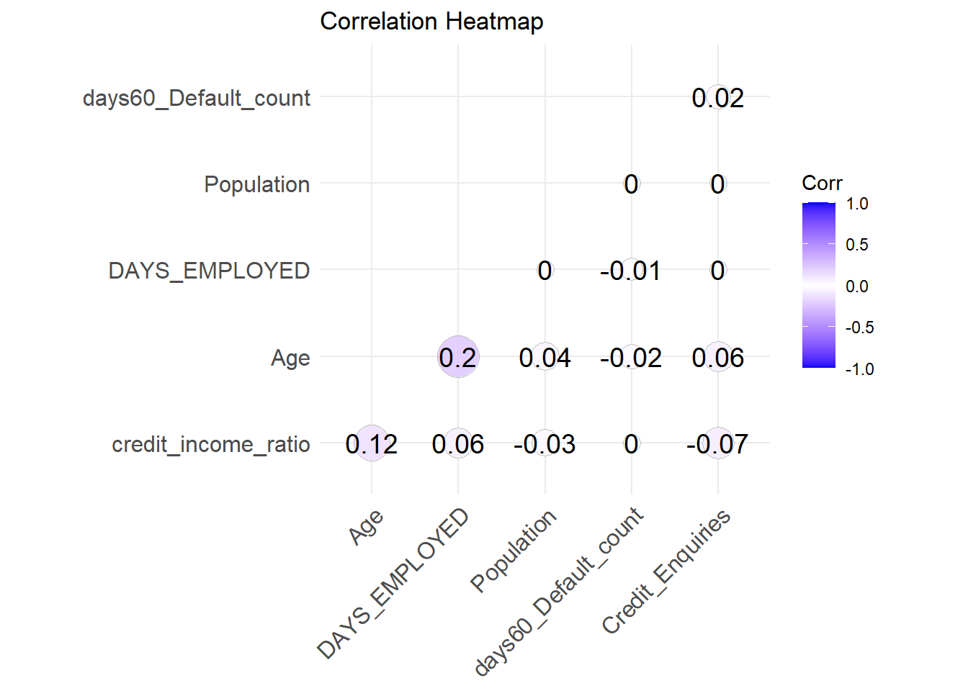
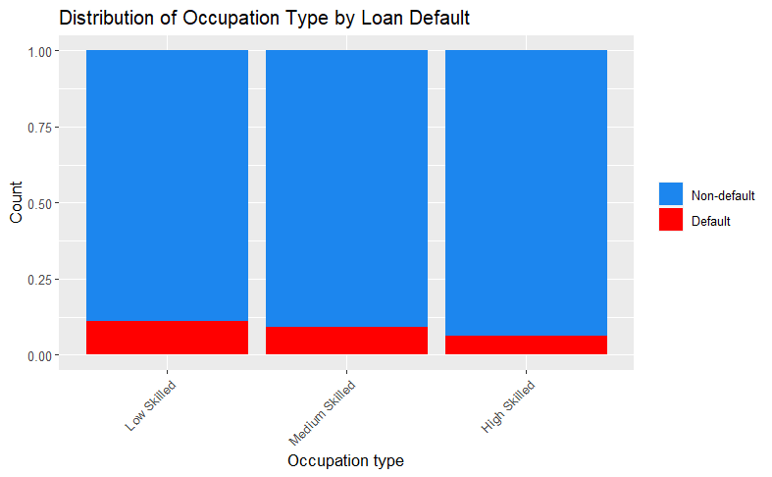
EXPLORATORY DATA ANALYSIS

Slide 10
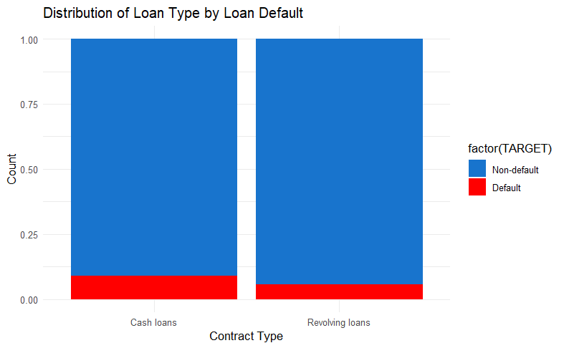
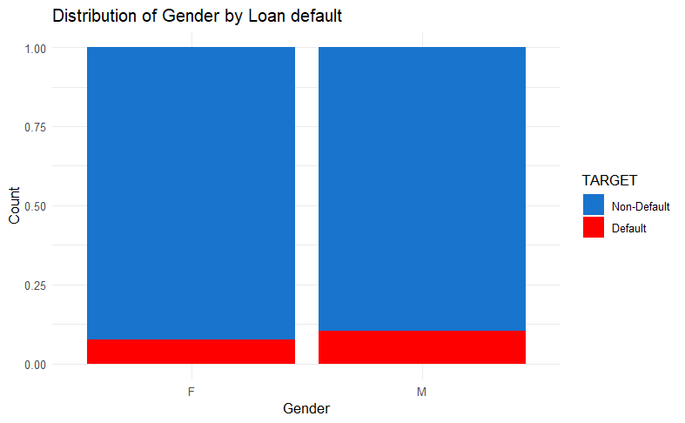

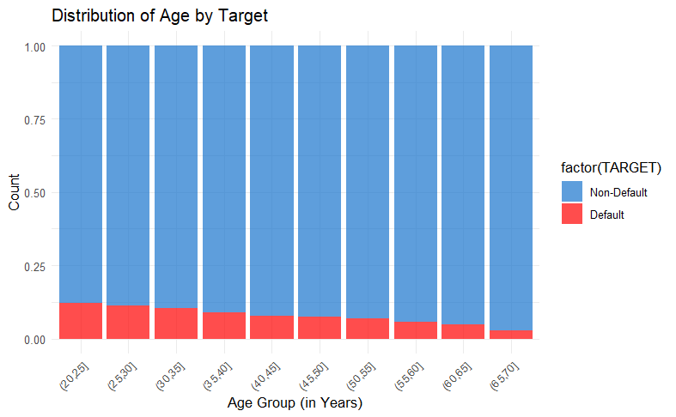
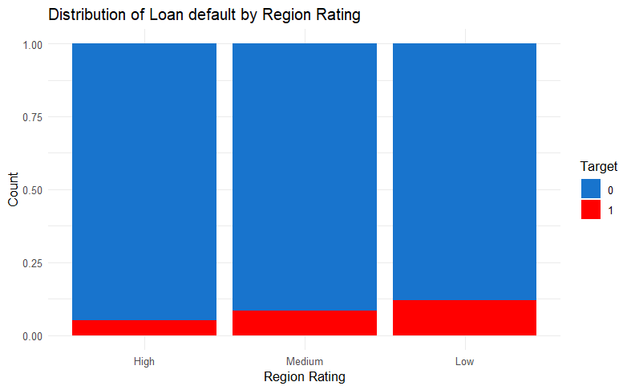

Slide 11



MODELS
LOGISTIC REGRESSION
RANDOM FOREST
NAÏVE BAYES
Logistic Regression offers effectiveness of each predictor on the likelihood of the outcome.
Forest offer variable importance measures, highlighting each predictor's contribution to overall prediction.
Naive Bayes Model offers simple and effective probabilistic algorithms and assume data is conditionally independent.

Slide 12
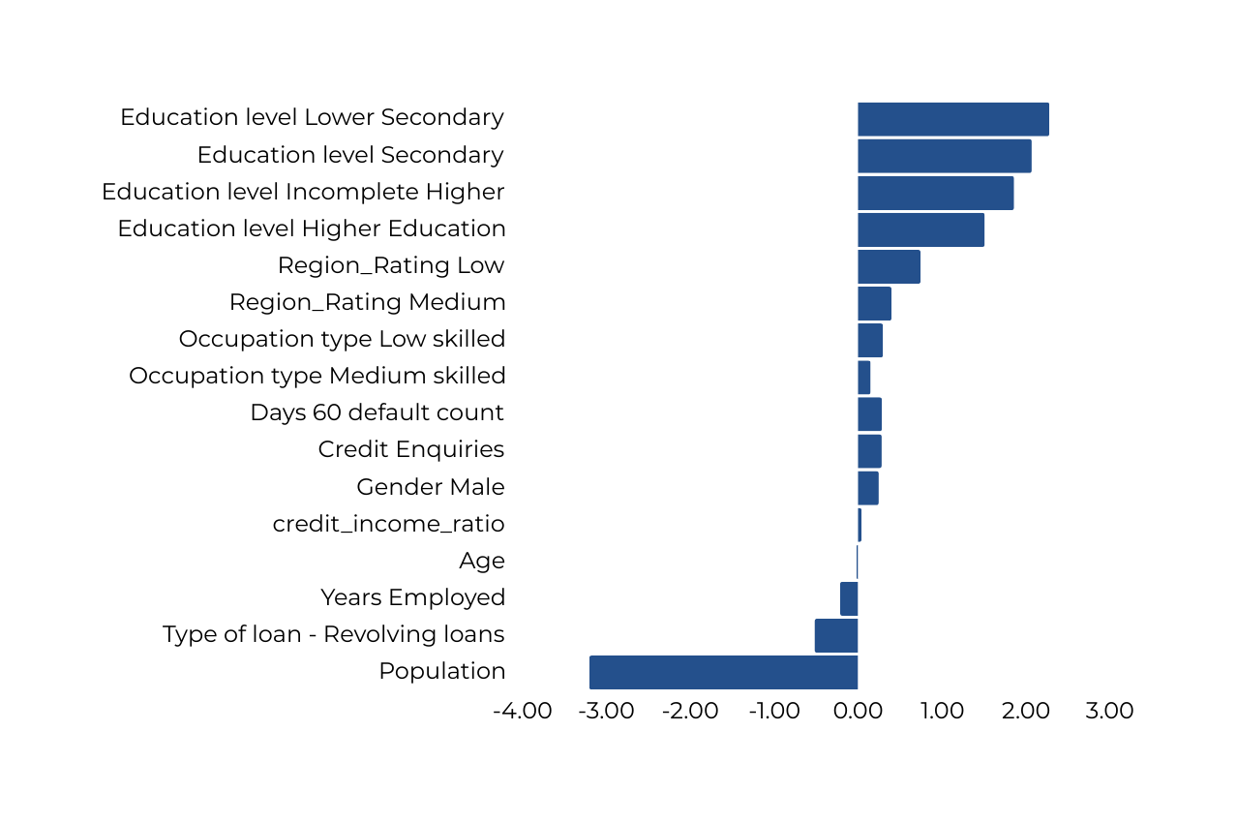



RESULTS: LOGISTIC REGRESSION
Coefficients
91.2%
22.1%
28.3%
Specificity
Sensitivity
Accuracy

Slide 13
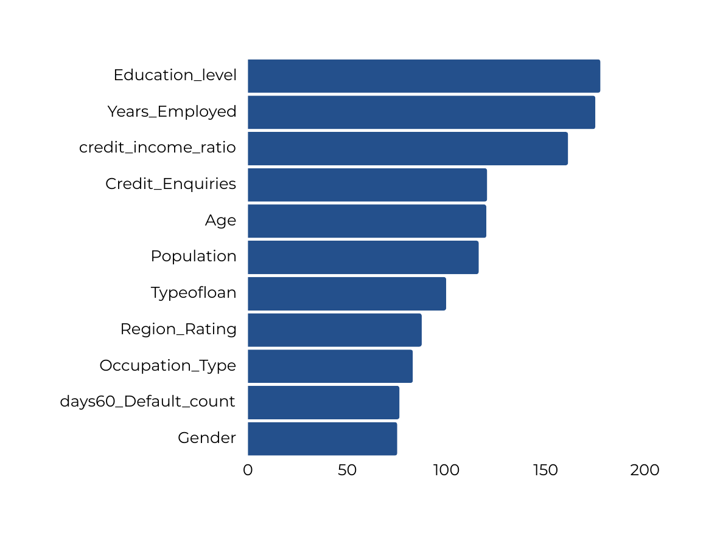



RESULTS: RANDOM FOREST
FEATURE IMPORTANCE: RANDOM FOREST MODEL
85.9%
28.0%
33.2%
Specificity
Sensitivity
Accuracy

Slide 14
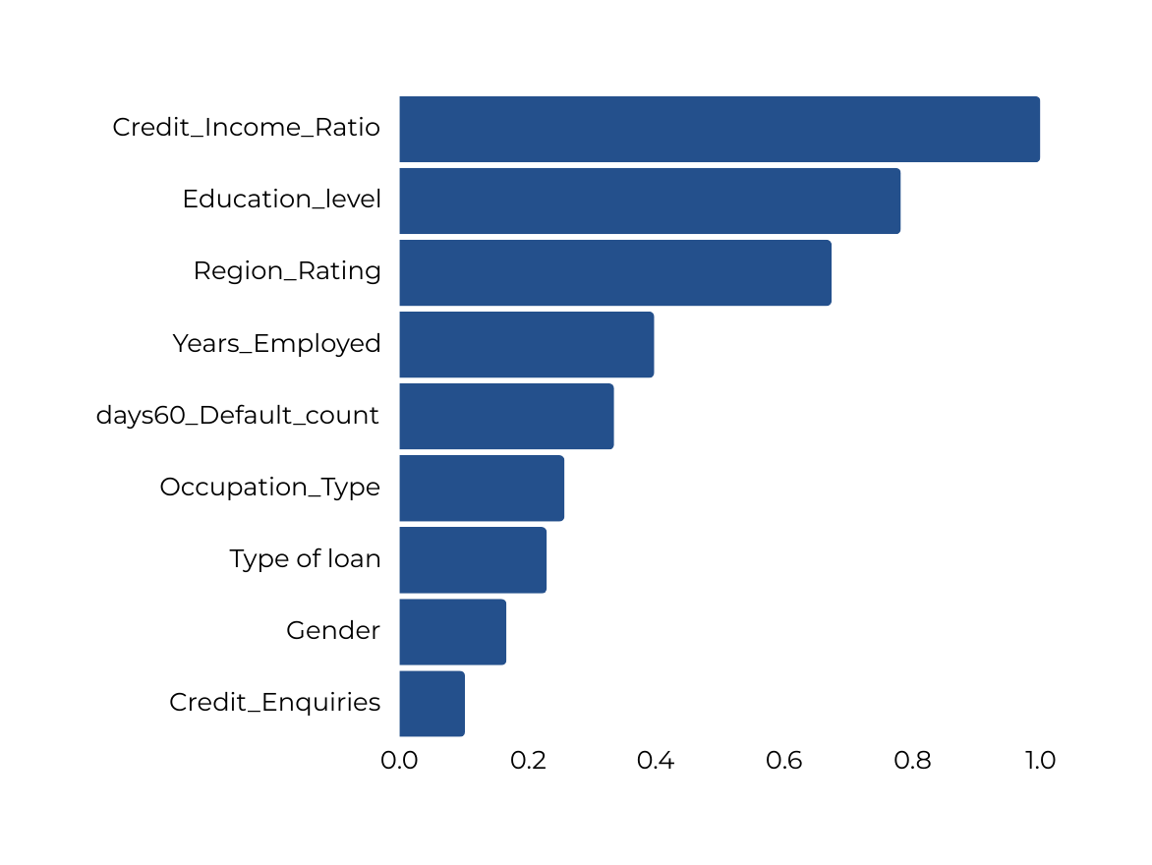



RESULTS: NAIVE BAYES
FEATURE IMPORTANCE: NAIVE BAYES
94.3%
14.5%
21.7%
Specificity
Sensitivity
Accuracy

Slide 15
MODELS COMPARISIONS:
Performance | Logistic Model | Random Forest | Naive Bayes
Specificity | 91.2% | 85.9% | 94.3%
Sensitivity | 22.1% | 28.0% | 14.5%
Accuracy | 28.3% | 33.2% | 21.7%

Slide 16
CONCLUSIONS
Identification of Risk characteristics: Models identified key predictors of loan default, including credit income ratio, education level, occupation type, region rating, age, population, 60 days default count, credit inquiries, and years employed.
Demographic Insights: Age and occupation significantly influence loan repayment behavior, with older individuals and certain employment categories exhibiting varying default rates.
Financial Indicators: Higher credit-to-income ratios indicate greater risk due to the challenge of repaying larger debts relative to income, emphasizing the importance of this financial indicator.
Geographic Variation: Region Rating variable implies geographic factors influence default rates, possibly due to regional economic variations and crime rates.

Slide 17
RECOMMENDATIONS
Credit Policy Adjustment: Financial institutions should prioritize risk factors like credit income ratio, occupation, and age in their scoring models to enhance risk assessment for new loans. Implementing cautionary profiles, especially for high-risk occupations, can secure loans with full collateral.
Targeted Financial Products: Develop tailored financial products for higher-risk groups identified in the analysis, such as offering lower credit limits or secured credit options.
Preventive Measures for High-Risk Regions: Institutions could implement more rigorous follow-up and recovery processes in regions identified as high risk to mitigate potential losses.
Educational Programs: Provide financial education programs for applicants in high-risk categories to help them better manage their finances and understand the implications.

Slide 18

THANK YOU

Slide 19
APPENDIX

Slide 20
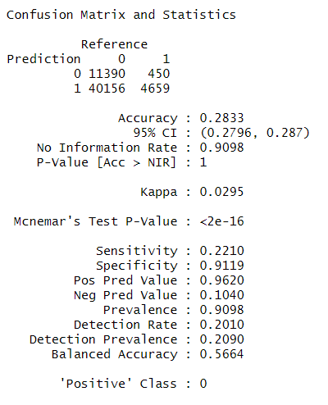
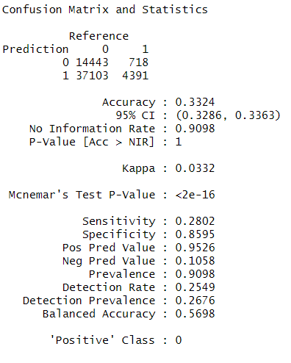
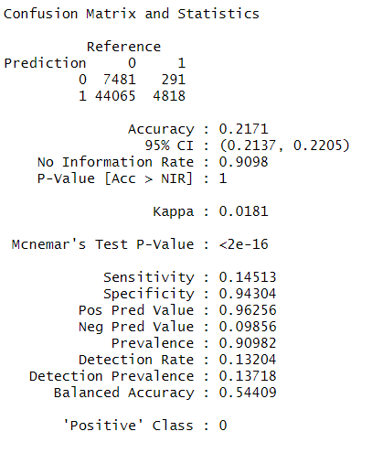
APPENDIX 1: CONFUSTION MATRIX
LOGISTIC MODEL
RANDOM FOREST
NAIVE BAYES

Slide 21
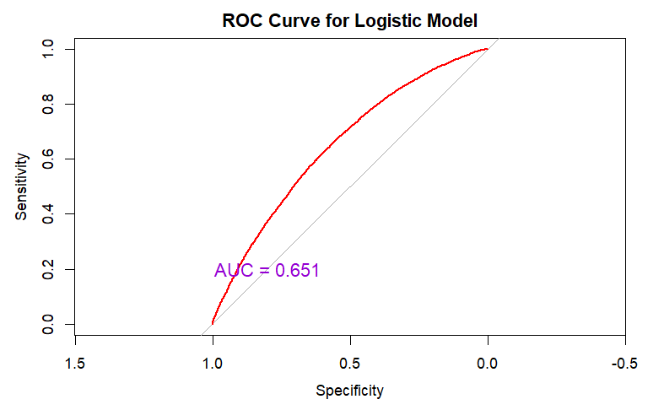
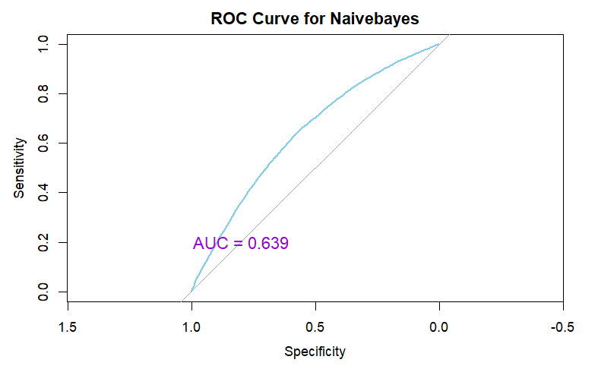
APPENDIX 2: RECEIVER OPERATING CHARACTERISTIC

Slide 22
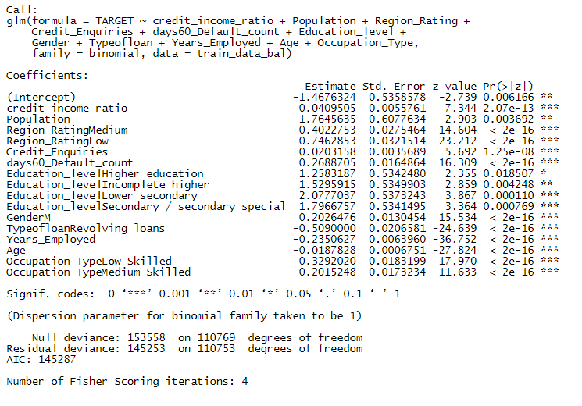
APPENDIX 3: LOGISTIC MODEL

Slide 23
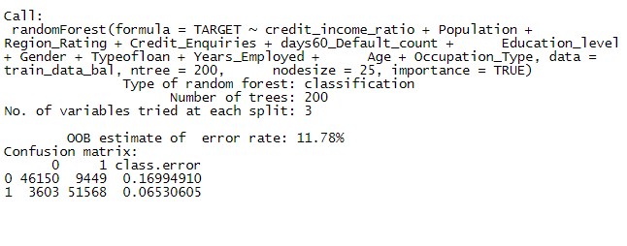
APPENDIX 4: LOGISTIC MODEL

Slide 24
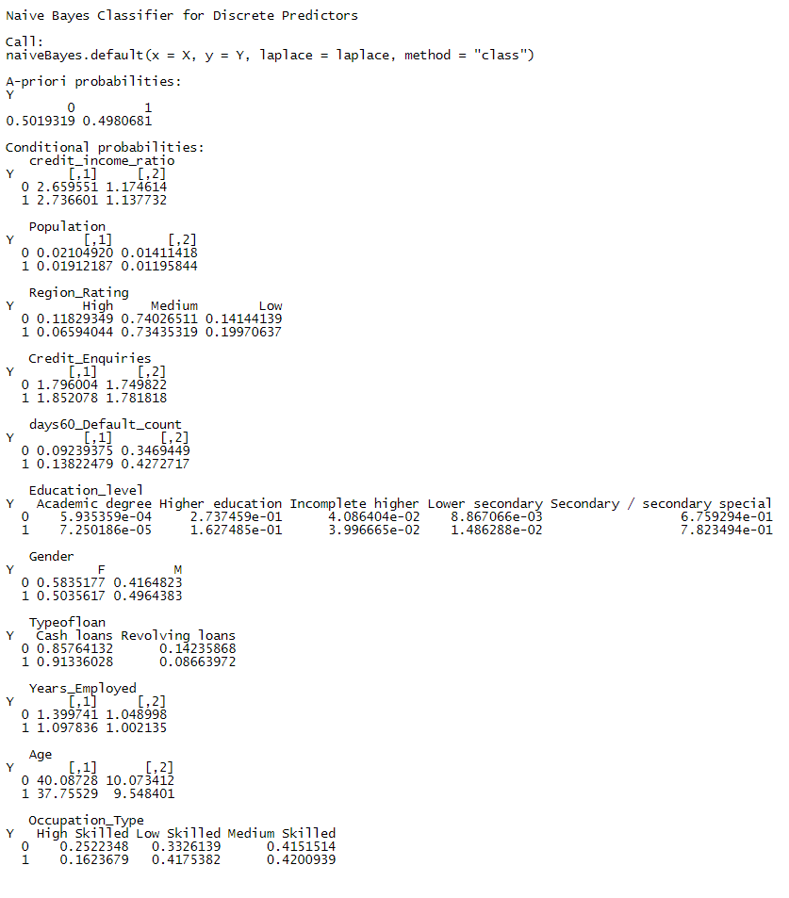
APPENDIX 5: NAIVE BAYES

Slide 25
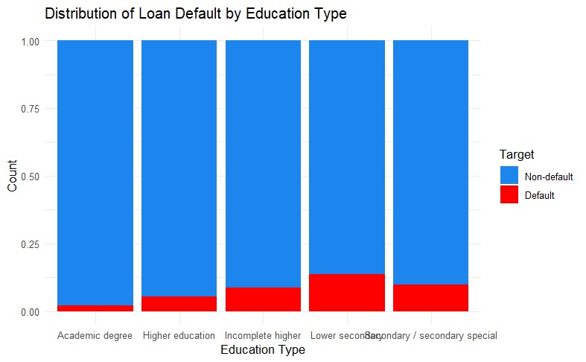
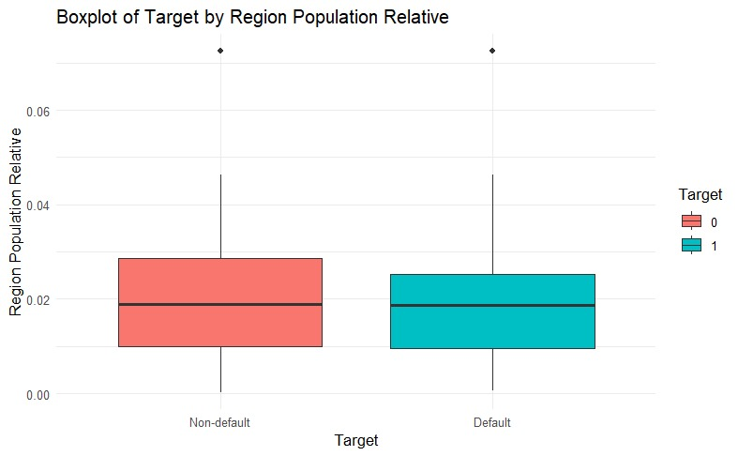
APPENDIX 6: EXPLORATORY DATA ANALYSIS

