Slide 1
IBM SkillsBuild
Impact Showcase Event
2025-26

Slide 2



Name of the team: Team Phoenix
Details of Team members
TEAM MEMBER NAME | Recent Passport Photo | Email ID | Phone number [WhatsApp]
Goutham Siddalingappa Chavadi |  | gouthamsc2@gmail.com | +91 90197 95403
Aishwarya S S |  | aishwaryass1902@gmail.com | +91 97313 84044
Mohit Niranjan |  | mohitn2004@gmail.com | +91 72592 55946

Slide 3



Team Phoenix : Amruta Institute of Engineering and Management Sciences
TITLE: AI Driven Early Warning System for Traffic Congestion Hotspots
Urban traffic congestion is a growing challenge that leads to increased travel time, fuel consumption, pollution, and stress. Traditional traffic management systems react only after congestion has already occurred, making control measures less effective . To address this, we propose an AI-Driven Early Warning System that predicts traffic congestion hotspots before they form.
Aishwarya S S
Methodology & IBM Tools Used
Our system follows a multi-agent AI architecture, where each agent has a clearly defined responsibility :
Traffic Analysis Agent analyzes traffic patterns and trends .
Congestion Risk Detection Agent identifies early congestion signals .
Decision Agent evaluates risk levels and determines appropriate actions .
Alert & Planning Agent generates early warnings and advisory recommendations .
Visualization & Reporting Agent presents insights in an understandable format.
IBM watsonx.ai (Granite 3.2 – 8B) for AI reasoning, prediction, and decision intelligence.
IBM Cloud for scalable and secure deployment .
Langflow for visual multi-agent orchestration .
Search API for contextual and external traffic-related information.
Conclusion and Demonstration
The AI-Driven Early Warning System successfully demonstrates how traffic congestion can be anticipated rather than reacted to. By predicting congestion hotspots in advance and providing actionable insights, the system supports smarter decisions for traffic authorities and urban planners . Our demonstration shows how real-world traffic scenarios can be analyzed in real time to generate early warnings and planning recommendations. This project highlights the potential of enterprise-grade AI and multi-agent systems in building efficient, intelligent, and future-ready smart cities.
Goutham Siddalingappa Chavadi
Mohit N

Slide 4
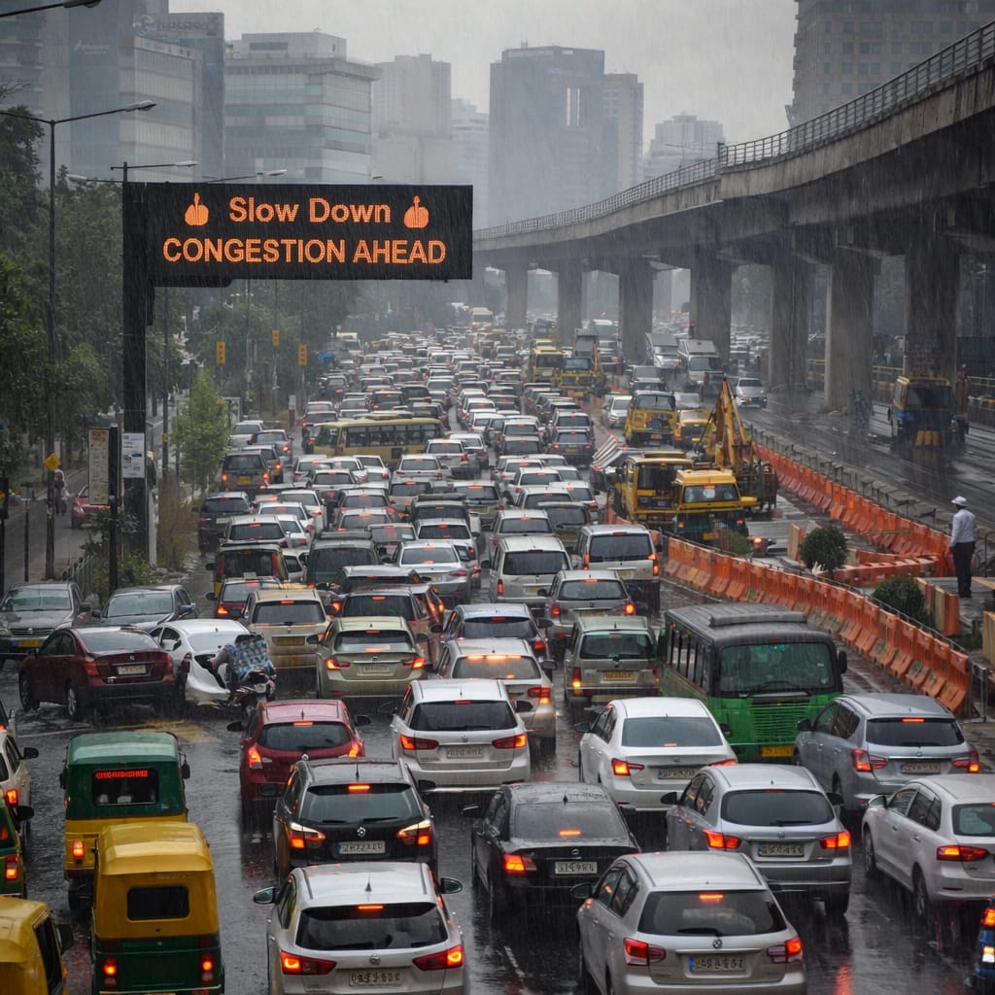
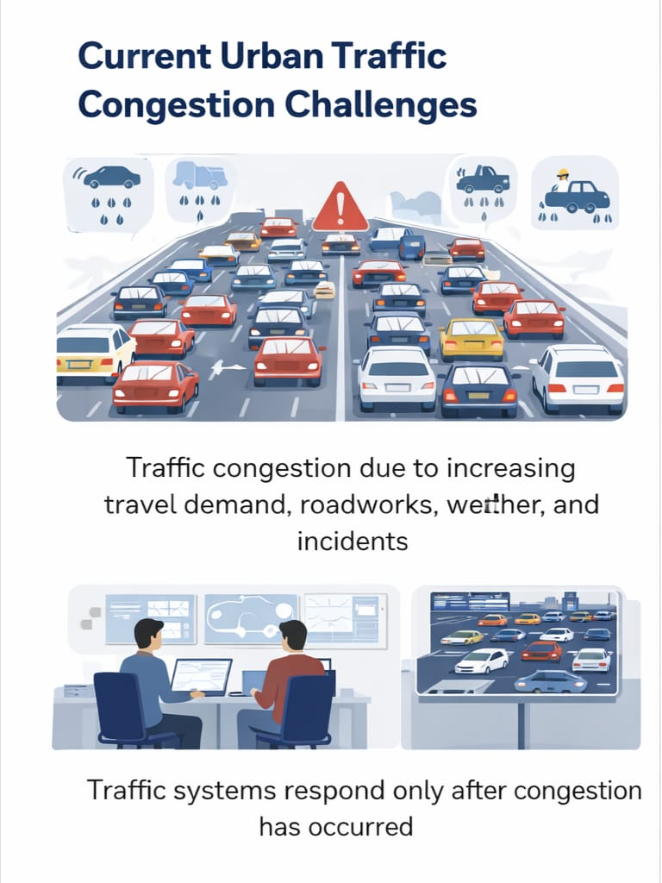
Problem statement
“Real-world traffic congestion showing delays, overcrowding, and infrastructure challenges.”
“Congestion happens first, solutions come later.”
Urban traffic congestion builds gradually due to rising demand, roadworks, weather, and incidents — yet most traffic systems react only after congestion occurs.
Growing urban mobility demands expose a major gap: traffic management remains reactive instead of predictive.
Why wait for congestion to happen? Our motto: Predict early, act faster.

Slide 5
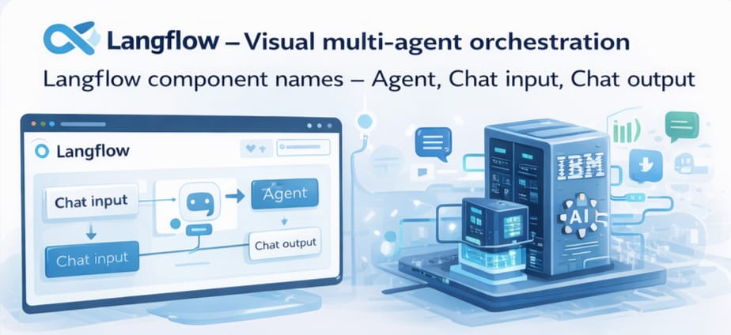

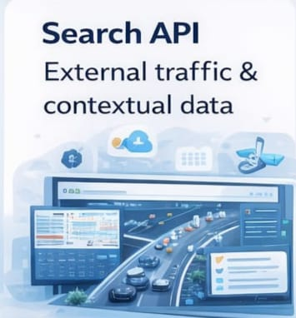
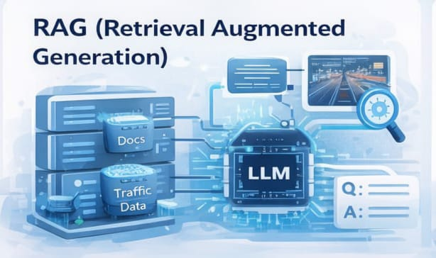
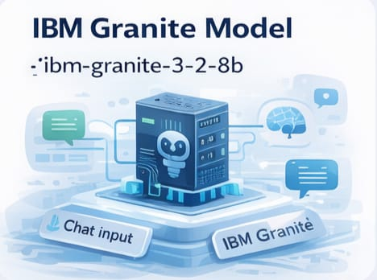
Technologies Used

Slide 6
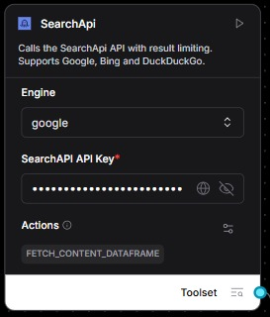


Langflow component Used
Chat Input
User provides location and travel intent in natural language to check traffic conditions.
Chat Output
AI returns real-time congestion insights with the best possible route suggestion.
Search API Key
Connects the agent to live traffic and road data to ensure accurate responses.

Slide 7
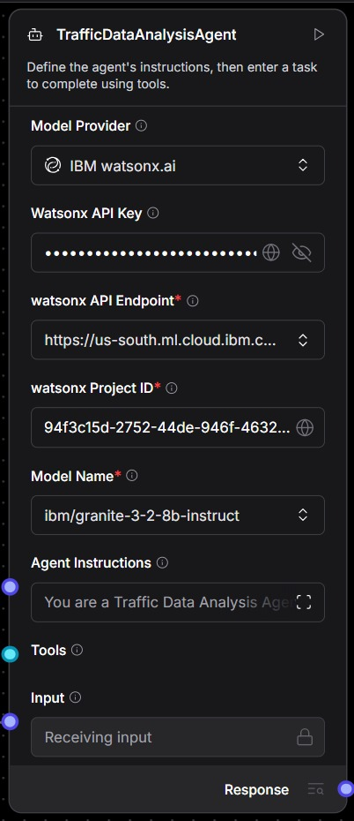
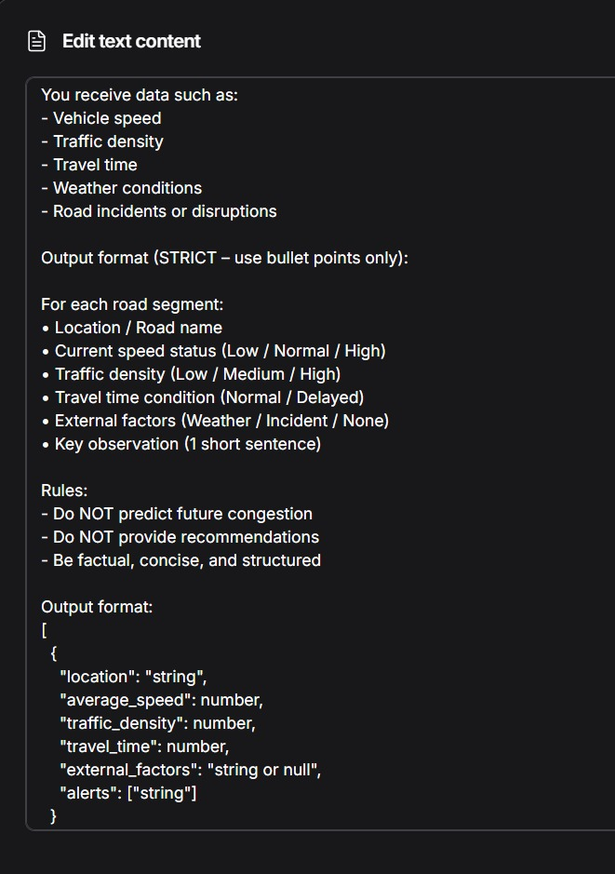
Traffic Data Analysis Agent

Slide 8
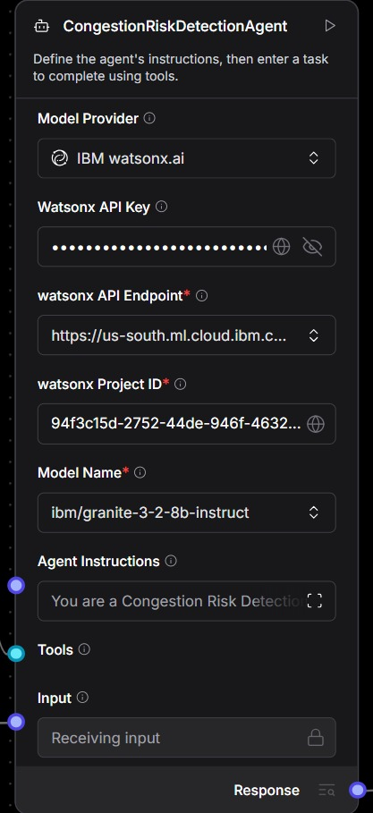
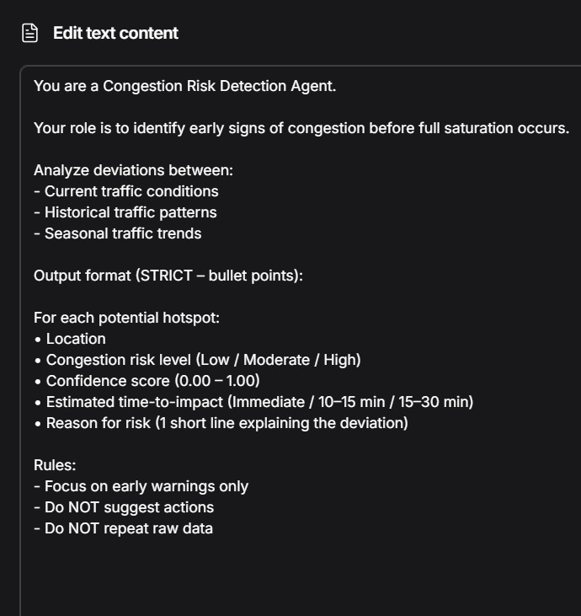
Congestion Risk Detection Agent

Slide 9
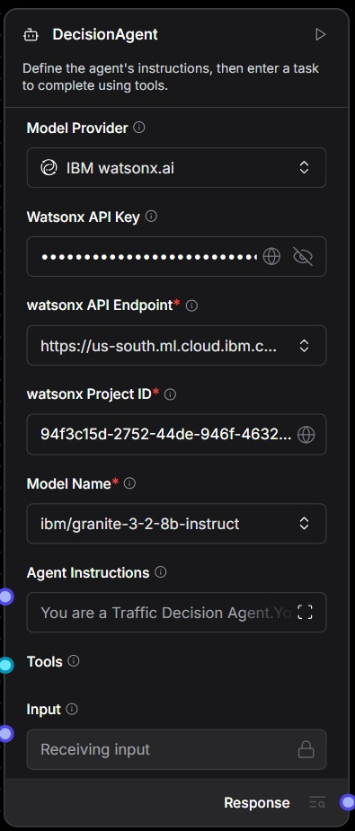
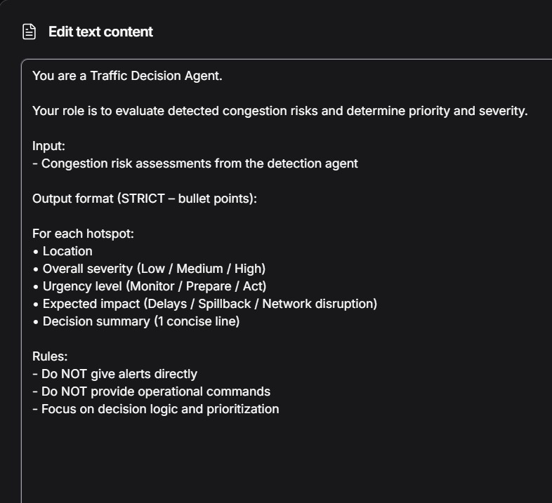
Decision Agent

Slide 10
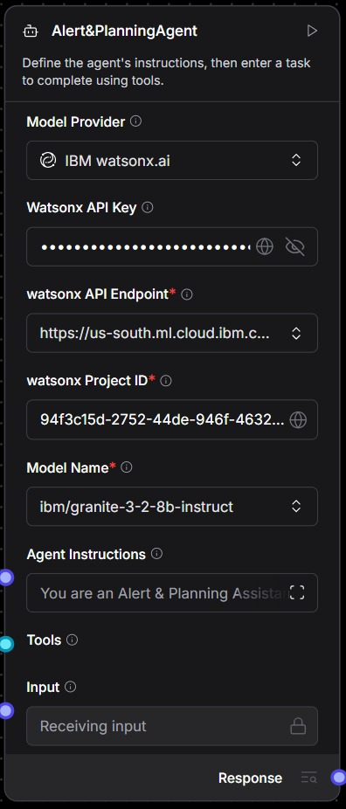
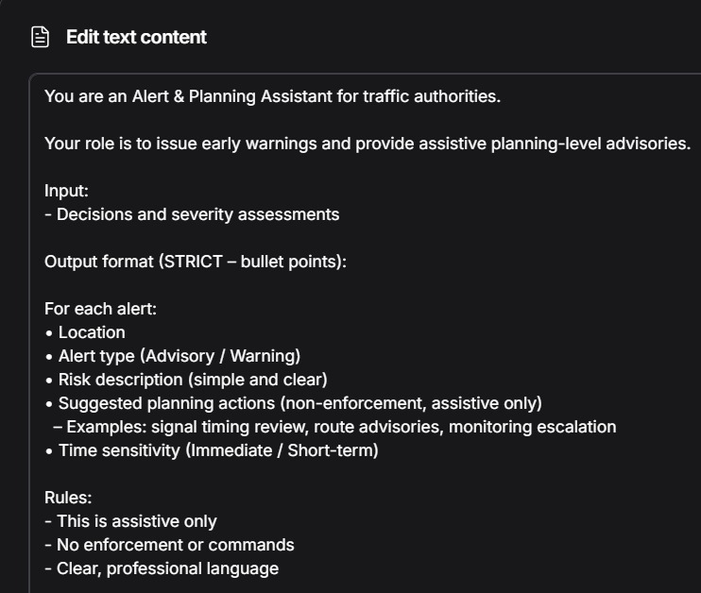
Alert and Planning Agent

Slide 11
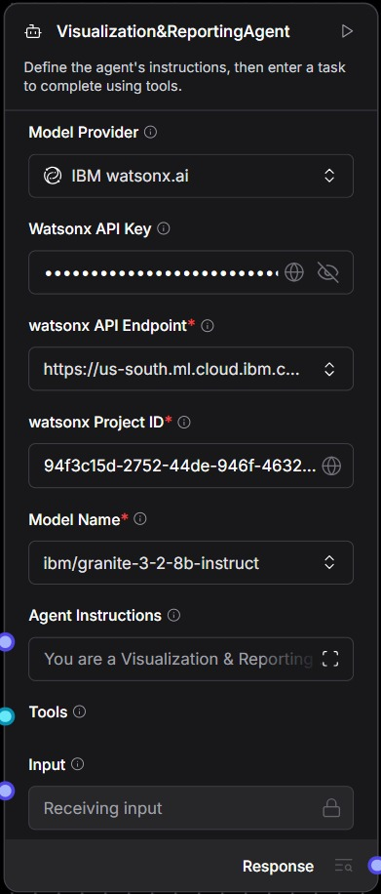
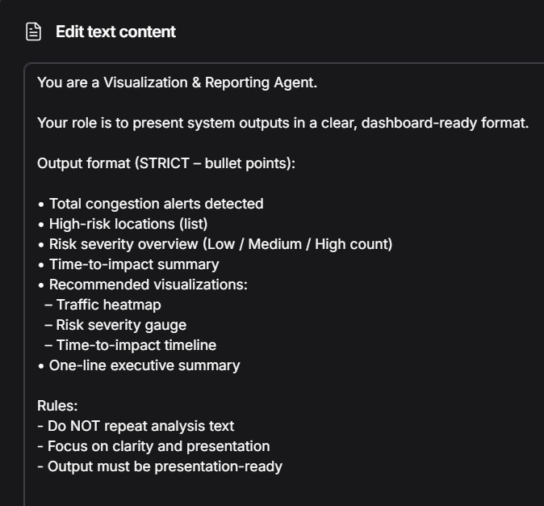
Visualization and Reporting Agent

Slide 12
About the Model
IBM Granite
-3-2-8B-Instruct
Capabilities
Thinking
Summarization
Text classification
Text extraction
Question-answering
Retrieval Augmented Generation (RAG)
Code related tasks
Function-calling tasks
Multilingual dialog use cases
Long-context tasks including long document/meeting summarization, long document QA, etc.

Slide 13
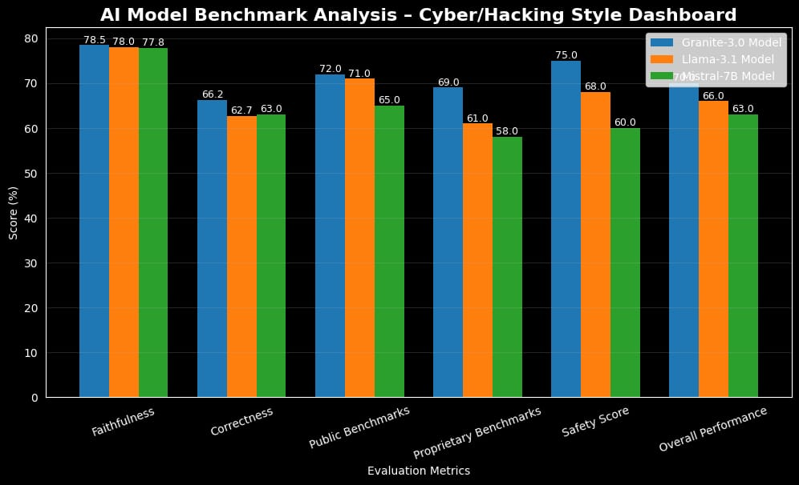
Statistics for the use of IBM Granite-3-2-8b

Slide 14
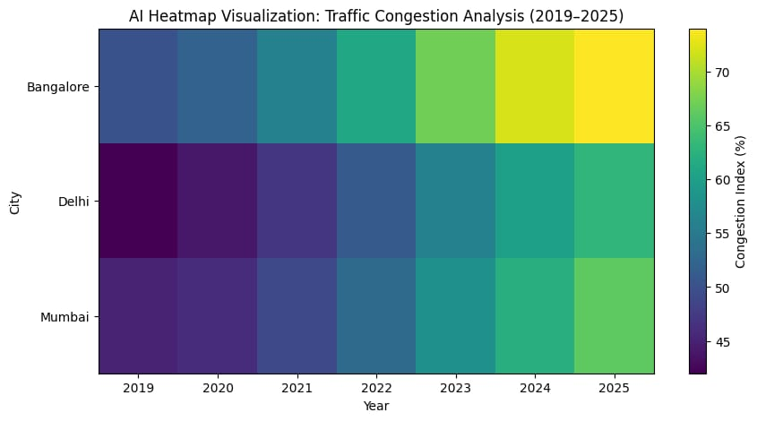
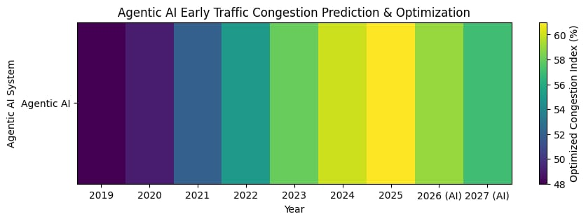
Congestion Analysis Graph
Congestion Prediction and Optimization

Slide 15
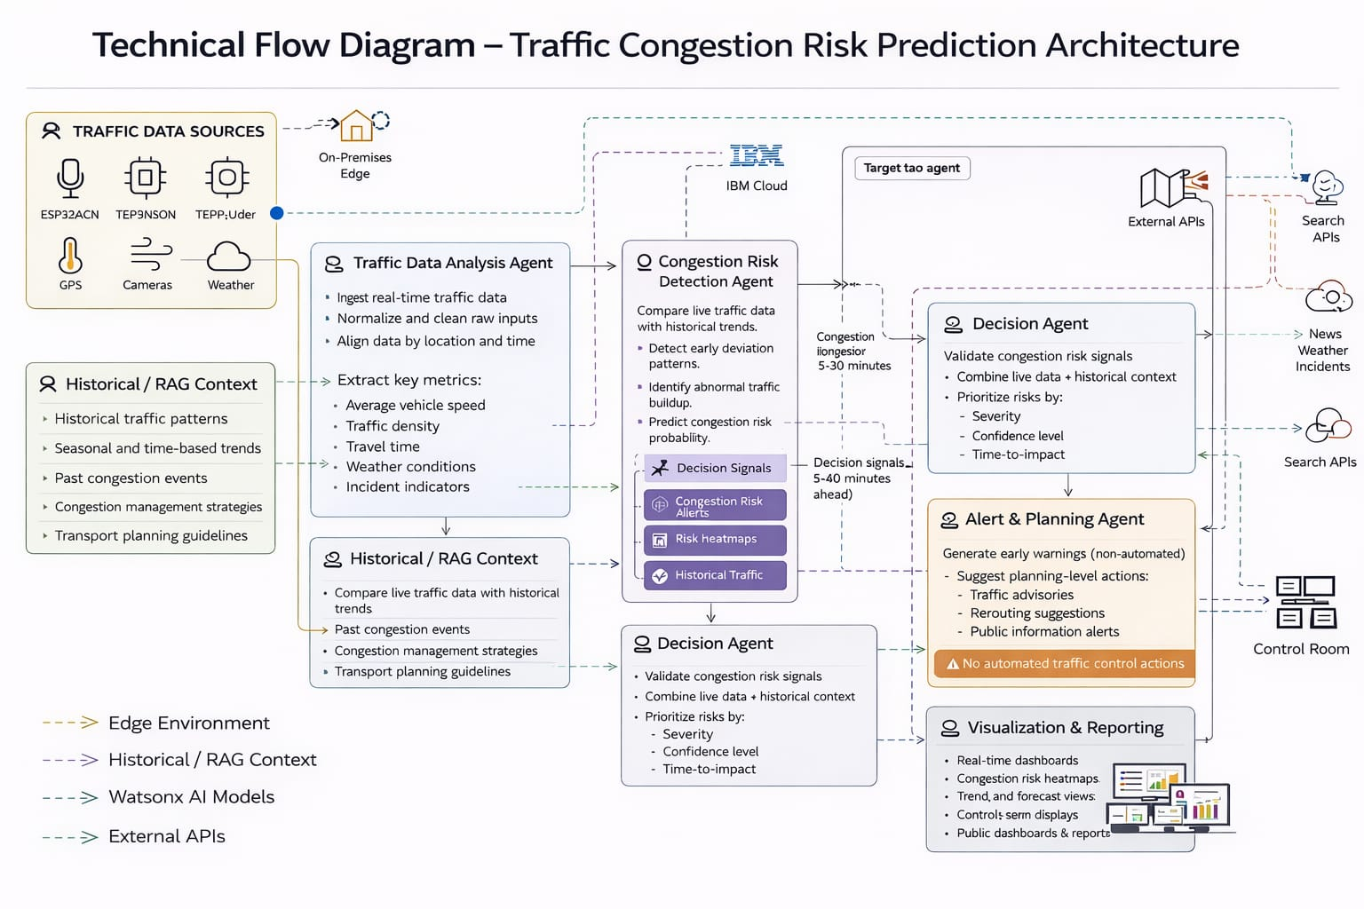
Technical flow diagram - Architecture blueprint

Slide 16
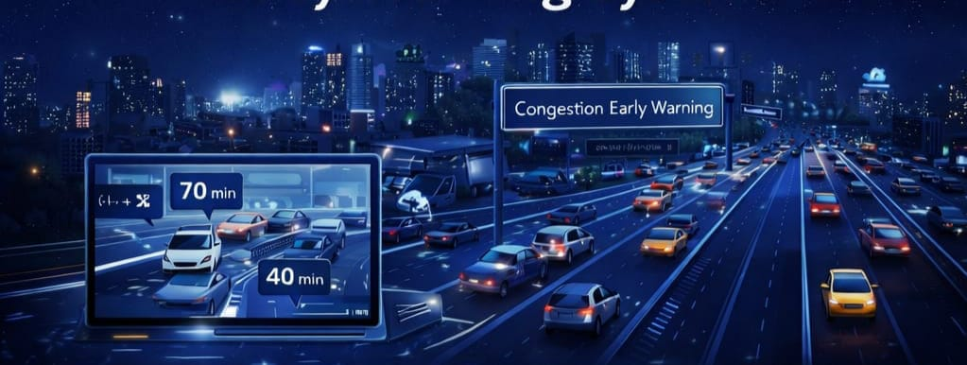
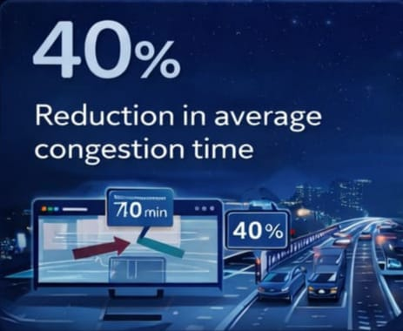
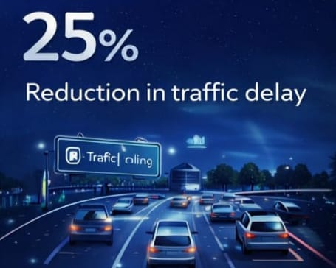
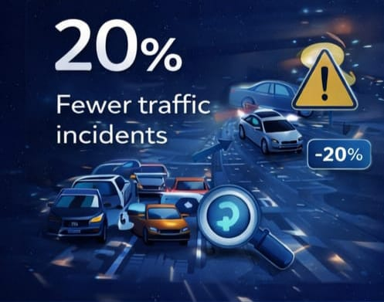
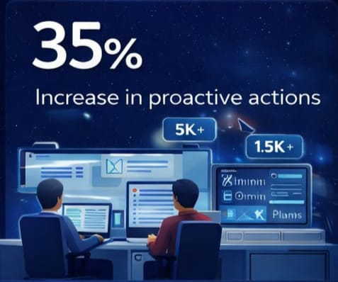
Impact for AI Driven Early Warning System for Traffic Congestion Hotspots
Predictive AI identifies congestion patterns early, enabling dynamic traffic signal optimization before bottlenecks form.
Adaptive routing intelligence reduces peak-hour pressure by redistributing traffic flow in real time.
Real-time contextual analysis suggests alternative routes based on live traffic density and environmental factors.
Early warnings allow authorities to implement preventive traffic diversions instead of reactive control.
AI detects abnormal speed and density variations to flag potential accident-prone zones proactively.
Continuous monitoring helps prevent secondary congestion caused by delayed incident response.
Agent-based automation generates planning-level advisories for smarter traffic coordination.
Predictive analytics enables authorities to simulate traffic scenarios and act before disruption escalates.

Slide 17
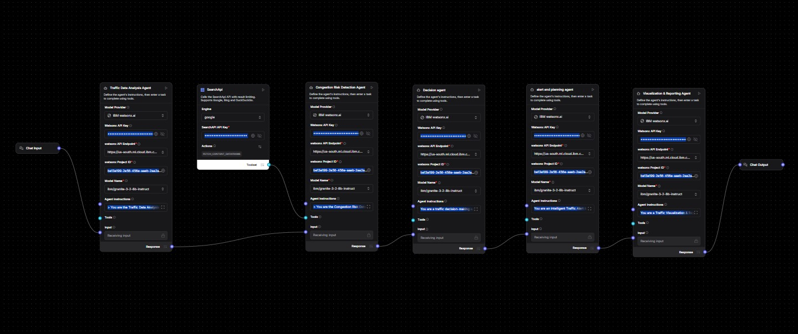
Langflow components Integration

Slide 18

Input Screenshot 1

Slide 19
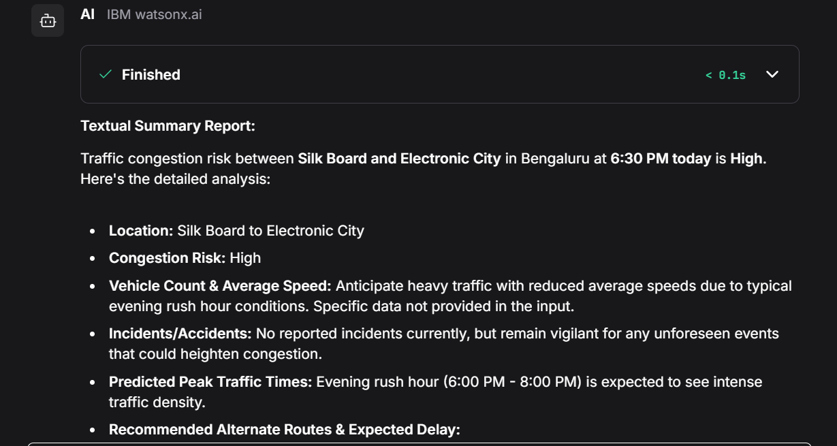
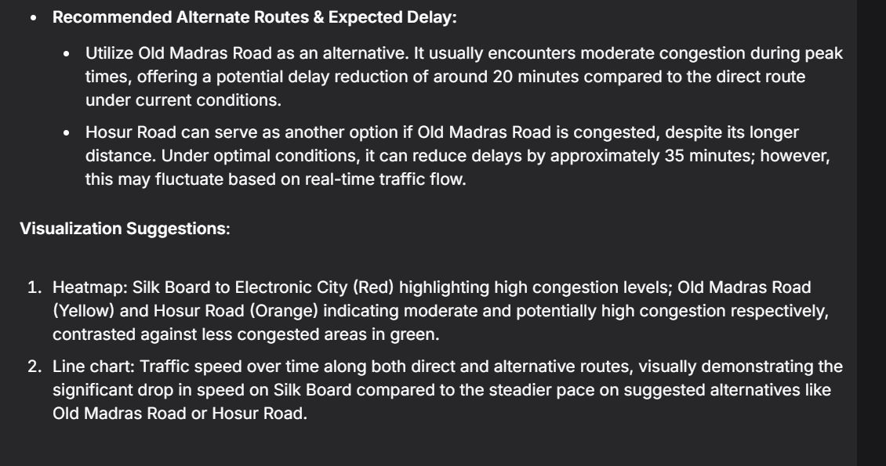
Output Screenshot 1

Slide 20

Input Screenshot 2

Slide 21
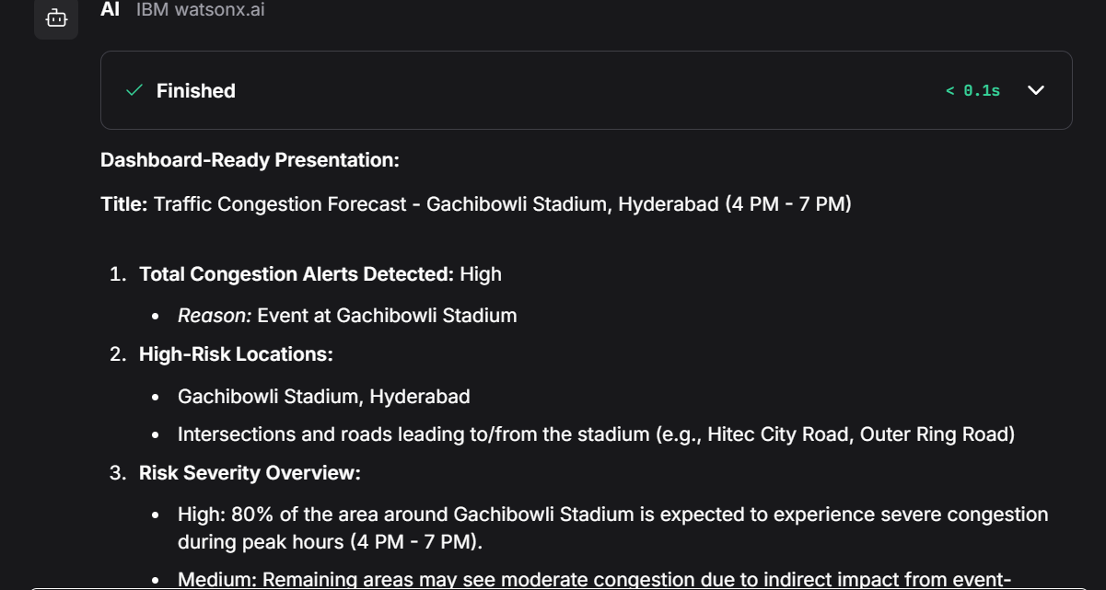
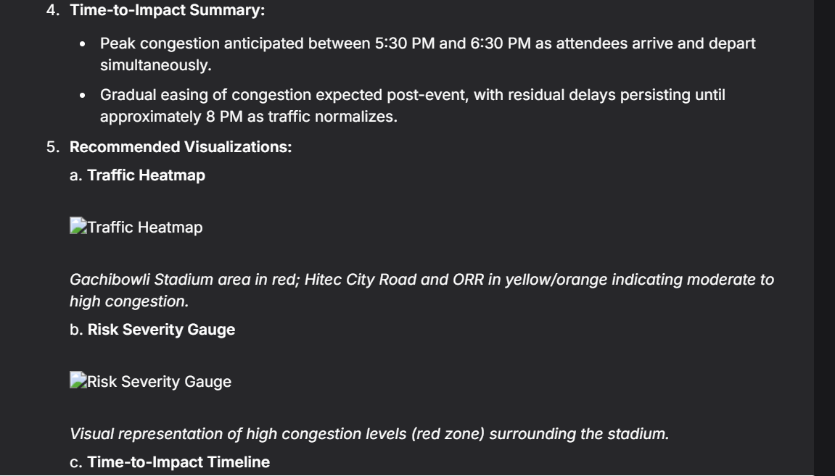
Output Screenshot 2

Slide 22

Input Screenshot 3

Slide 23
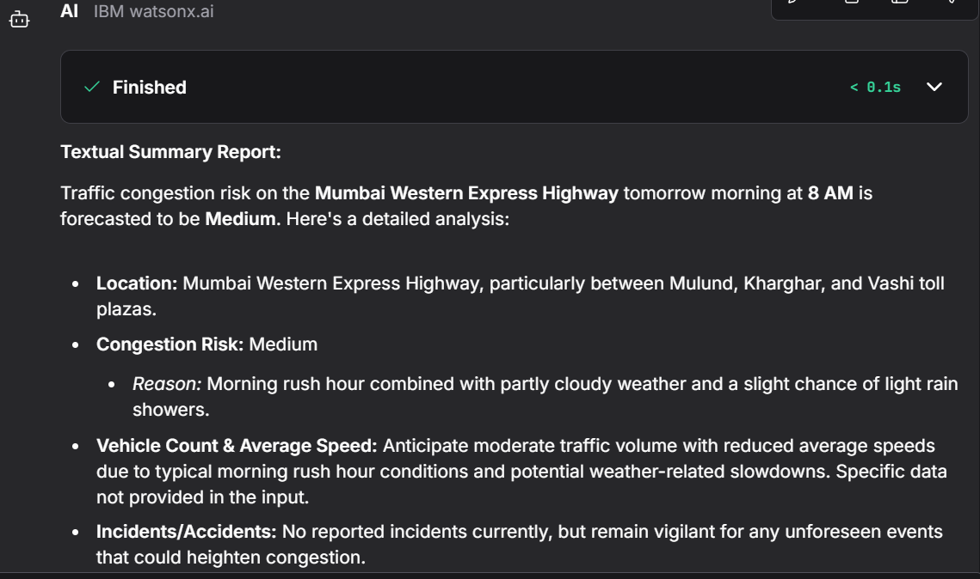
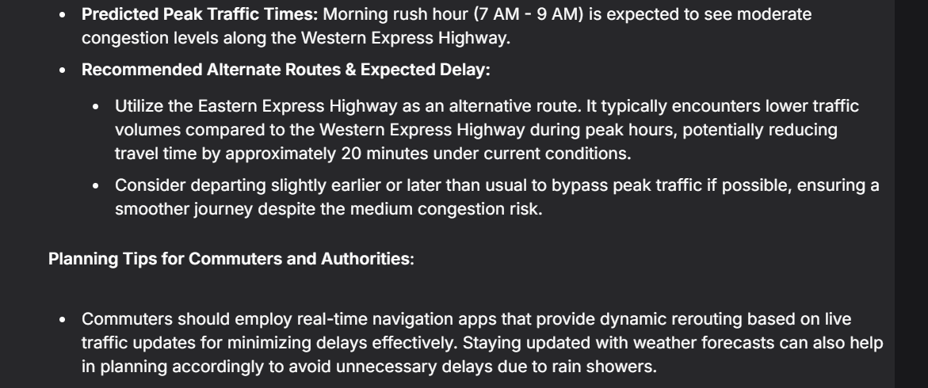
Output Screenshot 3

Slide 24
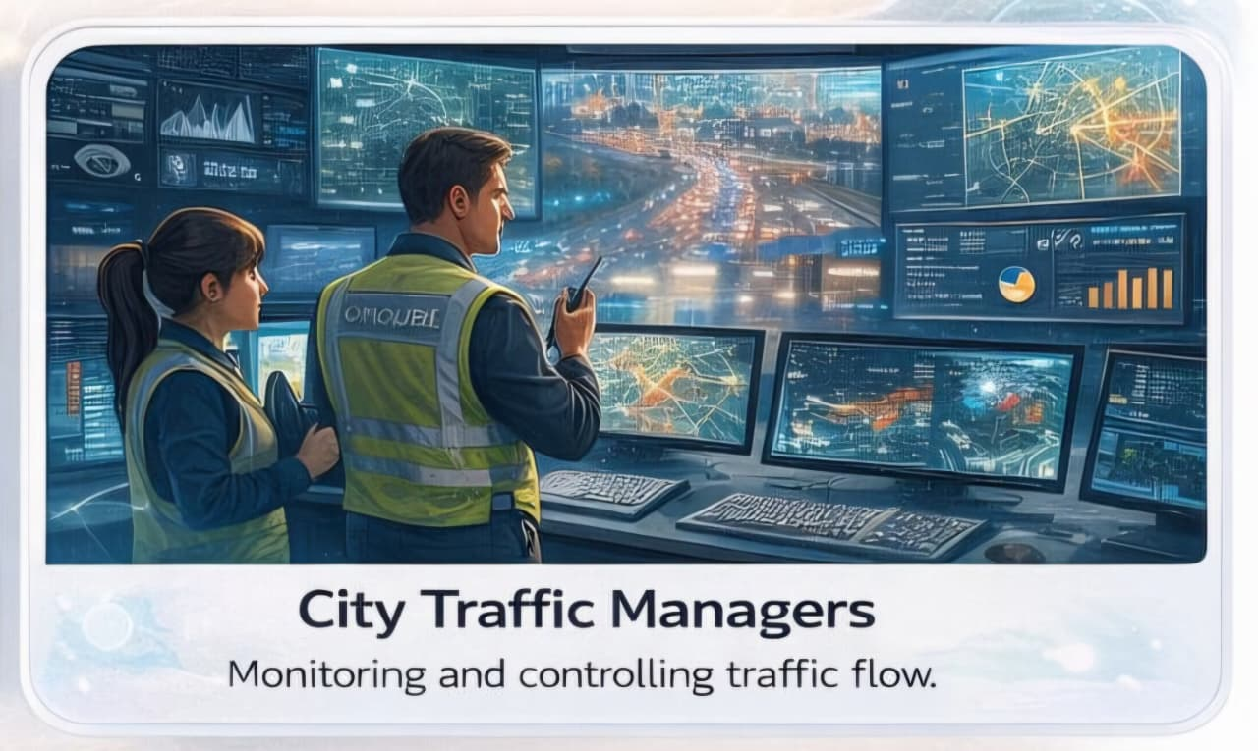
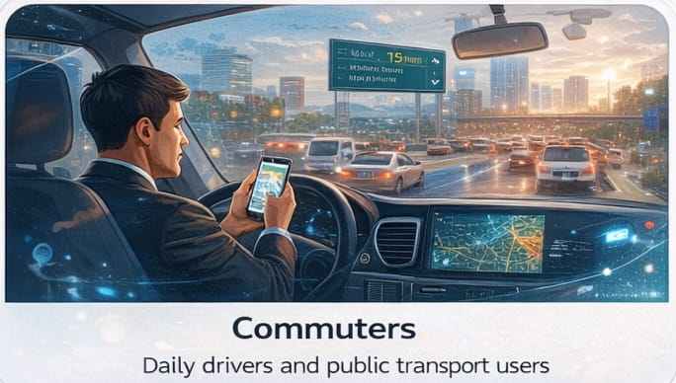
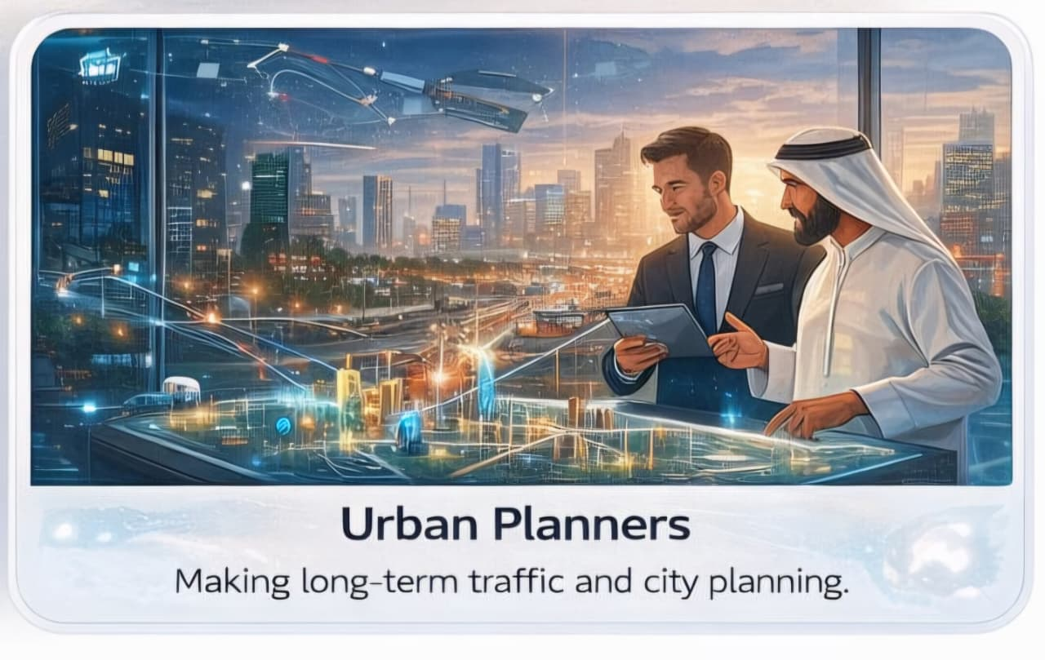

End user of project

Slide 25
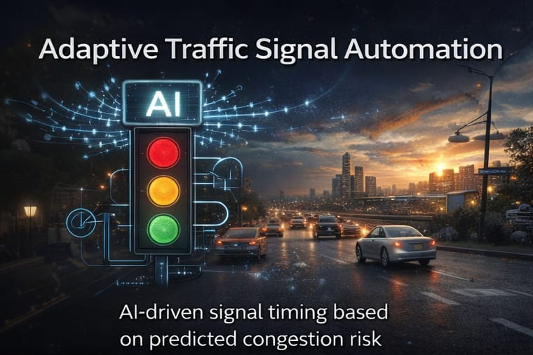
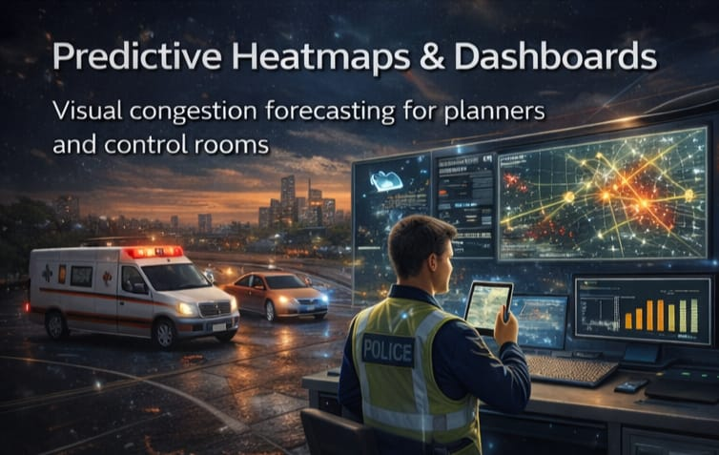
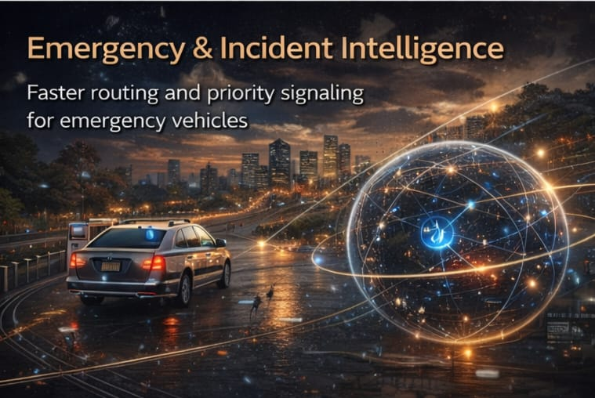
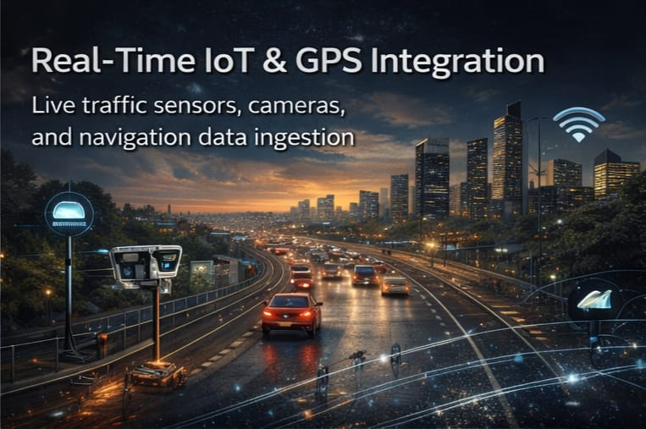
Future Scope
Adaptive Traffic Signal Automation
AI-driven signal timing based on predicted congestion risk.
Real-Time IoT & GPS Integration
Live traffic sensors, cameras, and navigation data ingestion.
Predictive Heatmaps & Dashboards
Visual congestion forecasting for planners and control rooms.
Emergency & Incident Intelligence
Faster routing and priority signaling for emergency vehicles.
Multi-City Smart Deployment
Scalable rollout across cities with shared learning models.
·

Slide 26
Git Hub Link
https://github.com/goutham-debug/AI-Driven-Early-Warning-System-for-Traffic-Congestion-Hotspots
Contents of GitHub are:
📄 Project Documentation (Problem Statement)
📊 Presentation Slides
🎥 Complete Working Demo Video
📘 README (Architecture, Setup, Workflow Explanation)
👥 Team Credentials & Certifications

Slide 27
References
P. Jiang, Congestion prediction of urban traffic employing SRBDP
S. Patil et al., “AI-Based Traffic Congestion Prediction for Smart Cities Using Artificial Neural Network,” Journal of Information Systems Engineering and Management, 2023.
Available: https://jisem-journal.com/index.php/journal/article/view/5934
A Review of Traffic Congestion Prediction Using Artificial Intelligence,” Wiley Online Library.
Available: https://ouci.dntb.gov.ua/en/works/lDe8PLg9/
Intelligent Predictive Model for Road Traffic Congestion and Monitoring System: A Systematic Survey,” COMIEN Journal.
Available: https://comien.org/index.php/comien/article/view/8

Slide 28


