Slide 1
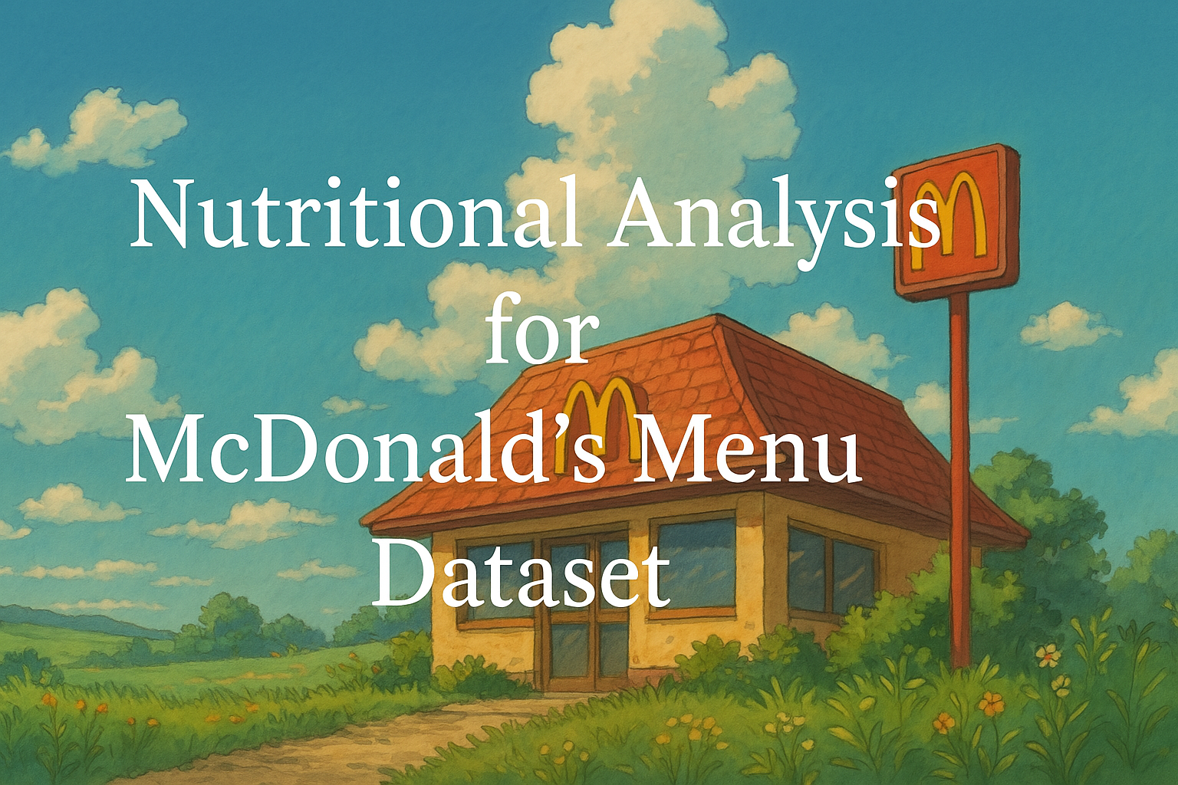

Slide 2
Introduction
This project focuses on analyzing the nutritional values of McDonald’s menu items using the provided dataset.
Preprocess and clean the dataset
Visualize key nutritional insights
Recommend strategies to encourage healthier menu choices

Slide 3
Data Preprocessing Techniques for Nutritional Analysis
Outlier Detection: Used Interquartile Range (IQR) to identify extreme values in the dataset.
IQR Calculation: Determined Q1, Q3, and IQR to establish upper and lower bounds for calorie values.
Outlier Handling: Applied Capping Method to replace extreme outliers with the nearest valid boundary. ensuring a more balanced dataset without losing important information.
Data Normalization: Ensured that calorie values remain within a reasonable range to maintain dataset integrity.

Slide 4
McDonald's Nutritional Dataset Overview
Category Count:
The dataset includes 9 unique food categories, such as Breakfast, Chicken & Fish, Salads, Beverages, and Desserts.
Menu Items:
It contains 260 individual menu items, each associated with detailed nutritional values.
Nutritional Features:
There are 14 nutritional attributes including Calories, Total Fat, Sodium, Carbohydrates, Protein, and Sugars.
Analysis Purpose:
This dataset is useful for health-focused analysis, menu optimization, and creating data-driven visual dashboards.

Slide 5
Visualizations Using Power BI:
Overview Dashboard – Displays total menu items and key nutritional statistics.
Caloric Analysis – Uses bar charts, pie charts, and heat maps to show calorie distribution.
Beverage Contribution – Compares sodas, coffees, and other beverages' impact on calorie intake.
Nutritional Comparisons – Evaluates grilled vs. crispy chicken and egg whites vs. whole eggs.

Slide 6
Strategic Recommendations:
Customer Awareness: Implement clear menu labeling to highlight key nutrients like calories and sodium.
Visual Aids: Use traffic light indicators (Green: Healthy, Yellow: Moderate, Red: High) to assist in decision-making.
Health-Focused Initiatives: Offer meal recommendations based on dietary preferences like low-carb or high-protein diets.
Menu Optimization : Introduction healthier alternatives, adjust portion sizes, and optimize combo meals for balanced nutrition

