Slide 1



Business Management & Your Future Career

Slide 2

Business management is the coordination and organization of business activities. Business managers oversee operations and help employees reach their top productivity levels. A business manager may also supervise or train new employees, help a business reach its operational and financial objectives.
What does your job include as a business manager?

Slide 3
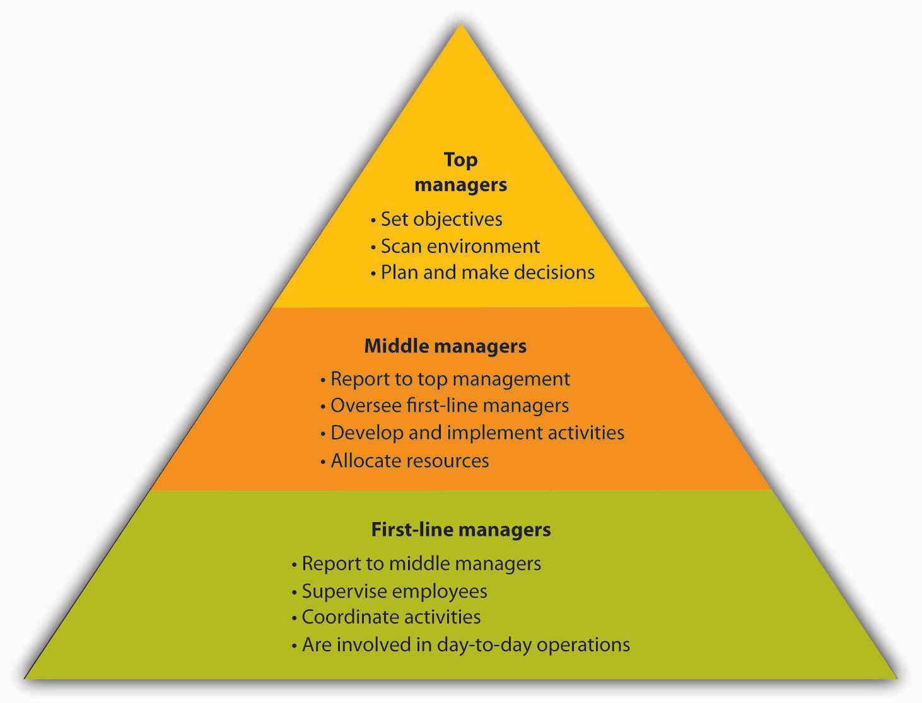
Levels of management

Slide 4
NATURE OF MANAGEMENT
UNIVERSALITY
SOCIAL PROCESS
PURPOSEFUL
INTANGIBLE
COORDINATION
CREATIVITY
DYNAMIC FUNCTION

Slide 5
SCOPE OF MANAGEMENT
FINANCIAL MANAGEMENT
MARKETING MANAGEMENT
PERSONNEL MANAGEMENT
PRODUCTION MANAGEMENT
OFFICE MANAGEMENT

Slide 6
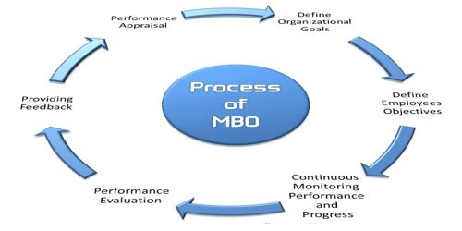

Slide 7
TIPS FOR EFFECTIVE MANAGEMENT Career
Communication is the key to successful management; if you want to successfully achieve an organization’s targets, you must communicate the overall needs and expectations with your team
Management is a continuous process; there will be times when you need to assess your team’s skills and train them to foster growth and professional development
Everyone should be on the same page when it comes to accomplishing common objectives
The primary objective of management is to achieve goals; you need to be goal-oriented and have measures in place to track
Management isn’t easy and there will be plenty of roadblocks and setbacks that may obstruct your progress; a positive mindset helps deal with challenges more effectively

Slide 8
Thank YOU!

