Slide 1


BRANDING
to improve your Job capacity

Slide 2
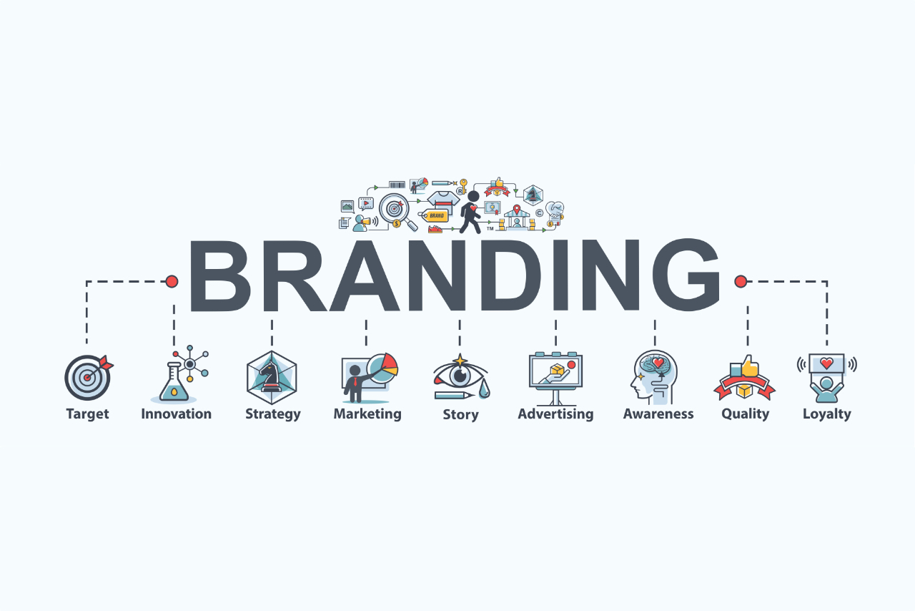
What is branding?
Branding is the marketing practice of actively shaping your brand. That’s the basic definition, but there is so much more that goes into it.
Branding is what your business needs to break through the clutter and grab your ideal customer’s attention. It’s what transforms first-time buyers into lifetime customers and turns an indifferent audience into brand evangelists. It’s what you need to stand out, make an impact and take your business to the next level.

Slide 3
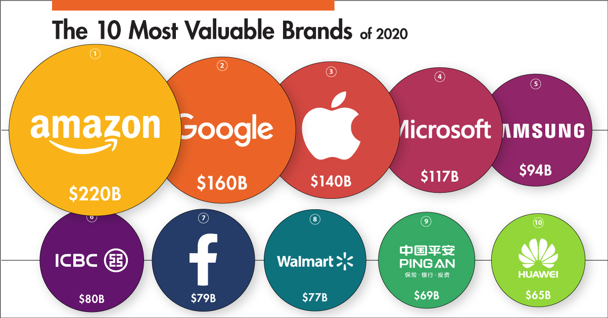

Slide 4
TOP ADVANTAGES OF A STRONG BRAND EQUITY
Ease of Recognition
Creating Emotional Connections with the Customers
Armoring against negative exposure
Developing Credibility for New Product or Service Introductions
Better Negotiating Power

Slide 5
WAYS TO COMMUNICATE YOUR BRAND TO CUSTOMERS
Showcase your brand in the real world.
Set clear, broad brand guidelines.
Create cohesive online and offline experiences.
Offer self-service opportunities.

Slide 6
BRAND POSITIONING
Is defined as the way you differentiate yourself from your competitors and how consumers identify and connect with your brand. It’s comprised of the key qualities and values that are synonymous with your company.
The positioning of your brand helps inform consumers why they should choose you over your competitors and is one of the few things you can completely own about your company.

Slide 7
A successful positioning tactic is usually based on the 4 C's:
Clarity: You must have a clear vision of the product and the target market.
Consistency: Your message must be consistent through all aspects of the product.
Credibility: The image that you project must be credible. For example, Toyota could never be seen as a luxury car because of their image, that is why they chose a different name for their more expensive car line; Lexus.
Competitiveness: You must offer something unique that your competitors can't. For example, the iPod was not only a great mp3-player, but the ability to download music from the iTunes Store gave it a huge advantage in the digital music industry.
Drawing a perceptual map of your competitors can help you position your product successfully.

Slide 8


AN EXAMPLE OF STRONG BRAND POSITIONING AND WHY THEY WORK
NIKE
Nike started their product with a focus on performance and innovation. They invented the waffle shoe and built their brand targeting serious athletes. Their product offerings have now moved beyond shoes, and they offer athletic attire that enhances performance.
Their branding and messaging focuses on empowerment, from their tagline “Just Do It” to their namesake, the Greek Goddess of Victory. Their models and athletes aren’t smiling and happy, they’re doing physical activities with their game faces on.
Nike’s brand is focused on the concept of innovation for serious athletes to help you perform at your best every single time.

Slide 9
THANK YOU!

