Slide 1

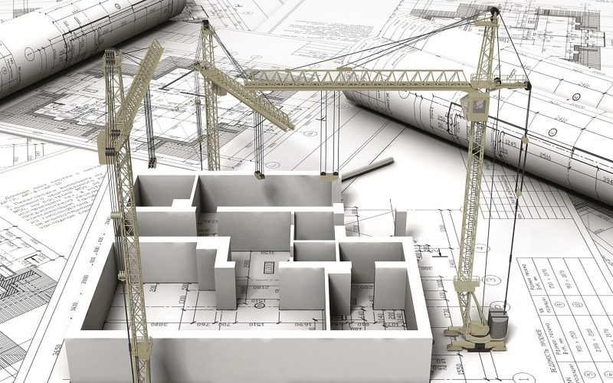
ARCHITECTURE ENGINEERING

Slide 2
Introduction
Architectural engineering, also known as building engineering, is the application of engineering principles and technology to building design and construction.
Architectural drafting and designing services are considered as one of the most important sections of ar4chitectural engineering.
Architectural engineer in the structural, mechanical, electrical, construction or other engineering fields of building design and construction.

Slide 3
Architectural Engineer Responsibilities:
Designing, analyzing, and altering plans, prototypes, or structures.
Ensuring building plans, prototypes, and structures are operating safely, efficiently, and reliably.
Assisting team members with project objectives, budgets, and timelines.
Establishing project goals.
Identifying and solving problems in building plans, prototypes, and structures.
Ensuring building systems are functional, reliable, and safe.
Participating in site visits.
Testing and evaluating building systems to find problems and improvements.
Reading, interpreting, and explaining complex technical documents.
Consulting with clients on building projects.

Slide 4
Architectural engineering jobs
Engineering technician
Draftsman
Production supervisor
Mechanical designer
Manufacturing engineer
Architectural project manager
Civil engineer

Slide 5
Advantages of Working as an Architect
You may be able to travel the world
Architects don’t work many extra hours
You have free weekends and holidays
Architects have decent work-life balance
Healthy mix between office work and hands-on work
Architects can work indoors most of the time
You can be creative as an architect
Architects don’t have to do heavy physical work
Working as an architect can be interesting
Can help you for your own life
You can help out your family and friends
Teleworking may be possible

Slide 6



The 3 Best Works of Architecture in Dubai

