Slide 1


WRITING AN EFFECTIVE RESUME
Your resume describes your qualifications and what makes you unique.

Slide 2
Your Resume Questions
What is a Resume?
A resume tells a potential employer . . .
Why do I need a resume?
How can a resume help me?
When and how do I use a resume?

Slide 3
Resume Sections
Personal Information
Education
Work Experience
References
Other
Skills/Training
Awards or Achievements
Leadership Experience

Slide 4
Top 5 Resume Writing tips
Be strategic
Keep it consistent
Include a variety of experiences
Think like an employer
Keep it visually balanced

Slide 5
The Main Steps In Writing An Efficient Resume
Pick the Right Resume Format & Layout
Mention Your Personal Details & Contact Information
Use a Resume Summary or Objective
List Your Work Experience & Achievements
Mention Your Top Soft & Hard Skills
(Optional) Include Additional Resume Sections - Languages, Hobbies, etc.
Tailor Your Information For the Job Ad
Craft a Convincing Cover Letter
Proofread Your Resume and Cover Letter

Slide 6
Resume Do’s and Dont’s
Do Highlight Relevant Experience
Don’t Mention Anything Controversial
Do Show Your Career Progress and Advancement
Don’t Highlight Irrelevant Information
Do Rely on Common, Everyday English
Don’t Add Details that Could Spark Bias or Discrimination

Slide 7
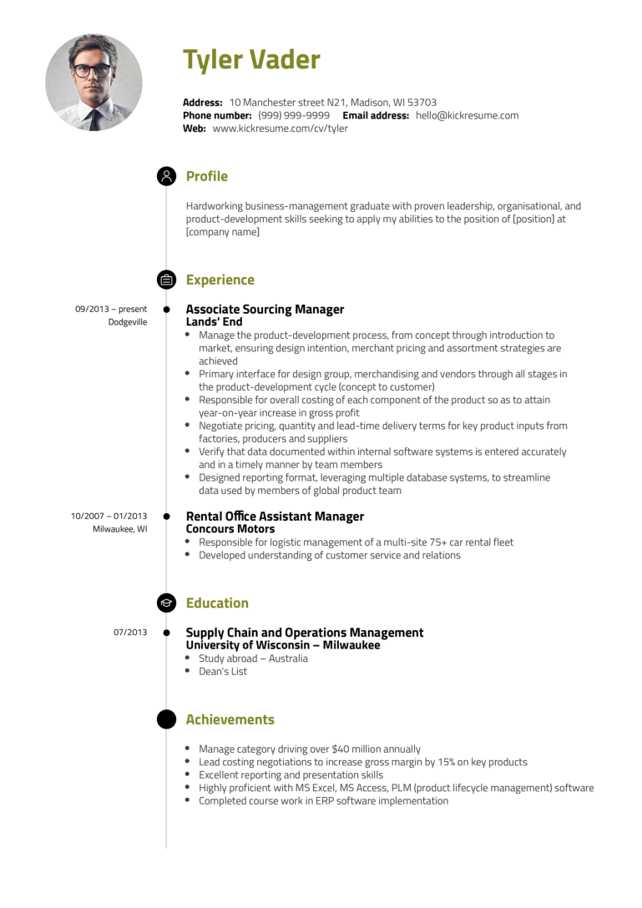
Operative Resume sample

Slide 8
References
Include References
Former teachers or professors
Work supervisors
Professional colleagues
Contacts from work-related
associations or volunteer work
Include Contact Info
Phone number
Email
Address

Slide 9
Resume Blunders
“I am an extremely fast leaner”
“Instrumental in ruining entire operation for a Midwest chain store”
"I am a rabid typist“
“Received a plague for Salesperson of the Year“
“Dramatically increased exiting account base, achieving new company record”
“Seeking a party-time position with potential for advancement”
“Consistently tanked as top sales producer for new accounts”

Slide 10
THANK YOU!

