Slide 1



Why NIH Clinical Research Matters
Your Name Here
Title

Slide 2
NIH Clinical Research
What is it?
  It is medical research that involves people like you
Why does it matter?
  It is essential to public health, it drives medical discovery and, reduces the burden of disease and illness
How can you get involved?
  You can learn lots more on the new NIH website http://clinicalresearchtrials.nih.gov
Notes:
Clinical trials are part of clinical research and at the heart of all medical advances. Clinical trials look at new ways to prevent, detect, or treat disease. There is testing of new drugs or new combinations of drugs, new surgical procedures, or new ways to use existing treatments. The goal of clinical trials is to determine if a new test or treatment works and is safe. Clinical trials can also look at other aspects of care, such as improving the quality of life for people with chronic illnesses.
People participate in clinical trials for a variety of reasons. Healthy volunteers say they participate to help others and to contribute to moving science forward. Volunteers also participate to help others, but also to possibly receive the newest treatment and to have the additional care and attention from the clinical trial staff. Clinical trials offer hope for many people and an opportunity to help researchers find better treatments for others in the future.

Slide 3
Awareness of Clinical Research
First step is to regularly have the public think about participating and consider how they can help advance medical discovery
One of the major barriers to recruitment to clinical research trials is a lack of awareness of the opportunity to participate both by the patient and the physician
Notes:
Having the public aware of the concept and importance of clinical research is key to supporting discussions with physicians about considering participation.

Slide 4
Studies Indicate that Awareness Changes Attitudes
32% of adults indicate they would be very willing to participate in a clinical trial if asked (1)
28% indicated they would consider it, but had some reservations (1)
Focus groups found that many lack familiarity with clinical trials. They generally expressed negative attitudes about participation. These attitudes significantly changed after learned more (2)
Comis, 2003, NIH FG report 2011
Notes:
Today, the lack of public awareness and knowledge about clinical research trials are among the greatest challenges to recruiting volunteers.

Slide 5
Why is NIH Focusing on Educating the Public on this topic?
Estimates suggest that upwards of 80% of clinical research studies struggle with the need to find more participants (3)
Up to 20% of some clinical trials close due to lack of participation (4)
Groundbreaking medical advances will only happen through clinical research participation
Recent national reports have strongly urged the NIH to engage the public in support of clinical research
CISCRP.org, Chang, 2011
Notes:
Clinical research is vital to the National Institutes of Health (NIH) mission of enhancing public health, lengthening life, and reducing the burdens of illness and disability. Only through clinical research do we gain insights and answers about the safety and effectiveness of drugs and therapies. However, low volunteer participation in these trials cause critical medical advances to slow or to stall all together.

Slide 6
Health Care Providers are Key
75% of patients will enroll in a trial when asked to by their health care provider
32% of patients in clinical trials said that their health care provider took the time to answer all their questions
Participating patients were more likely to have first learned about a clinical trial through their health care provider
Notes:
Health care providers play an important role in raising awareness about the option of clinical trial participation. By having a focused conversation about treatment options including clinical trials, a patient can be made aware of, and invited to enroll a clinical research study.

Slide 7
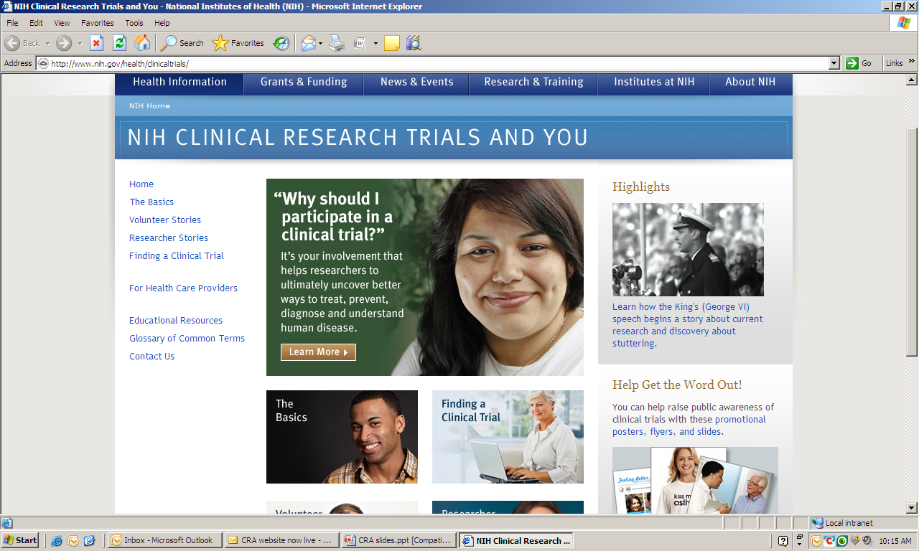
Notes:
This is the homepage for the new educational site. The left column lists the content for the site. These correspond to the categories in the center. And on the right column.

Slide 8
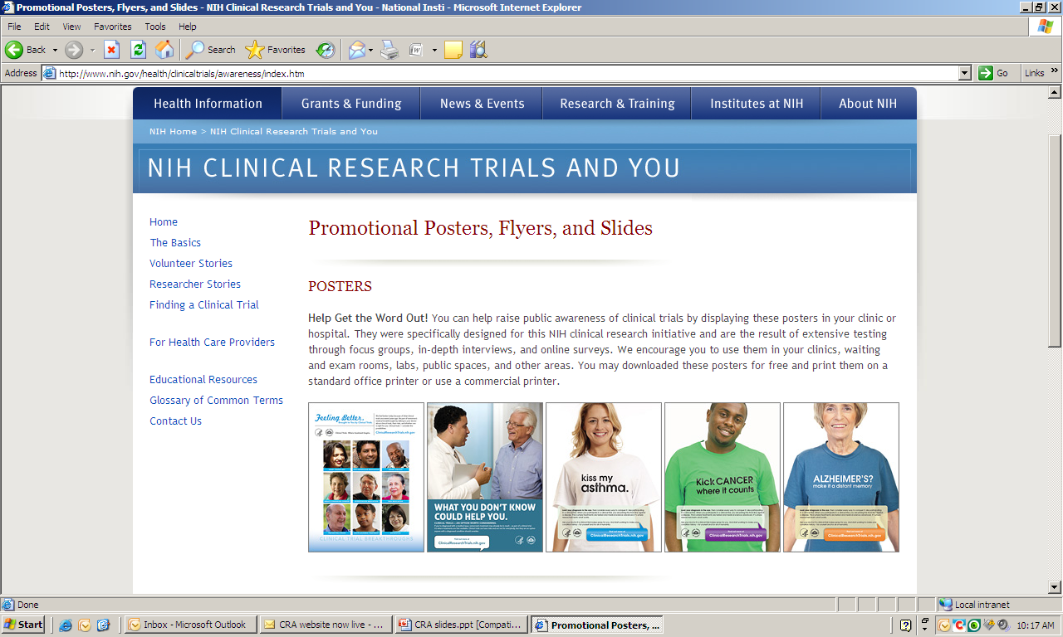
Notes:
You can help raise public awareness of clinical trials by displaying these posters in your clinic or hospital. They were specifically designed for this NIH clinical research initiative and are the result of extensive testing through focus groups, in-depth interviews, and online surveys. We encourage you to use them in your clinics, waiting and exam rooms, labs, public spaces, and other areas. You may download these posters and flyer and print them on a standard office printer or use a commercial printer.
There is a power point slide set to educate patients and fellow professionals about the importance of clinical research.
Finally, we have included a newsletter article, that you can customize to your needs, that will further promote clinical research.

Slide 9
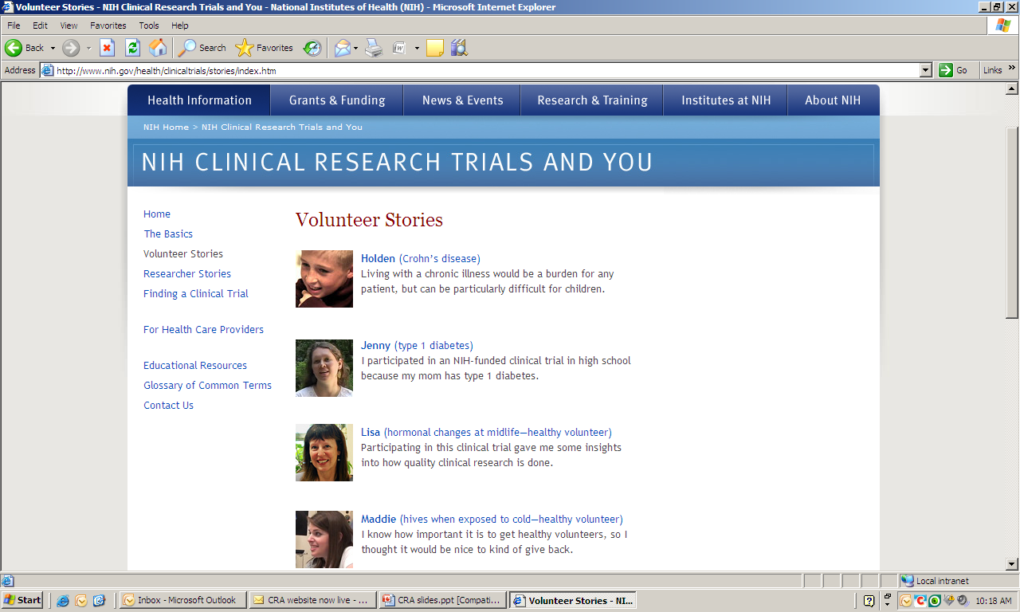
Notes:
The concept of research volunteer stories is very popular with our user-testing. Hearing the research volunteer talk about why they decided to participate and what that participation meant to them can be helpful for others considering the idea of a clinical trial.

Slide 10
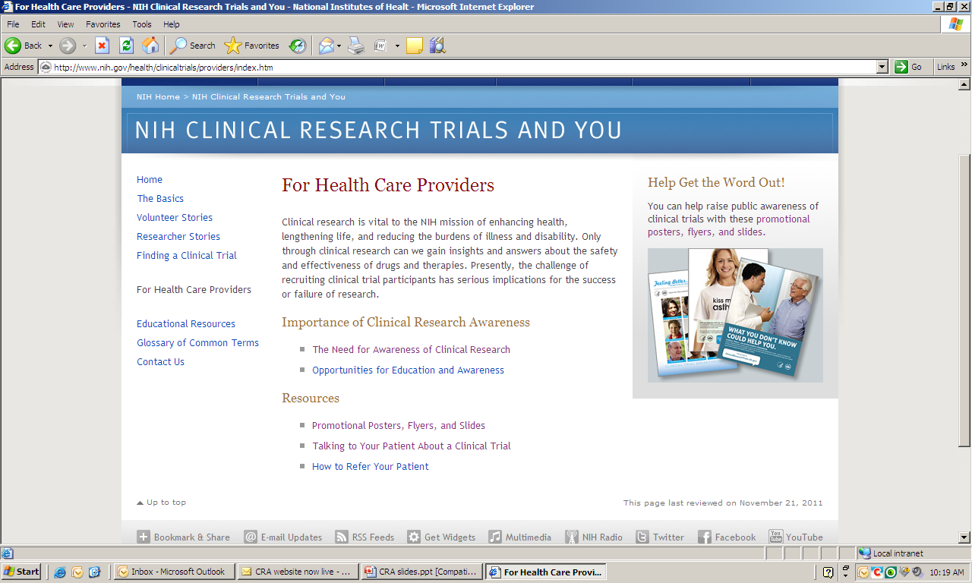
Notes:
The majority of volunteers entering a trial do so because of an invitation by a health care provider. This site wants to support that conversation by providing background information about clinical research as well as evidence-based tips on how best to talk with a potential volunteer about a trial.

Slide 11
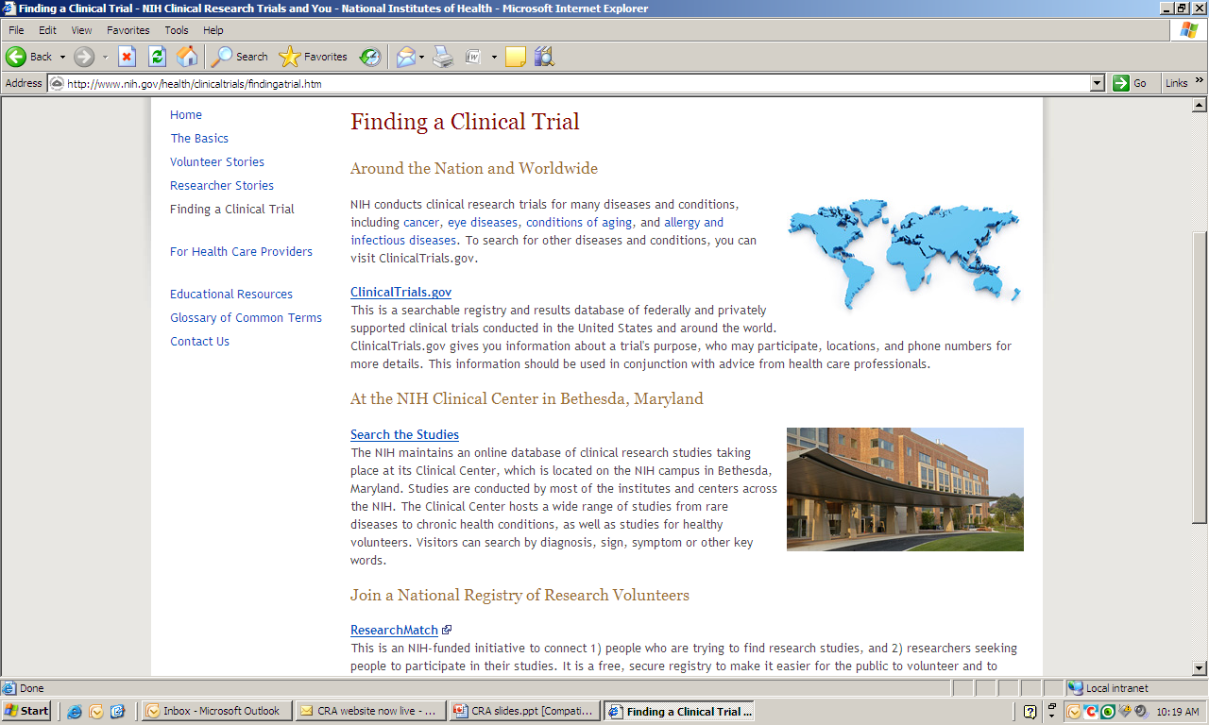
Notes:
The heart of this site is the ability for users to actually find a clinical trial that is appropriate for them. Clinicaltrials.gov is the site that houses all the NIH-funded trials. There are many ways to structure the search and instructions are provided.

Slide 12
Use this Helpful Site to
Educate patients, health professional colleagues, and community audiences about clinical research and opportunities for participation
Display the audience-tested posters in your office waiting room, exam rooms, and your institution
Add any of these slides to your presentations
Contact us with suggestions for other ways to promote clinical research
Notes:
Here are some of the many ways that you can use this site for education of the public, patients, and health care providers. Please click on the “Contact us” tab to tell us of other ideas you may have for clinical trial education for these audiences.

Slide 13
http://Clinicalresearchtrials.nih.gov
Notes:
URL for the site

Slide 14
References
1. Comis R, Miller J, Aldige C, Krebs L, Stoval E. Public attitudes toward participation in cancer clinical trials. J Clin Oncol. 2003; March; 21(5); 830-35
2. Pretesting NIH clinical trial awareness messages: A focus study with patients, caregivers, and the general public. Bethesda, MD: National Institutes of Health, April, 2011
3. Center for Information and Study of Clinical Research Promotion (CISCRP) website: CISCRP.org
4. Cheng SK, Dietrich MS, Dilts DM. Predicting accrual achievement: monitoring accrual milestones of NCI-CTEP-sponsored clinical trials. Clin Cancer Res. 2011 Apr 1;17(7):1947-55

Slide 15



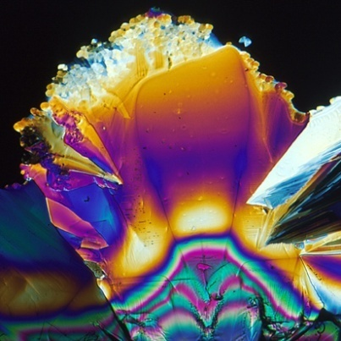
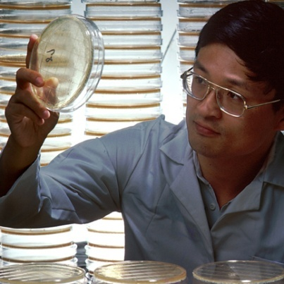
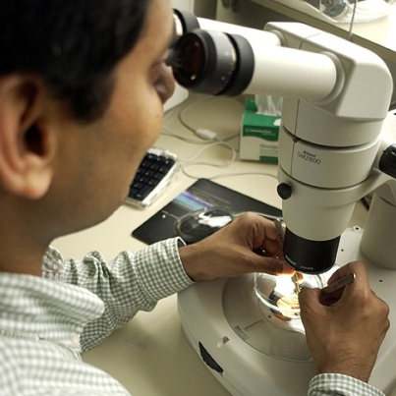
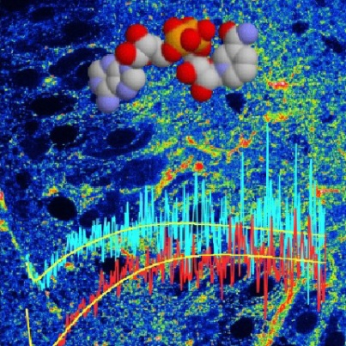
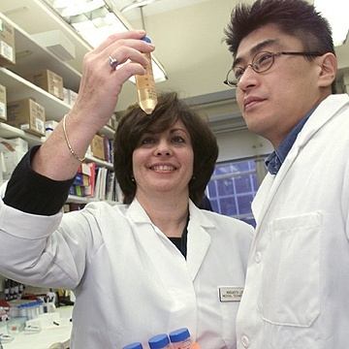
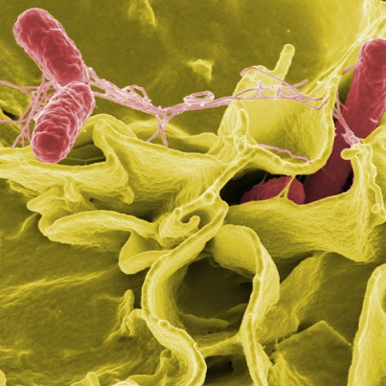
NIH
Turning Discovery Into Health

