Slide 1
PROCESS CONTROL AND AI APPLICATIONS : CHL4020
FEEDBACK CONTROL OF A CHEMICAL REACTOR USING PID CONTROLLER
By Group -02
Devang Dobliyal (B21CH007)
Harsh Raj (B21CH008)
Jahnavi Pandey (B21CH010)
Kachhawa Goutham (B21CH011)
PAGE 01

Slide 2
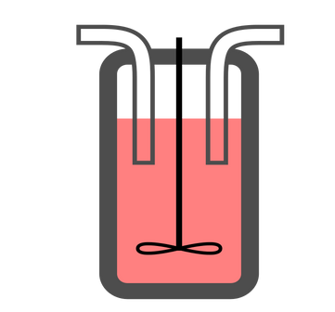

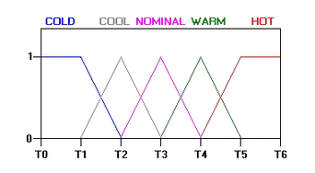
CSTR (Continuous Stirred Tank Reactor)
REACTOR:
CONTROL VARIABLE:
Temperature
#AD6237
CONTROLLERS USED:
PID Controller
Fuzzy Controller
PAGE 02

Slide 3
Motivation
The Continuous Stirred Tank Reactor (CSTR) control problem is particularly controversial due to its non-linear dynamics.
Increasing energy costs are driving the need for thermally integrated processes.
safety measures to prevent the issues in the chemical plants are important in ensuring the plant’s normal operation.
There is a critical need for advanced control systems in industrial processes.
Fuzzy logic offers low computational cost and flexibility in handling complex non-linear issues, providing approximate reasoning over traditional crisp assumption models in real-world applications.
PAGE 03

Slide 4
Previous Attempts
1950
Initial efforts in developing mathematical models for process control, focusing on mass and energy balance.
1960
Introduction of control strategies based on non-linear models.
1970
Implementation of PID control systems and the advent of adaptive control techniques.
#AD6237
Emergence of advanced control methodologies including neural networks, fuzzy logic, and model predictive control (MPC).
1990
2010
Application of artificial neural networks (ANN) and genetic algorithms for process control optimization.
PAGE 04

Slide 5
Industrial Application
Oil and Gas: They manage flow rates, pressure, and temperatures in pipelines, refineries, and processing plants.
Food and Beverage: Temperature control in pasteurization processes and environmental conditions in fermentation processes are managed by PID controllers.
Pharmaceuticals: PID and fuzzy controllers regulate critical variables such as temperature, pressure.
Petrochemicals: PID controllers are widely used in the petrochemical industry for process control, while fuzzy controllers handle more complex and adaptive scenarios.
Plastics Manufacturing: In plastics manufacturing, PID controllers manage simple tasks, while fuzzy controllers handle complex, multivariable processes like polymerization.
PAGE 05

Slide 6
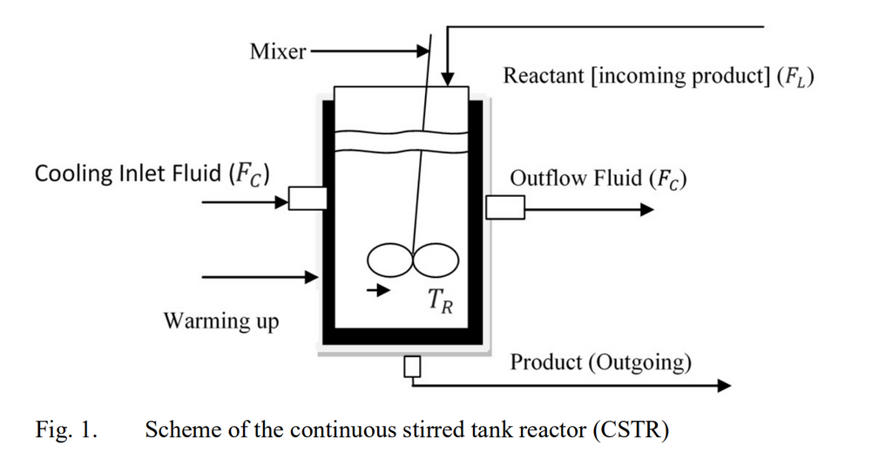
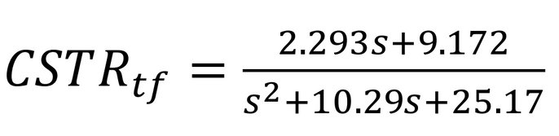
CSTR Modeling and Transfer Function
Assumptions:
It is perfectly agitated.
The mass densities of the input component and that produced are equal and identical.
The volume of liquid ܸin the reactor is kept constant.
Rate of Reaction : r = k*Ca
where k is given by equation:
K=Ko*exp(Ea/R*Tr)
.
PAGE 06

Slide 7
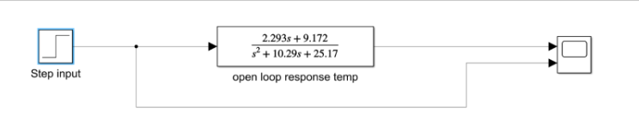
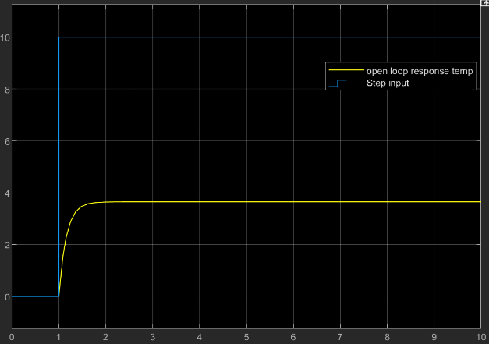
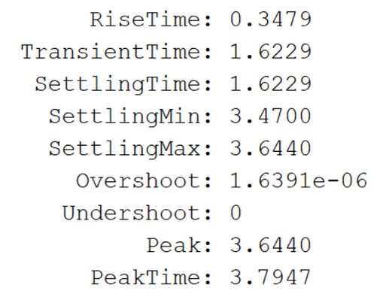
Open Loop System
Block diagram for open loop system
Results:
PAGE 07

Slide 8
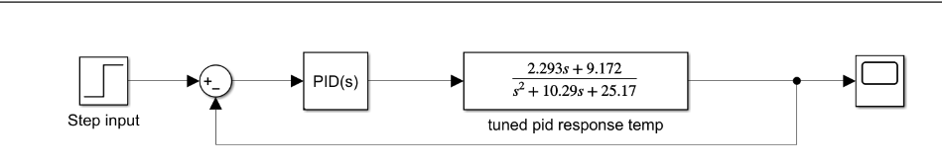
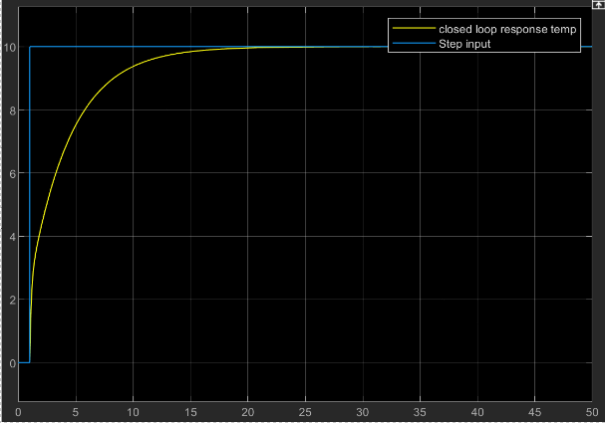
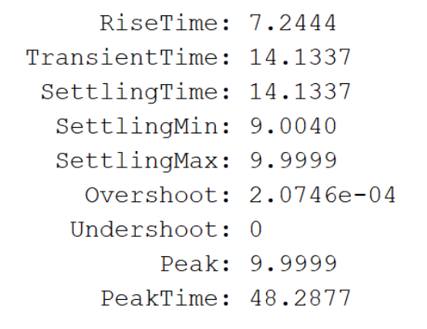
Closed loop without tuning
Block diagram for PID Controller
Parameters:
P = 1
I = 1
D = 0
Results:
PAGE 08

Slide 9
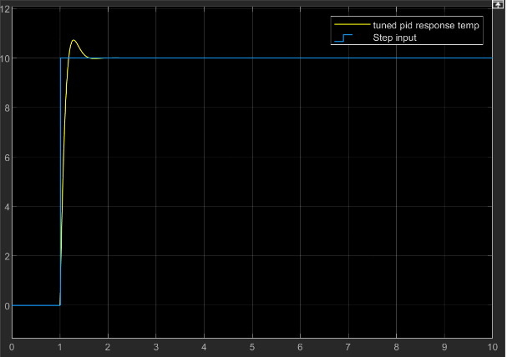
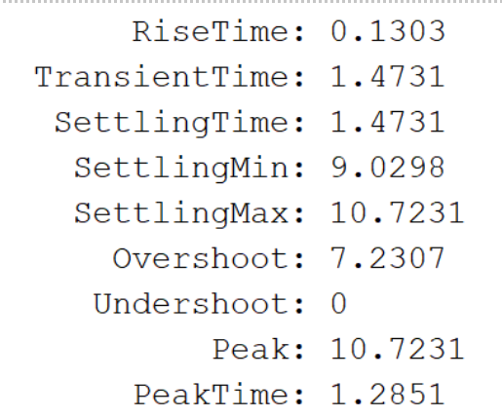
PID Controller : Auto Tuning
Tuned Parameters:
P = 4.17169602708866
I = 50.9712560094397
D = -0.00301394977236811
Results:
PAGE 09

Slide 10
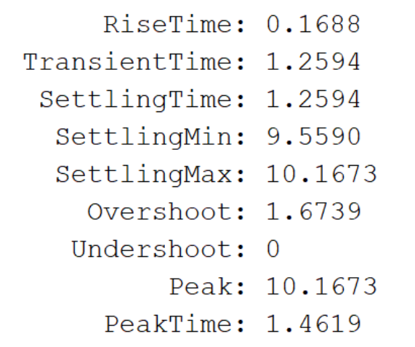
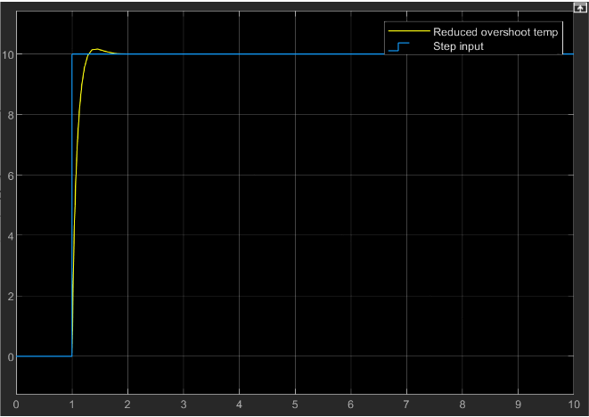
PID Controller : Re-Tuning
Results:
PAGE 10

Slide 11
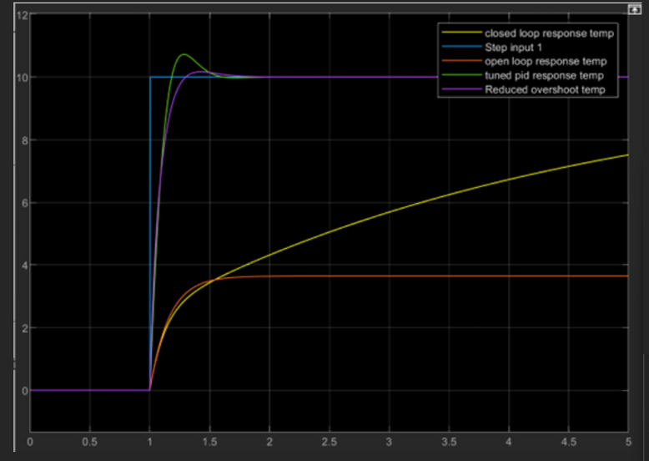
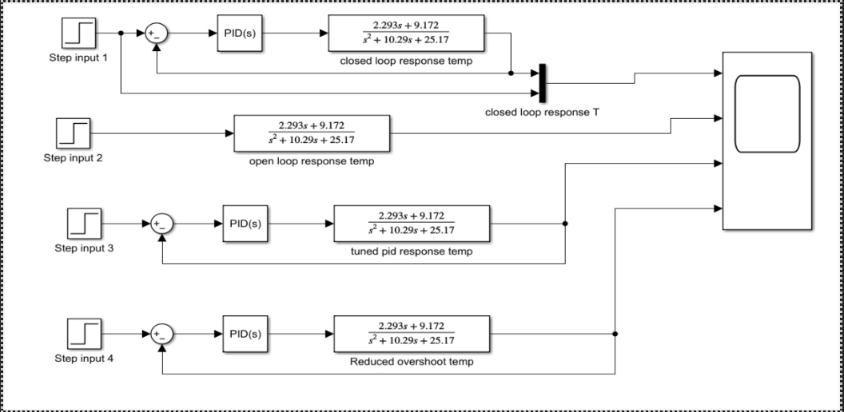
PID Controller : Comparison
Combined Block diagram
Combined Results
PAGE 11

Slide 12
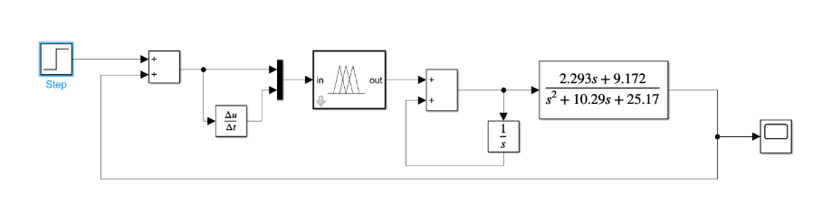
Fuzzy Controller
Block diagram for Fuzzy Controller
PAGE 12

Slide 13
Fuzzy Controller
Reduces overshoot and improves stability.
Quickens the system's reaction to sudden changes.
Predicts and responds to rate of change in errors, helping to prevent future ones.
Integrates the error over time, addressing any continuous offset that remains after the initial control actions.
Corrects steady state errors.
To improve system's accuracy
To eliminate any long-term bias in the control signal .
NEED
FOR
DERIVATIVE
NEED
FOR
INTEGRATOR
PAGE 13

Slide 14
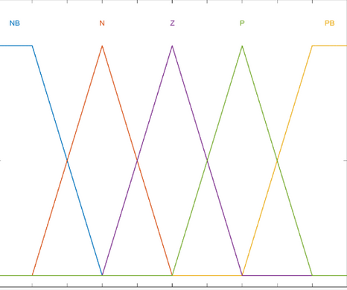
Fuzzy Controller : Member Functions
What is Member Function?
A membership function in fuzzy logic quantifies the degree of membership of an input value to a specific fuzzy set.
Membership degree ranges from 0 to 1, with 0 indicating no membership and 1 indicating full membership.
Values between 0 and 1 represent partial membership, reflecting partial alignment with the set's characteristics.
Triangular membership functions are commonly used due to their simplicity and ease of interpretation.
The triangular membership function is represented by a triangular shape.
It is defined by three parameters: 'a', 'b', and 'c', representing the minimum, peak, and maximum values of the fuzzy set, respectively.
The 'b' parameter indicates the center point or peak of the fuzzy set.
PAGE 15

Slide 15
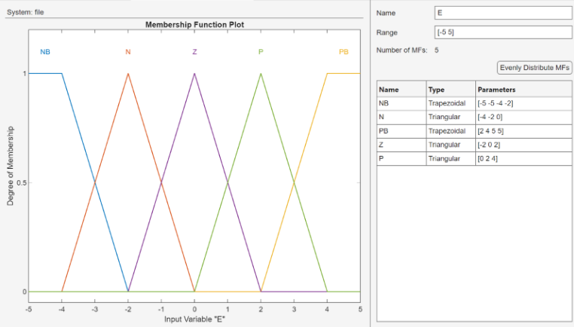
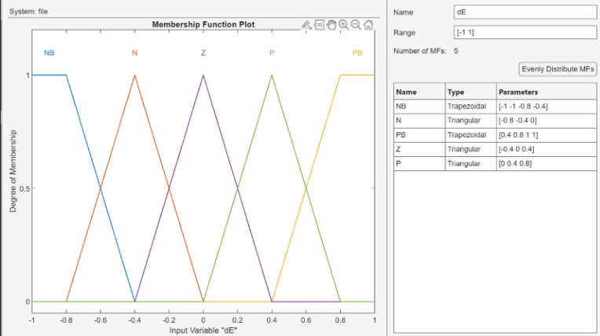
Fuzzy Controller : Member Functions
Input : E , dE
PAGE 16

Slide 16
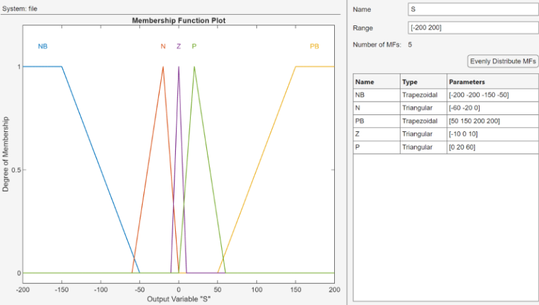
Fuzzy Controller : Member Functions
Output : S
PAGE 17

Slide 17
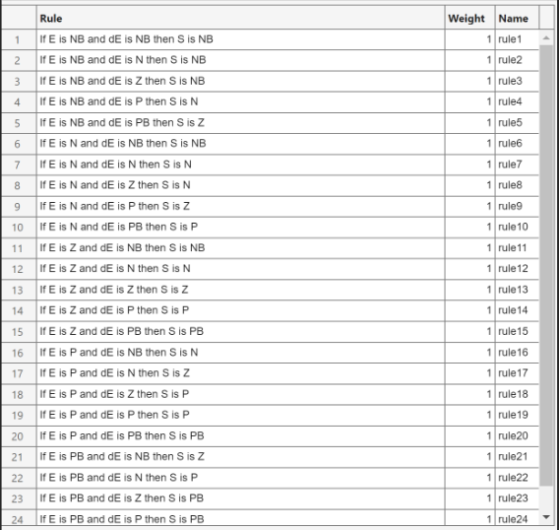
Fuzzy Controller : Rules
Define input and output variables and their linguistic terms.
Create IF-THEN rules based on expert knowledge or data analysis.
Convert crisp inputs to fuzzy sets using assigned membership functions (fuzzification).
Evaluate rules based on current fuzzy input values (fuzzy inference).
Convert fuzzy output back to crisp values for practical application (defuzzification).
PAGE 14

Slide 18
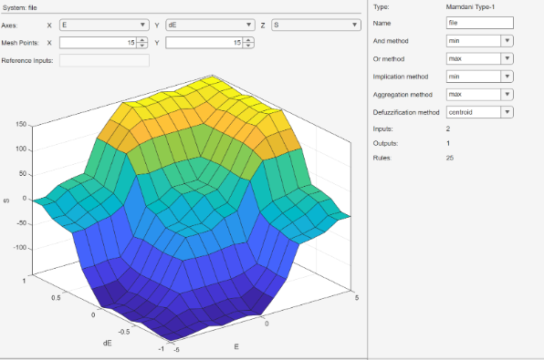
Fuzzy Controller : Control Surface
Fuzzy Control Surface
PAGE 18

Slide 19
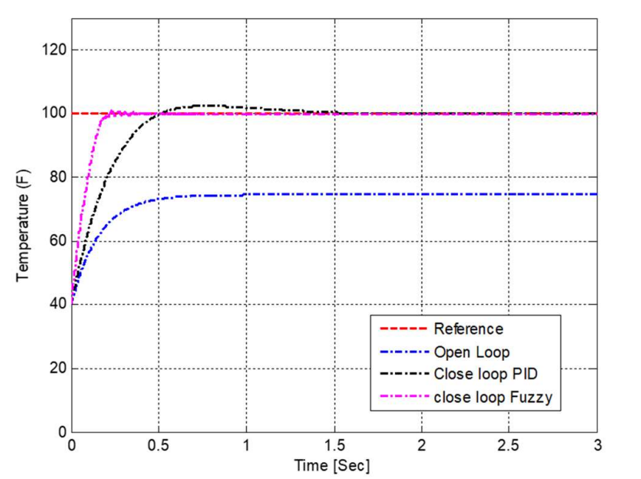
Comparison: PID vs Fuzzy
The closed loop fuzzy control provides the most accurate control with no overshoot and fast settling time.
The closed loop PID control is faster than open loop but has a slight overshoot before settling at the reference temperature.
The open loop control system is the slowest and does not reach the reference temperature.
PAGE 19

Slide 20
Comparison: PID vs Fuzzy
Criteria
PID Controller
Fuzzy Controller
Linear, model based requires a mathematical model
Model-free, based on rule sets and human reasoning
Control Logic
Parameters (P, I, D) need manual tuning
Parameters self update depending on the rules given
Tuning
Exhibits greater overshoot in comparison
Minimal to no overshoot produced
Overshoot
Robust to certain types of disturbances and uncertainties
Extremely robust, especially with high levels of uncertainty
Robustness
Relatively easy to implement in hardware and software
Can be more challenging to implement effectively
Implementation
PAGE 20

Slide 21
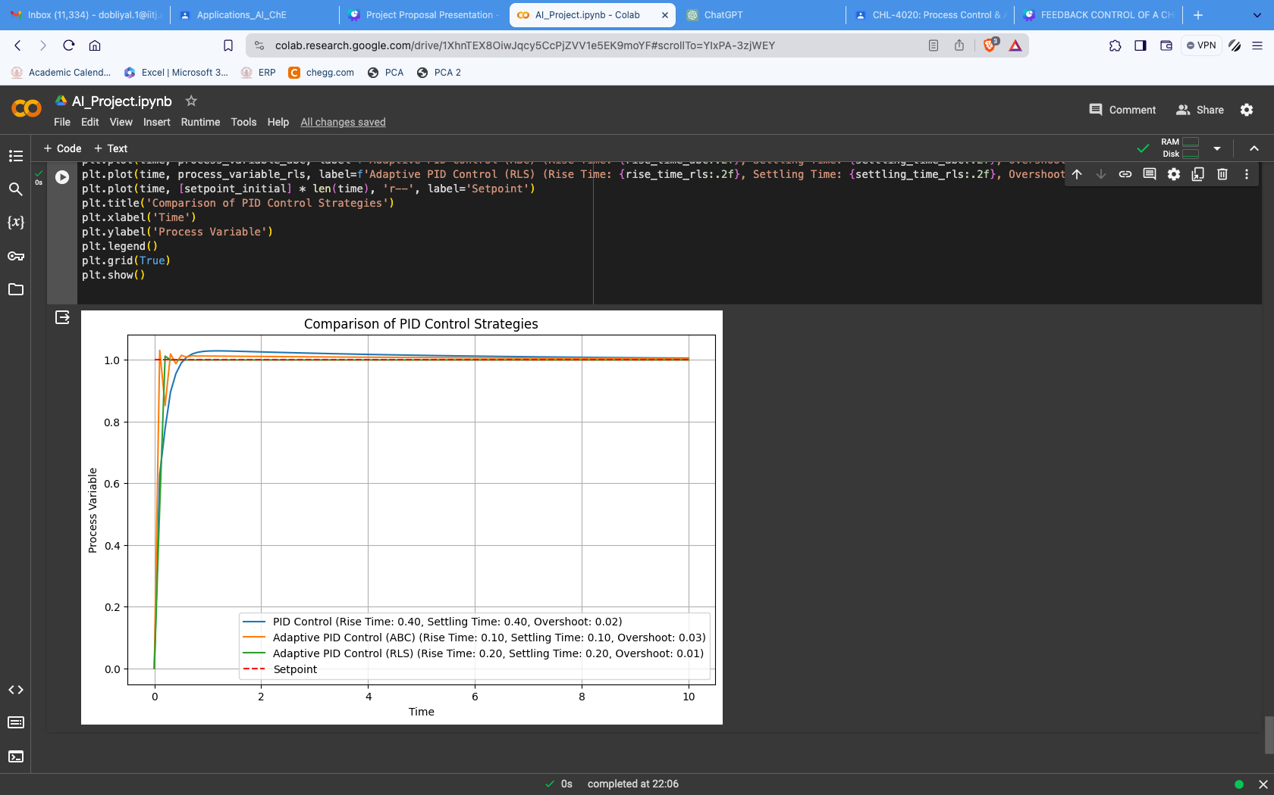
Adaptive Control Strategies Comparison
Strategies implemented :
RLS(Relative Least Square)
ABC (Artificial Bee Colony)

Slide 22
Conclusion
In comparing the performance for various adaptive strategies we can observe that the performance of RLS is best followed by ABC. Both adaptive methods outperform the traditional PID tuning method.
The developed approach has broad applicability across industries such as chemical, pharmaceutical, and biotechnology for managing the CSTR system and improving process efficiency and quality.
PAGE 24

Slide 23
Thank You
PAGE 25

