Slide 1
Mass Transfer Project MATLAB module for Finding the Number of Stages in Gas Absorption column.
Presentation By
1. Nitesh Meena (B20CH025)
2. Kachhawa Goutham (B21CH011)

Slide 2
Objective
A comprehensive source to understand absorption columns.
Create a interactive graph that shows the number of stages based on given input parameter.

Slide 3
Introduction
Gas absorption is a unit operation in chemical engineering that involves the preferential dissolution of one or more components of a gas mixture into a liquid solvent.
Key Concepts:
Mass transfer from gas phase to liquid phase
Solvent selection and optimization
Applications of Gas Absorption
Pollution Control
Gas Purification
Product Manufacturing

Slide 4
Choice of solvent for absorption
Gas solubility
Volatility
Corrosiveness
Cost
Viscosity
Miscellaneous: solvent if possible be nontoxic, non-flammable, and chemically stable and should have a low freezing point.

Slide 5
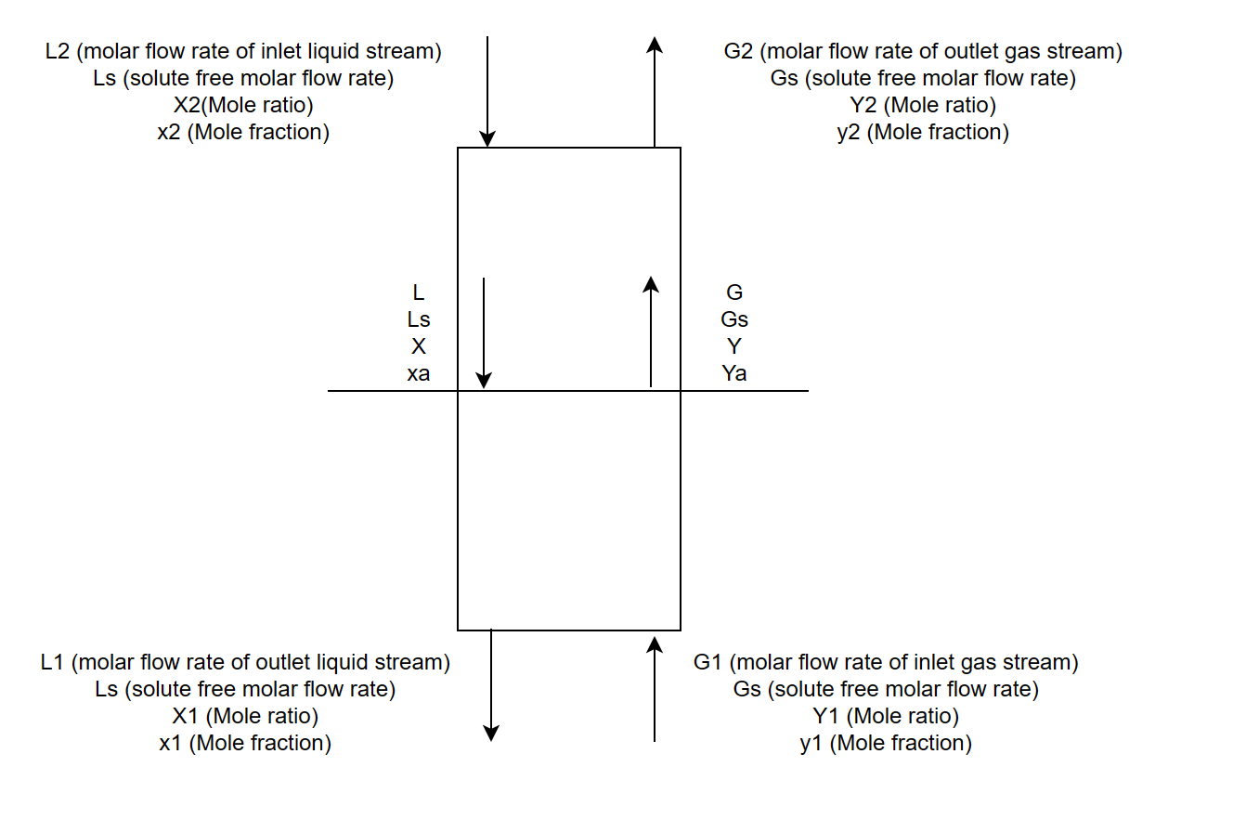

Material Balances for countercurrent flow and one component transfer
Material Balances at any point of the gas absorber column.
The above equation represent a straight line(the operating line) on X,Y coordinates.
Fig: Flow quantities for an absorber

Slide 6
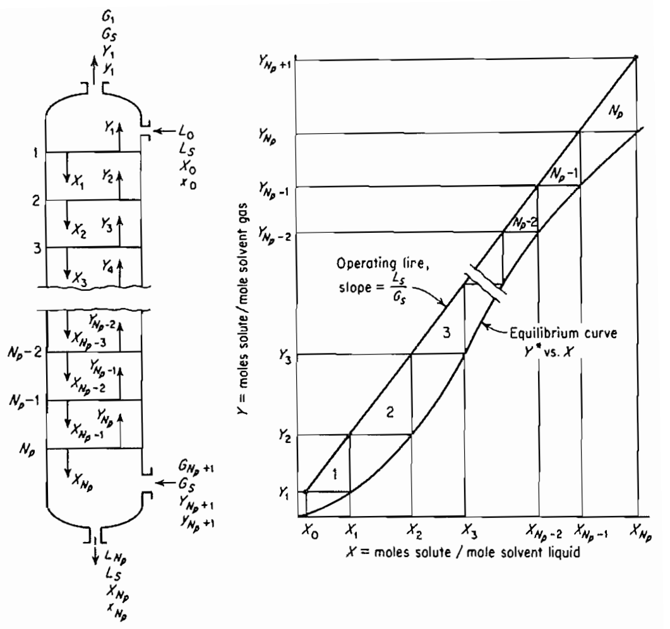
Counter current multistage operation
Stepwise contact of the liquid and gas. A tray is defines as one where the average composition of all the gas leaving the tray is in equilibrium with the average composition of all liquid leaving the tray. And the number of ideal trays requires to bring a given change in composition of the liquid or the gas can be calculated graphically.
Fig: Tray absorber

Slide 7
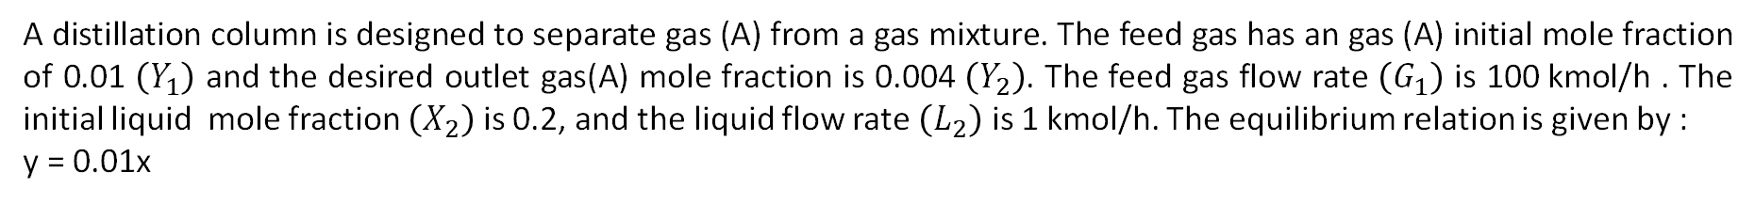
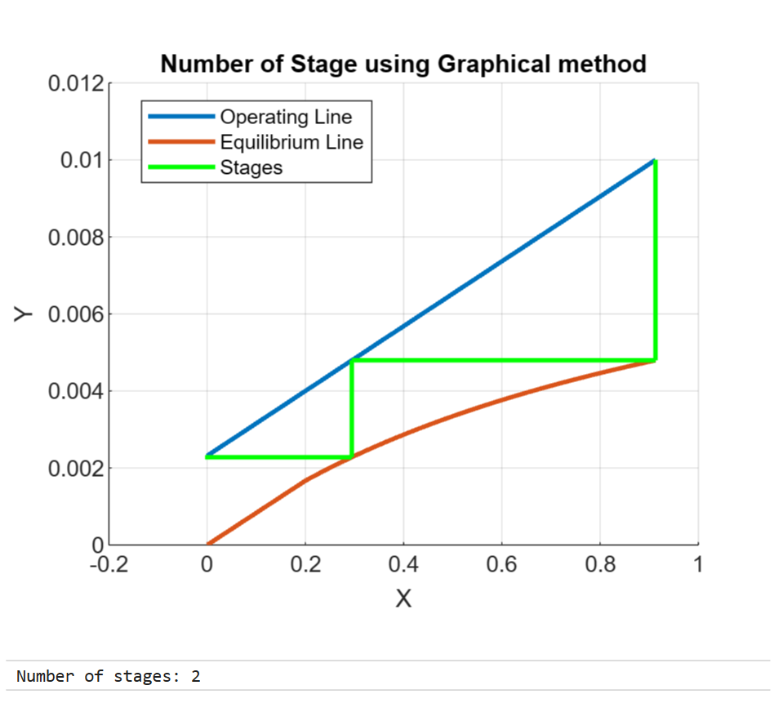




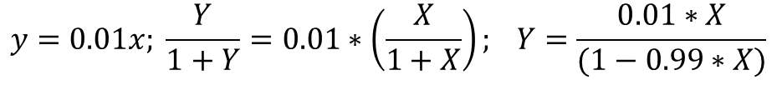
MATLAB module to calculate the Number of stages
Fig: Number of stages calculations using graph

Slide 8
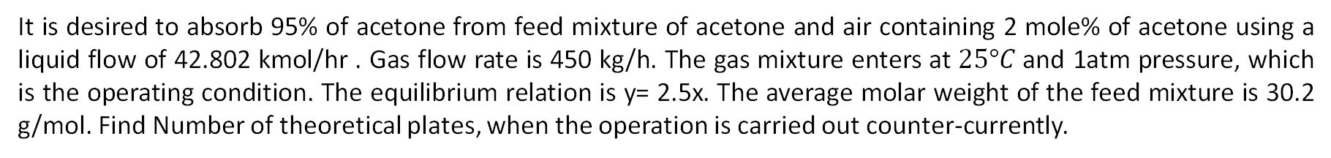
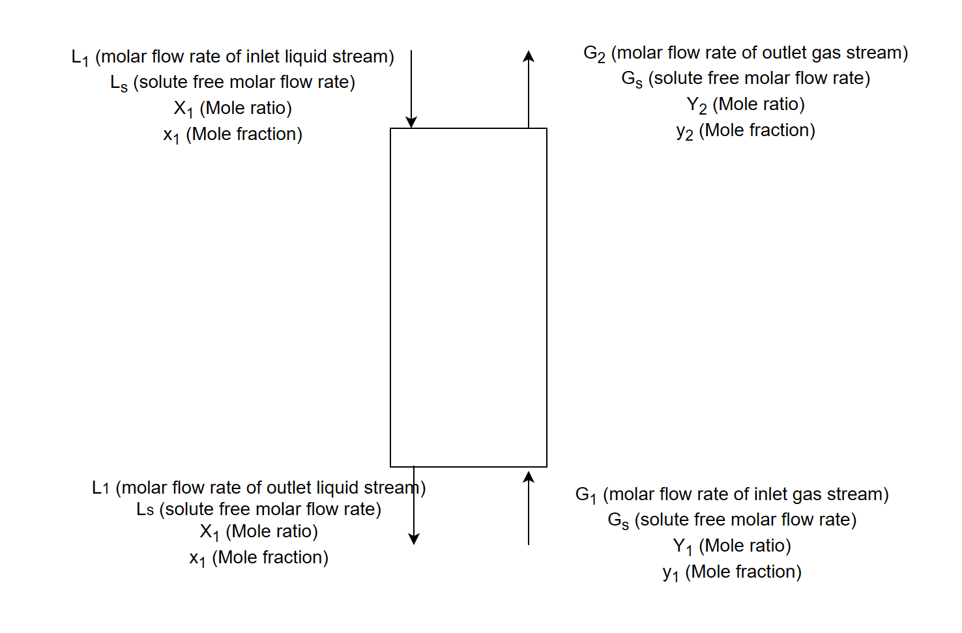


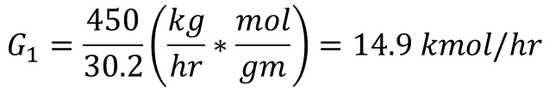

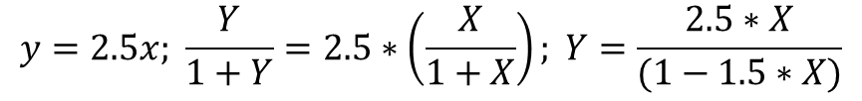

Example 2
Given data:
Fig: Notations for the given problem

Slide 9

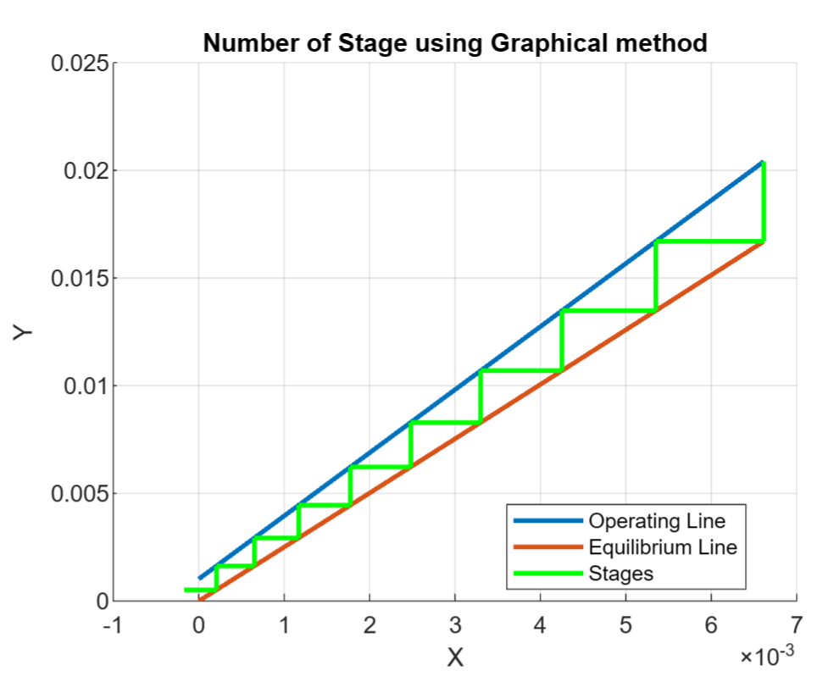
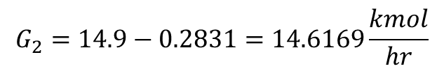



Using the values obtained:
Fig : Number of stages calculation

Slide 10
Thank You
References:
Robert E. Treybal. Gas Absorption.
Paritosh Usmanpukar
https://medium.com/@usparitosh/matlab-app-tutorial-making-an-app-for-finding-the-ideal-number-of-gas-absorber-stages-graphically-7f3e78995652

