Slide 1

Managing Interest Rate Risk
Goutham Balaraman
Financial Engineer

Slide 2
Overview
Scope
Risk management by hedging
Valuation
Careers

Slide 3
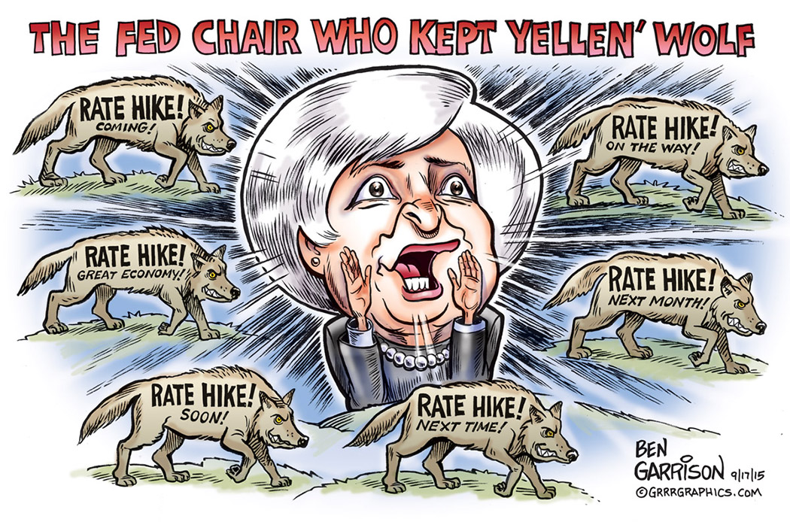

Slide 4
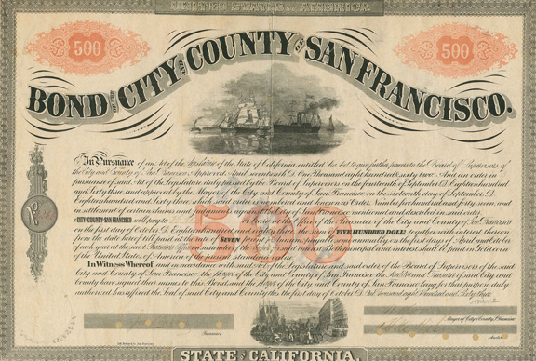
Fixed income Investors
Fixed income investments experience price fluctuations due to interest rate volatility
Price is inversely proportional to interest rates
Sensitivity of FI assets to interest rates is proportional to asset’s maturity

Slide 5

Mortgage lenders & Servicers
Lenders provide a locked in mortgage fixed rate
Lenders are exposed to the risk of rising rates before loans are closed
Servicers are exposed to the risk of losing borrowers due to prepayment

Slide 6

Small & large businesses
Lot of companies use debt for financing operations and expansion
Companies often get floating rate loans from banks and investors
Companies with floating rates are exposed to interest rate hikes

Slide 7
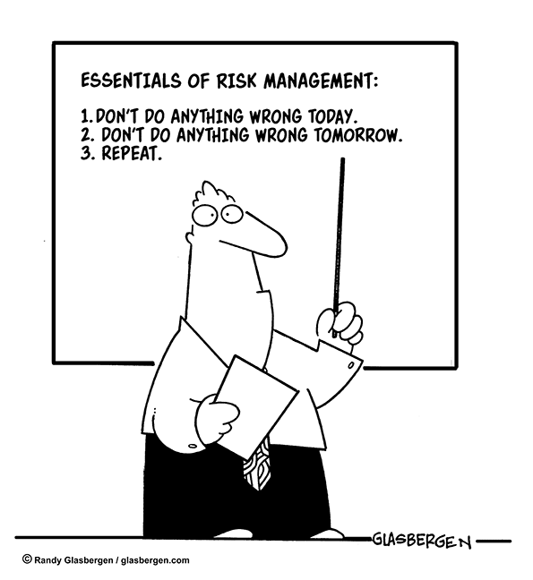

Slide 8
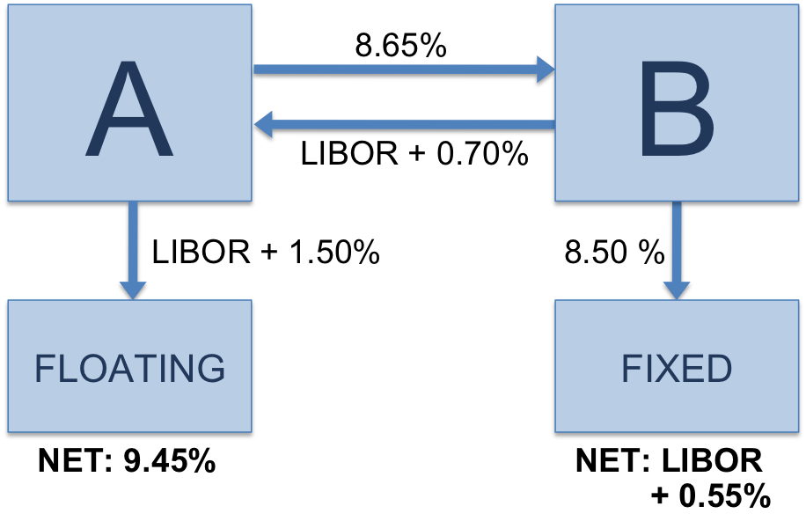
Interest rate swaps
Vanilla Structure
A pays fixed to B and receives floating rate
B pays floating rate to A and receives fixed rate
Types
Fixed for floating, same or different currencies
Floating for Floating
Fixed for Fixed
Amortizing notional swap
Cancellable Feature
Credit: Suicup, Wikipedia
Suggested Reading: http://europe.pimco.com/EN/Education/Pages/InterestRateSwapsBasics1-08.aspx
Notes:
A borrows from market @ LIBOR+1.5%; B borrows from market @ 8.5%
A nets LIBOR

Slide 9
Interest Rate Swap
Swap rate is the rate that the fixed payer pays (8.65%)
A nets: (L + 1.5%) + 8.65 – (L+0.70%) = 9.45%
B nets: 8.5% - 8.65% + (L + 0.7%) = L + 0.55%
Value of the swap is net present value of the net cashflows
Credit: Suicup, Wikipedia

Slide 10
Interest rate SWAP DYNAMICS
Interest Rate
Fixed Income Asset
Fixed Payer
Fixed Receiver
Notes:
Swap contract for fixed payer (fixed receiver) is worth more (less), when interest rates rise
Swap contract for fixed payer (fixed receiver) is worth less (more), when interest rates fall

Slide 11
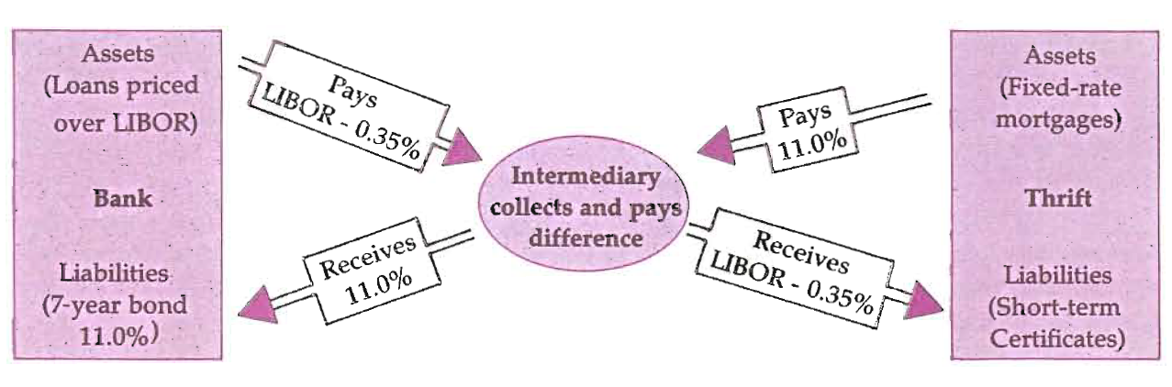
Risks Associated with Interest Rate Swaps
Interest Rate Risk
The payer loses when rates rise
The receiver loses when the rates fall
Credit Risk
Counterparty could default
This could expose the company to IR Risk

Slide 12
Interest rate futures
Agreement between two parties to buy or sell a fixed income asset at a given time in the future.
The underlying could be an asset such as treasury bond or treasury bill
Futures contract can be closed out before delivery
Contracts can be valued by finding the cheapest to deliver
Suggested Reading: Charles S. Morris, Managing Interest Rate Risk with Interest Rate Futures, Economic Review, March 1989

Slide 13
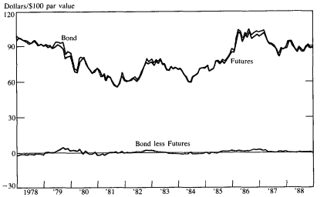
Treasury Bond Hedged
Treasury bond futures and treasury bond prices
Source: Charles S. Morris, Managing Interest Rate Risk with Interest Rate Futures, Economic Review, March 1989

Slide 14
Interest rate futures DYNAMICS
Interest Rate
Fixed Income Asset
Long Treasury Futures
Short Treasury Futures

Slide 15
Treasury futures USE Case - Mortgage banker
Mortgage banker commits to 4% interest rate on a $100,000 mortgage in 2 months
If rates remain the same, then he can sell for $100,000
If rates rise, then the value of the mortgage drops, say $98,000
Interest Rate
Mortgage Asset
Short Treasury Futures

Slide 16
Treasury futures USE Case - SECURITY Dealer
Security dealer agrees to deliver $10M face value of bonds in two months
Agreed price is $90 for a par of $100, current price is $89.50
Rates drop, price rise, dealer has to purchase at a high cost, profits can shrink
Interest Rate
Dealer Profit
Long Treasury Futures
Notes:
Rates drop, price

Slide 17
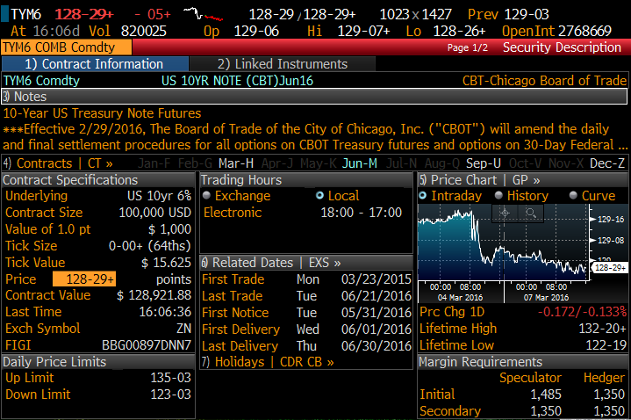
Treasury Futures valuation
Futures price
10 Year Note Futures for June 2016 deliverable
Underlying Information
Delivery Information

Slide 18
Deliverable basket
Security | CF | Maturity | Coupon | Price
912828P7 Govt | 0.7607 | 2/28/2023 | 1.5000% | 98.65625
912828P4 Govt | 0.6867 | 2/15/2026 | 1.6250% | 97.484375
912828P3 Govt | 0.774 | 1/31/2023 | 1.7500% | 100.296875
912828VB Govt | 0.7669 | 5/15/2023 | 1.7500% | 100.1875
912828UN Govt | 0.7873 | 2/15/2023 | 2.0000% | 101.984375
912828J2 Govt | 0.7367 | 2/15/2025 | 2.0000% | 100.921875
912828K7 Govt | 0.7249 | 8/15/2025 | 2.0000% | 100.75
912828N3 Govt | 0.7939 | 12/31/2022 | 2.1250% | 102.8125
912828XB Govt | 0.7391 | 5/15/2025 | 2.1250% | 101.890625
912828G3 Govt | 0.7587 | 11/15/2024 | 2.2500% | 103.046875
912828M5 Govt | 0.7367 | 11/15/2025 | 2.2500% | 102.890625
912828D5 Govt | 0.7723 | 8/15/2024 | 2.3750% | 104.140625
912828VS Govt | 0.8023 | 8/15/2023 | 2.5000% | 105.40625
912828WJ Govt | 0.7855 | 5/15/2024 | 2.5000% | 105.15625
912828WE Govt | 0.8111 | 11/15/2023 | 2.7500% | 107.140625
912828B6 Govt | 0.806 | 2/15/2024 | 2.7500% | 107.140625
Adjusted Futures Price = Futures Price x Conversion Factor = 128.921*0.7939 = 102.3503
Basis = Cash Price - Adjusted Futures Price = 102.8125 – 102.3503 = 0.46212 per $100

Slide 19
Face Value Weighted Hedging – Treasury Futures
The par of the security matches the par of the futures contract
Extremely simple hedge
Ignores differing risk characteristics of different coupons and maturities
Asset: $10 million face value of the 1-3/4% 22 note
Hedge: Sell 100 futures contract

Slide 20
CF Weighted Hedging – Treasury Futures
Use conversion factor to determine the hedge
Treasury futures will tend to track or correlate with the CTD security
Other coupons and maturity will not be well hedged
Asset: $10 million face value of the 1-3/4% 22 note
Conversion Factor Asset: 0.7077
Hedge: Sell 71 futures contract with reference to the 0.7077 conversion factor to execute a hedge

Slide 21
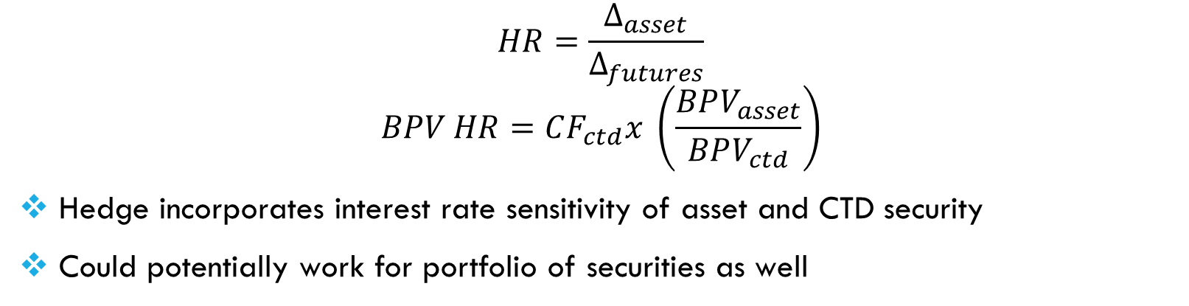
BPV weighted hedging – Treasury Futures
$$HR=\frac{Δ_{asset}}{Δ_{futures}}$$
$$BPV HR=CF_{ctd}x \left(\frac{BPV_{asset}}{BPV_{ctd}}\right)$$
Hedge incorporates interest rate sensitivity of asset and CTD security
Could potentially work for portfolio of securities as well
Asset: $10 million face value of the 1-3/4% 22 note
CTD security: 3-3/8%-19 note
BPV Asset: $8550 per $10 million
BPV CTD security: $7050 per $10 million
Conversion Factor CTD: 0.8604
HR = 0.8604 * 8550 / 7050 = 104.3
Hedge: Sell 104 futures contract
Source and recommended reading: https://www.cmegroup.com/education/files/understanding-treasury-futures.pdf

Slide 22
Futures Vs SWAPS
Futures contracts are standardized contracts, with specific delivery dates (3 month intervals)
Futures contracts are readily available, and cost less
Futures are guaranteed by the exchange and by margins held
Swaps are private contracts and the agreement can be customized to business operation needs
Swaps need a counterparty and can cost more
Swaps have the risk that a counter party may default

Slide 23
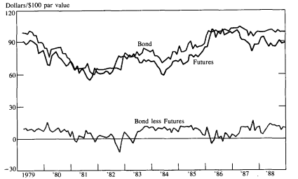
Various risk Exposures
Term Structure Risk
Risk due to change in IR term structure
Exposure to IR when assets and liabilities have different maturities
Basis Risk
Calendar basis risk
IR risk due to change in spreads
Mortgage investments exposed to mortgage spread changes
Options Risk
IR risk due to fixed income options – embedded vs external
Sensitive to changes in interest rates as well as volatilities
Counterparty Credit Risk
Treasury bond futures and corporate bond prices
Notes:
*Term structure risk: A company could have liabilities that need to pay 4% for 10 years. Assets pay fixed at 6% for 2 years. Now the proceeds after 2 years may need to be reinvested. If interest rates dip, the assets could yield lower.
*Basis risk: Mortgage assets are based on mortgage rates, which is a a spread on 10 year treasury rates. After the crisis, the mortgage spread were higher, which has gradually gone down since. Here is a case where one is exposed to basis risk.
* Options risk: Interest rate risk due to fixed income options – embedded or external.

Slide 24
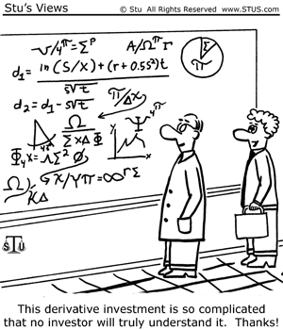

Slide 25
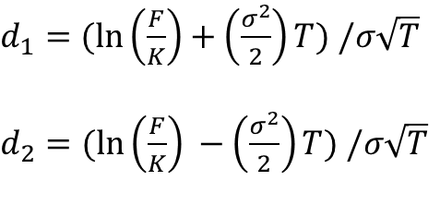
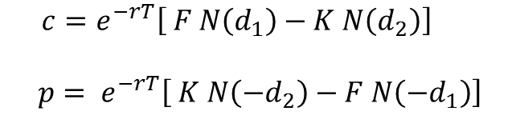
Black Model
Black model is similar to Black-Scholes formula for stocks, except the futures price is the stochastic variable.
Call/Put price for a futures option is give as:
$$c=e^{−rT}\left[ F N\left(d_{1}\right)−K N\left(d_{2}\right)\right]$$
$$p= e^{−rT}\left[ K N\left(−d_{2}\right)−F N\left({−d}_{1}\right)\right]$$
$d_{1}=$ $(ln\left(\frac{F}{K}\right)+\left(\frac{σ^{2}}{2}\right)T) /σ\sqrt{T}$
$d_{2}=$ $(ln\left(\frac{F}{K}\right) −\left(\frac{σ^{2}}{2}\right)T) /σ\sqrt{T}$

Slide 26
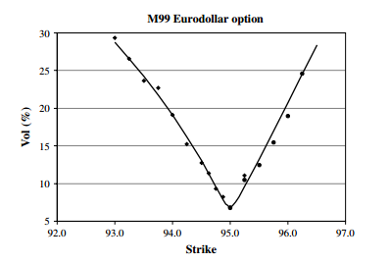
Volatility Smile
Source and suggested reading: Pat Hagan, Deep Kumar, Andrew S Lesniewski & Diana E Woodward, Managing Smile Risk, Wilmott, pp. 84-108 (September 2002) http://www.math.ku.dk/~rolf/SABR.pdf

Slide 27
Different volatility Approaches
Black Model:
Constant volatility approach
Cannot reconcile with volatility smiles
Dupire Model or Local Volatility Models:
Generalizes BS approach by treating vols as a function
Cannot reconcile with dynamic behavior of smiles and skews
SABR model:
Stochastic volatility models

Slide 28
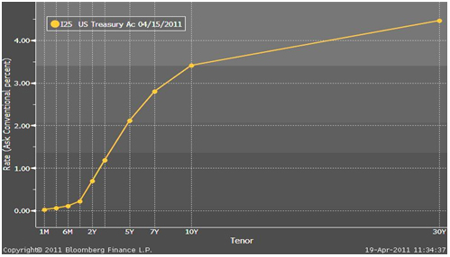
Yield curve
Fundamental to pricing fixed income instruments
Constructed from liquid instruments that are traded
Bootstrapping is employed to construct the curve
Yield curve could be positively sloped, inverted or flat
Source: http://www.naic.org/capital_markets_archive/110422.htm

Slide 29
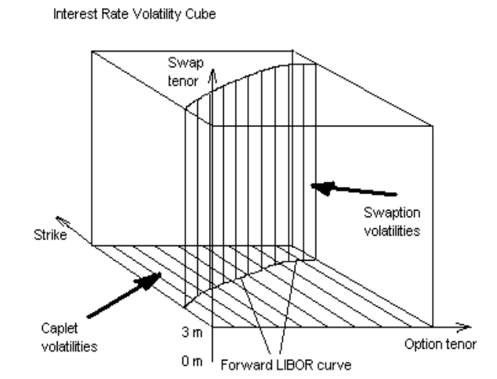
Volatility Surface
Source and suggested reading: Pat Hagan, Michael Konikov, Interest rate volatility cube: construction and use, http://www.javaquant.net/papers/PandorasCube.pdf

Slide 30
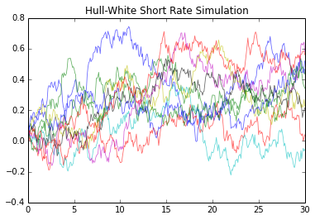
Interest rate models
Short rate models
Single factor
Multi factor
Market models
Models allowing negative interest rates
Models easier to calibrate to the market
Models calibrated to market swaptions or caps

Slide 31




Valuing (OTC) deals
Payoffs can be nonstandard – percentage LIBOR
Can have optionality embedded – cancellable swaps
Nonstandard notionals – amortizing principal
Need attention to different nuances in the terms

Slide 32
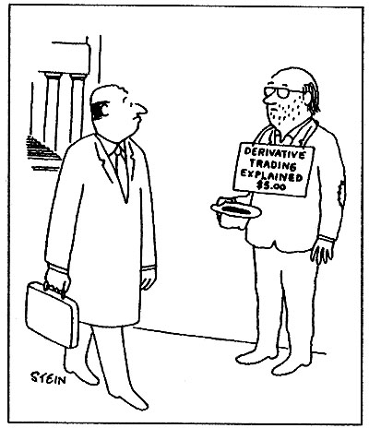
Career
Quantitative Developers / Researchers
Financial Engineer
Pre-trade support Analyst
Post-trade support Analyst
Analyst in insurance companies
Analysts in Treasury
Model Validation Analysts
Risk Management in Banks
Analysts in mortgage companies

Slide 33
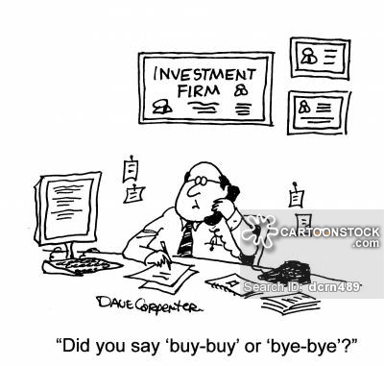
Thank You

Slide 34
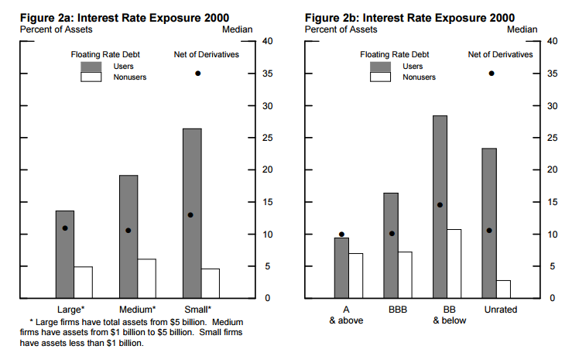
Interest Rate Derivative Hedging
Daniel Covtiz & Steven A. Sharpe, Do Nonfinancial Firms Use Interest Rate Derivatives to Hedge?, FEDS 2005-39, http://www.federalreserve.gov/pubs/feds/2005/200539/200539pap.pdf

Slide 35

Insurance companies
Insurance companies sell products to
Protect from adverse events – Term Life Insurance
Mitigate exhaustion of financial resources over time - Annuities
Save for future in a tax advantaged way – Permanent Life Insurance
Interest rate falls can expose assets to reinvestment risks
Interest rate rise can lead policy holders to cashout on their policies
Notes:
The liabilities and assets can have different maturities. This could mean the proceeds from assets may need to be reinvested at lower interest rates

Slide 36
Corporate bond Hedged
Treasury bond futures and corporate bond prices
Source: Charles S. Morris, Managing Interest Rate Risk with Interest Rate Futures, Economic Review, March 1989

