Slide 1

Designing a GitOps-Native
Kubernetes Platform as a Product
Building a golden path that's fast, secure, and consistent — by design, not by heroics.
Goutham K
SWE II @ Akamai, building Akamai Cloud

Slide 2
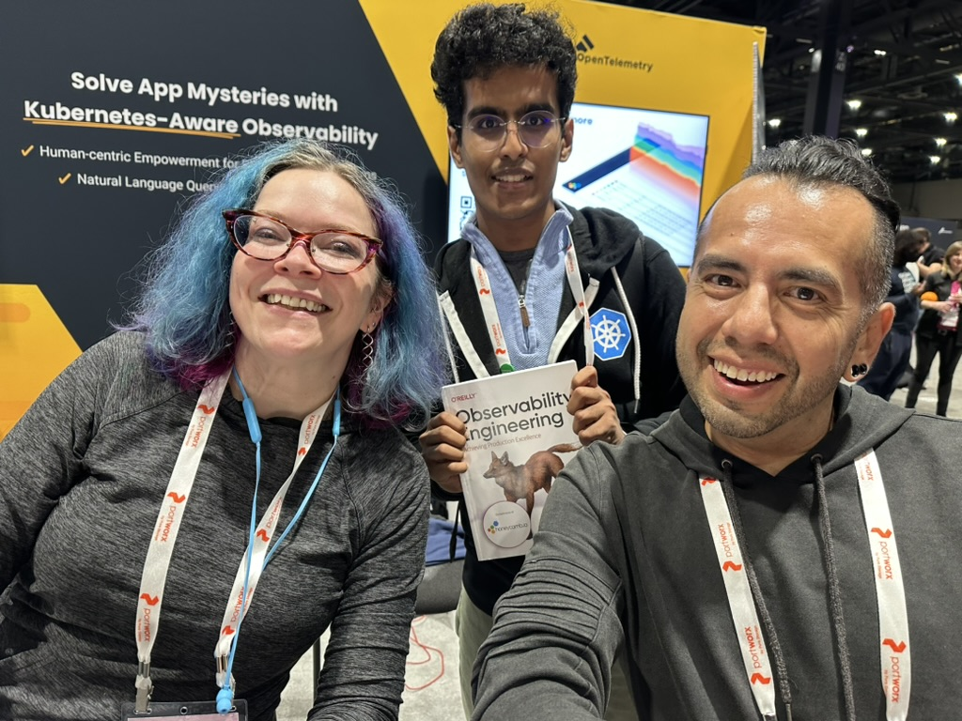
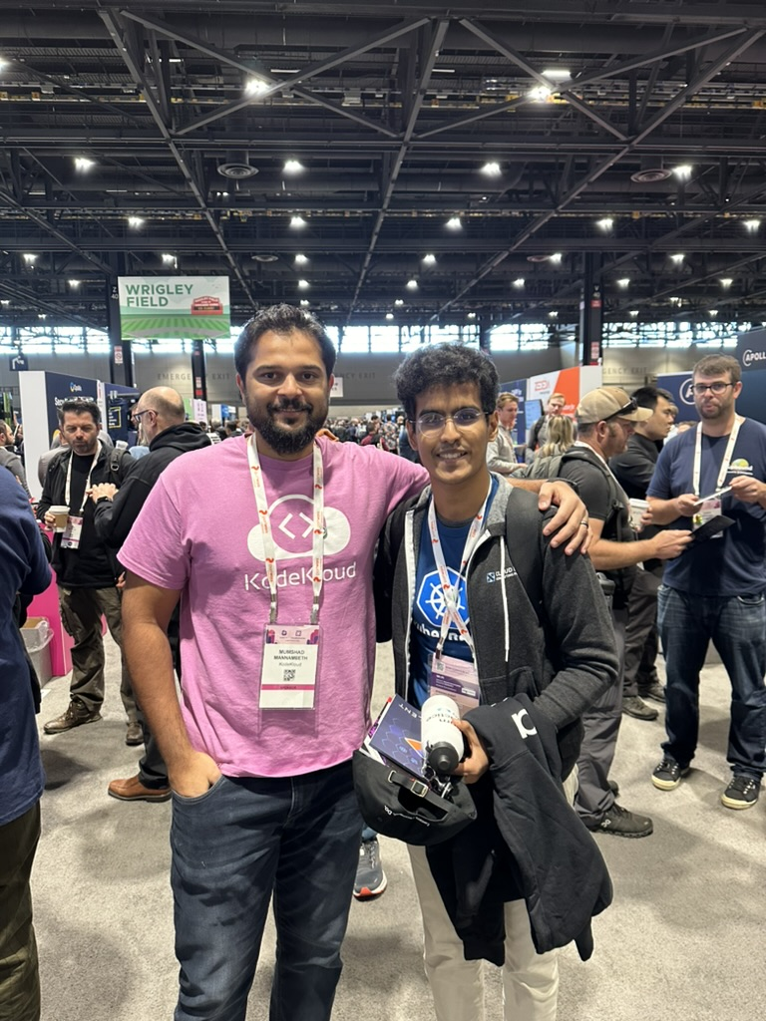
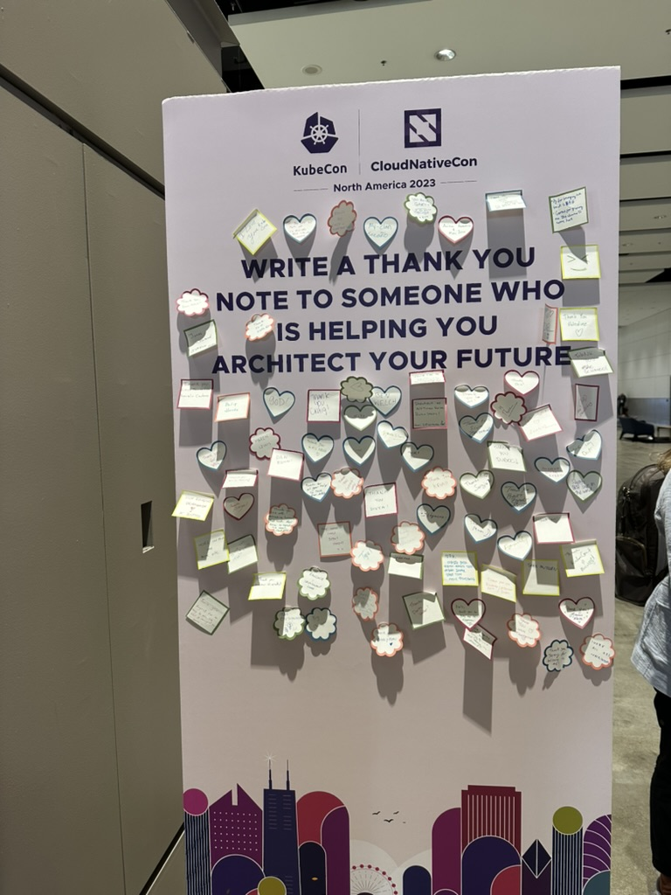
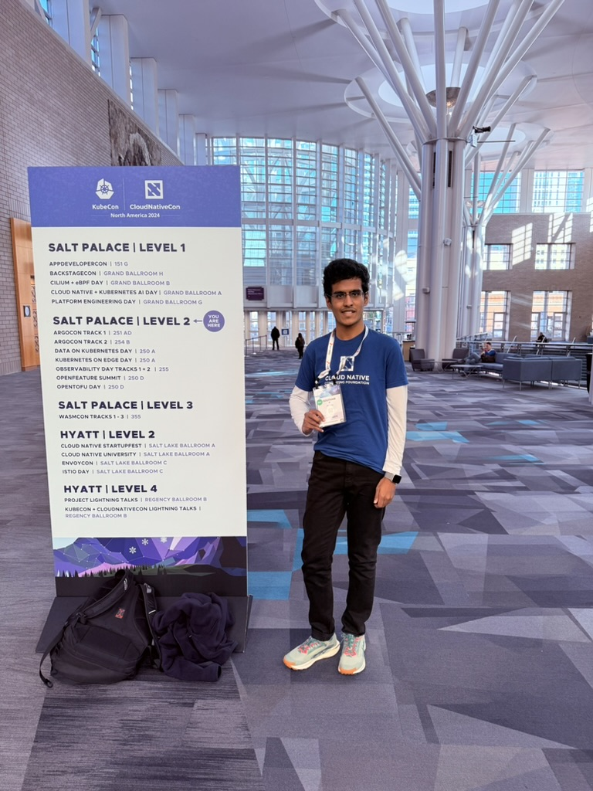
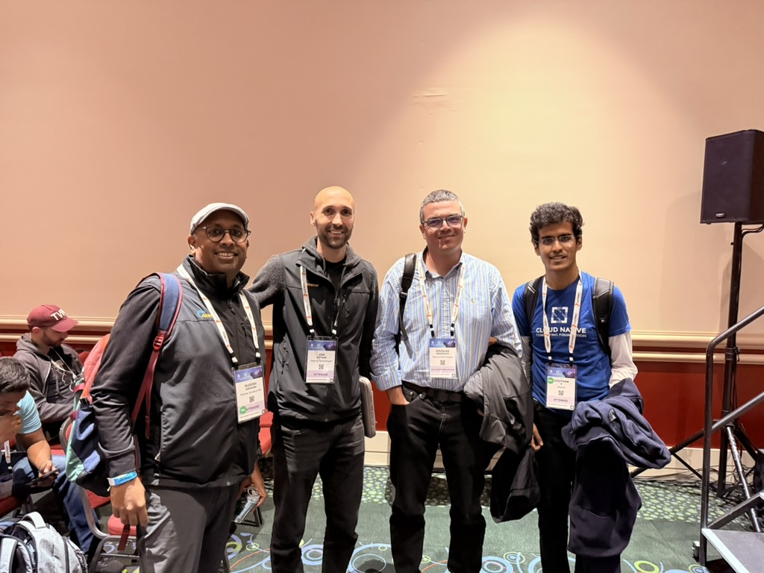
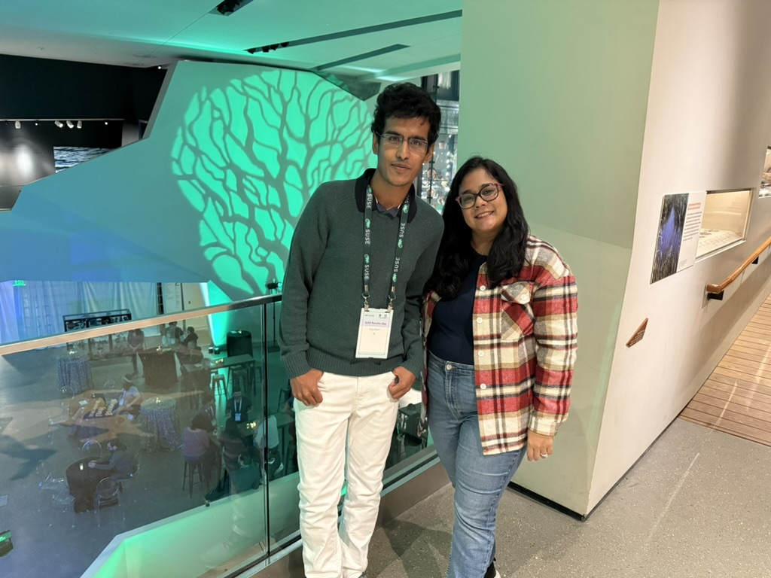
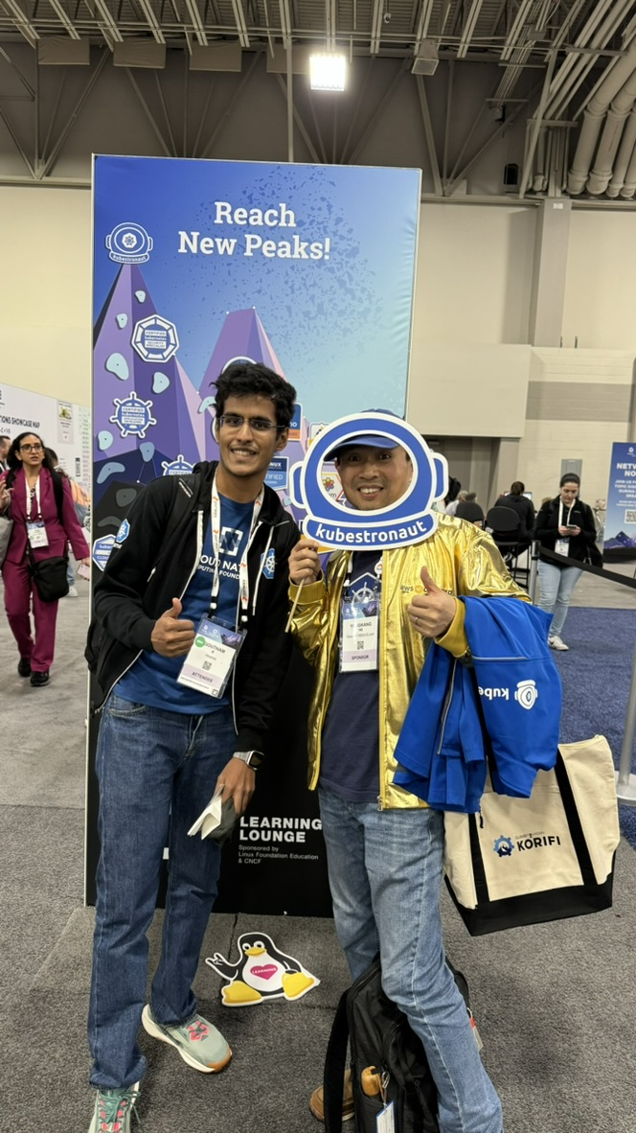
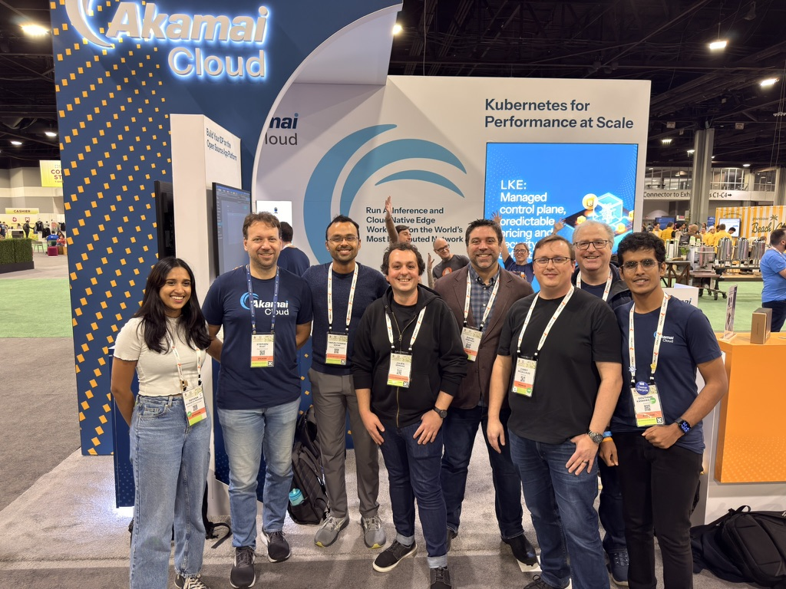
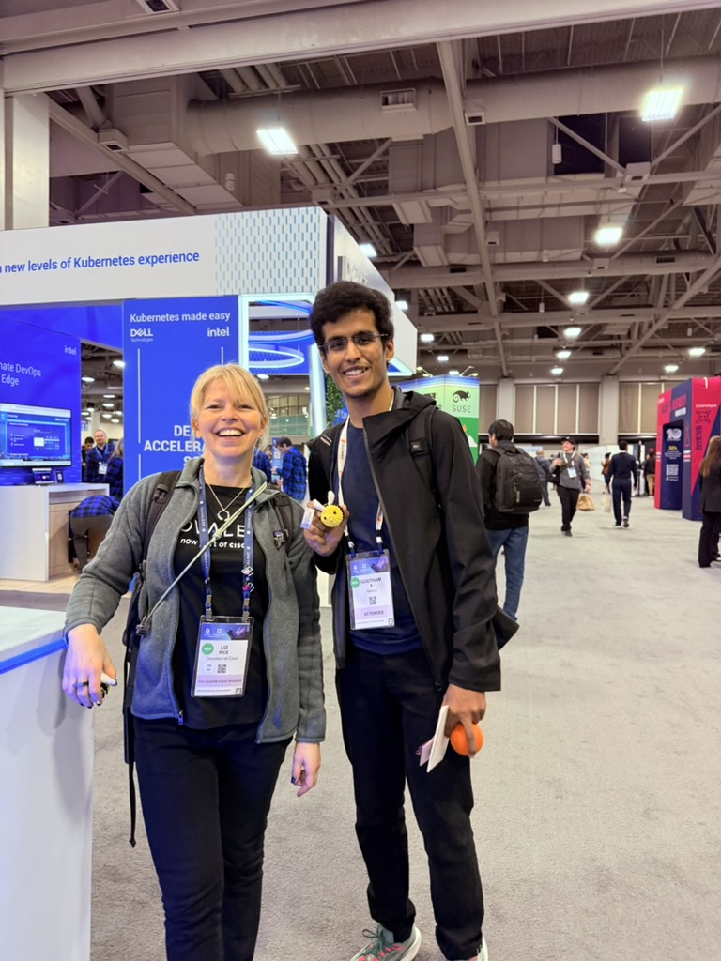
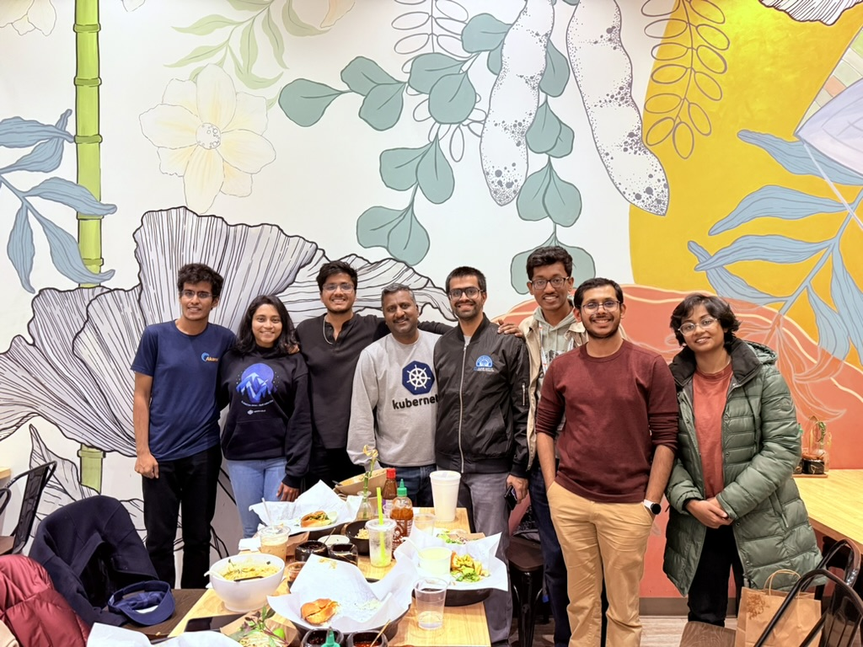
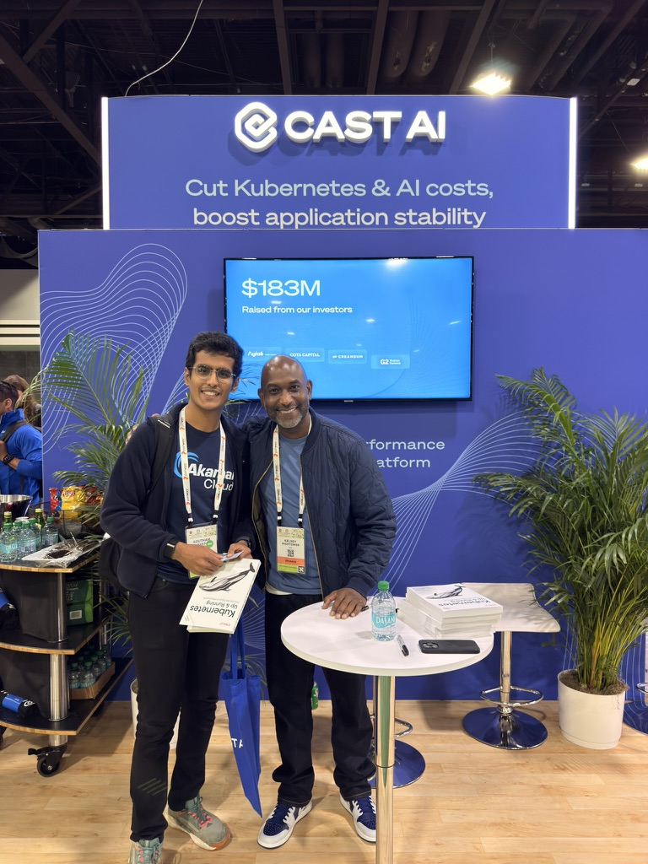
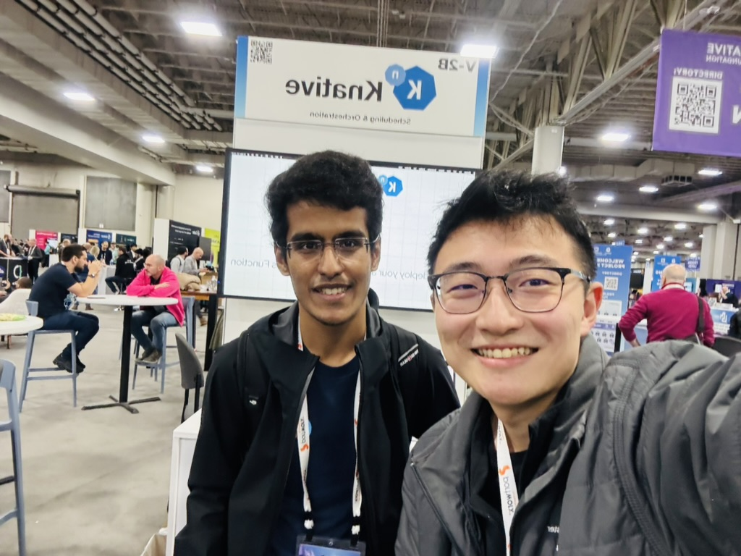
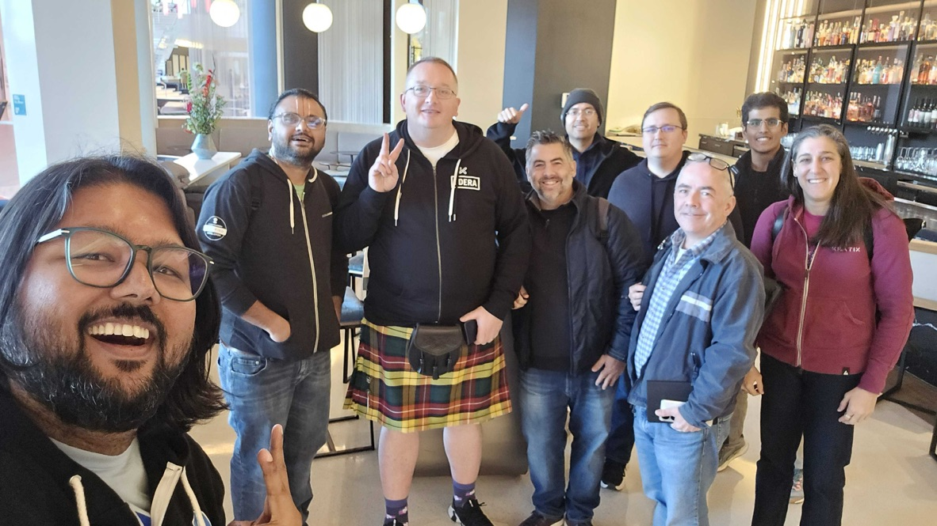
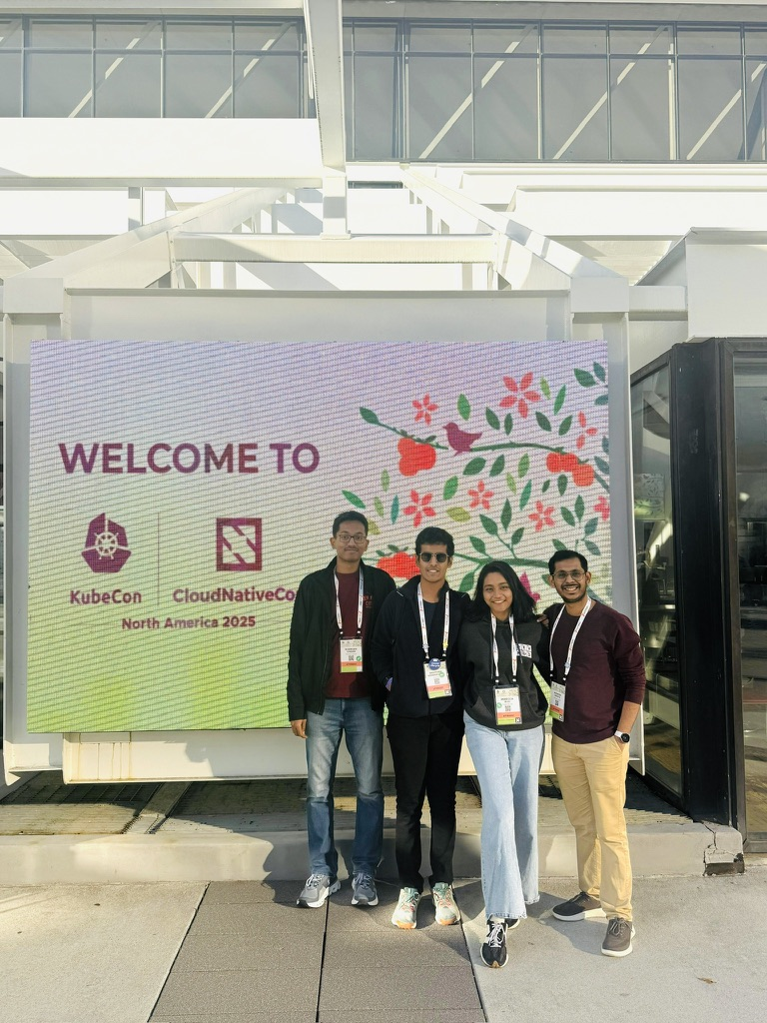
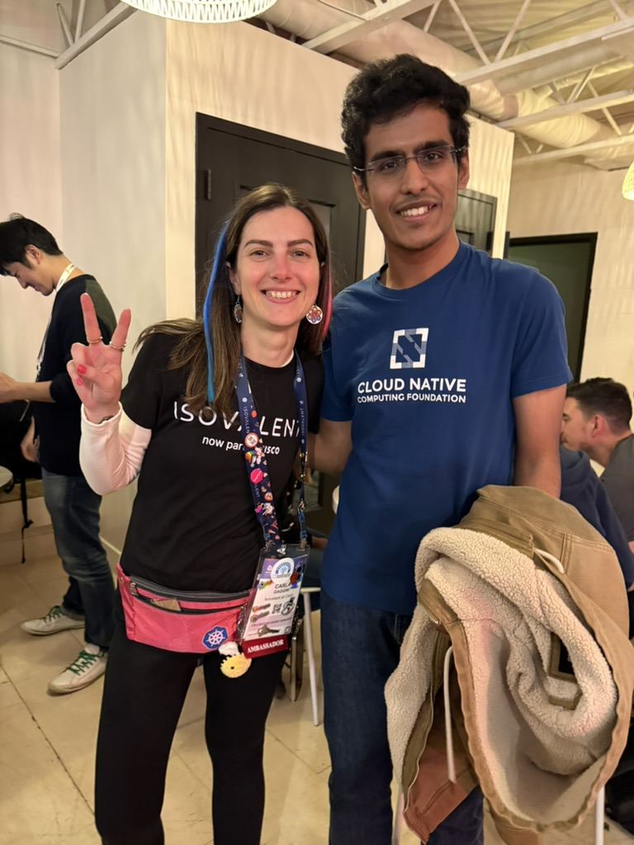

Slide 3
What We'll Cover
Why Platform Engineering
I
DevOps's autonomy tax · ticket ops vs. self-service · the golden path
The GitOps Spine
II
GitOps as the backbone · management cluster to app clusters
Building the Stack, Tool by Tool
III
ArgoCD · Crossplane · Kyverno · Cilium · and more
The Full Picture
IV
Shared responsibility · success metrics · a day in the life
Key Takeaways
V
What worked, what we'd do differently, and what's next
Notes:
Okay I'd like this talk to be kind of like a narrative based on five acts and I'd like to take you all through them one by one, starting with one all the way to five

Slide 4



ACT 1 · WHY PLATFORM ENGINEERING
DevOps gave teams freedom.
Freedom has a tax.
Autonomy accelerated delivery
Independent teams shipped faster — but inherited infrastructure they never signed up to own.
Cognitive load went up, not down
"Build the feature" quietly became "build the feature, and the pipeline, and the cluster config."
Duplicated effort, duplicated risk
Every team solving the same infrastructure problems differently means every team can fail differently, too.
02
Notes:
Open here: DevOps's promise was autonomy and speed. It delivered both — but the autonomy came with a hidden tax. Teams that used to just write application code now also own Dockerfiles, CI pipelines, cluster configuration, and security posture. That cognitive load, multiplied across dozens of teams solving the same problems in slightly different ways, is what platform engineering exists to fix. This is the 'why' before we get to any tooling.
So that's the tax everyone's paying. Now — what if there were a different way to get the same outcome?

Slide 5


ACT 1 · WHY PLATFORM ENGINEERING
Ticket Ops vs. Self-Service
Ticket Ops
Self-Service
File a request, then wait
Request and receive, autonomously
Manual, one-off provisioning
Automated, golden-path provisioning
Knowledge lives in someone's head
Knowledge lives in docs and templates
Every request queues behind the last one
Bottlenecked by nothing but your own backlog
03
Notes:
"What if developers could just... get what they need, themselves — no ticket, no waiting on another team?”
Ticket ops – this is the world you just live through or lived through, : Developers wait on a human in another team to provision a database, a namespace, an access grant.
Self-service: this is the alternative. the same outcome, but on-demand, through an API/portal/PR, with no human in the loop for the common case. This is the operational definition of platform engineering — not a team, a mindset shift.
Since it’s a product, we know every product comes with a manual. And the manual in our world is – developer docs.
So you really are just driving your service/application logic, without friction from the infra layer.
"Turns out there's a name for this. It's called platform engineering."

Slide 6
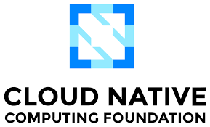
ACT 1 · WHY PLATFORM ENGINEERING
Platform Engineering
Building internal developer platforms that give teams self-service over their full delivery lifecycle — from code to production.
Developer Self-Service
Build, test, deploy, and roll back — entirely through self-service, without opening a ticket.
Reduce Cognitive Load
Platform teams absorb infrastructure complexity so product teams can stay focused on features.
Platform as a Product
Internal developers are your customers. Their adoption — not a mandate — is what makes it succeed.
Source: cncf.io/blog/2025/11/19/what-is-platform-engineering/

Slide 7



ACT 1 · WHY PLATFORM ENGINEERING
Treat the Platform Like a Product
Internal developers are your customers
Their adoption, not a leadership mandate, is what makes the platform succeed.
Roadmap driven by feedback, not decree
Built with the teams who'll use it, prioritized by what actually unblocks them.
Thin and opinionated, not all-encompassing
The platform is the smallest layer that gives a consistent experience — not a rebuild of every tool underneath it.
04
Notes:
Platform-as-a-product is the mindset that separates a platform team people love from one they route around. Three things matter: who you're building for (internal devs, treated as real customers), how you decide what to build (feedback loops, not top-down mandates), and how much you build (the thinnest viable layer — delegate to managed/external implementations wherever you can, and focus your effort on the interface).

Slide 8
ACT 1 · WHY PLATFORM ENGINEERING
The Data Backs This Up
DORA's 2025 State of AI-Assisted Software Development report — nearly 5,000 respondents
90%
76%
5%
of organizations now run an internal developer platform
have a dedicated platform team
productivity gain from developer independence alone
DORA'S CORE FINDING
AI doesn't fix a fragmented platform — it amplifies whatever's already there. When platform quality is high, AI's effect on performance is strong and positive. When it's low, the effect is negligible.
Source: dora.dev/capabilities/platform-engineering · 2025 DORA State of AI-Assisted Software Development
Notes:
This is the 'I'm not just making this up' slide. Lead with the three numbers — pause on each briefly, they're already convincing on their own. Then land the navy callout as the real point: platform quality is what determines whether AI's productivity gains actually show up, or get quietly absorbed by downstream bottlenecks. This is what makes the rest of the talk feel urgent rather than just best-practice — it's not 'nice to have', it's the difference between AI helping and AI making things worse. Bridges straight into the Golden Path slide.

Slide 9
ACT 1 · WHY PLATFORM ENGINEERING
The Golden Path
A paved, opinionated route from idea to production — pre-wired with the right defaults, so the right way is also the easy way.
So what does a golden path actually look like... on Kubernetes?
05
Notes:
Land the definition of golden path here, then pivot: this whole talk from here on is one extended, concrete answer to that question. Use this as the literal bridge sentence into Act 2.

Slide 10
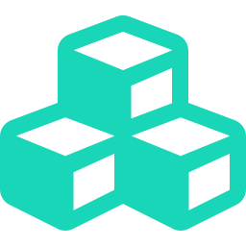

ACT 2 · THE ARCHITECTURE
Kubernetes makes this
easier and harder
Declarative APIs are perfect for self-service
Custom resources are a natural fit for "describe what you want" platform interfaces.
...but CRDs, controllers, and multi-tenancy multiply what can go wrong
More moving parts, more failure modes, more ways for one team's mistake to reach another's.
For security-sensitive workloads, speed and safety can't trade off
Regulated and security-sensitive teams need both at once — not one at the expense of the other.
06
Notes:
Kubernetes is simultaneously the best and worst possible substrate for a platform. Best, because everything is already an API and a controller pattern — that's free self-service infrastructure. Worst, because that same extensibility means a much larger surface area to secure and govern, especially once you're running workloads that touch regulated or sensitive data. The rest of this talk is the architecture that resolves that tension.

Slide 11
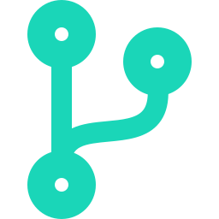

ACT 2 · THE ARCHITECTURE
Three Principles, One Platform
GitOps
Zero Trust
Shift-Left Governance
Git is the single source of truth for everything — apps and infrastructure alike.
Least privilege by default. Every escalation is a reviewed, logged change.
Guardrails are built into the pipeline from day one — not bolted on after an audit.
07
Notes:
These three principles are the spine of everything that follows. Every tool we look at in Act 3 is in service of one (or more) of these three ideas. Worth naming explicitly so the audience has a mental hook to hang the rest of the talk on.

Slide 12



ACT 2 · THE ARCHITECTURE
GitOps, Concretely
Desired state lives in Git
Not in someone's terminal history, and not in a console click someone forgot to document.
A controller continuously reconciles reality to match it
The cluster is always being pulled back toward what Git says it should be.
Every change is a pull request
Reviewed, approved, and logged — the exact same workflow your team already trusts for code.
Drift isn't a fire drill
Manual changes get auto-corrected, and rollbacks are just reverting a commit.
08
Notes:
This is the plain-language definition before we show the diagram. Four properties: declarative source of truth, continuous reconciliation, PR-based change approval, and self-healing drift correction. All four show up again and again in Act 3 — point back to this slide when you get to ArgoCD.

Slide 13
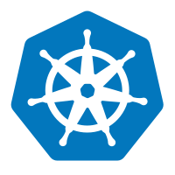





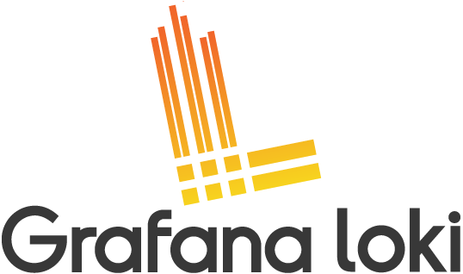
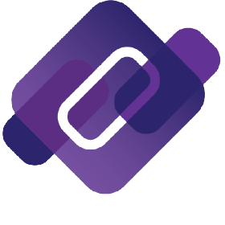
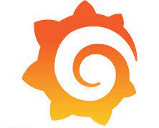
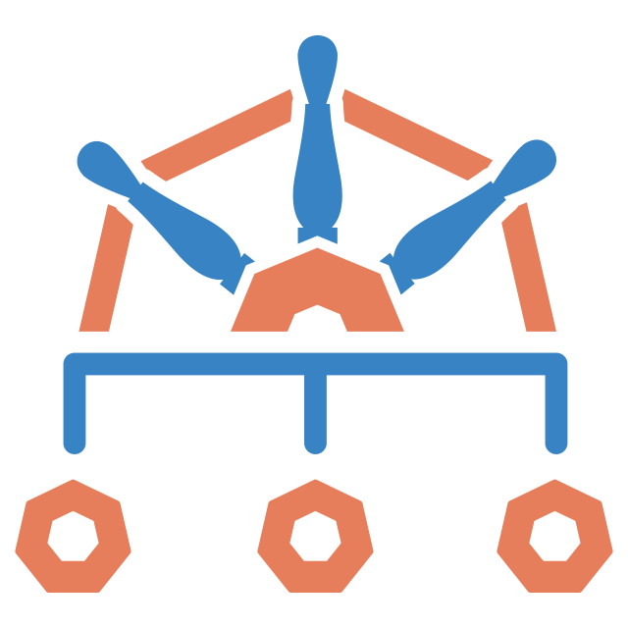

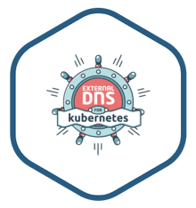
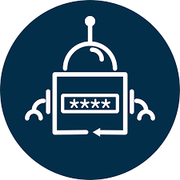
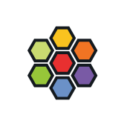
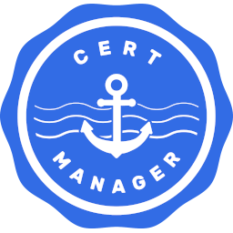
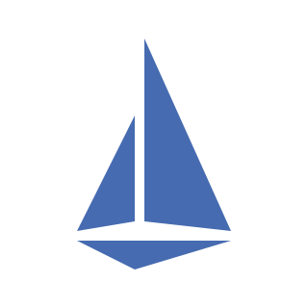

ACT 2 · THE ARCHITECTURE
Operators
git
App
App
ArgoCD
Crossplane
App
App
Platform Components
Platform Components
Prometheus
App
Tempo
App
Platform Components
Prometheus
Tempo
Loki
Prometheus
Tempo
Platform Components
CoreDNS
Loki
CoreDNS
Grafana
Prometheus
Tempo
Loki
CoreDNS
Grafana
Kyverno
Kyverno
OpenTelemtry
Grafana
Loki
CoreDNS
Kyverno
OpenTelemtry
External Secrets
ExternalDNS
Grafana
ExternalDNS
OpenTelemtry
External Secrets
Kyverno
Cilium
OpenTelemtry
Cert Manager
Cert Manager
External Secrets
Cilium
External Secrets
Cilium
Istio
Istio
kagent
Akamai Cloud CSI
Cilium
Istio
Akamai Cloud CSI
Akamai Cloud CCM
Akamai Cloud CSI
Akamai Cloud CCM
Descheduler
Istio
Akamai Cloud CCM
Descheduler
NodeProblemDetecor
Akamai Cloud CSI
NodeProblemDetecor
Descheduler
Linode
Akamai Cloud CCM
NodeProblemDetecor
Linode
Linode
VM
Linode
VM
Descheduler
Linode
Linode
Linode
NodeProblemDetecor
Linode
Linode
Linode
AppCluster Z
VM
VM
Linode
Linode
VM
VM
Linode
Linode
Linode
Linode
Management Cluster
AppCluster A
VM
VM
AppCluster N
09
Notes:
This is the north-star diagram for the whole talk, drawn straight from the platform's real reference architecture. A management cluster — running ArgoCD and Crossplane, synced from Git via the cloud provider's API — provisions and continuously reconciles a fleet of application clusters, one per team or service, each carrying the same baked-in platform component stack. Tell the audience you'll come back to this exact diagram in Act 4 once every piece has been explained.

Slide 14


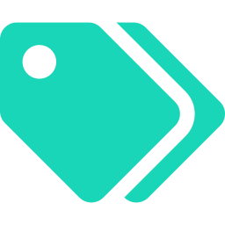
ACT 2 · THE ARCHITECTURE
Clusters That Arrive Pre-Wired
Hardened base image, secure by default
CIS-aligned baseline configuration from the moment the cluster exists — not bolted on afterward.
Baseline add-ons, already installed
Observability, certificate management, and vulnerability scanning ship with every cluster.
Teams version against the platform, not a dozen tools
One version number to track, not a matrix of independent component versions.
10
Notes:
This is the payoff of the golden path concept from Act 1, made concrete: a team doesn't provision a bare cluster and then bolt on a dozen tools themselves. They get a cluster that's already most of the way toward a secure, observable, compliant baseline — off the shelf. We'll unpack exactly what's inside that baseline for the rest of this act.

Slide 15
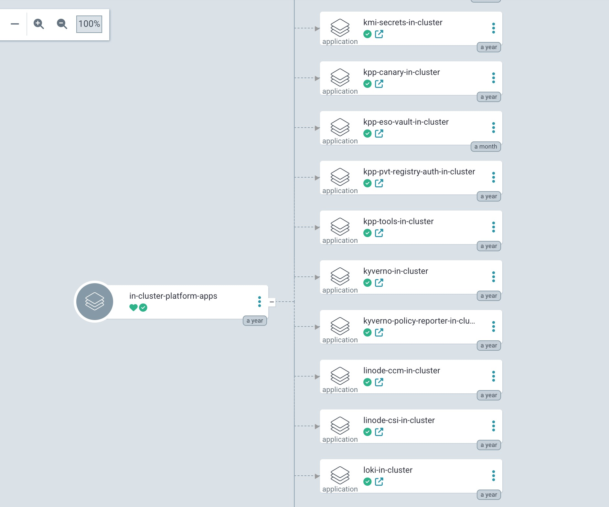

ACT 3 · BUILDING IT LAYER BY LAYER
ArgoCD: the Platform's Control Plane
App-of-apps: one repo describes the whole platform
A single Git tree is the entry point for every cluster, every add-on, every config.
Continuous sync between Git and cluster state
What's running is always converging toward what's declared — automatically, on a loop.
One auditable pane of glass
Every change, who approved it, and when it shipped — all in one place, all queryable.
11
Notes:
ArgoCD is the engine that makes GitOps real rather than aspirational. The app-of-apps pattern means the platform team manages one root application that fans out into everything else — every cluster add-on, every policy, every piece of platform config is itself a GitOps-managed application. This is also your answer when someone asks 'how do you prove what changed and who approved it' — that's just Argo's sync history plus your Git history.

Slide 16

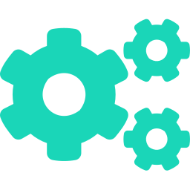

ACT 3 · BUILDING IT LAYER BY LAYER
Crossplane: Infrastructure as an API
"Give me a cluster" becomes a custom resource
Provisioning infrastructure looks exactly like provisioning any other Kubernetes object.
Compositions are the golden path, codified
The platform team defines what "a cluster" means once; every team gets the same good defaults.
Management policies prevent drift and accidental deletion
Manual changes get reconciled back; destructive actions need to go through Git, not a console.
12
Notes:
Crossplane is what turns the management cluster from Slide 9 into something that can actually create the application clusters. The mental model: instead of a wiki page that says 'run this Terraform to get a cluster,' you get a CustomResourceDefinition. Requesting infrastructure is now a pull request adding a YAML file — exactly the same review/approval workflow your team already uses for application code.

Slide 17
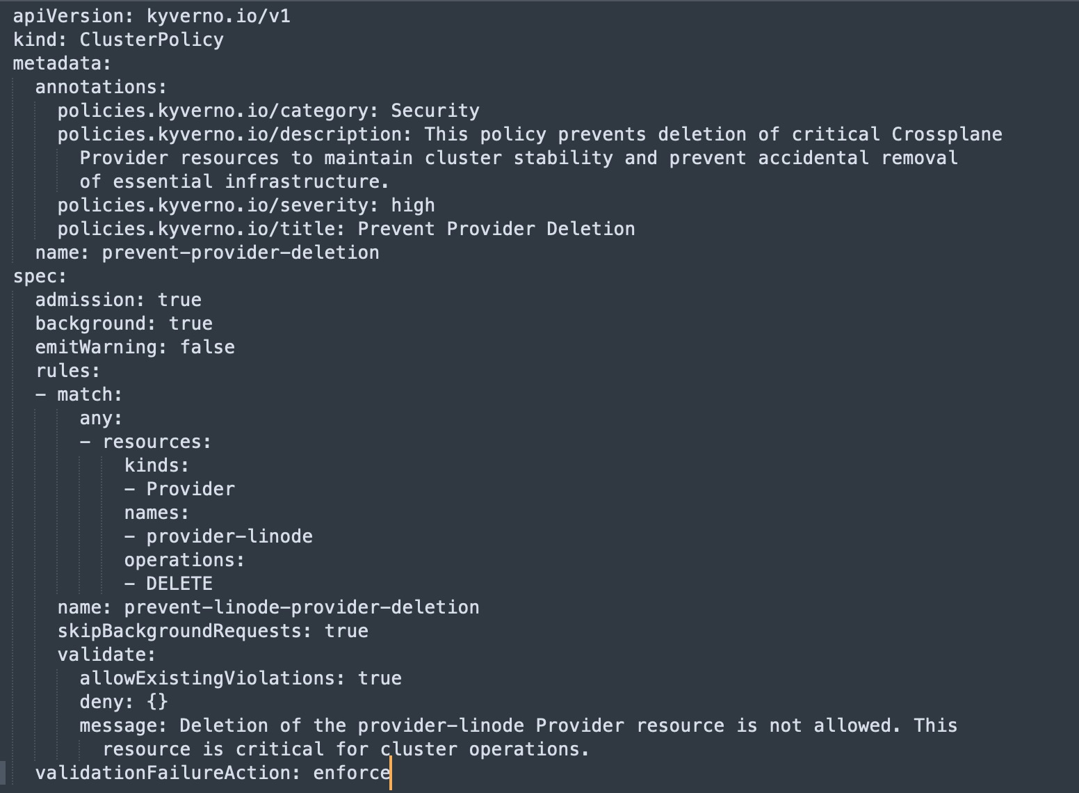


ACT 3 · BUILDING IT LAYER BY LAYER
Kyverno: Guardrails by Default
A restricted security baseline, everywhere
Every workload, in every namespace, starts from the same locked-down default posture.
No more "please review my YAML"
Policy isn't a person in a review queue — it's enforced automatically, the same way every time.
Caught at admission, not in production
A misconfigured workload is rejected before it ever starts running, not discovered after.
13
Notes:
Kyverno turns 'we have a security policy document' into 'the cluster physically will not run something that violates it.' That's the shift-left governance principle from Act 2, made literal: the gate is in the admission controller, not in a human's inbox.

Slide 18

ACT 3 · BUILDING IT LAYER BY LAYER
...With Room to Breathe
The exception pattern
Real workloads occasionally need a narrow exception — say, one sidecar that genuinely needs elevated privilege.
The exception is scoped to that one case, written declaratively, and lives in Git — not in a Slack thread or someone's memory.
At audit time, the exception is the documentation: what was allowed, for what, approved by whom, since when.
14
Notes:
Kyverno enforces a restricted security baseline on everything, automatically, no exceptions. That's a clean, satisfying rule — but you’re probably asking: "okay, but surely something needs to run with elevated privilege sometimes?
The exception is scoped to one specific case (one container, one capability), not a blanket exemption for a whole namespace or user
Kubernetes' native Pod Security Admission exemptions only let you exempt by username, runtime class, or entire namespace — all too coarse for real use, since exempting "the whole namespace" because one sidecar needs root quietly exempts everything else in it too

Slide 19
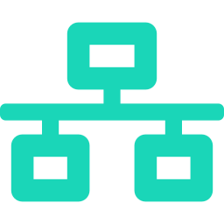
ACT 3 · BUILDING IT LAYER BY LAYER
Cilium: Zero Trust at the Network Layer
eBPF dataplane
Policy enforcement in the kernel — no sidecar proxy required for basic L3/L4 control.
L3 through L7 network policy
Control who can talk to whom, down to the specific API call or HTTP method.
Deny by default, allow deliberately
Connectivity is something you grant in Git, not something that exists until proven dangerous.
15
Notes:
Cilium is the zero-trust principle from Act 2 applied to the network. The eBPF point matters technically (no sidecar tax, line-rate enforcement) but the bigger story for this audience is policy: every connection between workloads is denied unless something explicitly allowed it, and that allow-list lives in Git like everything else.

Slide 20
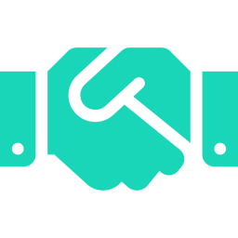
ACT 3 · BUILDING IT LAYER BY LAYER
Filling the Gap: a Service Mesh for Encryption
Cilium handles policy; Istio adds transparent mTLS
Pod-to-pod traffic gets encrypted in transit without any application code change.
Used together, not as competitors
Each covers a layer the other doesn't — network policy and identity-based encryption aren't the same problem.
17
Notes:
Keep this one brief — it's a supporting detail, not a main pillar. The point is just that Cilium's policy engine and a service mesh's mTLS layer are complementary, not redundant: one decides who's allowed to talk to whom, the other guarantees that conversation is encrypted and identity-verified in transit. Worth a sentence so nobody asks 'wait, what about encryption?' five minutes later.

Slide 21


ACT 3 · BUILDING IT LAYER BY LAYER
Audit Everything,
Alert on the Exceptions
Every API action is logged, tied to a real identity
Not a shared service account — an individual, traceable user or system.
Privileged credentials are expected to come from one place
The GitOps controller is the only "normal" user of high-privilege access.
Anyone else using them is an alert, not a surprise
Deviation from that expectation is exactly the signal worth investigating first.
19
Notes:
This slide is the zero-trust principle showing up as an operational control rather than a policy document: you don't just say 'use least privilege,' you build monitoring that assumes only the automation should ever use elevated credentials, and treat any other use as a signal worth investigating immediately.

Slide 22


ACT 3 · BUILDING IT LAYER BY LAYER
Onboarding Without a Ticket
OIDC makes it easy
Same client ID, no secrets
The same SSO config ships to every team
Nothing bespoke to configure per cluster — onboarding doesn't require a ticket to an identity team.
Same-day access in, clean access out
Offboarding is exactly as simple as onboarding, because identity was never duplicated anywhere.
20
Notes:
This directly answers 'secure OIDC/SSO-based onboarding through GitOps' from the talk's premise. The detail worth keeping even at a high level: combining the Kubernetes API's built-in OIDC support with a PKCE-based authorization flow means there's no client secret and no server secret to manage — so the exact same configuration can ship to every single team without any per-team secret provisioning step.

Slide 23


ACT 3 · BUILDING IT LAYER BY LAYER
RBAC That Doesn't Require a PhD
A simplified config maps teams to roles
Most teams never have to write a line of raw Kubernetes RBAC YAML.
Power users can still drop to native RBAC
The simple format expands into real ClusterRoleBindings — nothing is hidden or limited.
Either way, it's a reviewed pull request
Code owners and CI checks apply to permissions exactly like they apply to application code.
21
Notes:
This slide is about approachability without losing power. Most users just want 'give my team read access' — they shouldn't need to understand ClusterRoleBindings to get that. But the simplified format is sugar over the real thing, not a replacement for it, so anyone with a genuinely custom need can still write native RBAC and plug it into the same review pipeline.

Slide 24
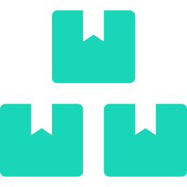

ACT 3 · BUILDING IT LAYER BY LAYER
Upgrades Become Git Diffs
The platform ships as one versioned bundle
Cluster version and every add-on version travel together — no mix-and-match matrix to test.
Teams adopt a new version on their own schedule
The platform team ships it; each team chooses when they're ready to move.
Rolling back is reverting a commit
Not a 2am incident — just the same Git workflow, run in reverse.
22
Notes:
This is the direct answer to 'how do you simplify upgrades.' Bundling the whole platform — Kubernetes version plus every add-on — as a single versioned release massively shrinks the test matrix, because you're qualifying one combination at a time instead of every permutation of independently-versioned components.

Slide 25
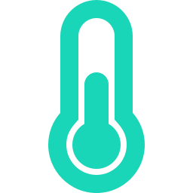
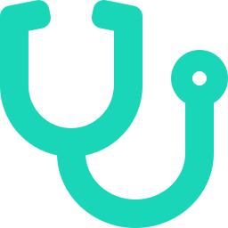
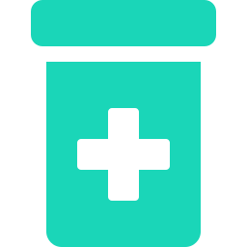
BONUS · CLOSING THE LOOP
kagent: A Doctor for Your Cluster
An open-source, Kubernetes-native AI agent (CNCF Sandbox) that debugs the way a clinician would — symptom, exam, diagnosis, fix.
Symptom
Examination
Diagnosis
Prescription
Pod crash-looping, latency spiking, a deploy failing
Pulls logs, metrics, traces, and events
Reasons across signals to the actual root cause
Suggests — or applies — the fix
kagent — CNCF Sandbox project · github.com/kagent-dev/kagent
Notes:
kagent is a real, open-source CNCF Sandbox project (originally from Solo.io) — a Kubernetes-native framework for running AI agents that handle troubleshooting, configuration, and observability tasks. The doctor metaphor maps directly: a symptom shows up (crash loop, latency spike), the agent examines the same signals an SRE would (logs, metrics, traces, events), reasons to a root cause rather than just the loudest error, and prescribes a fix. The closing line matters most for this audience: because agents and tools are defined as Kubernetes CRDs, kagent's actions can flow through the exact same GitOps review path as everything else in this talk — it's not a black box making unreviewed changes to your cluster.

Slide 26
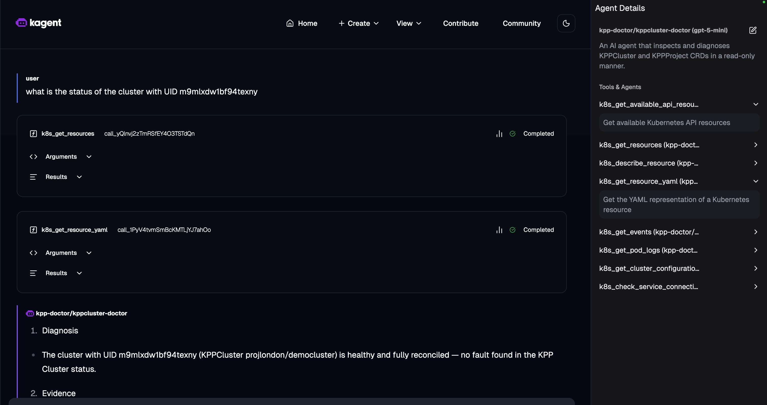
BONUS · CLOSING THE LOOP
Not Just a Metaphor
A real kagent agent — diagnosing a live cluster, read-only.
Real tool calls → real diagnosis: “healthy and fully reconciled — no fault found.”
Notes:
This is a real screenshot from a kagent agent I built — kppcluster-doctor — scoped read-only to inspect KPPCluster/KPPProject CRDs. Walk through it live if there's time: the user asks for the status of a cluster by UID, the agent calls k8s_get_resources and k8s_get_resource_yaml (both real, completed tool calls against the live API), and returns a diagnosis: healthy, fully reconciled, no fault found. The point isn't the specific cluster — it's that the doctor metaphor from the previous slide isn't aspirational, it's running today, read-only, with the same guardrails as everything else in this platform.

Slide 27
ACT 4 · PLATFORM AS PRODUCT
A Shared Responsibility Model
The Platform Team Owns
Every Team Owns
The control plane and its reliability
How they actually use the platform
The golden path and its defaults
Their own workload's security posture
The guardrails everyone inherits
Their own compliance story end-to-end
Common tools every team can reuse
Choosing when they adopt a new version
25
Notes:
The platform team's goal is to empower teams to build secure, compliant systems — not to build those systems for them. That distinction matters: the platform provisions and manages the lifecycle of the control plane; what runs on top, and whether that usage is itself compliant, stays with the team that owns it. This keeps the platform team's surface area sane as the number of users grows.

Slide 28

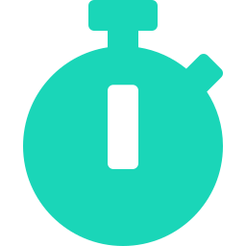

ACT 4 · PLATFORM AS PRODUCT
Measuring Whether It's Working
Deployment frequency & lead time for changes
The classic DORA pair — borrowed because they still work.
Time to first deploy for a brand-new service
How long from "we have an idea" to "it's running in production"?
Time from CVE disclosure to "we know who's affected"
Central visibility turns this from a scramble into a lookup.
Adoption — are teams choosing the platform, or routing around it?
The only metric that tells you if "platform as a product" is actually true.
26
Notes:
Close the loop back to Act 1's 'platform as a product' framing: if you don't measure it, you're not actually treating it like a product. These four metrics span the DORA-style delivery metrics, an onboarding-speed metric, a security-response metric, and — most honestly — adoption, which is the metric that actually tells you whether the platform's value proposition holds up against people's alternative of just doing it themselves.

Slide 29

ACT 4 · PLATFORM AS PRODUCT
A Day in the Life
Opens a PR requesting a new cluster
It's merged; the cluster exists a few minutes later. No ticket, no human in the loop.
SSO just works
Access matches their team's role automatically — nothing requested, nothing extra granted.
Ships a change; a guardrail catches a misconfig
Rejected at admission, with a clear reason — before it was ever a production incident.
Never files a ticket, never waits on a human
That sentence is the entire pitch for treating the platform as a product.
27
Notes:
Bring it back to the developer's actual experience as the closing image of Act 4, right before the takeaways. Everything we've covered — GitOps, zero trust, shift-left governance, the whole tool stack — exists in service of this one paragraph being true for an ordinary developer on an ordinary day.

Slide 30

ACT 5 · CLOSE
Takeaways
Treat the platform as a product, not a project.
Adoption is earned from users, not mandated from leadership.
Make the golden path the path of least resistance.
If the secure way is also the easy way, people will take it.
Guardrails belong in Git, not in someone's memory.
Declarative, reviewable, and still there after that person changes teams.
Security and speed aren't opposites when both are automated.
The trade-off only exists when one of them is still manual.
28
Notes:
Four crisp closing points, each a callback to something earlier in the talk. Deliver these slowly — this is the slide people actually screenshot.

Slide 31


Thank You
Questions?
github.com/gouthamhusky
Notes:
Closing slide — leave it up during Q&A.

