Slide 1

Grafana for Kubernetes-based
Platforms
Every Kubernetes cluster, every region, one dashboard
Goutham K. | SWE II @ Akamai Cloud
Notes:
20 min content + 4 min Q&A. Open cold on the numbers slide — do not introduce yourself first. The illustration is the talk's thesis in one picture: an operator conjuring clusters into existence. You can call back to it on the "what is an operator" slide.

Slide 2
What we'll talk about.
01
A cluster is stuck. Which one, where, and whose?
02
What an operator actually does
03
Management clusters, tenant clusters
04
Turning conditions into time series
05
Demo time!
Q
Questions
Notes:
Do not read this list out. Point at row 01, say "we start here", point at row 05, say "and most of the time goes here" — then move. 20 seconds. If you would rather protect the cold open, move this slide to just after the 02:40 page so the hook lands first.

Slide 3
THE FLEET
1,000s
50
50
tenant K8s clusters
regions
engineers/SREs on the platform team
03 · the problem
Notes:
Open here, cold. Say the numbers, nothing else. The third number is the punchline — a small team, a large fleet. ~30s.

Slide 4
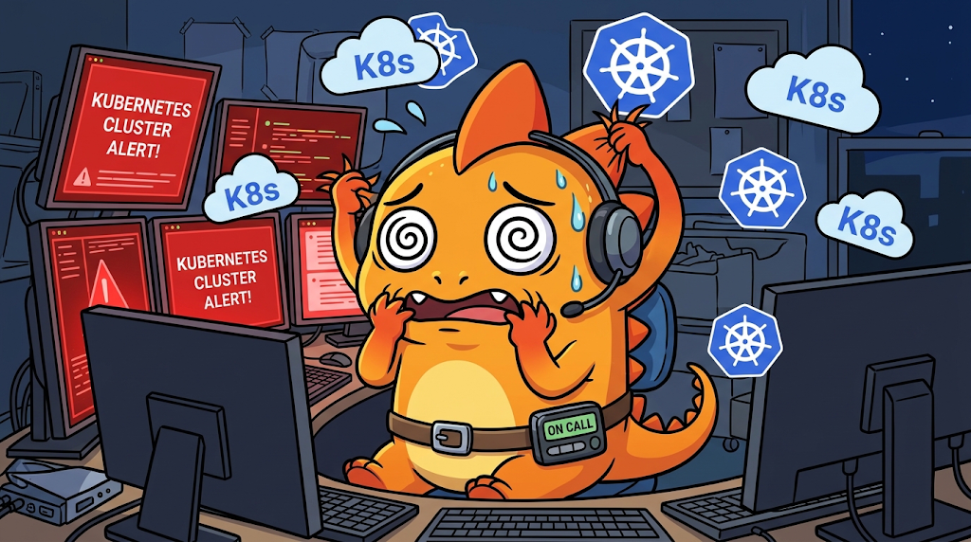
The page comes in at 02:40
"Hey Grot, Cluster tuvbkdh1l4he8s5lg is cooked.Whatup?"
04 · the problem
Notes:
Do NOT show the dashboard yet. Promise it: "by the end, one table answers this in one glance." ~90s. This question is the spine of the whole talk — you return to it on the second-to-last slide.

Slide 5
What is a
Kubernetes operator?
A program that watches something you declared, compares it with what actually exists, and closes the gap — over and over, for as long as it runs.
You already own one of these. It's mounted on a wall in your house.
05 · what is an operator
Notes:
Name it before explaining it. Read the definition slowly, then deliver the last line and pause — it is the setup for the thermostat on the next slide. ~40s. Do not define pods, controllers or CRDs here.

Slide 6

A thermostat is a controller
Desired
Observed
Act
Repeat
20°C
18°C
turn on the heat
forever
You never tell it to turn on the heat. You tell it what you want, and it closes the gap.
06 · what is an operator
Notes:
45 seconds, no Kubernetes vocabulary at all. The audience is beginner-to-K8s — this is the concept that has to land, everything else is naming.

Slide 7
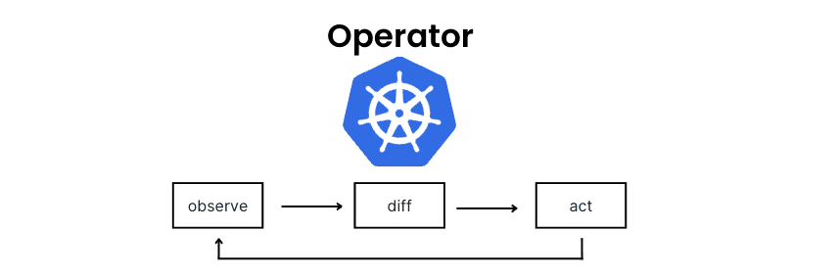
Same loop, with Kubernetes words on it
Desired
Observed
Act
Repeat
replicas: 3
running: 2
create 1 more
forever
07 · what is an operator
Notes:
~2 min. Deliberately identical layout to the thermostat slide — the repetition is the teaching device. Do not explain pods. The diagram restates the same loop in the canonical observe/diff/act vocabulary — point at it once, do not walk it a second time.

Slide 8
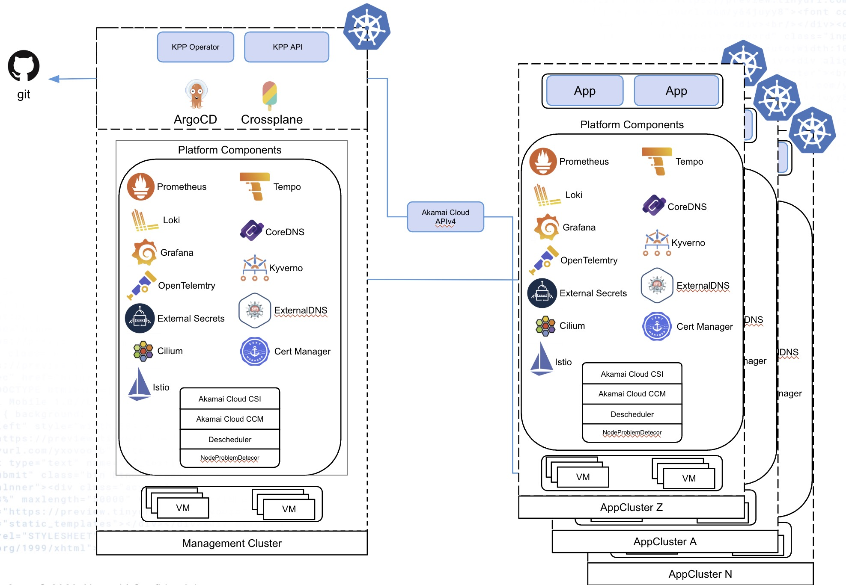
One management cluster, many tenant clusters
Notes:
~1 min. This is the only architecture diagram in the deck — keep it to two boxes and a fan-out. Resist adding Crossplane, ArgoCD, the API layer.

Slide 9
Is it ready?
Where is it stuck?
Notes:
Say this out loud and pause. This is the transition into the instrumentation section and the sentence the whole talk hangs on. ~15s.

Slide 10
Reconciling a cluster has stages
A Deployment reconciles in milliseconds. This takes minutes to hours.
InfrastructureReady
APITokenReady
ArgoAppReady
Synced
Each one is a flag the operator writes back onto the resource, every loop.
10 · platform architecture
Notes:
Spend time here — this list becomes the dashboard's columns later, and the audience needs to recognise it when it reappears. ~1 min.

Slide 11
THE INSTRUMENTATION PROBLEM
This is where the operator writes what it knows
status:
conditions:
- type: InfrastructureReady
status: "True"
- type: ArgoAppReady
status: "False"
reason: SyncFailed
Your operator already knows why it's stuck. It just never leaves the cluster.
12 · CR to time series
Notes:
Beat 1 of 6 in the transformation sequence. Same object carries through the next several slides — say so, so nobody loses the thread.

Slide 12
PATTERN 1
Identity goes in labels. The value is meaningless.
tenant_cluster_info{cluster_uid, name, projectId, region, version} = 1
Cardinality is inventory
And it's a join table
count(tenant_cluster_info)
Anything keyed on cluster_uid picks up region, version, owner
same as metrics like: kube_pod_info, node_uname_info, argocd_app_info.
14 · CR to time series
Notes:
Name the pattern out loud — "info metric". Once named, people start seeing it everywhere in exporters they already run.

Slide 13
PATTERN 2 · THE ONE THAT MATTERS MOST
Condition is a label, not a metric name
Do this
Not this
tenant_cluster_status{
cluster_uid,
condition
} = 0 | 1
tenant_cluster_infra_ready
tenant_cluster_argo_ready
tenant_cluster_token_ready
tenant_cluster_synced
Add a fifth condition to the operator. Option A costs you nothing — it's a new column, automatically. Option B costs a metric, a panel, a query and an alert rule.
15 · CR to time series
Notes:
The single most important design decision in the system. Cardinality is clusters x conditions — trivial. The decision is free and it compounds. ~1 min.

Slide 14
ALL OF IT, IN GO
The whole exporter is one GaugeVec
Declare it once
Set it every reconcile
var clusterStatus = prometheus.NewGaugeVec(
prometheus.GaugeOpts{
Name: "tenant_cluster_status",
Help: "Condition, 1 = True",
},
[]string{
"cluster_uid", "name", "condition",
},
)
func init() {
metrics.Registry.MustRegister(clusterStatus)
}
// one series per condition
for _, c := range cluster.Status.Conditions {
v := 0.0
if c.Status == metav1.ConditionTrue {
v = 1
}
clusterStatus.WithLabelValues(
uid, name, string(c.Type),
).Set(v)
}
Declare once, register once, set every loop. The condition name is a label, not a variable — so a seventh condition needs no code here at all.
16 · CR to time series
Notes:
The concrete form of the previous slide: the labels slice is where "condition is a dimension" actually lives. Point at string(c.Type) on the right and the "condition" entry on the left — those two are the same decision. ~60s. Do not read the code aloud line by line.

Slide 15
PATTERN 3
0 and 1 give you boolean algebra
Question | PromQL | What it is
All stages passed? | min by (cluster_uid) | AND
Anything passing? | max by (cluster_uid) | OR
Fleet pass rate per stage? | avg by (condition) | mean of 0/1
How many exist? | count(..._info) | cardinality
Don't count your conditions. min them.
17 · CR to time series
Notes:
Most quotable slide in the deck. The self-deprecating anti-pattern lands harder than a hypothetical — it's real and it's ours.

Slide 16
One condition, six transformations
1 YAML type: ArgoAppReady, status: "False"
2 Go NewGaugeVec(..., []string{"cluster_uid","condition"})
3 Series tenant_cluster_status{cluster_uid="tuv…", condition="ArgoAppReady"} 0
4 Scrape OTel collector → VictoriaMetrics or any Prometheus compatible server
5 PromQL min by (cluster_uid, name) (tenant_cluster_status)
6 Column a Yes / No cell in a table
20 · CR to time series
Notes:
The narrative payoff of the section, and the transition into the demo. If you're short on time, this slide can carry patterns 1-5 alone.

Slide 17
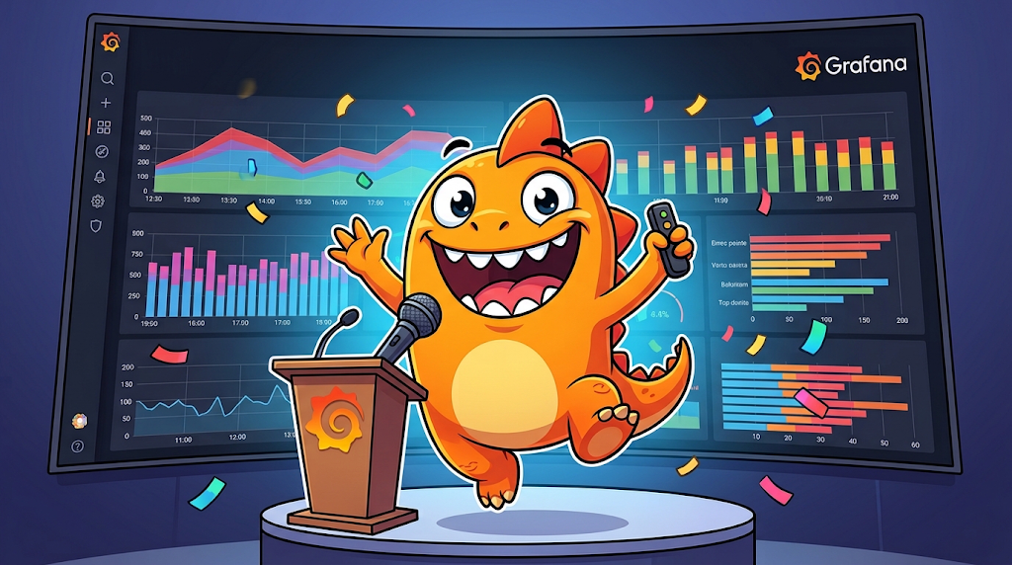
Demo!
Notes:
SWITCH TO THE DASHBOARD. Pre-set the filters before you start talking. Avoid: Cluster Health gauge (thresholds inverted, 100% healthy renders red), Project Ready Status (same), ArgoCD Reconcile Latency (a committed hideSeriesFrom hides p95/p99), Global Max Clusters gauge (ratio inverted, reads ~2000%), Project to Cluster Mapping (broken join, empty columns). Next three slides are your fallback if the demo dies.

Slide 18
Your operator already knows why it's stuck.
It writes conditions every reconcile. Just export them!
One gauge · condition as a label · min to aggregate
Notes:
The transferable takeaway — not Grafana-specific, not KPP-specific. This is the line you want repeated at the bar afterwards. ~30s.

Slide 19
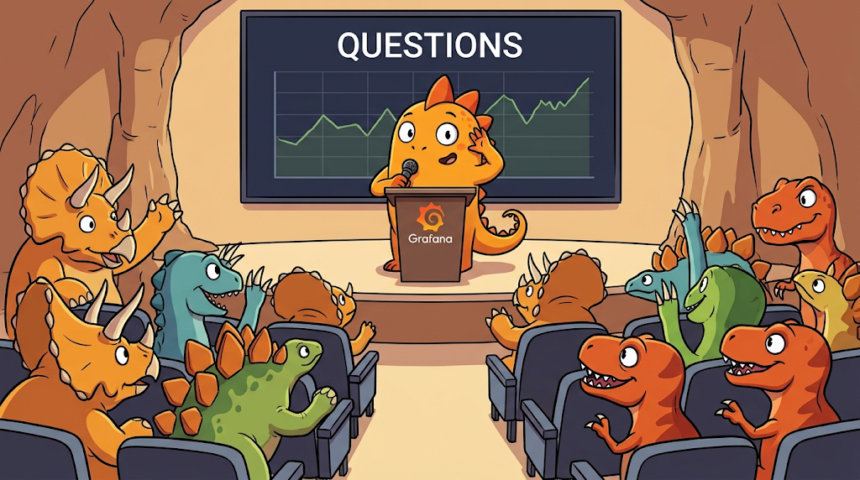
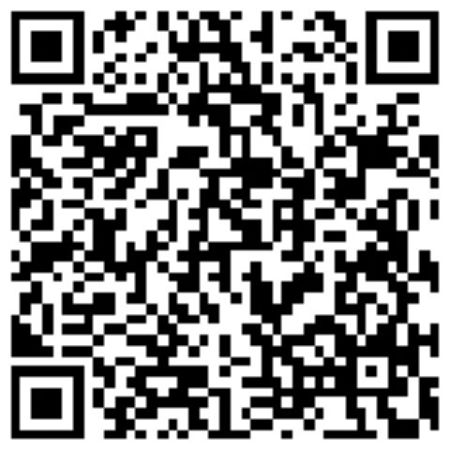

Questions?
LET'S CONNECT!
LinkedIn
linkedin.com/in/goutham-kanags
GitHub
github.com/gouthamhusky
Notes:
Leave this up for the whole Q&A. Expect: "why not kube-state-metrics CRS metrics?" (answer: you may not need Go at all — good question, take it), "what's your cardinality?" and "why VictoriaMetrics?".

