Slide 1
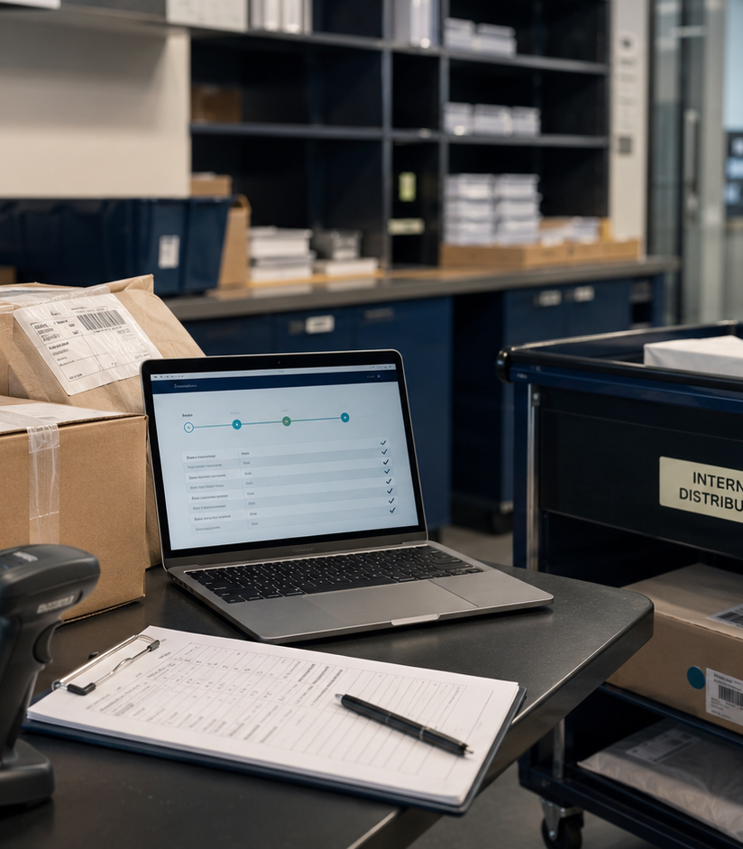
ONE ACCOUNTABLE WORKFLOW ACROSS THREE LOCATIONS
Centralized Receiving
Gouthami Vadithya
Procurement · Supply Chain · Operations
Notes:
[Sources]
- User-provided resume and portfolio project content.
- Representative project visual generated for this portfolio.

Slide 2
The problem worth solving
02
Receiving practices varied by location, weakening traceability between delivery, inspection, internal distribution, goods receipt, and invoice matching.
WHY IT MATTERED
The issue affected decisions, ownership, and execution, not just reporting.
3 locations · SAP Ariba · Process design
Notes:
[Sources]
- User-provided resume and portfolio project content.
- Representative project visual generated for this portfolio.

Slide 3
How I approached the work
03
01
02
03
04
Mapped the current state from the PO
Defined scan and inspection controls
Assigned handoffs and ownership
Connected receipts to invoice exceptions
The sequence moved from defining the decision to building evidence, testing options, and making the recommendation usable.
Notes:
[Sources]
- User-provided resume and portfolio project content.
- Representative project visual generated for this portfolio.

Slide 4
What changed
Designed a single receiving model covering the full journey from approved purchase order to internal delivery and three-way match.
3 locations · SAP Ariba · Process design
Portfolio case study by Gouthami Vadithya
Notes:
[Sources]
- User-provided resume and portfolio project content.
- Representative project visual generated for this portfolio.

