Slide 1
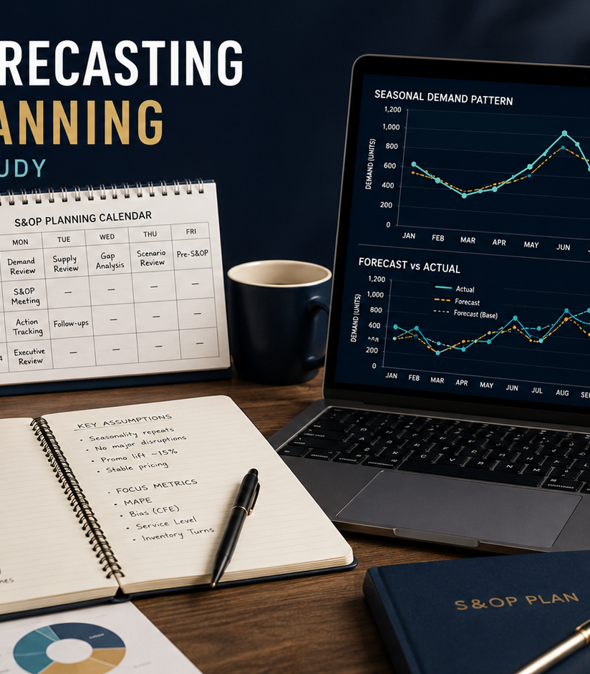
ACADEMIC CASE STUDY
Demand Forecasting and S&OP
Gouthami Vadithya
Procurement · Supply Chain · Operations
Notes:
[Sources]
- User-provided resume and portfolio project content.
- Representative project visual generated for this portfolio.

Slide 2
The problem worth solving
02
Seasonal demand, promotions, and forecast bias made a single historical average unreliable for inventory and capacity decisions.
WHY IT MATTERED
The issue affected decisions, ownership, and execution, not just reporting.
Academic model · Forecasting · Scenario planning
Notes:
[Sources]
- User-provided resume and portfolio project content.
- Representative project visual generated for this portfolio.

Slide 3
How I approached the work
03
01
02
03
04
Separated trend and seasonality
Compared forecasting methods
Measured MAPE and bias
Built base, upside, and downside plans
The sequence moved from defining the decision to building evidence, testing options, and making the recommendation usable.
Notes:
[Sources]
- User-provided resume and portfolio project content.
- Representative project visual generated for this portfolio.

Slide 4
What changed
Produced a modeled, decision-ready forecast connected to inventory, capacity, and a monthly S&OP cadence.
Academic model · Forecasting · Scenario planning
Portfolio case study by Gouthami Vadithya
Notes:
[Sources]
- User-provided resume and portfolio project content.
- Representative project visual generated for this portfolio.

