Slide 1
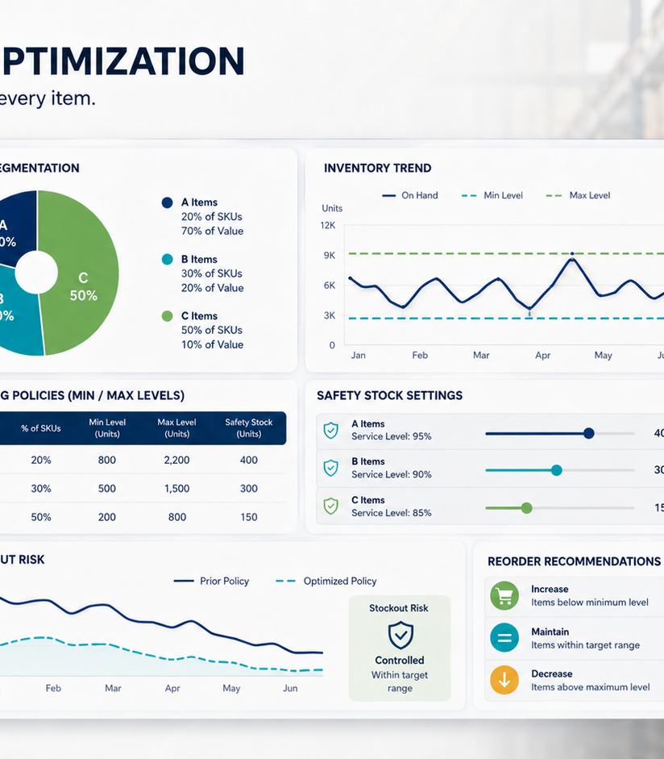
RESETTING REPLENISHMENT RULES AROUND VALUE AND DEMAND
Inventory Optimization
Gouthami Vadithya
Procurement · Supply Chain · Operations
Notes:
[Sources]
- User-provided resume and portfolio project content.
- Representative project visual generated for this portfolio.

Slide 2
The problem worth solving
02
Static reorder settings did not reflect differences in item value, demand variability, or lead time.
WHY IT MATTERED
The issue affected decisions, ownership, and execution, not just reporting.
Tableau · ABC analysis · Safety stock
Notes:
[Sources]
- User-provided resume and portfolio project content.
- Representative project visual generated for this portfolio.

Slide 3
How I approached the work
03
01
02
03
04
Segmented items using ABC analysis
Reset min, max, and safety stock
Linked policy to demand behavior
Built inventory-risk visibility
The sequence moved from defining the decision to building evidence, testing options, and making the recommendation usable.
Notes:
[Sources]
- User-provided resume and portfolio project content.
- Representative project visual generated for this portfolio.

Slide 4
What changed
Improved replenishment discipline and identified $30K in annual carrying-cost savings in the project analysis.
Tableau · ABC analysis · Safety stock
Portfolio case study by Gouthami Vadithya
Notes:
[Sources]
- User-provided resume and portfolio project content.
- Representative project visual generated for this portfolio.

