Slide 1
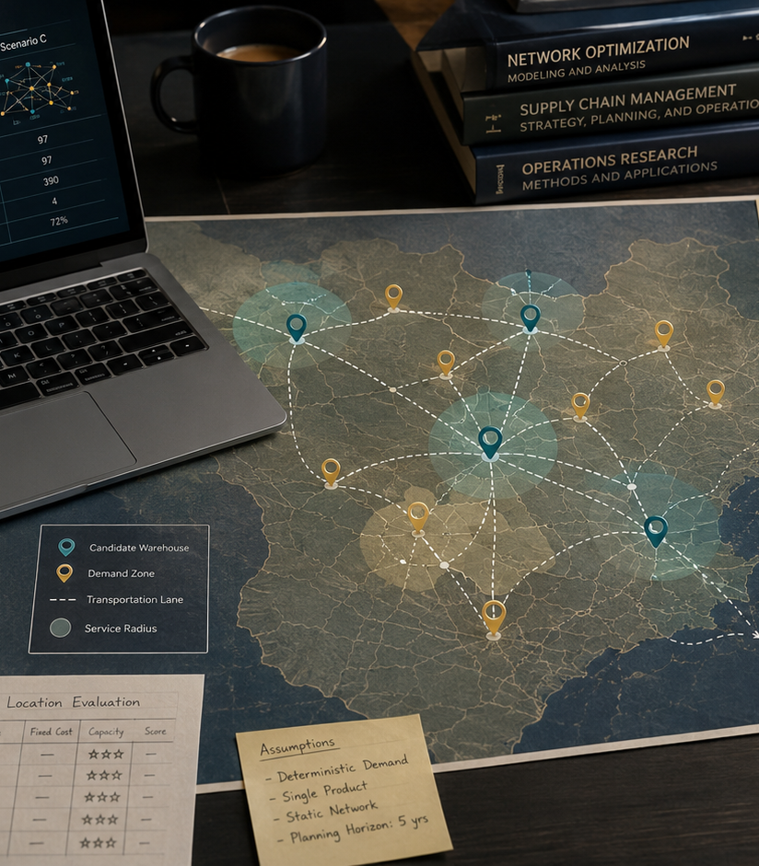
ACADEMIC CASE STUDY
Supply Chain Network Design
Gouthami Vadithya
Procurement · Supply Chain · Operations
Notes:
[Sources]
- User-provided resume and portfolio project content.
- Representative project visual generated for this portfolio.

Slide 2
The problem worth solving
02
The lowest fixed-cost network increased delivery distance, while the highest-service network added facility cost and excess capacity.
WHY IT MATTERED
The issue affected decisions, ownership, and execution, not just reporting.
Academic model · Network optimization · Logistics
Notes:
[Sources]
- User-provided resume and portfolio project content.
- Representative project visual generated for this portfolio.

Slide 3
How I approached the work
03
01
02
03
04
Mapped demand and candidate sites
Modeled capacity and lane cost
Compared three network scenarios
Stress-tested growth and disruption
The sequence moved from defining the decision to building evidence, testing options, and making the recommendation usable.
Notes:
[Sources]
- User-provided resume and portfolio project content.
- Representative project visual generated for this portfolio.

Slide 4
What changed
Recommended a modeled distribution network that balanced cost, service coverage, capacity, and resilience.
Academic model · Network optimization · Logistics
Portfolio case study by Gouthami Vadithya
Notes:
[Sources]
- User-provided resume and portfolio project content.
- Representative project visual generated for this portfolio.

