Slide 1
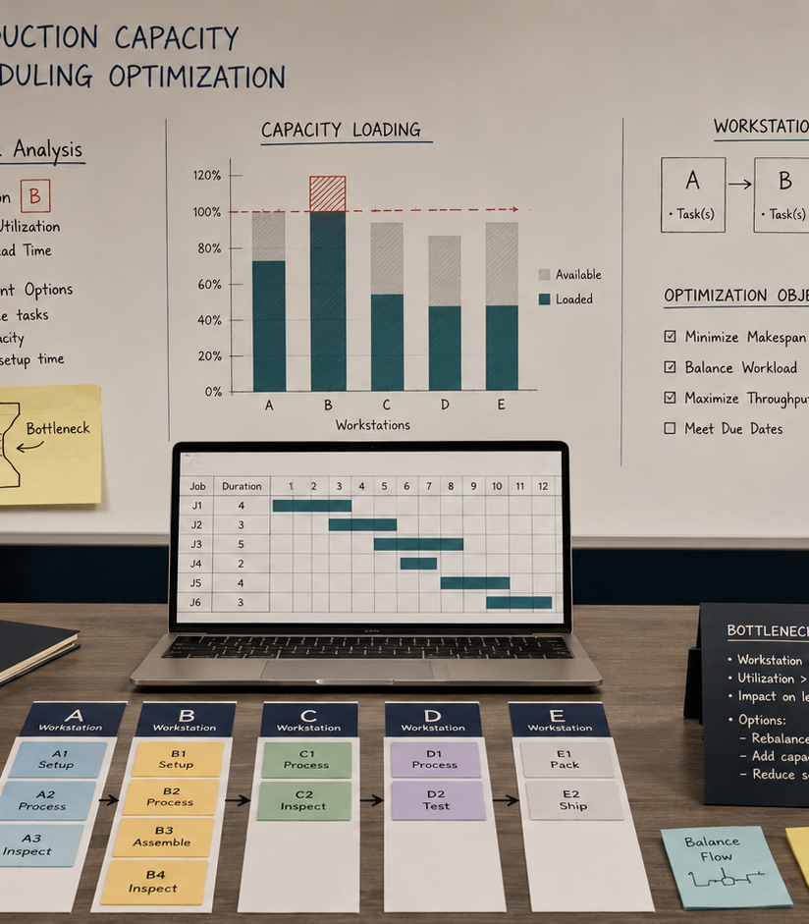
ACADEMIC CASE STUDY
Production Capacity and Scheduling
Gouthami Vadithya
Procurement · Supply Chain · Operations
Notes:
[Sources]
- User-provided resume and portfolio project content.
- Representative project visual generated for this portfolio.

Slide 2
The problem worth solving
02
A due-date-only schedule overloaded one constrained workstation and created a plan that was aggressive but not operationally feasible.
WHY IT MATTERED
The issue affected decisions, ownership, and execution, not just reporting.
Academic model · Capacity · Operations research
Notes:
[Sources]
- User-provided resume and portfolio project content.
- Representative project visual generated for this portfolio.

Slide 3
How I approached the work
03
01
02
03
04
Mapped routes and processing time
Identified the bottleneck
Compared sequencing rules
Tested capacity and setup scenarios
The sequence moved from defining the decision to building evidence, testing options, and making the recommendation usable.
Notes:
[Sources]
- User-provided resume and portfolio project content.
- Representative project visual generated for this portfolio.

Slide 4
What changed
Built a modeled schedule with less congestion at the constraint and clearer job-priority tradeoffs.
Academic model · Capacity · Operations research
Portfolio case study by Gouthami Vadithya
Notes:
[Sources]
- User-provided resume and portfolio project content.
- Representative project visual generated for this portfolio.

