Slide 1
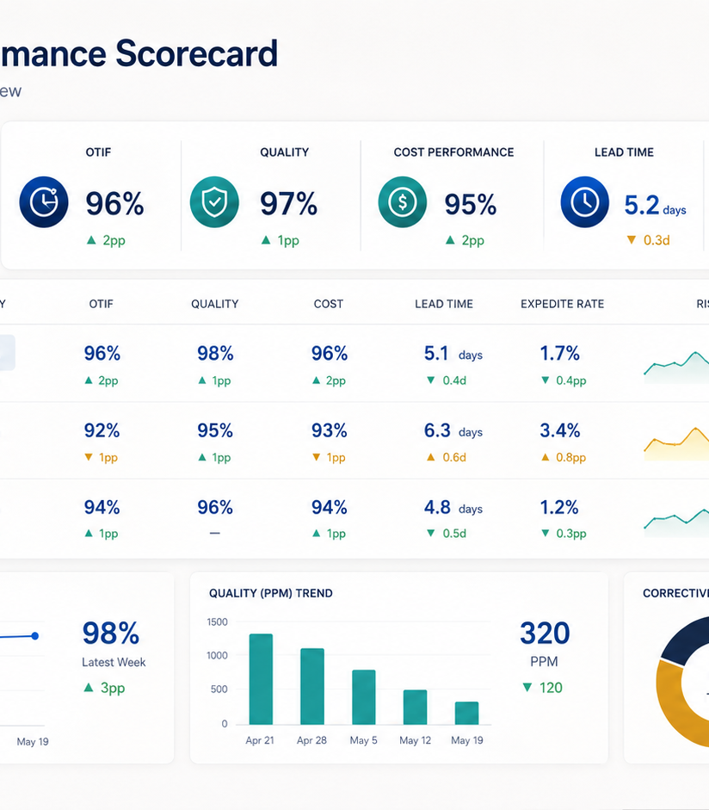
TURNING SUPPLIER DATA INTO WEEKLY CORRECTIVE ACTION
Supplier Performance Scorecard
Gouthami Vadithya
Procurement · Supply Chain · Operations
Notes:
[Sources]
- User-provided resume and portfolio project content.
- Representative project visual generated for this portfolio.

Slide 2
The problem worth solving
02
Supplier conversations were reactive and spread across delivery updates, quality issues, expediting, and cost discussions.
WHY IT MATTERED
The issue affected decisions, ownership, and execution, not just reporting.
OTD · OTIF · Quality · Cost · Corrective action
Notes:
[Sources]
- User-provided resume and portfolio project content.
- Representative project visual generated for this portfolio.

Slide 3
How I approached the work
03
01
02
03
04
Defined shared performance measures
Built a weekly supplier scorecard
Prioritized risk using trends
Assigned corrective actions and owners
The sequence moved from defining the decision to building evidence, testing options, and making the recommendation usable.
Notes:
[Sources]
- User-provided resume and portfolio project content.
- Representative project visual generated for this portfolio.

Slide 4
What changed
Established one fact base for supplier reviews and supported 98% delivery performance with clearer accountability.
OTD · OTIF · Quality · Cost · Corrective action
Portfolio case study by Gouthami Vadithya
Notes:
[Sources]
- User-provided resume and portfolio project content.
- Representative project visual generated for this portfolio.

