Slide 1
ITServicePro
IT Services Management Portal
A centralized dashboard for managing support tickets,
service requests, IT assets, clients, and knowledge.
Mini Project Presentation
Presented by: ____________________ | Department: ____________________
ITServicePro | IT Services Management Portal 1

Slide 2
Problem Statement & Objectives
Why a unified IT service portal is useful
Problem Statement
Project Objectives
• IT issues may be reported through scattered messages or manual communication.
• Tracking ticket status and ownership can be difficult.
• Hardware assets, clients, and service requests may be recorded separately.
• Managers need a quick view of workload and service activity.
• Provide one interface for common IT support operations.
• Create, search, resolve, and delete support tickets.
• Record service requests, IT assets, and client details.
• Display summary statistics and support CSV reporting.
ITServicePro | IT Services Management Portal 2

Slide 3
System Overview
High-level workflow of the ITServicePro portal
1
Administrator / User
Opens the portal and selects a module
2
Web Interface
Forms, tables, navigation, and dashboard cards
3
Application Logic
Validates input and handles create/update/delete actions
4
Data Storage
Stores tickets, requests, assets, and client records
5
Reports
Calculates totals and exports ticket data
ITServicePro | IT Services Management Portal 3

Slide 4
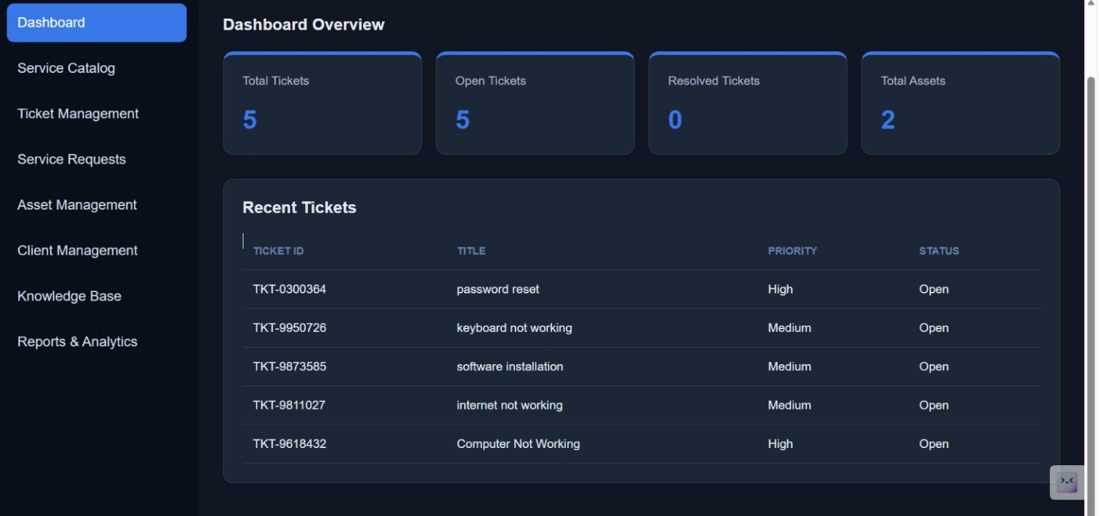
Dashboard Overview
Summary cards and recent-ticket table
ITServicePro | IT Services Management Portal 4

Slide 5
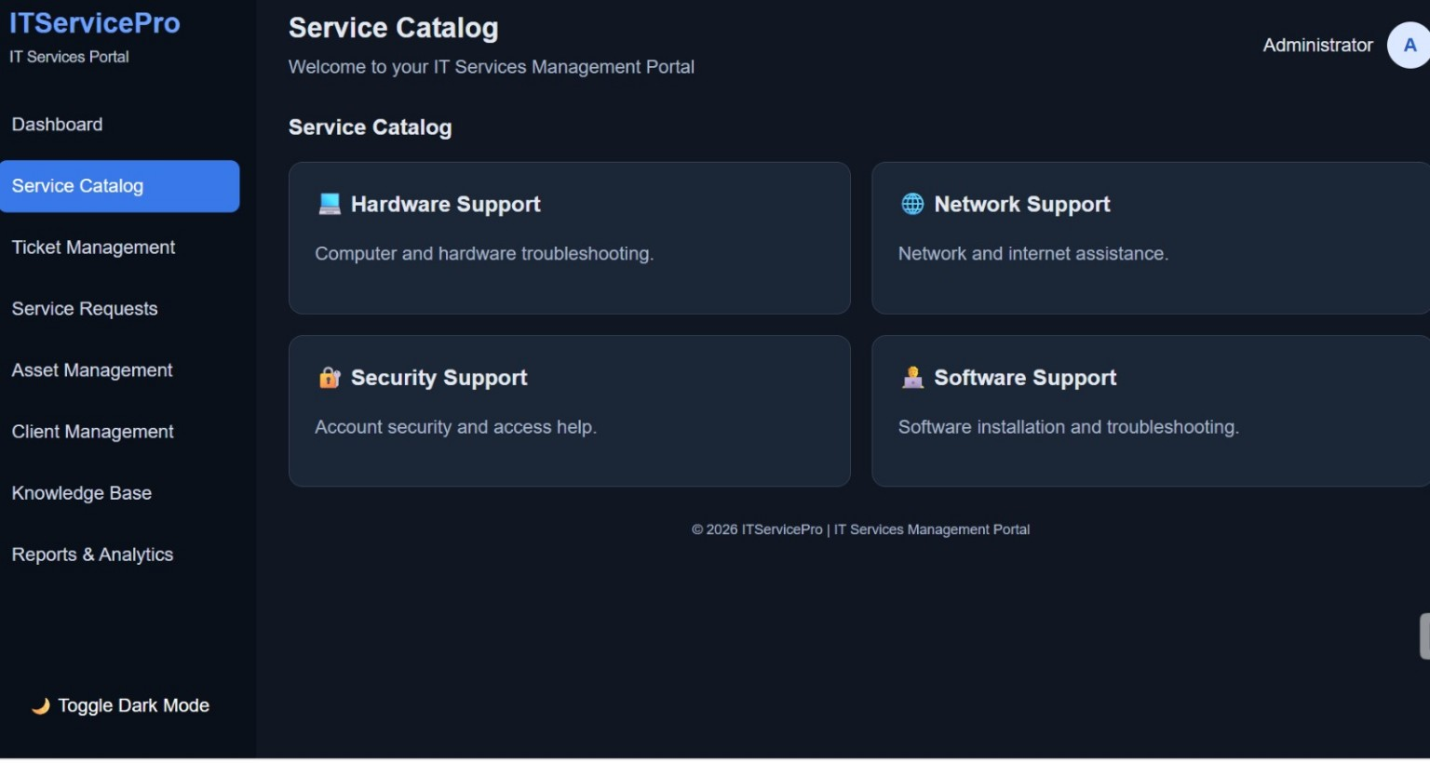
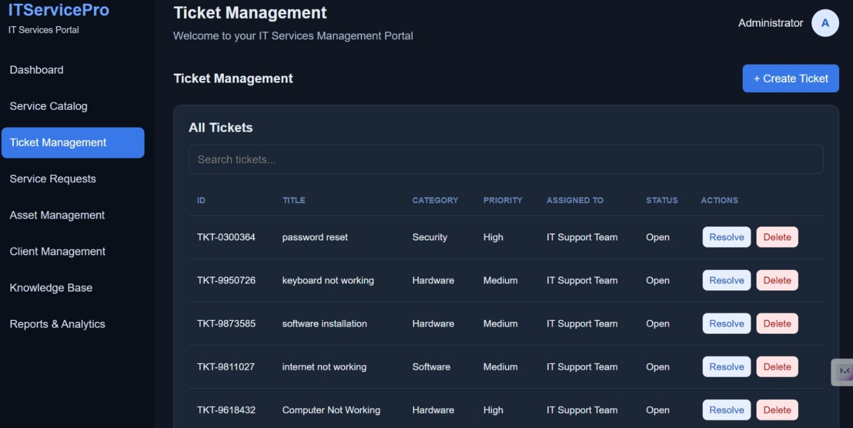
Service Catalog & Ticket Management
Browse support categories and manage issue lifecycle
ITServicePro | IT Services Management Portal 5

Slide 6
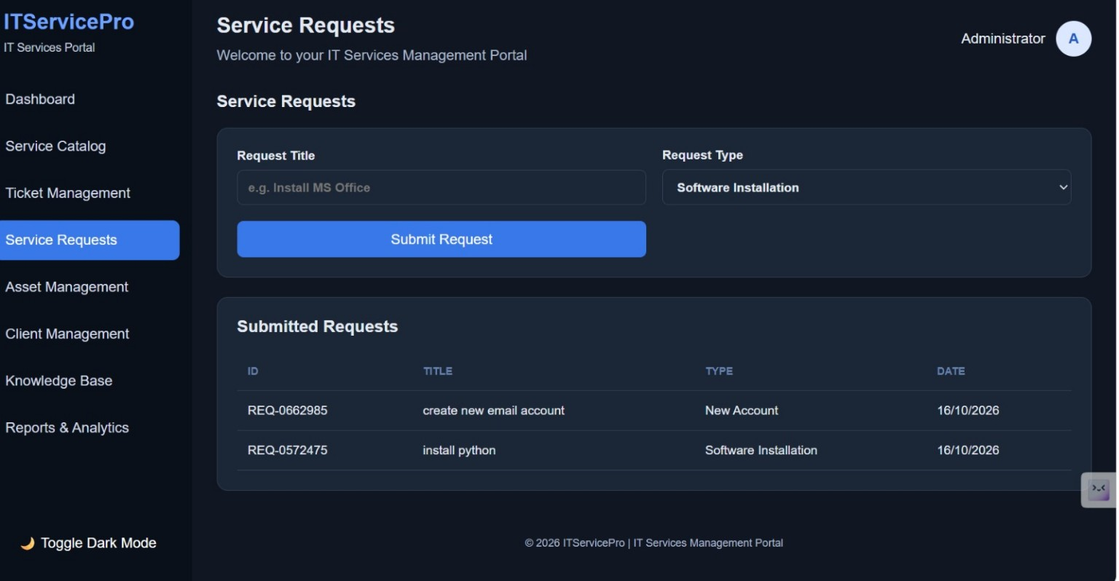
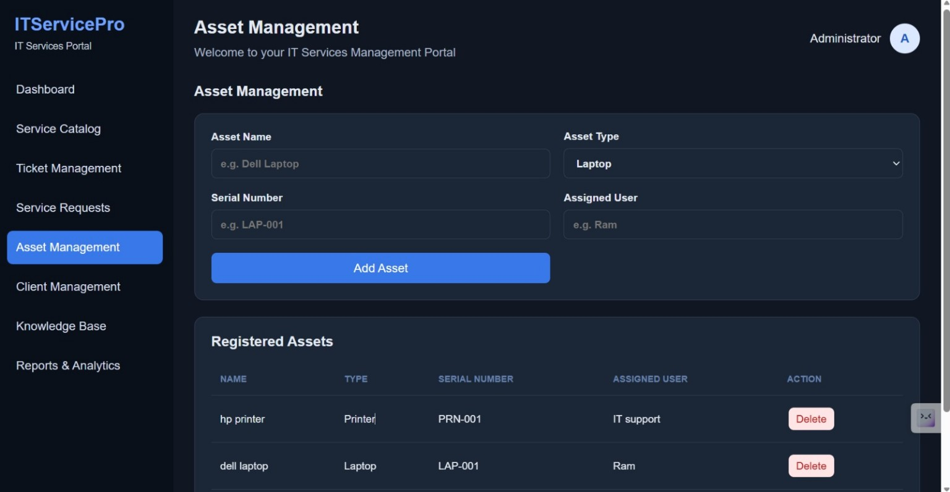
Service Requests & Asset Management
Capture service needs and maintain an inventory
ITServicePro | IT Services Management Portal 6

Slide 7
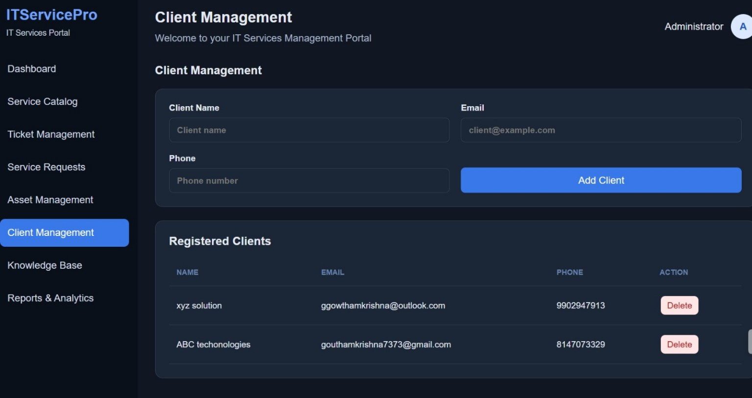
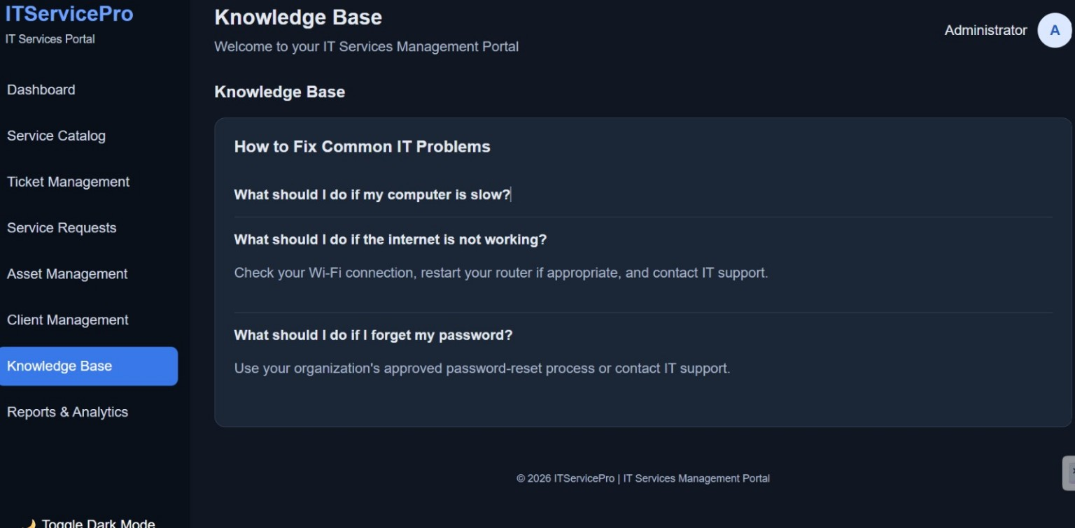
Client Management & Knowledge Base
Maintain client contacts and provide self-help guidance
ITServicePro | IT Services Management Portal 7

Slide 8
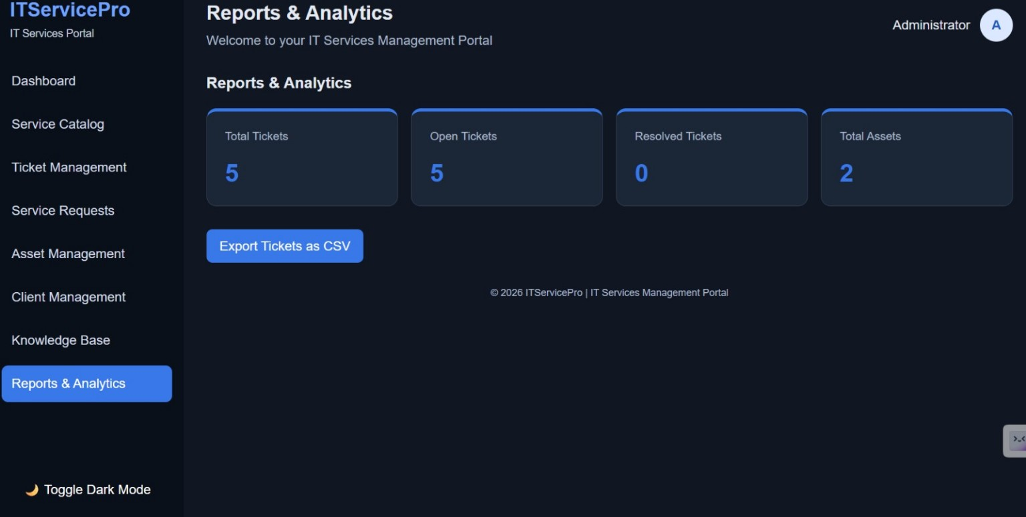
Reports & Analytics
At-a-glance metrics and ticket export
ITServicePro | IT Services Management Portal 8

Slide 9
Next Steps & Future Enhancements
Recommended work to move from a polished prototype to a reliable system
• Connect a persistent database such as SQLite or MySQL so records remain after refresh/restart.
• Add secure login, role-based access, and password hashing.
• Validate all form fields and prevent duplicate serial numbers or invalid contact details.
• Add ticket editing, assignment, comments, timestamps, and priority/status filters.
• Make dashboard metrics update automatically from stored records.
• Test every button, empty form, invalid input, delete confirmation, and CSV export.
• Improve accessibility and responsive layout for mobile and tablet screens.
ITServicePro | IT Services Management Portal 9

Slide 10
Conclusion
ITServicePro brings common IT support activities into a single portal. The current interface demonstrates ticket tracking, service requests, asset and client records, a knowledge base, and reporting. The next priority is to verify the workflows end-to-end and connect secure persistent storage so the dashboard reflects real data.
Thank You
ITServicePro | IT Services Management Portal 10

