Slide 1
MCIS 6204 - Data Structure and Algorithms (C++ Labs) Lab#3
MCIS 2018

Slide 2
Overview
Lab3#A
Lab3#B

Slide 3
- Input Data
Lab3A
Lab3Adata.txt
0.7497790548868464
0.6462076498775827
0.32616335534841256
0.37582682849958304
-999.99
0.41621372481399
0.6463706270883212
0.7655177221930171
0.2650562905607654
0.14762994129539841
0.9627229328823885
-999.99
0.08133929860959621
0.9560335264804165
0.8155875415237163
-999.99
0.019074104888079813
0.8270564200270186
-999.99
0.7497790548868464 0.6462076498775827 0.32616335534841256 0.37582682849958304 -999.99 | 0.08133929860959621 0.9560335264804165 0.8155875415237163 -999.99
0.41621372481399 0.6463706270883212 0.7655177221930171 0.2650562905607654 0.14762994129539841 0.9627229328823885 -999.99 | 0.019074104888079813 0.8270564200270186 -999.99

Slide 4
- Output Result
Lab3A
The previous group had a sum of 2.10.
The current overall total had a sum of 2.10.
The previous group had a sum of 3.20.
The current overall total had a sum of 5.30.
The previous group had a sum of 1.85.
The current overall total had a sum of 7.15.
The previous group had a sum of 0.85.
The current overall total had a sum of 8.00.
The overall total had a sum of 8.00.

Slide 5
Sentinel value
A sentinel value is a special value in the context of an algorithm which uses its presence as a condition of termination.
int main( )
{
const double SENT = -999.99;
while ( input != SENT)
{
}
}

Slide 6
Functions
The Top-down design approach is based on dividing the main problem into smaller tasks, then implementing each simple task by a subprogram or a function.
In programming, function refers to a segment that groups code to perform a specific task. Depending on whether a function is predefined or created by programmer.

Slide 7
Advantages of Top-down Design
Breaking the problem into parts helps us to clarify what needs to be done
At each steps of refinement, the new parts become less complicated
Part of the solution may turn out to be reusable
Breaking the problem into parts allows more than one person to work on the solution

Slide 8
Types of function
Two type of function:
1. Library function
2. User-defined function
Library functions are the bult-in function in C++. Programmer can user library function by invoking function directly.
User-defined function allows programmer to define their own function.

Slide 9
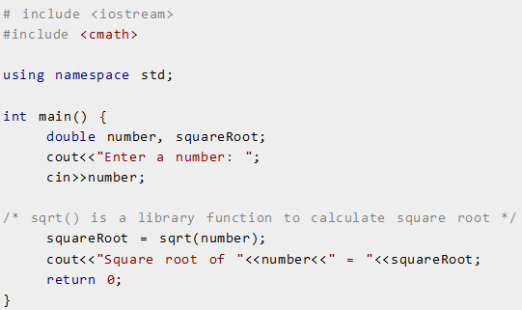
Library Function
sqrt( ) library function is invoked to calculate the square root of a number. sqrt( ) is written in #include <cmath>

Slide 10
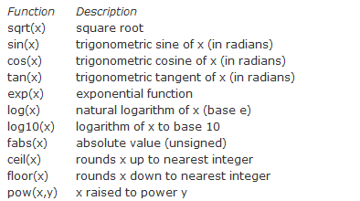
Built-in functions in #include <cmath>
Math library functions allow the programmer to perform a number of common mathematical calculations:

Slide 11
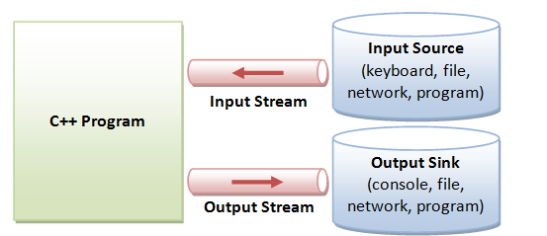
Stream IO
C++ IO are based on streams, which are sequence of bytes flowing in and out of the program(just like water flowing through a pipe).
In input operation, data byte flow from an input source into the program. In output operations, data bytes flow from the program to an output sink.
cout << value;
cin >> variable;
Formatted output is carried out on streams via the stream insertion << and

Slide 12
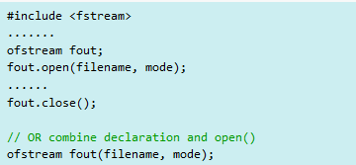
File Output
The steps are:
1. Construct an ofstream object.
2. Connect it to a file(i.e., file open) and set the mode of file
operation.
3. Perform output operation via insertion >> operator or
write( ), put( ) functions.
4. Disconnect and free the ofstream object.

Slide 13
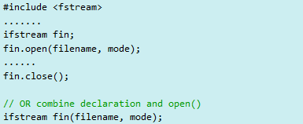
File Input
The steps are:
1. Construct an ifstream object.
2. Connect it to a file(i.e., file open) and set the mode of file
operation.
3. Perform output operation via extraction << operator or
read( ), get( ), getline functions.
4. Disconnect and free the ifstream object.

Slide 14
File Open Modes
The available file mode flags are:
ios::in | Open for input operations.
ios::out | Open for output operations.
ios::binary | Open in binary mode.
ios::ate | Set the initial position at the end of the file. If this flag is not set, the initial position is the beginning of the file.
ios::app | All output operations are performed at the end of the file, appending the content to the current content of the file.
ios::trunc | If the file is opened for output operations and it already existed, its previous content is deleted and replaced by the new one.

Slide 15
basic file I/O – write
Create file and put some text into it.
#include <iostream> #include <fstream> //To use C++’s function for File I/O. using namespace std; int main ( ) { ofstream SaveFile; SaveFile.open (“cpp-file.txt”, ios::out); // D:/C++/Day4/Day4/cpp-file.txt SaveFile << “Save some text into file “; SaveFile.close( ); return 0; }

Slide 16
basic file I/O – read
Create file and put some text into it.
#include <iostream> #include <fstream> //To use C++’s function for File I/O using namespace std; int main ( ) { ifstream InFile; InFile.open ("D:/C++/Day4/Lab4.txt“,ios::in); double aNumber; while (!InFile.eof()) // { InFile >> aNumber; cout << aNumber << " \n"; } OpenFile.close(); cin >> aNumber; return 0; }

Slide 17
Program Structure
#include <iostream> #include <fstream> using namespace std; double readData(double SENT, ifstream *openfile); int main ( ) { ifstream InFile; InFile.open ("D:/C++/Day4/Lab4.txt“,ios::in); Overall Sum; return 0; } Double readData(double sent, ifstream *Openfile) { group Sum }

Slide 18
Function Prototyping
double readData(double sent, ifstream *openfile);
The prototype describes the function interface to compiler by giving details such as:
- Functions name
- Type signature (number of argument,
parameter type, and return type)
When the function is called, the compiler use the template to ensure that proper arguments are passed, and the return value is treated correctly.

Slide 19
Function Prototyping continued …
Function prototype is a declaration statement in the calling program.
type function-name ( parameter-list);
The argument-list contains the types and names of arguments that must be passed to the function.
Each argument variable must be declared independently inside the parentheses.
foat avg(int x, int y); //Correct Optional
float avg(int, int ); //Correct
foat avg(int x, y ); //Illegal

Slide 20
Function Prototyping – Earlier versions of C
#include <stdio.h>
/* If this prototype is provided, the compiler will catch the error in
int main().
If it is omitted, then the error may go unnoticed.
*/
int myfunction(int n); /*Prototype */
int main(void) { /*Calling function */
printf("%d\n", myfunction());/*Error:forgot argument to myfunction */
return 0;
}
int myfunction(int n) { /* Called function definition */
if (n == 0)
return 1;
else
return n * myfunction(n - 1);
}

Slide 21
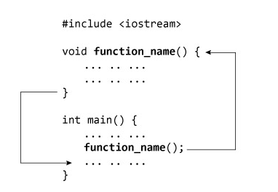
User-defined Function
A user-defined function groups code to perform a specific task and that group of code is given a name(identifier).

Slide 22
User-defined Function – Format
type name ( par1, par2, …,n ) { Statement }
type is the function data type specifier of the data returned by the function.
name is the identifier by which it will be possible to call the function.
Par1, Par2, …n : Each parameter consist of a data type specifier followed by an identifier.
Statement is the function’s body. It is a block of statement surrounded by braces { }.

Slide 23
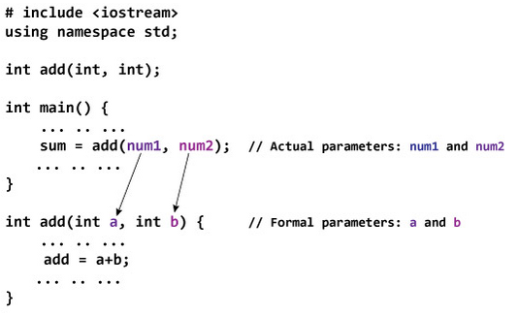
Passing Argument to Function
In programming, argument refers to data this is passed to function(function definition) while calling function.

Slide 24
Argument VS. Parameter
A parameter represents a value that the procedure expects you to pass when you call it. The procedure's declaration defines its parameters.
An argument represents the value you pass to a procedure parameter when you call the procedure. The calling code supplies the arguments when it calls the procedure.

Slide 25

Argument VS. Parameter
A function parameter (formal parameter) is a variable declared in the function declaration:

Slide 26

Argument VS. Parameter
An argument(actual parameter) is the value that is passed to the function by caller:

Slide 27
Argument vs. Parameter - examples
Void | Non void
void addition (int a, int b) { int r; r=a+b; cout << "The result is " << z; } int main () { int z; addition (5,3); return 0; } | int addition (int Par1, int Par2) { int r; r=a+b; return (r); } int main () { int z; z = addition (Arg1, Arg2); cout << "The result is " << z; return 0; }

Slide 28
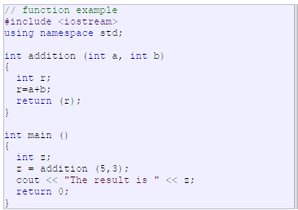
User-defined Function – Example

Slide 29

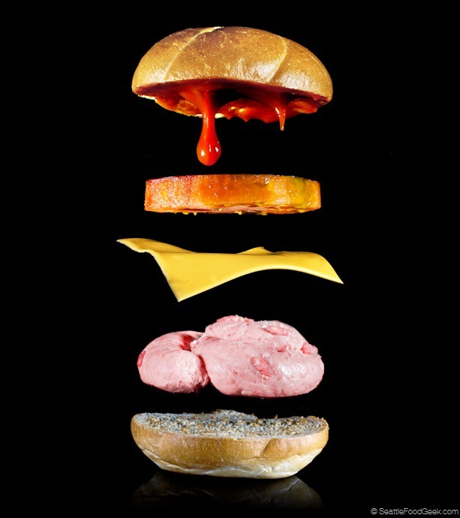


How to buy a hamburger ?
int main( )
{
string hanguger = “ “;
int dollars = 10;
hamburger = getHamburger(dollars);
return 0;
}
string SgetHamburger(int dollar)
{
String hamburger = “ “;
String Cheese = “Cheese”;
String Bread = “Bread”;
if (dollar == 10)
hambuger = Cheese + Bread;
return hamburger;
}

Slide 30
What is sentinel values ?
Whenever you read a sequence of inputs , you need to have some method of indicating the end of the sequence.
In this case we use sentinel values which is not an actual input but serves as a singnal for termination.
cin >> salary;
while ( salary != -999.99)
{
sum = sum + salary ;
}
0.7497790548868464 0.6462076498775827 0.32616335534841256 0.37582682849958304
-999.99
0.41621372481399 0.14762994129539841 0.9627229328823885
-999.99

Slide 31
int main( )
{
const double SENT = -999.99;
while( !OpenFile.eof())
{
groupSum = readData(&OpenFile, SENT);
}
} // end of main method
0.7497790548868464 0.6462076498775827 0.32616335534841256 0.37582682849958304
-999.99
0.41621372481399 0.14762994129539841 0.9627229328823885
-999.99
double readData(*OpenFile, double sent)
{
*OpenFile >> input;
while ( input != SENT )
{
sum = sum + input ;
*OpenFile >> input;
}
return sum;
}

Slide 32
Function Calling in C++
There are two ways to pass parameters to functions.
- Pass by Value
- Pass by Reference
Until now, in all the function we have seen, the argument passed to the functions have been passed by value.
This means that when calling a function with parameters, what we have passed to the function were copies of their values.

Slide 33
Function Calling - Pass by reference
A C++ program can pass to a function the memory location(reference) of the variable used to make the function call, instead of copying their values.
Any change to the value of parameters will change the value of the variable of the calling function.
Main | Function
int main ( ) { int x =1; y = 3, z =7; duplicate (x, y, z ); cout << x << y << z; } | void duplicate (int &a, int &b, int &c) { a*=2; // a = a * 2; b*=2; c*=2; }

Slide 34
Function Calling - Pass by reference & Value
…
double readData(double SENT, ifstream *openfile);
int main ( )
{
ifstream OpenFile;
OpenFile.open ("D:/C++/Day4/Lab4.txt“,ios::in);
double groupsum = readData( SENT, &OpenFile );
return 0;
}
double readData(double sent, ifstream *Openfile)
{
…
return groupSum;
}

Slide 35
C++ Pointers
C++ Pointers are easy and fun to learn. Some C++ task are performed more easily with pointers, and other C++ tasks (dynamic memory allocation) cannot be performed without them.
As you know every variable is a memory location and every location has its address defined which can be accessed using ampersand(&) operator an address in memory.

Slide 36
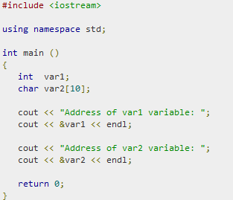

C++ Pointers - Example

Slide 37

What are the pointers ?
A Pointer is a variable whose value is the address of another variable. Like any variable or constant, you must declare a pointer before you can work with it.
type *var-name;

Slide 38
Reference and Dereference Operator ( & , * )
& is the reference operator and can be read as “address of”
* is the dereference operator and can be read as “value pointed by”

Slide 39
Example Reference operator &
andy = 25;
fred = andy;
ted = &andy;

Slide 40
Example Dereference operator *
andy = 25;
fred = andy;
ted = &andy;
beth = *ted;

Slide 41
Using Pointers in C++
There are few important operations, which we will do with the pointers very frequently.
(a) Define a pointer variables
int *ip;
(b) Assign the address of a variable to a pointer
ip = &var;
(c) Finally access the value at the address available
in the pointer variable
cout << ip << endl; // address stored in ip
cout << *ip << endl; // value pointer by ip

Slide 42
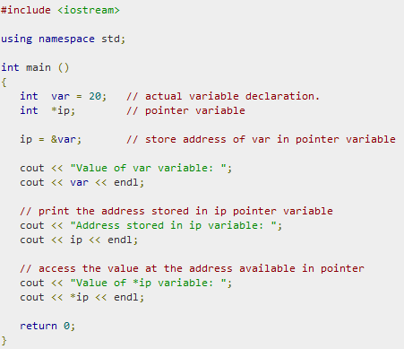
Using Pointers in C++ - Examples
ip ?
*ip ?

Slide 43
Address Operator &
The “address of” operator (&) gives the memory address of variable
Memory address:
1020
1024
…
…
100
…
…
…
a
int a = 100;
//get the value,
cout << a; //prints 100
//get the memory address
cout << &a; //prints 1024

Slide 44
Address Operator &
Memory address:
1020
1024
1032
…
88
100
…
…
…
a
b
#include <iostream>
using namespace std;
void main(){
int a, b;
a = 88;
b = 100;
cout << "The address of a is: " << &a << endl;
cout << "The address of b is: " << &b << endl;
}
Result is:
The address of a is: 1020
The address of b is: 1024

Slide 45
Pointer Variables
Memory address:
The value of pointer p is the address of variable a
A pointer is also a variable, so it has its own memory address
1020
1024
1032
…
88
100
…
1024
…
a
p
int a = 100;
int *p = &a;
cout << a << " " << &a <<endl;
cout << p << " " << &p <<endl;
Result is:
100 1024
1024 1032

Slide 46
Dereferencing Operator *
We can access to the value stored in the variable pointed to by using the dereferencing operator (*),
Memory address:
1020
1024
1032
…
88
100
…
1024
…
a
p
int a = 100;
int *p = &a;
cout << a << endl;
cout << &a << endl;
cout << p << " " << *p << endl;
cout << &p << endl;
Result is:
100
1024
1024 100
1032

Slide 47
Function Calling - Pass by reference & Value
…
double readData(double SENT, ifstream *openfile);
int main ( )
{
ifstream OpenFile;
OpenFile.open ("D:\\C++\\Day4/Lab4.txt“,ios::in);
double groupsum = readData( SENT, &OpenFile );
return 0;
}
double readData(double sent, ifstream *Openfile)
{
…
return groupSum;
}

Slide 48
Read data from the file -1
#include <iostream>
#include <fstream>
int main ( )
{
ifstream OpenFile;
OpenFile.open ("D:\C++\Day4/Lab4.txt“,ios::in);
double groupsum = readData( SENT, &OpenFile );
return 0;
}
double readData(double sent, ifstream *Openfile)
{
…
return groupSum;
}

Slide 49
Read data from the file -2
0.7497790548868464
0.6462076498775827
0.32616335534841256
0.37582682849958304
-999.99
0.41621372481399
0.6463706270883212
0.7655177221930171
0.2650562905607654
0.14762994129539841
0.9627229328823885
-999.99
0.08133929860959621
0.9560335264804165
0.8155875415237163
-999.99
0.019074104888079813
0.8270564200270186
-999.99
double readData(double sent, ifstream *Openfile);
{
*Openfile >> Input;
…
return groupSum;
}

Slide 50
while loop
Loops
- Repeat a statement number of times to be executed
- Must group them in a block by enclosing them in braces { }
Flowchart of while loop
format
while ( expression ) statement;
true
condition
statement
false

Slide 51
while loop example -1
This program displays the numbers
1 through 10 and their squares
#include <iostream.h>
void main(void)
{
int num = 1; // Initialize counter
cout << "number number Squared\n";
cout << "-------------------------\n";
while (num <= 10)
{
cout << num << "\t\t" << (num * num) << endl;
num++; // Increment counter
}
}

Slide 52
program output -1
number number Squared
------------------------- 1 1 2 4 3 9 4 16 5 25 6 36 7 49 8 64 9 81 10 100

Slide 53
Read data from the file -2
0.7497790548868464
0.6462076498775827
0.32616335534841256
0.37582682849958304
-999.99
0.41621372481399
0.6463706270883212
0.7655177221930171
0.2650562905607654
0.14762994129539841
0.9627229328823885
-999.99
0.08133929860959621
0.9560335264804165
0.8155875415237163
-999.99
0.019074104888079813
0.8270564200270186
-999.99
double readData(double sent, ifstream *Openfile);
{
double groupsum;
*Openfile >> Input;
while (input != sent)
{
groupsum += groupsum;
}
return groupsum;
}

Slide 54
Function Calling - Pass by reference & Value
int main ( )
{
ifstream OpenFile;
OpenFile.open ("D:\\C++\\Day4/Lab4.txt“,ios::in);
double groupsum = readData( SENT, &OpenFile );
return 0;
}
double readData(double sent, ifstream *Openfile)
{
… while (input != sent)
{
groupsum += groupsum;
}
return groupsum;
}

Slide 55
How to handle next group ?
int main ( )
{
double OverAllsum=0; double GroupSum =0;
ifstream OpenFile;
OpenFile.open ("D:\\C++\\Day4/Lab4.txt“,ios::in);
double groupsum = readData( SENT, &OpenFile );
return 0;
}

Slide 56
How to handle next group ?
int main ( )
{
double OverAllsum=0; double GroupSum =0;
ifstream OpenFile;
OpenFile.open ("D:\\C++\\Day4/Lab4.txt“,ios::in);
double groupsum = readData( SENT, &OpenFile );
cout << GroupSum;
cout << OverAllSum;
return 0;
}

Slide 57
How to handle next group ?
int main ( )
{
double OverAllsum=0; double GroupSum =0;
ifstream OpenFile;
OpenFile.open ("D:\\C++\\Day4/Lab4.txt“,ios::in);
while ( !OpenFile.eof()) {
double groupsum = readData( SENT, &OpenFile );
cout << GroupSum;
cout << OverAllSum;
}
return 0;
}

Slide 58
- Input Data
Lab3B
Lab3Adata.txt
0.7497790548868464
0.6462076498775827
0.32616335534841256
0.37582682849958304
-999.99
0.41621372481399
0.6463706270883212
0.7655177221930171
0.2650562905607654
0.14762994129539841
0.9627229328823885
-999.99
0.08133929860959621
0.9560335264804165
0.8155875415237163
-999.99
0.019074104888079813
0.8270564200270186
-999.99
0.7497790548868464 0.6462076498775827 0.32616335534841256 0.37582682849958304 -999.99 | 0.08133929860959621 0.9560335264804165 0.8155875415237163 -999.99
0.41621372481399 0.6463706270883212 0.7655177221930171 0.2650562905607654 0.14762994129539841 0.9627229328823885 -999.99 | 0.019074104888079813 0.8270564200270186 -999.99

Slide 59
- Output
Lab3B
The average of the group is 0.52.
The average of the group is 0.53.
The average of the group is 0.62.
The average of the group is 0.42.
The average overall inputs is 0.53.

Slide 60
Main
1> while ( OpenFile.eof())
{
num = readData( &OpenFile, dArr, SENT);
sum = sumNumers(dArr, num)
}

Slide 61
Declare an array
const int Size_Arr = 100;
const double SENT = -999.99;
double dArr [SIZE_ARR] = { 0 };

Slide 62
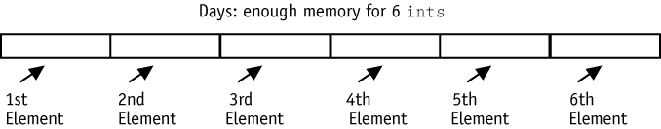
Arrays
An array is a series of elements of the same type
placed in contiguous memory locations that can be
individually referenced by adding index to a unique
identifier.

Slide 63
Array Declaration
Declaration
type arrayName [arraySize];
char letters[25]; // 1 byte * 25 → 25 bytes
short rings[100]; // 2bytes * 100 → 2000 bytes
int miles[84]; // 4btyes * 84 → 336 bytes
float tmp[12]; // 4bytes * 12 → 48 bytes
double score[10]; // 8bytes * 10 → 80 bytes
Initializing Arrays
int billy[5] = { 16, 2, 77, 40, 120 };

Slide 64
Accessing Array Elements
An element is accessed by indexing the array name.
- This is done by placing the index of the element
within square brackets after the name of the array.
double salary = banance[9];
- This statement will take 10th element from the array
and assign the value to salary variable.

Slide 65
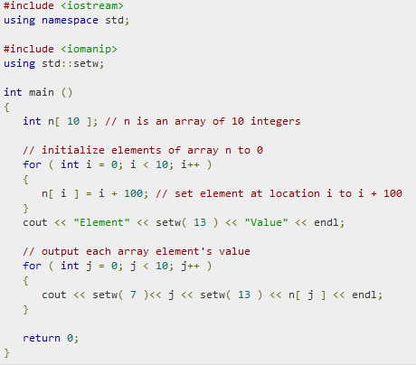
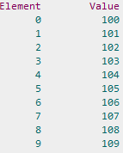
Array – Examples

Slide 66
Arrays as parameters
(a) Declare Array
int myArray[24];
(b) Function call
myFunction( myArray, 24);
(c) Array passed call-by-reference
- function knows where the array is stored

Slide 67
Arrays as parameters – Examples
// arrays as parameters #include <iostream> using namespace std; void printarray (int arg[ ], int length) { for (int n=0; n<length; n++) cout << arg[n] << " "; cout << "\n"; } int main () { int firstarray[ ] = {5, 10, 15}; int secondarray[ ] = {2, 4, 6, 8, 10}; printarray (firstarray,3); printarray (secondarray,5); return 0; }

Slide 68
Read Data
int readData(ifstream *OpenFile, double x[ ], double sent)
{
*OpenFile >> aNumber;
while( aNumber != sent)
{
x[idx] = aNumber;
idx++;
*OpenFile >> aNumber;
}
return idx;
}

Slide 69
for loop – steps
It works in the following way
1. initialization is executed. Generally it is an initial value
settings for a counter variable. ( Executed only once)
2. condition is checked. If it is true the loop continues,
otherwise the loop ends and statement is skipped
3. Statement is executed. As usual, it can be either a single
statement or block enclosed in braces { }
4. Finally, whatever is specified in the increase field is
executed and the loop gets back to step 2.
for ( int n = 10; n > 0; n -- ) { cout << n << “ ,“ ; } cout << “fire”; | 10,9,8,7,6,5,4,3,2,1, fire!

Slide 70
Sum numbers
double sum readData(double arr[ ], int num)
{
double x = 0;
for(int i=0; i < num; i++)
{
x +=arr[i];
}
return x;
}

Slide 71
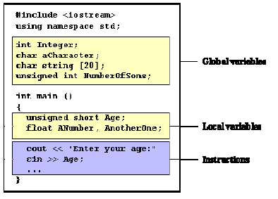
Scope of Variables
Global variable - A variable declared in the main body of the source code, outside all functions.
Local variable – Declared within the body of a function or a block.

Slide 72
Formatting Output
setw
-Output the value of an expression in specific columns.
-The value of the expression can be either string or a number.
-The output is right-justified.
cout << setw(5) << x << endl;
setpression
-controls the output of floating-point numbers
-cout setpression(n); //where n is the decimal places
fixed
-To output floating-point numbers in a fixed decimal format

Slide 73
Formatting Output
Limit the output to 8 characters with setw(8) and setprecision(3) sets the decimal precision to be used to format floating-point values on output operations.
#include <iomanip> … cout << setw(6) << setprecision(3) << fixed << aVar << “\n”;

