Slide 1
Tech-Talk
ESB-RTP
Dewashish Phate

Slide 2
Contents
Agenda
CRD Insurance
SCF
ESB Challenges
Something New
Fun facts
Task

Slide 3
Agenda
Documentation
Awareness
Knowledge Share
Learning Curve

Slide 4
CRD Insurance
Transaction flow
OTP
- DB
tp-esb-reqlogger-ms
uuid
DTP
ESB
Common Platform ms
Payload
OTP
Retry
DTP
ESB
Common Platform ms
LTP
TP-26-ms

Slide 5
Static flow
OTP Client
ESB
DTP
Payload
Log files
tradeport_dtp_to_otpms_insurepod.log
tradeport_otp_to_otpms_insurepod.log
tradeport_otp_to_dtp_insurepod.log
tradeport_otp_to_ltp_insurepod.log
tradeport_otp_to_dtp_static_insurepod.log

Slide 6
SCF
Notification flow
S2B
ESB
OTP-MS
Payload
Acknowledgement flow
S2B
ESB
OTP-MS
Payload
Authentication
Log files
tradeport_otpms_to_s2b_scf.log
tradeport_s2b_to_otpms_scf.log

Slide 7
ESB Challenges
Logging(Efficient)
Request logger ms
Code consistency

Slide 8
Something New
Message Enricher
Logreader

Slide 9
Fun Facts
First computer Bug
Excepetion
Programmer and coder
The first programmer - Ada Lovelace

Slide 10
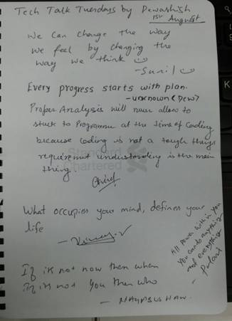
Task
Write down your dearest quote, famous saying, anything.....

