Slide 1
Spring Boot Basic Overview
8th Aug 2017
By Arvind Kumar Sharma

Slide 2
Contents
Background
Overview
Getting Started
Required Setup
Way To Create
Starting a Spring Boot App
Summary

Slide 3
Background
Spring is a fantastic open source framework, addresses the complexity of application development.
One of the chief advantages of the Spring framework is its layered architecture, which allows you to be selective about which of its components you use.
Spring is a cohesive framework for J2EE application development.
While developing desktop, web, enterprise, cloud or microservices application almost every application type need robust infrastructure which takes care of dependencys, auto configuration, actuator.
Spring provides convenient way over such application infrastructure issues introducing a framework called Spring Boot.
Spring boot provides best industry practices, helps to lift application from scratch and boost your application development speed.

Slide 4
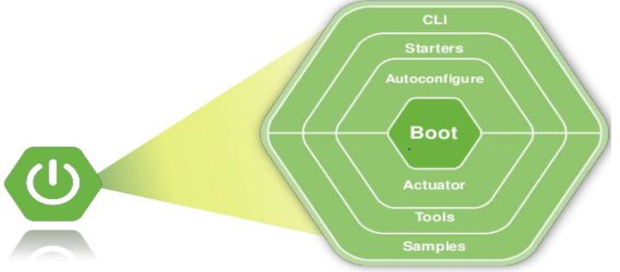
Overview
Spring boot is developed on top of the Spring Framework.
Spring Boot makes it easy to create stand-alone, production-grade Spring based Application that you can just "run".
it’s a modular framework which helps in building application infrastructure, taking care of CLI(command line interface), boot strapping, dependencies, framework integrations, testing, tools, auto-configuration and actuator.
It favours convenience over configuration and so it’s a great way to get quickly ride over spring platform.

Slide 5
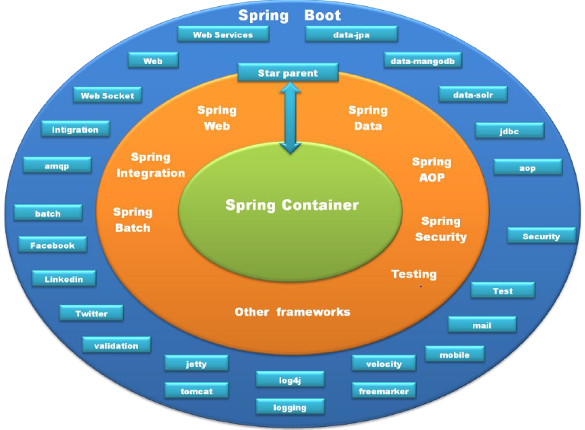
Overview
Spring boot encapsulates spring and many other frameworks and tools like apache velocity, log4j, tomcat and provide starters to take care of these frameworks and tools integration.

Slide 6
Getting Started
Spring Boot is the easiest recommended way to setup your spring application environment. Simply you need to choose one of the ways to initialise your spring application.
Spring Boot supports Ant, Maven, Gradle build Systems including traditional building methodology simply dump spring libraries in application class path, Maven and Gradle are the recommend ways to build your project.

Slide 7
Required Setup
Java 8 SDK
Maven/Gradle
Eclipse/Spring STS/ IDE

Slide 8
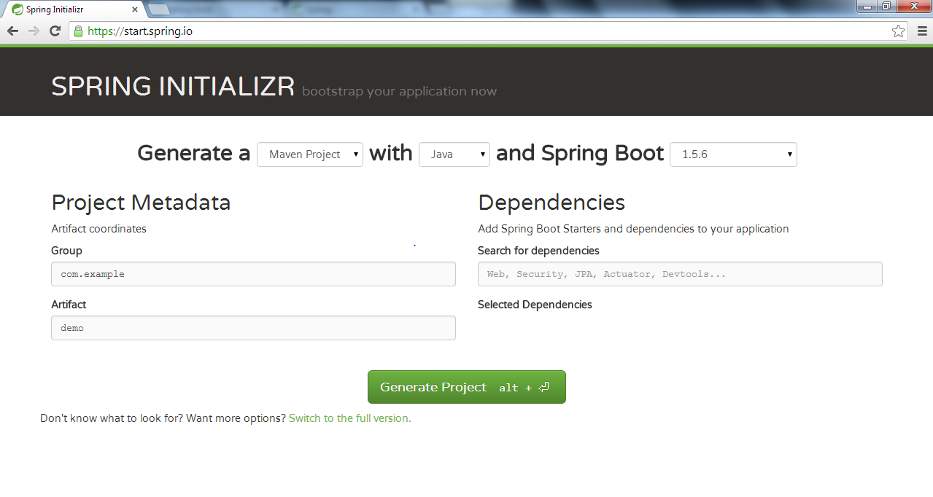
Way To Create
Spring Initializer

Slide 9
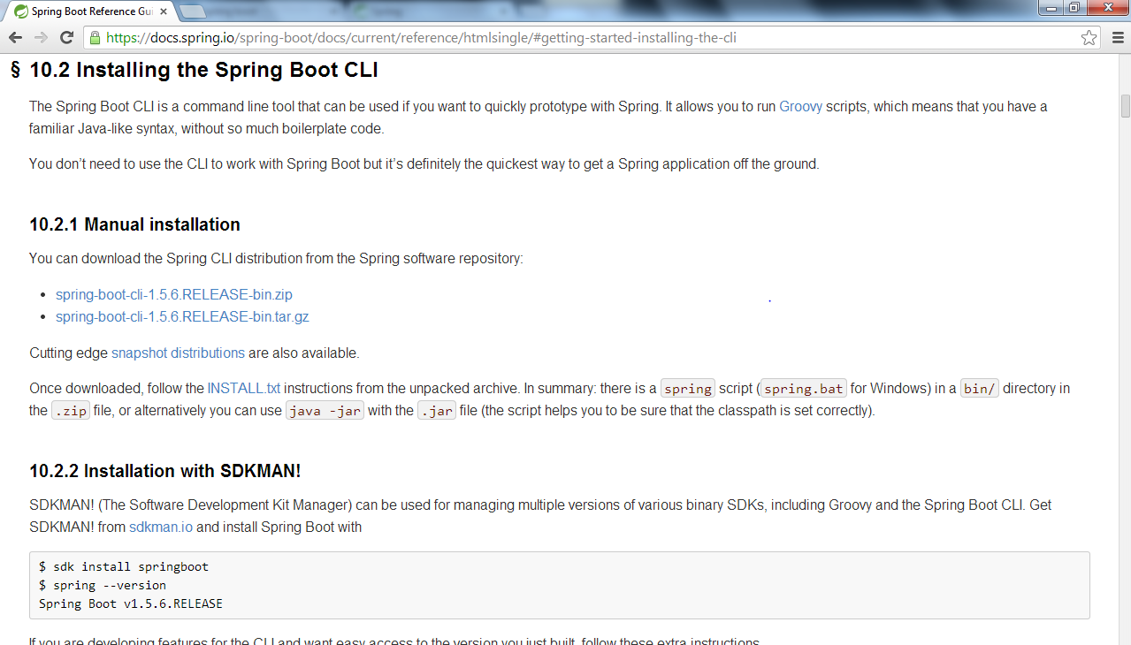
Way To Create
Spring Boot CLI
STS IDE

Slide 10
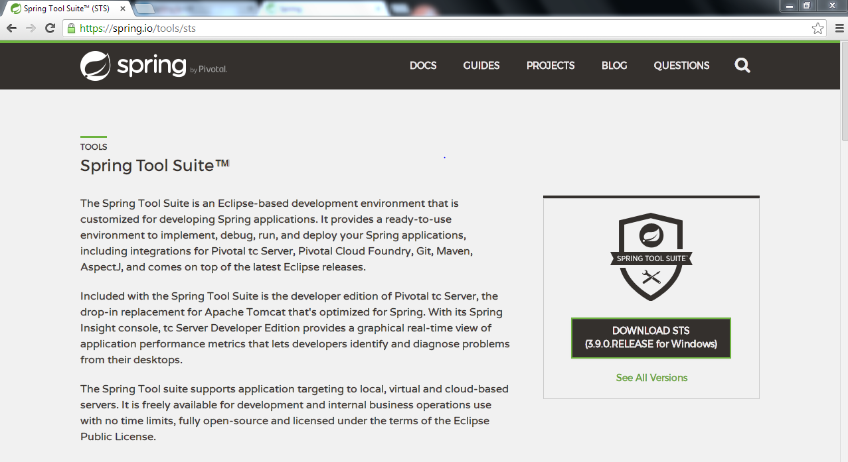
Way To Create
STS IDE

Slide 11
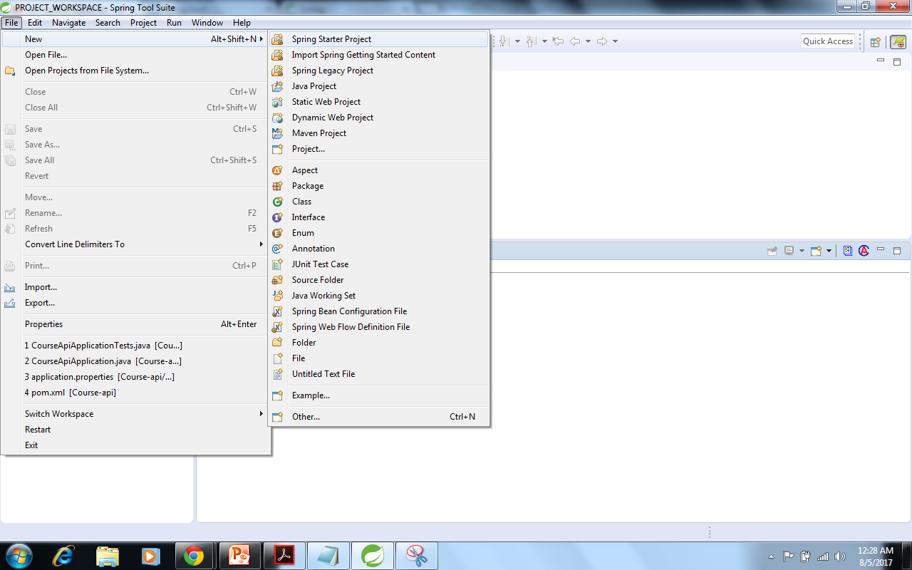
Starting a Spring Boot App
To Create Spring Boot App

Slide 12
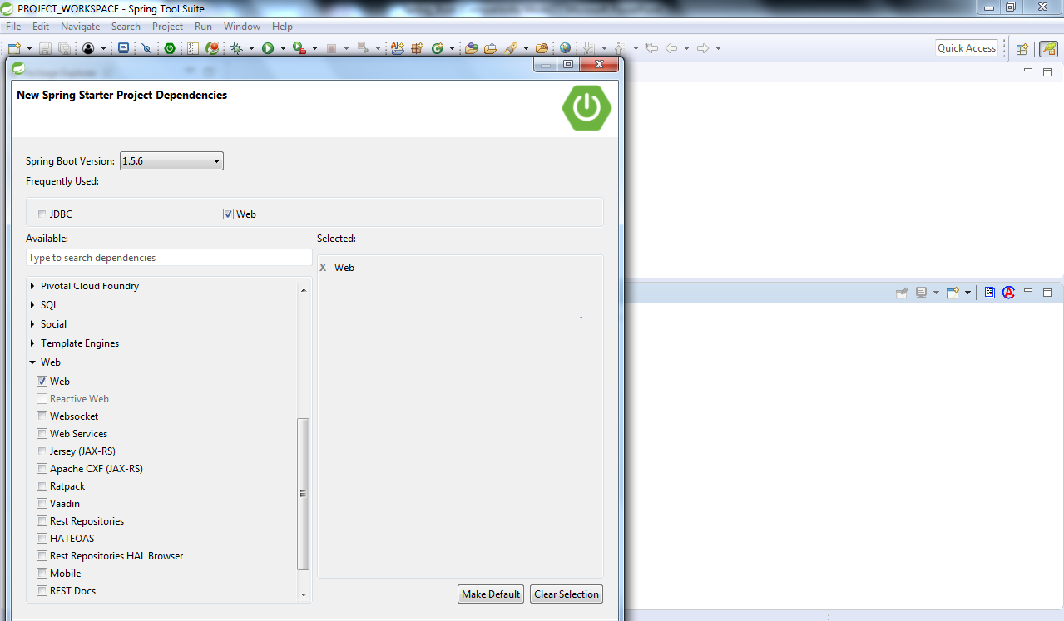
Starting a Spring Boot App
Spring Boot Dependency

Slide 13
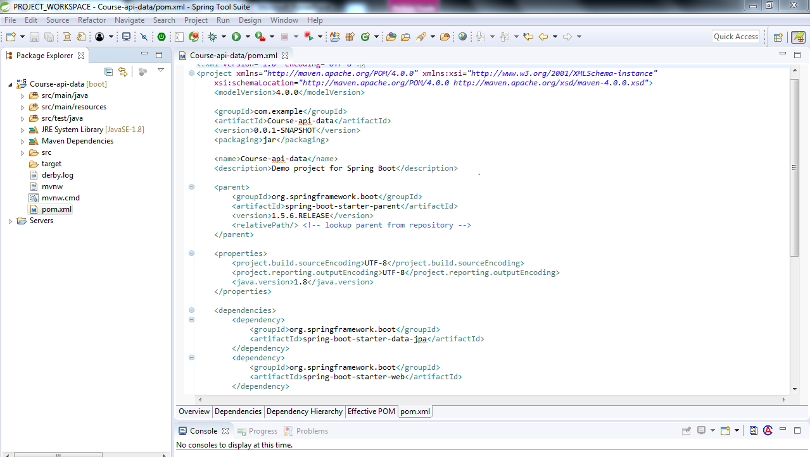
Starting a Spring Boot App
Pom.xml

Slide 14
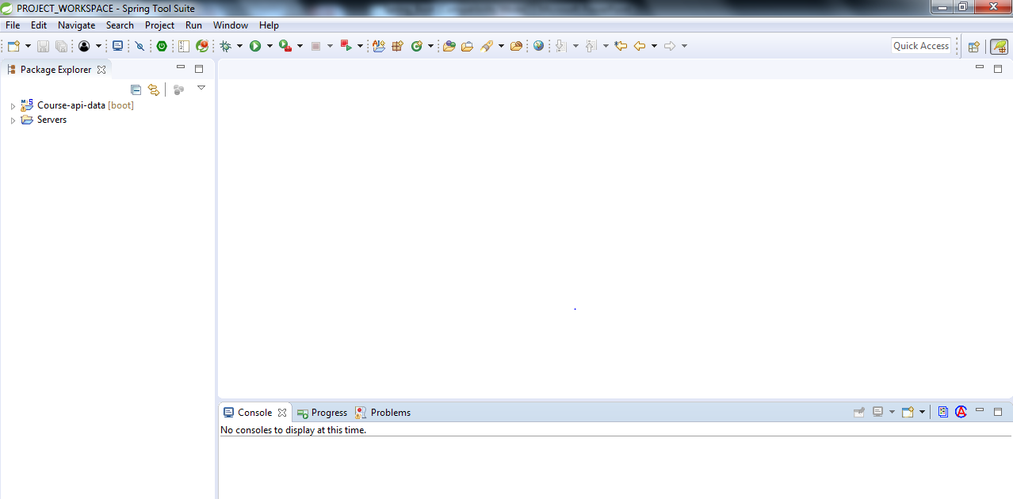
Starting a Spring Boot App
Spring Boot App

Slide 15
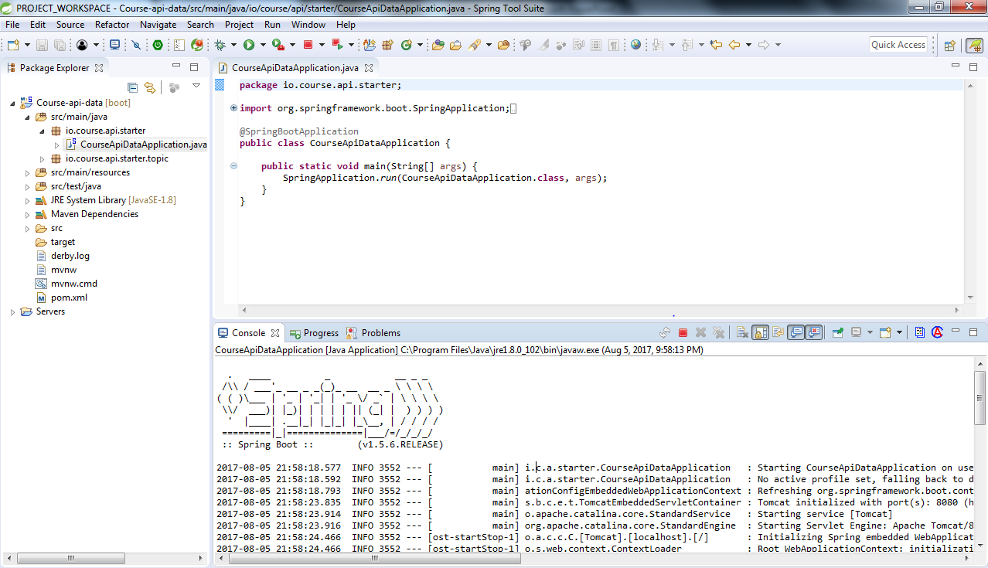
Starting a Spring Boot App
Spring Boot Starting Point

Slide 16
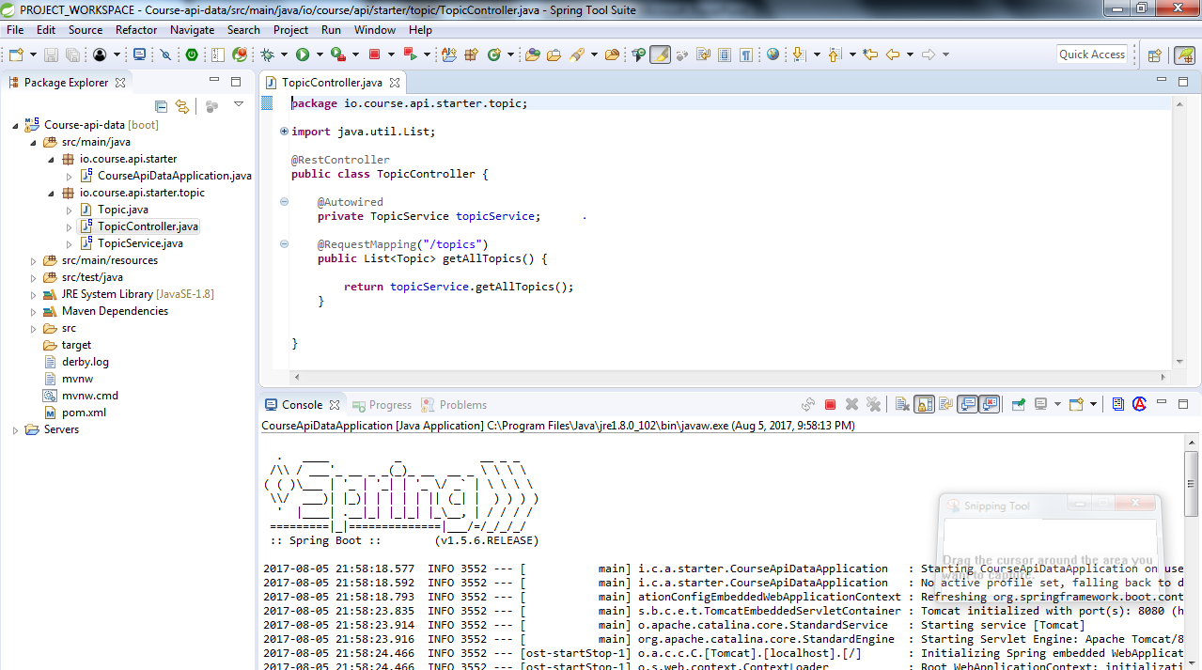
Starting a Spring Boot App
Topic Controller

Slide 17
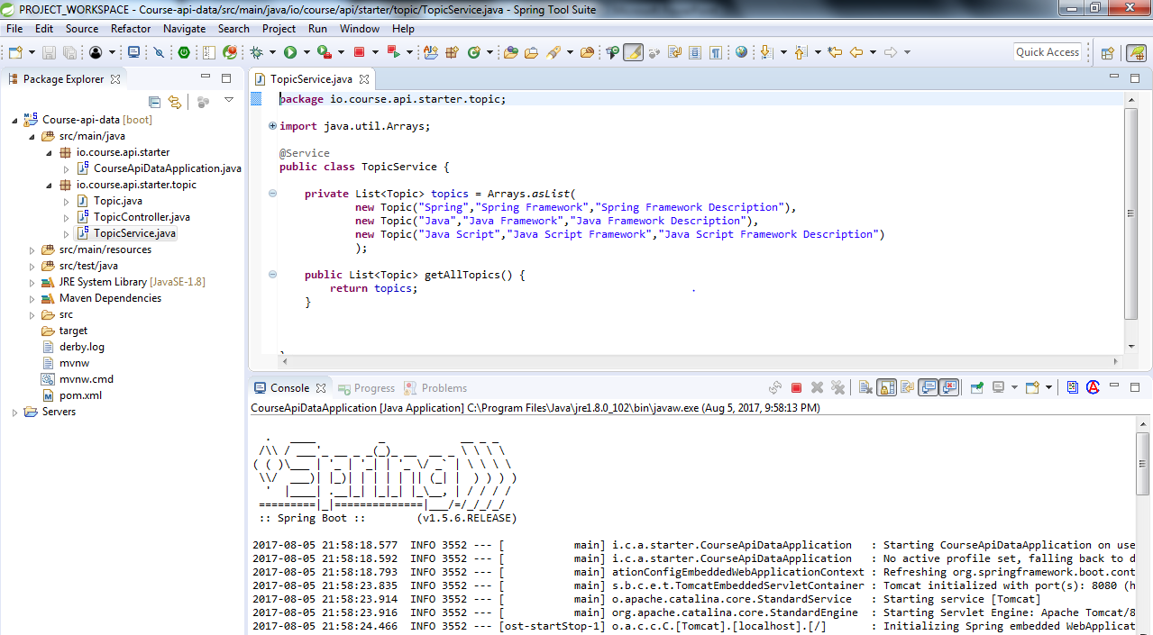
Starting a Spring Boot App
Topic Service

Slide 18
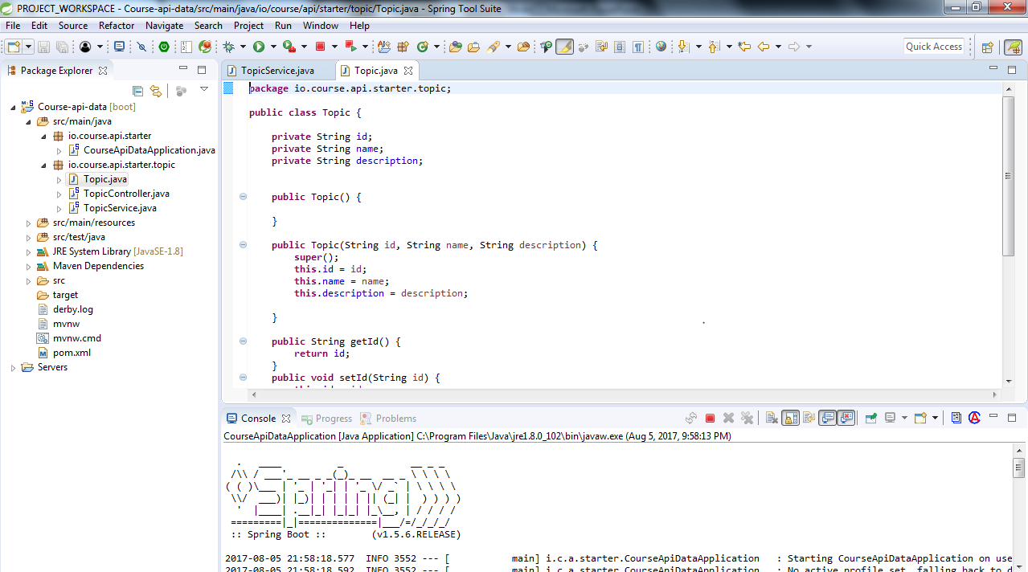
Starting a Spring Boot App
Topic Object

Slide 19
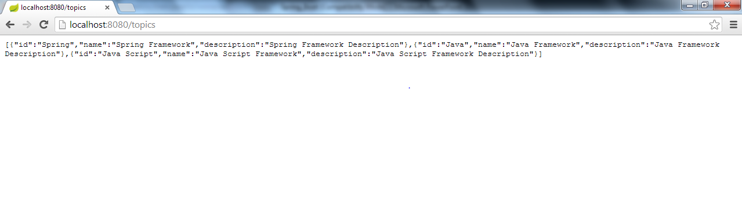
Starting a Spring Boot App
Output/Result

Slide 20
Summary
Spring boot simplifies spring developers life supporting Project build, auto-configuration, managing dependencies, devtools and actuators. It helps in building robust application infrastructure and boosts application development speed.

Slide 21
  Thank You !

