Slide 1
Tech-Talk
Introduction to Drools Engine
Wasim Akbar

Slide 2
Contents
Rule Engine
KIE
Introduction to JBoss Drools
Drools Rule Language
Questions

Slide 3
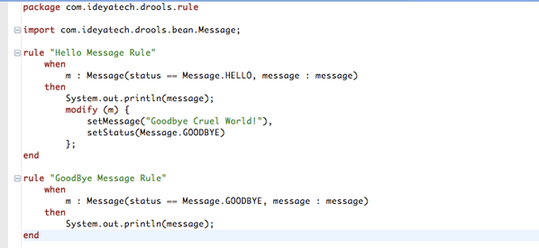
Rule Engine
Rule
Set of constraint
Business Policy
v

Slide 4
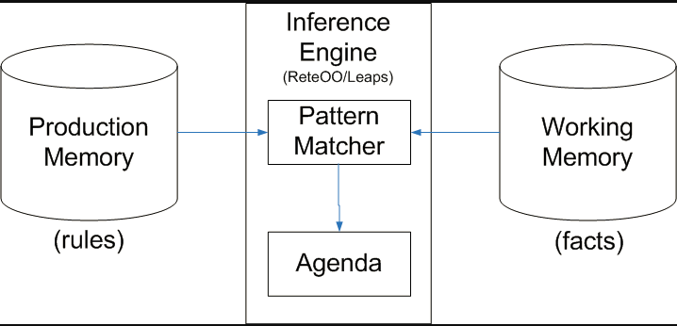
Rule Engine
Ontology
Rules
Data

Slide 5
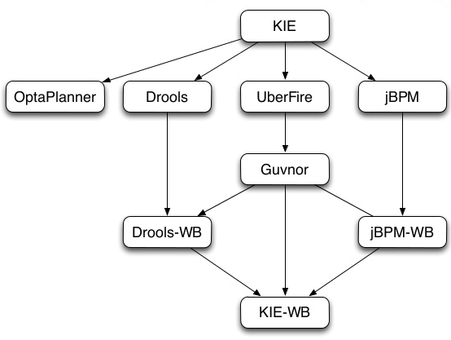
Introduction to JBoss Drools
Drools
JBPM
OptaPlanner
Drools Workbench
UberFire

Slide 6
JBoss Drools
Guvnor – Rule Manager
Drools Expert – Rule Engine
Flow - Process & Workflow
Fusion – Event Processing

Slide 7
Drools Guvnor
Web based rule management ,storage , editing and deployment environment
Rule Editing
Version Control
Categorization
Build & Deploy
Results

Slide 8
Drools Expert
Declarative , Rule Based Environment
Rete Algorithm
Drools Rule Format
Drools Rule Language (DRL)
Domain Specific Language (DSL)
Decision Tables
Guided Rule Editor
XML

Slide 9
Drools Rule Language(DRL)

Slide 10


