Slide 1
Tech-Talk
Introduction to JBPM
(JBoss Business Process Management)
Wasim Akbar

Slide 2
Contents
KIE
Introduction to JBPM
Process Languages
Questions

Slide 3
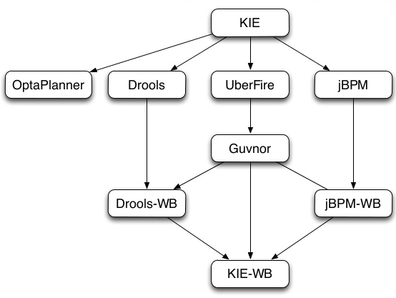
IKIE (Knowledge is Everything)
Drools
JBPM
OptaPlanner
Drools Workbench
UberFire

Slide 4
JBPM
Workflow & BPM Engine
Graphical Diagram
Execution Flow

Slide 5
Process Languages
JPDL
BPMN 2.0

Slide 6
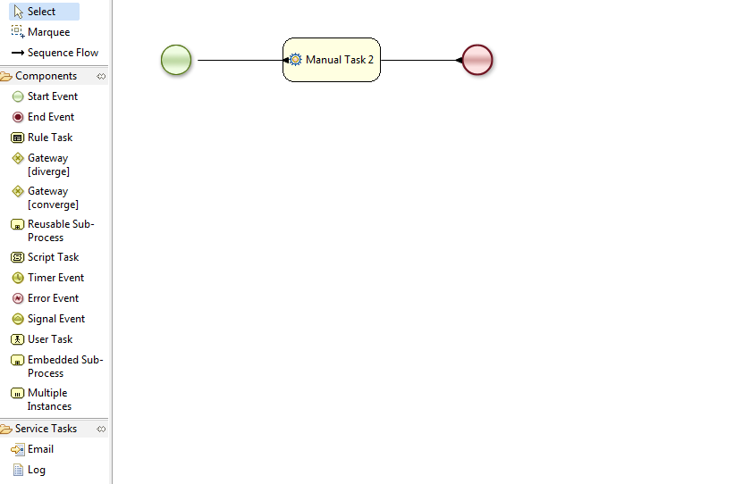
BPMN 2.0

Slide 7
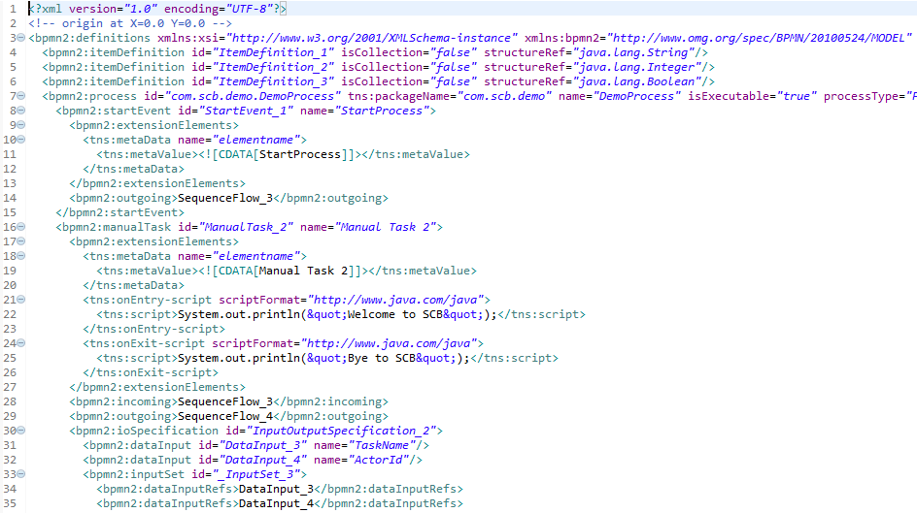
BPMN 2.0

Slide 8


