Slide 1
Git Basics and Best Practices
By Ashwath(1548816)

Slide 2
Objectives
About Version Control
Git - Goals
Git Architecture
The Three States
Git Data Transport Commands
Branching, Merging and Rebasing
Best Practices
Summary

Slide 3

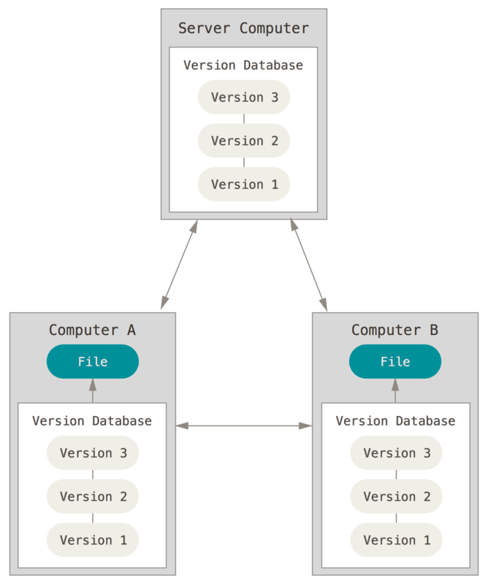
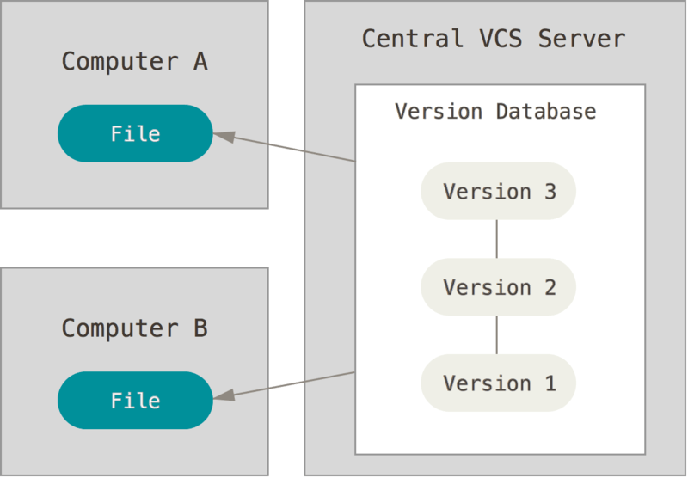
Getting Started –About Version Control
Version Control : Version control is a system that records changes to a file or set of files over time so that you can recall specific versions later
Local Version Control Systems
Centralized Version Control Systems Distributed Version Control Systems

Slide 4
Git - Goals
What is GIT ??
By far, the most widely used version control system in the world today.
Goals :
Speed
Simple design
Strong support for non-linear development (thousands of parallel branches)
Fully distributed
Able to handle large projects (speed and data size)

Slide 5
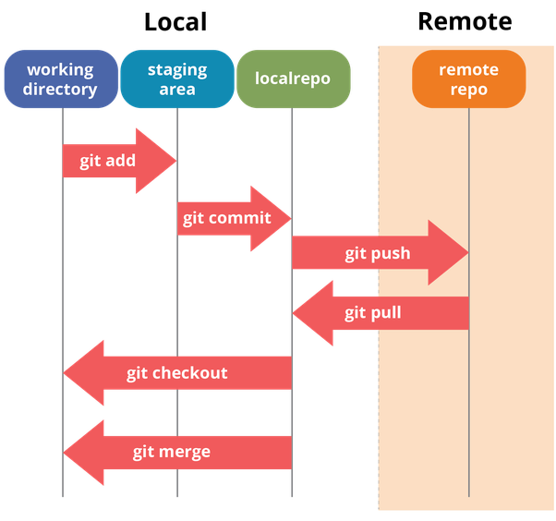
Git Architecture

Slide 6
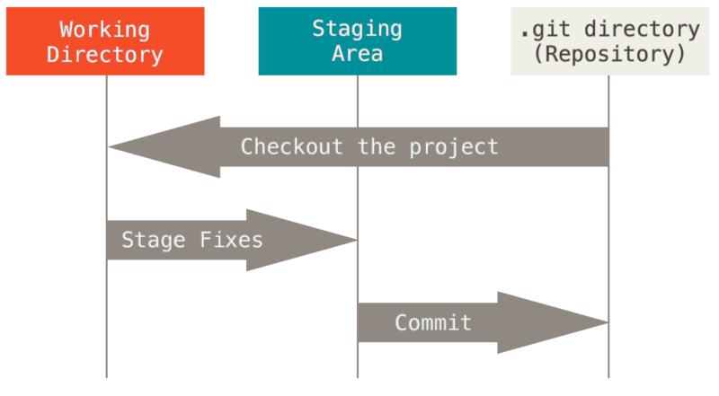
The Three States
The basic Git workflow-
You modify files in your working tree.
You stage the files, adding snapshots of them to your staging area. (Proposed next commit)
You do a commit, which takes the files as they are in the staging area and stores that snapshot permanently to your Git directory.

Slide 7
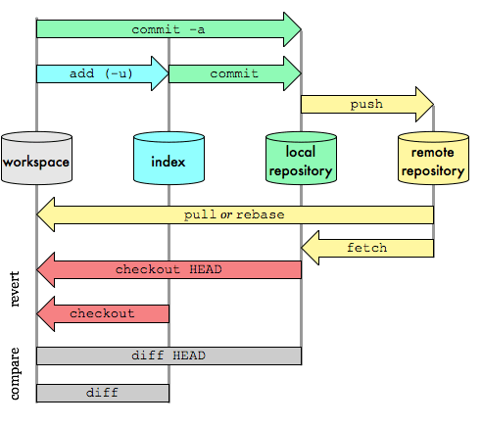
Git Data Transport Commands
Basic Command:
add, commit , push, pull, branch, checkout, merge , rebase, log

Slide 8
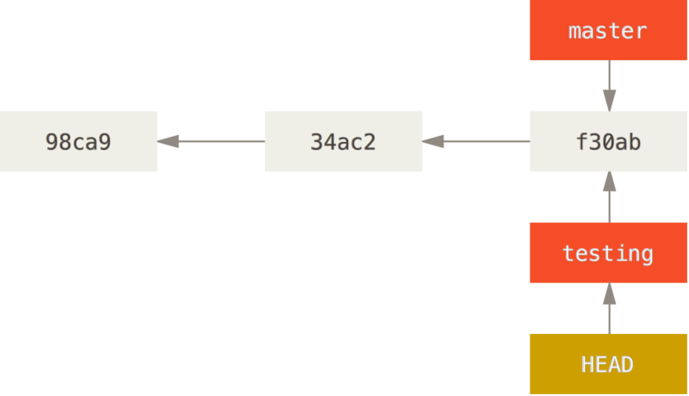
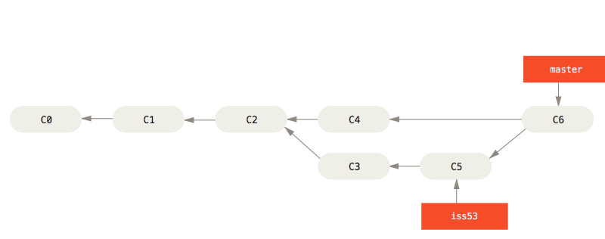
Basic Branching and Merging
Branching:
Merging:

Slide 9
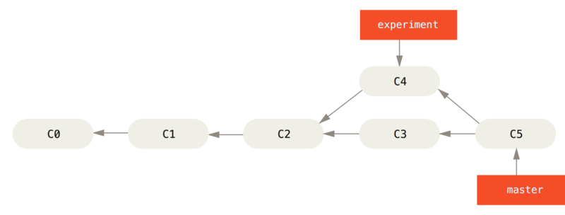
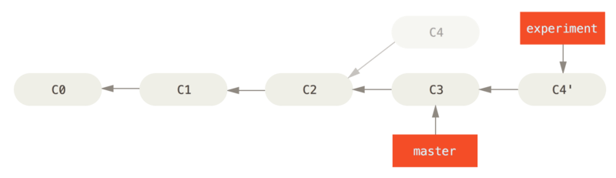
Rebasing
The Basic Rebase:
Merging into integrated work history
Rebasing the change introduced in c4 onto c3

Slide 10
Best Practices
Time for hands on :
Includes:
Init
Branching
Merge and Rebasing
Sharing and Updating
Video for the same is shared separately

Slide 11
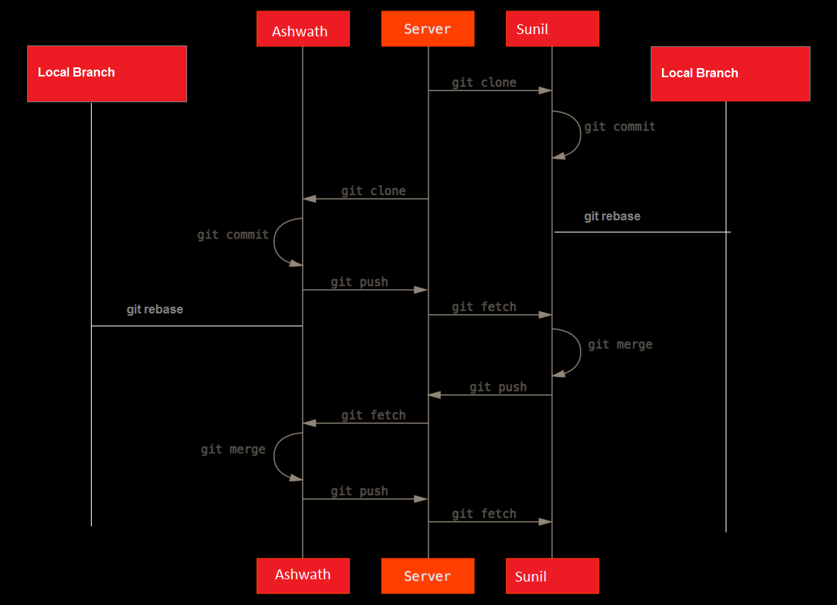
Practiced workflow

Slide 12
Summary
We covered fundamentals of Git
Three states of git
HEAD, INDEX and working directory
Basic work flow
Modify, stage and commit cycle
Branching and merging
Branch, merge and rebasing
Remote
Add remote, push, pull, fetch.
Distributed Workflow

Slide 13
Thank You!!

