Slide 1
Tech-Talk
Maven
Ashwath(1548816)

Slide 2
Objectives
Maven Introduction and Installation
Project Object Model (POM)
Dependency Management
Project Lifecycle Goals
Maven Repository
Project Management

Slide 3
Maven Introduction
Apache Maven is a software project management and comprehension tool. Based on the concept of a project object model (POM), Maven can manage a project's build, reporting and documentation from a central piece of information.
Maven Objectives:
Making easy build process - Builds
Providing Uniform build system - Releases/Distribution
Guidelines for best practices development

Slide 4
Maven Installation
Maven can be downloaded from https://maven.apache.org/download.cgi
For windows operating system select .zip
Extract the zip file
Update path in environment variable
Run mvn –version
Eclipse provides maven plugin –M2Eclipse from http://www.eclipse.org/m2e/

Slide 5
Maven Project
Maven project can be created from Eclipse or using command line.
“maven-arctype-quickstart” allows maven based project to be created
Coordinate | Definition
groupId | Groups a set of artifacts into a logical group (e.g. org.apache.maven)
artifactId | Name for a software artifact. (e.g., simple-webapp)
version | Numerical version for a software project (e.g, 1.2.3, 1.2, 1.2-beta)
packaging | Describes the contents of the software artifact (e.g., jar, zip, swc, swr, nar, war, ear, sar

Slide 6
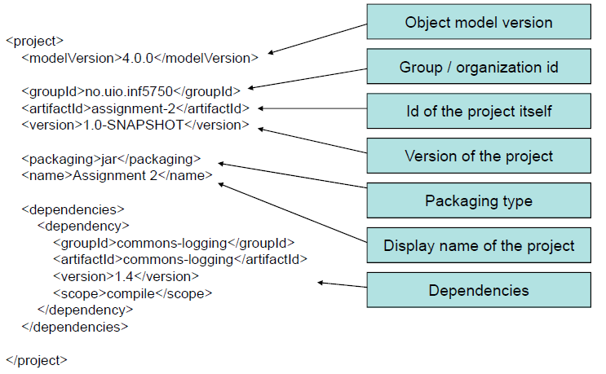
Project Object Model (POM)

Slide 7
Maven Dependency
Dependency Scope
compile (Default)
provided
runtime
test
system
Transitive Dependency
Dependency Version Ranges
Specifying a Dependency Range: 3.8 -4.0 <version>[3.8,4.0)</version>
Specifying a Dependency Range: <= 3.8.1 <version>[,3.8.1]</version>
Conflict Resolution
<exclusions>
<exclusion>
<groupId>org.sonatype.mavenbook</groupId>
<artifactId>project-b</artifactId>
</exclusion>
</exclusions>

Slide 8
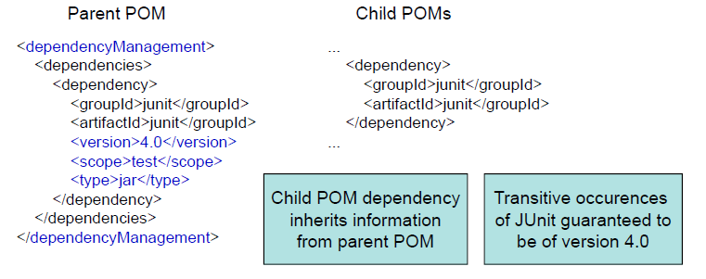
Dependency Management
Mechanism for centralizing dependency information
Favorable for projects that inherits a common parent
Useful for controlling versions of transitive dependencies

Slide 9
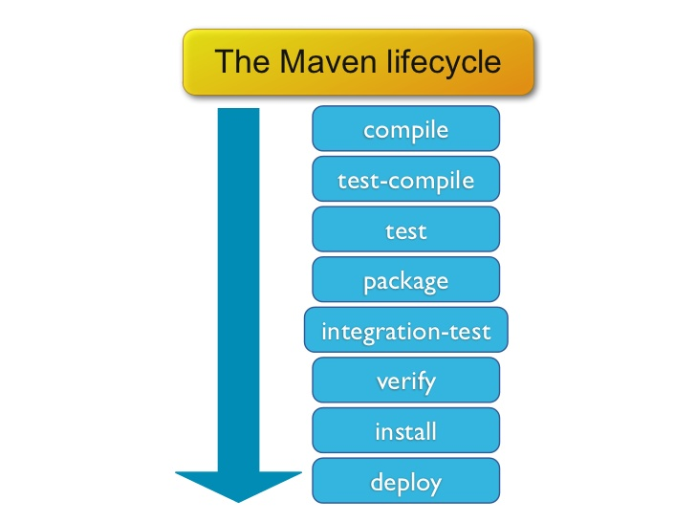
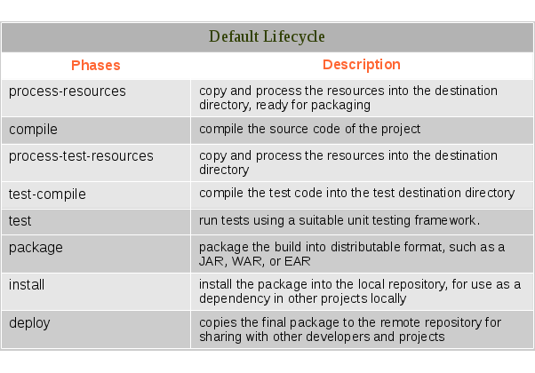
Project Lifecycle Goals

Slide 10
Maven Repositories
Repositories store artifacts and dependencies of various types. Artifacts from remote repositories are downloaded to local repository
Central repositories: Default Maven repository for download http://repo1.maven.org/maven2/
Local repositories : stores all your artifacts at ~/.m2/repository
Remote repositories : stores allows artifacts to be available to your project based on dependencies are mentioned

Slide 11
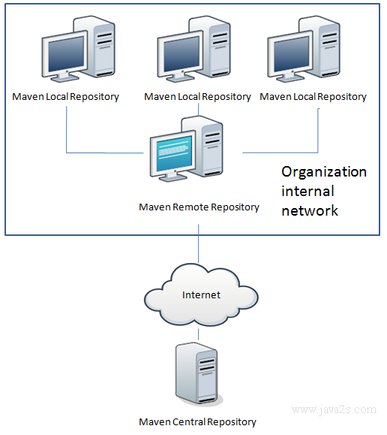
Maven Repositories cont..

Slide 12
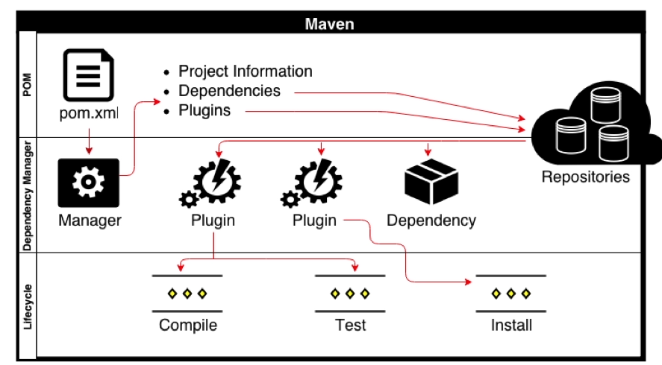
How Does Maven Work

Slide 13
Project Management
Powerful feature in Maven: Create a project site aautomatically
Info retrieved from the POM, source code
Provides information regarding
- Dependencies
- Issue tracking
- Licensing
- Development team
Provides various reports
- Test coverage
- Internationalisation
- JavaDocs

Slide 14
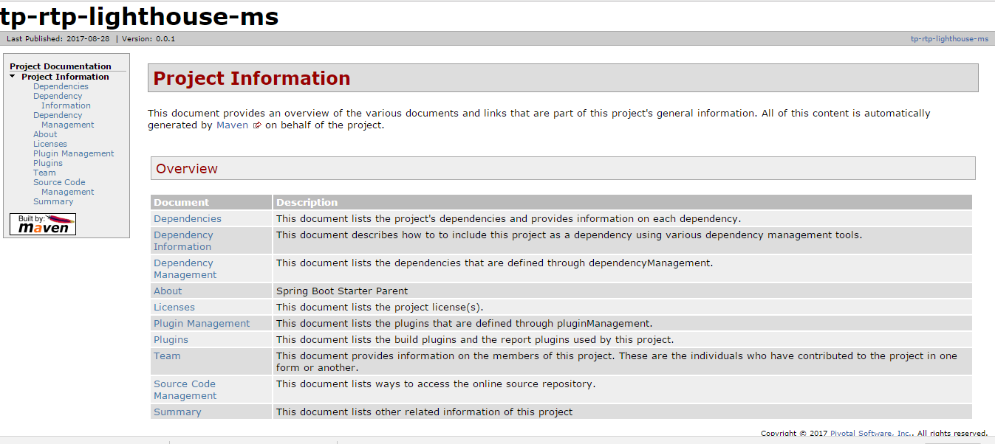
Maven site repository

Slide 15


Slide 16
Thank You!!

