Slide 1
MongoDB

Slide 2
Contents
What is MongoDB?
Setup the MongoDB Environment
CRUD Operations using mongo shell
Aggregation
Benefits and Limitation of MongoDB
Question?

Slide 3
What is MongoDB
Document-Oriented database
Stores data in flexible (JSON-like document)
NoSQL
Free and open source
Distributed database at its core (node and shards)
MongoDB

Slide 4
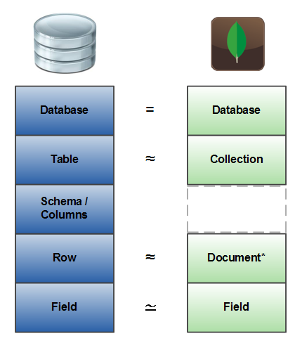
Terminology
RDBMS | MongoDB
Table, View | Collection
Row | Document
Index | Index
Join | Embedded Document
Foreign Key | Reference
Partition | Shard

Slide 5
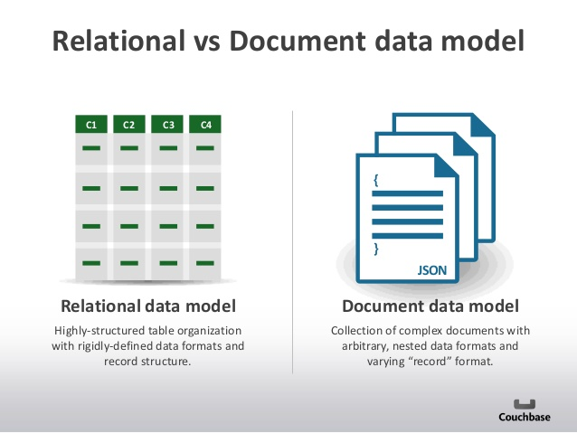
MongoDB Document Model

Slide 6
Setup the MongoDB Environment
Install MongoDB
Set Path:
C:\<PATH>\MongoDB\Server\3.2\bin
Create an empty folder where mongoDB stored the data md C:\<PATH>\data\db
Set the database path mongod --dbpath “C:\<PATH>\data\db”
Start the server mongod
Open another command prompt mongo

Slide 7
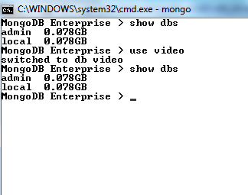
Create Database
use <databaseName>
to switch from default database to define database (even non-exists database name will work)
However, MangoDB doesn’t create any database yet, until you save something inside.

Slide 8
Create Collection
db.createCollection(<collectionName>)
create a collection without inserting a document.
db.<collectionNames>.insertOne(<document>)
create collection automatically when you insert any document.
specify options for the collection.
If the collection exists, it will add the document to existing collection. But if the collection does not exist, then it will create a collection.

Slide 9
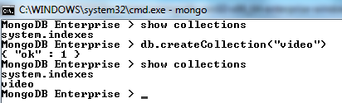
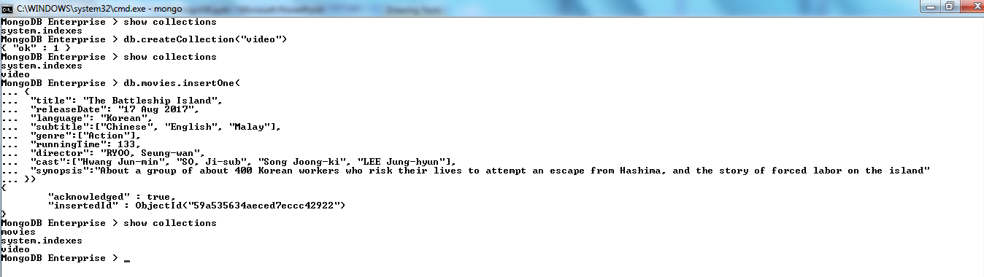
Create Collection Example

Slide 10
Insert Document Example
Insert One Document db.inventory.insertOne( { item: "canvas", qty: 100, tags: ["cotton"], size: { h: 28, w: 35.5, uom: "cm" } } )
Insert Multiple Documents db.inventory.insertMany([ { item: "journal", qty: 25, tags: ["blank", "red"], size: { h: 14, w: 21, uom: "cm" } }, { item: "mat", qty: 85, tags: ["gray"], size: { h: 27.9, w: 35.5, uom: "cm" } }, { item: "mousepad", qty: 25, tags: ["gel", "blue"], size: { h: 19, w: 22.85, uom: "cm" } } ])

Slide 11
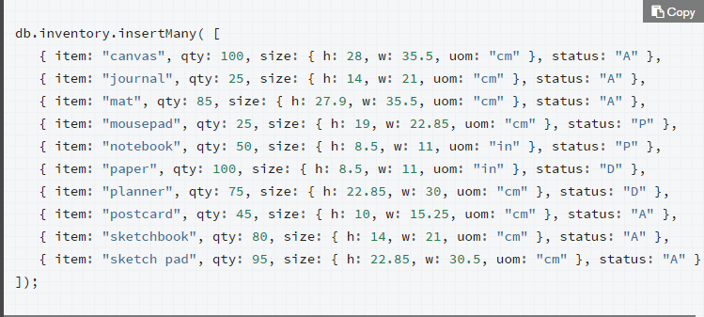
Update Document Example
Example Data:
Update One Example: db.inventory.updateOne( { item: "paper" }, { $set: { "size.uom": "cm", status: "P" }, $currentDate: { lastModified: true } } )
Update Multiple Documents db.inventory.updateMany( { "qty": { $lt: 50 } }, { $set: { "size.uom": "in", status: "P" }, $currentDate: { lastModified: true } } )
Replace a Document db.inventory.replaceOne( { item: "paper" }, { item: "paper", instock: [ { warehouse: "A", qty: 60 }, { warehouse: "B", qty: 40 } ] } )

Slide 12
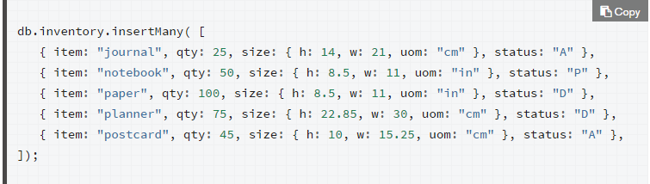
Delete Documents Example
Example Date
Delete All db.inventory.deleteMany({})
Delete all with conditions db.inventory.deleteMany({ status : "A" })
Delete only one document with condition db.inventory.deleteOne( { status: "D" } )

Slide 13
Query Operators
Name | Description
$eq | Matches value that are equal to a specified value
$gt, $gte | Matches values that are greater than (or equal to a specified value )
$lt, $lte | Matches values less than or ( equal to ) a specified value
$ne | Matches values that are not equal to a specified value
$in | Matches any of the values specified in an array
$nin | Matches none of the values specified in an array
$or | Joins query clauses with a logical OR returns all
$and | Join query clauses with a loginal AND
$not | Inverts the effect of a query expression
$nor | Join query clauses with a logical NOR
$exists | Matches documents that have a specified field

Slide 14
Read Documents
Oracle Query | MongoDB
SELECT * FROM inventory | db.inventory.find( {} )
SELECT * FROM inventory WHERE status = "D" | db.inventory.find( { status: "D" } )
SELECT * FROM inventory WHERE status in ("A", "D") | db.inventory.find( { status: { $in: [ "A", "D" ] } } )
SELECT * FROM inventory WHERE status = "A" AND qty < 30 | db.inventory.find( { status: "A", qty: { $lt: 30 } } )
SELECT * FROM inventory WHERE status = "A" OR qty < 30 | db.inventory.find( { $or: [ { status: "A" }, { qty: { $lt: 30 } } ] } )
SELECT * FROM inventory WHERE status = "A" AND ( qty < 30 OR item LIKE "p%") | db.inventory.find( { status: "A", $or: [ { qty: { $lt: 30 } }, { item: /^p/ } ] } )

Slide 15
Query on Embedded/Nested Documents
Example data:
{ item: "journal", qty: 25, size: { h: 14, w: 21, uom: "cm" }, status: "A" },
{ item: "notebook", qty: 50, size: { h: 8.5, w: 11, uom: "in" }, status: "A" },
Case | Example
Equality condition on a field | db.inventory.find( { size: { h: 14, w: 21, uom: "cm" } } )
Equality match on a nested field | db.inventory.find( { "size.uom": "in" } )
Specify condition on a nested field | db.inventory.find( { "size.h": { $lt: 15 } } )
Specify AND condition | db.inventory.find( { "size.h": { $lt: 15 }, "size.uom": "in", status: "D" } )

Slide 16
Query an Array
Example data:
{ item: "journal", qty: 25, tags: ["blank", "red"], dim_cm: [ 14, 21 ] },
{ item: "notebook", qty: 50, tags: ["red", "blank"], dim_cm: [ 14, 21 ] },
{ item: "paper", qty: 100, tags: ["red", "blank", "plain"], dim_cm: [ 14, 21 ] },
{ item: "planner", qty: 75, tags: ["blank", "red"], dim_cm: [ 22.85, 30 ] },
{ item: "postcard", qty: 45, tags: ["blue"], dim_cm: [ 10, 15.25 ] }

Slide 17
Query an Array
Case | Example
Exact elements to match with specified order | db.inventory.find( { tags: ["red", "blank"] } )
Exact elements to match without order | db.inventory.find( { tags: { $all: ["red", "blank"] } } )
Contains at least one element | db.inventory.find( { tags: "red" } )
To specify condition | db.inventory.find( { dim_cm: { $gt: 25 } } )
Query an array with compound filter conditions on the array elements | db.inventory.find( { dim_cm: { $gt: 15, $lt: 20 } } )
Query an array element that meets multiple criteria | db.inventory.find( { dim_cm: { $elemMatch: { $gt: 22, $lt: 30 } } } )
Query for an element by the array index position | db.inventory.find( { "dim_cm.1": { $gt: 25 } } )
Query an array by array length | db.inventory.find( { "tags": { $size: 3 } } )

Slide 18
Query an Array of Embedded Documents
Example data: { item: "journal", instock: [ { warehouse: "A", qty: 5 }, { warehouse: "C", qty: 15 } ] },
{ item: "notebook", instock: [ { warehouse: "C", qty: 5 } ] }
Case | Example
Equality condition on an array field match the specified document | db.inventory.find( { "instock": { warehouse: "A", qty: 5 } } )
Use the array index to query for a field in the embedded document | db.inventory.find( { 'instock.0.qty': { $lte: 20 } } )
Specify a query condition on a field embedded in an array of documents | db.inventory.find( { 'instock.qty': { $lte: 20 } } )
Meets multiple conditions on nested fields | db.inventory.find( { "instock": { $elemMatch: { qty: 5, warehouse: "A" } } } )
Meet at least one condition on nested fields | db.inventory.find( { "instock.qty": 5, "instock.warehouse": "A" } )

Slide 19
More on MongoDB Shell Command
https://docs.mongodb.com/manual/reference/method/

Slide 20
Aggregation
process data records and return computed results.
group values from multiple documents together, and can perform a variety of operations on the grouped data to return a single result.
Three ways to perform aggregation:
Aggregation pipeline
Map Reduce
Single purpose aggregation methods

Slide 21
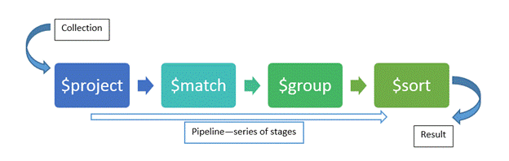
Aggregation Pipeline
Modeled on the concept of data processing pipelines.

Slide 22
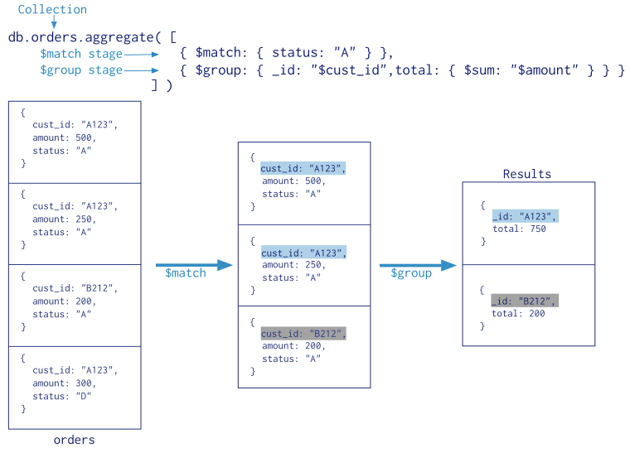
Aggregation Pipeline Example

Slide 23

Map-Reduce
Contains two phase:
Map Stage: Processes each document and emits one or more objects for each input document
Reduce Phase: Combines output of the map operation
Author1:1
Author1:2
Author2:1
Author2:2
Author3:1
Author3:1
Author2:1
…
Author1:1
…
Documents
Map
Reduce

Slide 24
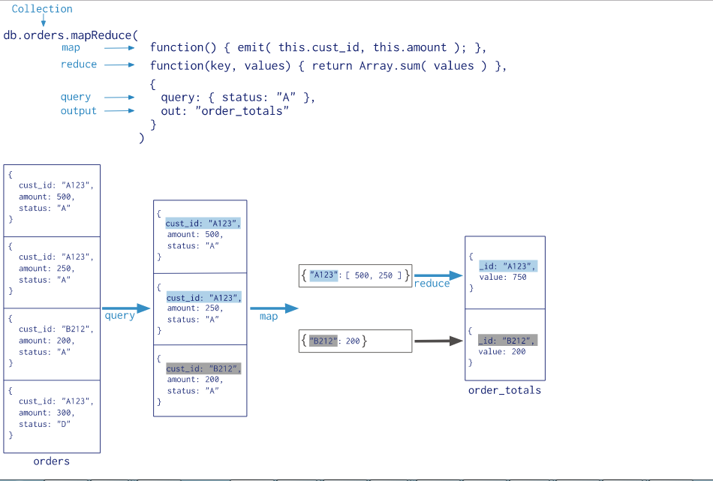
Map-Reduce Example

Slide 25
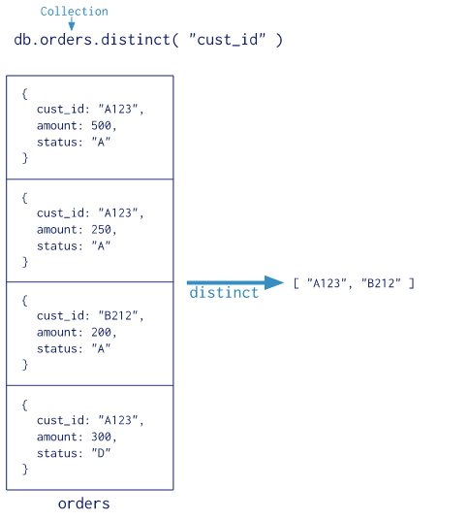
Single Purpose Aggregation Operations
Simple access to common aggregation processes
Provides
db.collection.count()
db.collection.distinct()

Slide 26
Benefits of MongoDB
 | MongoDB | RDBMS
Elastic Scaling | No scale out – distribute data across multiple hosts seamlessly | Scale up – bigger load and bigger server
DBA Specialists | NoSQL require less management, automatic repair and simpler data models | Require highly trained expert to monitor DB
Big Data | Designed for big data | Huge increase for big data
Flexible data model | Relaxed in structure of data | Change management to schema have to be carefully
Economics | Clusters of cheap commodity servers to manage data and transaction volumes | Rely on expensive proprietary servers to manage data

Slide 27
MongoDB Limitations
Maximum Document size is 16 megabytes
Naming restrictions:
Database Names: cannot contain /\. "$*<>:|? for window and /\. "$ for unix and linux systems and cannot contain null character and length of database names must have fewer than 64 characters
Collection Names should begin with an underscore or a letter character, and cannot:
contain the $.
be an empty string (e.g. "").
contain the null character.
begin with the system. prefix. (Reserved for internal use.)
Field Names: cannot contain dots or null characters, and they must not start with a dollar sign

Slide 28
More on MongoDB
https://university.mongodb.com/

Slide 29


