Slide 1
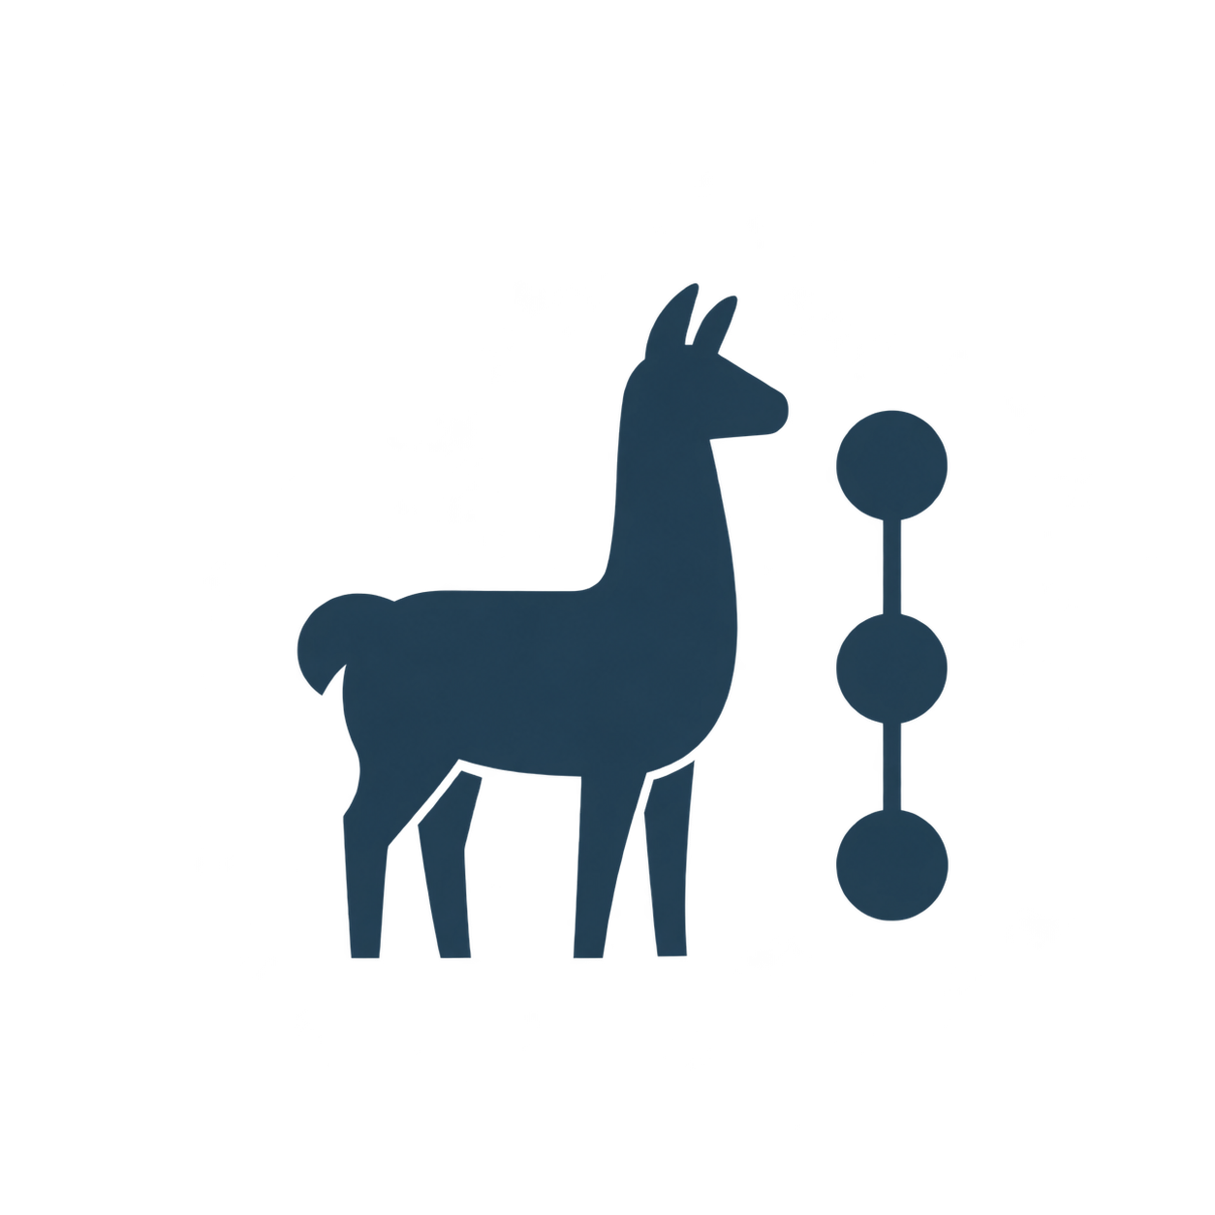
Foundation Layer
Orchestration Layer
Model & Retrieval
Components
Multi-Agent Frameworks
</>
Role
Definition
Model
Interfaces
AutoGen
CrewAI
LangChain
LlamaIndex
Retrieval
Components
Workflow
Control
MetaGPT
AI
Multi-Agent
QA System
Retrieval-Grounded
Synthesis
Answer & Task
Assessment
Benchmarks &
Evaluation Tools
Application
Resource Layer
Document
Understanding
RAG Component
Evaluation
QA & knowledge benchmarks
Representative Platforms
QA
HotpotQA
CoQA
MMLU
MuSiQue
STORM
Co-STORM
RAGFlow
Agent-task benchmarks
System Construction
& Evaluation
AgentBench
GAIA
WebArena
RAG tool: AutoRAG
Conceptual resource map; process assessment needs trace-level measures.

