Slide 1
Predictive Model of Movie Revenues
By Stephen Gou

Slide 2
Topics
Overview of the Project
Summary of the Result
What Made the Project Difficult?
Statistical Lessons Learned
Rules-of-thumb Learned

Slide 3
Goal
Build a model that predicts the total revenue of a modern American movie given certain features.

Slide 4
Data Collection
TMDB 5000 Movies dataset.
TMDB 5000 Credits dataset.
New York Times Review data.
New York Times Review Articles sentiment data.
Top actors ranking data.
Top directors ranking data.
U.S Annual CPI.

Slide 5
Features and Transformation
Budget
Runtime
Critics pick
Cast score
Director score
NYT Review sentiment polarity score
Genres (18)
Mpaa Rating (5)

Slide 6
Modelling
Evaluation Method: accuracy with 20% error margin.
Baseline: 61% accuracy by predicting the mean of log transformed revenue.

Slide 7
Modelling
Result
 | Baseline | OLS Regression | Regression Tree | kNN | Neural Network
Hyper Params | N/A | N/A | Split=MSE Depth=5 | k=5 | MLP: 2 layers (64,64), ReLu
Accuracy | 61% | 61% | 63% | 61% | 74%

Slide 8
What Made the Project Difficult
Can use any data and or features
Workflow is non-linear, and iterative
Nature of problem
Representation of features

Slide 9
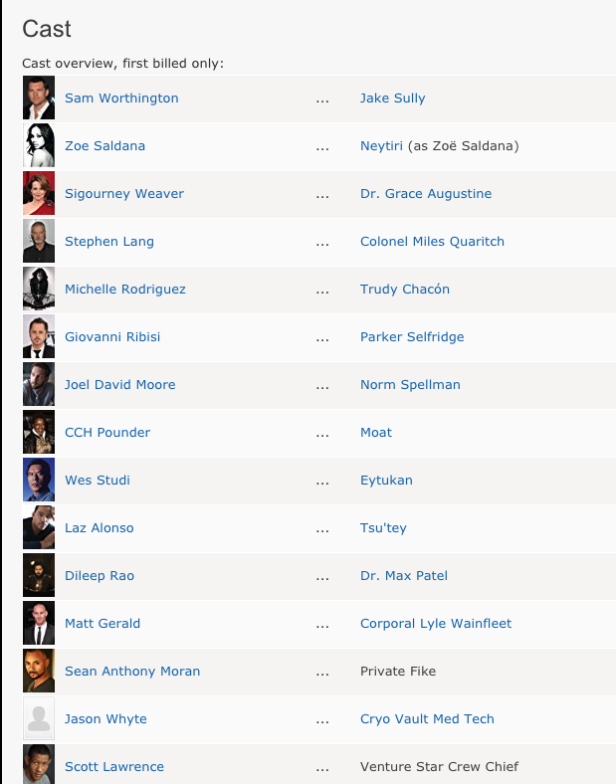
What Made the Project Difficult
Representation of features
1.41257782

Slide 10
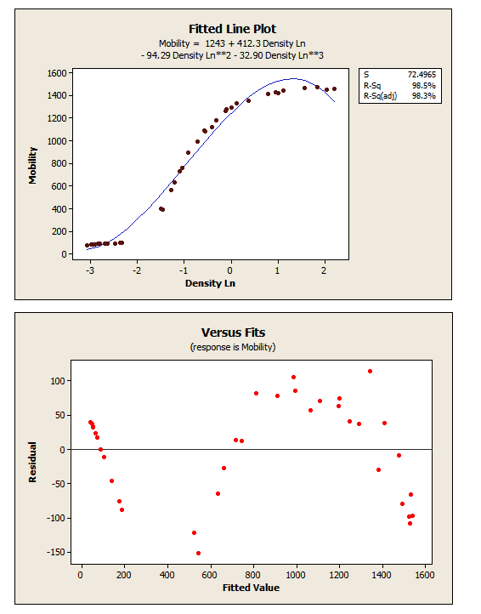
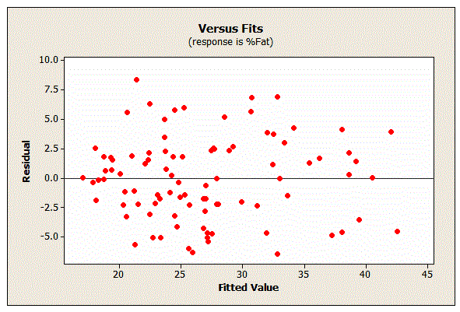
Statistical Lessons learned
Residual Plot
Source: http://blog.minitab.com/blog/adventures-in-statistics-2/regression-analysis-how-do-i-interpret-r-squared-and-assess-the-goodness-of-fit
http://blog.minitab.com/blog/adventures-in-statistics-2/why-you-need-to-check-your-residual-plots-for-regression-analysis

Slide 11
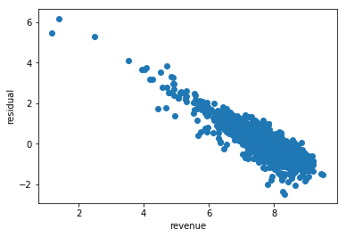
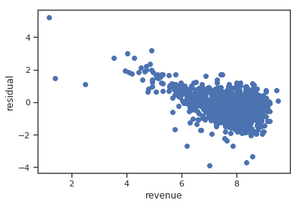
Statistical Lessons learned
kNN
Neural Network

Slide 12
Statistical Lessons learned
Multi-collinearity
Cause problem in coefficients
Severe in predictors of movie revenues. E.g. budget and cast score, budget and runtime, genre and mpaa rating
Condition Number
Dummy Variable Trap

Slide 13
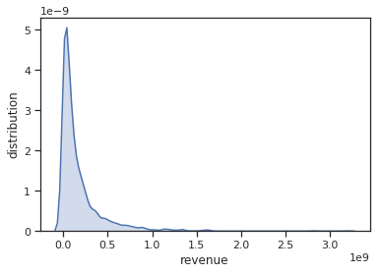
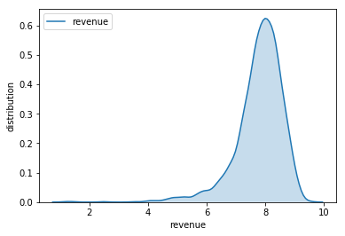
Statistical Lessons learned
Log transform large monetary value
Smaller value
Restore symmetry (Lognormally Distributed)
Outliers
Improve model performance

Slide 14
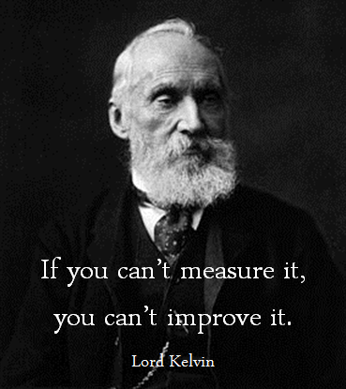
Rules-of-thumbs
Importance of evaluation method
Source: google image

Slide 15
Rules-of-thumbs
Always do sanity check on data.
Vagueness
Correctness
Assumption

Slide 16
Rules-of-thumbs
The KISS principle
e.g. popularity score

Slide 17
Thank you! Questions?

