Slide 1

Agile Unlocked Boosting Team Efficiency & Project Success

Slide 2
Let's start by discussing traditional project management methodologies.

Slide 3
Waterfall (The grandfather of all project management models)
The Waterfall methodology is one of the earliest formal approaches to software development and project management.

Slide 4
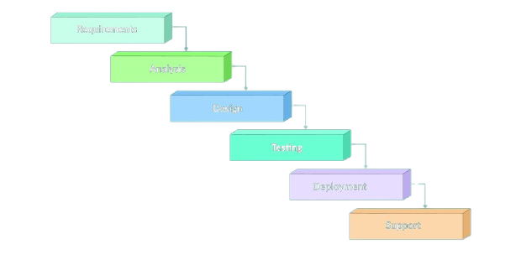
In Waterfall methodology tasks were executed in phases:
Each phase must be completely finished before moving to the next

Slide 5
In the Waterfall model, key parameters like budget, scope, and timeline are fixed from the very beginning. The client expects a high-quality final product—but meeting that expectation can be challenging. Why?
The client is only involved at the start (to define requirements) and at the end (to receive the product).
Late modifications are both difficult and expensive.
The linear structure means the client has to wait a long time before seeing any results.
This presents a major drawback: if the client is not satisfied with the final product, making changes at that stage can be extremely costly—in terms of time, money, and effort.

Slide 6
Now, let’s explore modern methodologies in project management.

Slide 7
The Agile Approach
The Agile approach is a project management and product development methodology that emerged as a response to traditional, plan-heavy approaches like Waterfall. At its core, Agile emphasizes flexibility, collaboration, customer focus, and delivering value in small increments rather than all at once.

Slide 8
The Agile Approach and Its Advantages
Short, incremental, and iterative development cycles
Continuous client involvement throughout the process
Rapid delivery of value through functional versions
Frequent collection of feedback that guides development
Adaptation to changing user needs
Through this approach, a minimum viable product can be quickly developed to test fundamental concepts and gather valuable experience feedback, allowing for adjustments to the project's direction.

Slide 9
Next, let’s look at some project management methods that are based on the Agile approach.

Slide 10
Scrum
Scrum is an agile framework that helps teams work collaboratively to deliver value iteratively and incrementally. Rather than being a strict methodology with step‐by‐step instructions, Scrum provides a set of principles and practices that allow teams to self-organize and adapt quickly to change.

Slide 11
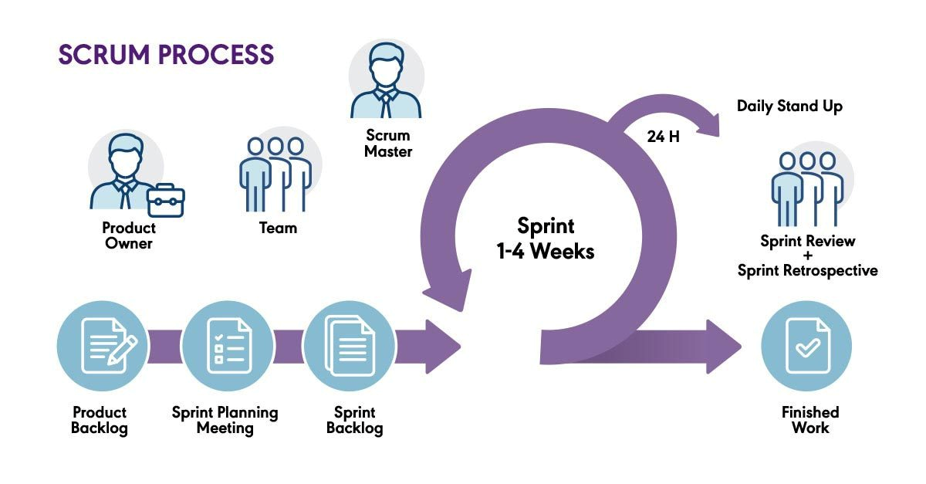

Slide 12
1. Key Roles in Scrum
Product Owner: Responsible for defining the product vision and maintaining the Product Backlog (a prioritized list of tasks and features).
Scrum Master: Facilitates the Scrum process, ensuring the team follows Scrum principles and removes obstacles.
Team: The development team that executes the work defined in the Sprint Backlog.

Slide 13
2. Scrum Workflow
Product Backlog: A prioritized list of tasks, features, and requirements that need to be developed.
Sprint Planning Meeting: The team selects items from the Product Backlog and creates a Sprint Backlog (a subset of tasks to be completed within a Sprint).
Sprint Backlog: A structured list of work items that the team commits to completing during a Sprint.

Slide 14
2. Scrum Workflow
Sprint Execution (1-4 Weeks):
The development team works on tasks in iterative cycles called Sprints.
A Sprint lasts between 1 to 4 weeks.
A Daily Stand-up (every 24 hours) is held where the team discusses progress, challenges, and plans for the day.

Slide 15
2. Scrum Workflow
Sprint Review & Sprint Retrospective:
Sprint Review: The team demonstrates completed work to stakeholders.
Sprint Retrospective: The team reflects on the Sprint, discussing improvements for the next iteration.

Slide 16
2. Scrum Workflow
Finished Work: Once reviewed, the completed tasks contribute to the overall product.
This cycle repeats for each Sprint, ensuring continuous improvement and delivery. Would you like a more detailed breakdown of any part?

Slide 17
KANBAN
Kanban (which means “visual card” in Japanese) is a system that helps visualize the flow of work. It originated from Toyota’s manufacturing system, but now it’s widely used in Agile project management.

Slide 18
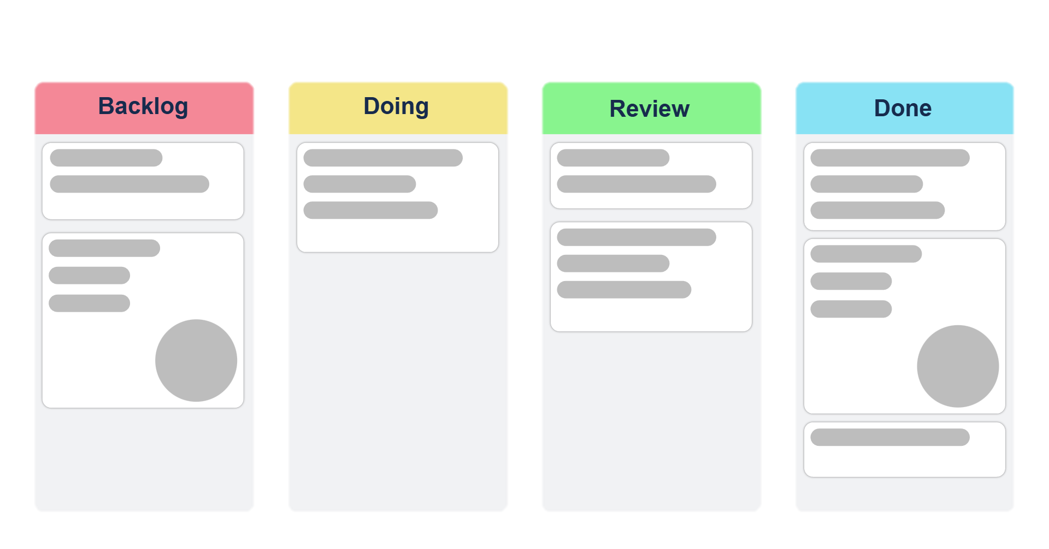
KANBAN BOARD

Slide 19
Understanding the Kanban Board :
Backlog
This column contains tasks that need to be done but haven't been started yet.
It's essentially a queue of pending work.
Doing
Tasks in this column are actively being worked on.
Work-in-progress (WIP) limits can be set to avoid overload.

Slide 20
Understanding the Kanban Board :
Review
This is where tasks go when they need approval, testing, or verification before completion.
Done
Tasks that have been completed successfully move to this column.
It serves as a record of finished work.

Slide 21
How It Works
Each task is represented by a card with details like a title, description, and possibly an assigned person.
Cards move from left to right as work progresses, making it easy to track status at a glance.
The system promotes continuous delivery, as tasks can move through the process smoothly without waiting for a batch completion

Slide 22
Stephen Hawking
Intelligence is the ability to adapt to change.

