Slide 1
Sales Analysis with SQL

Slide 2
Business Problem : To analyze sales data of Amazon to understand the different factors that affect sales of three different branches in 3 different Cities Mandalay, Naypyitaw & Yangon

Slide 3
Dimension of data : 17 columns and 1000 rows
Columns in the Data :
Column | Description
Column | Description
invoice_id | Invoice of the sales made
Branch | Branch at which sales were made
City | The location of the branch
customer_type | The type of the customer
Gender | Gender of the customer making purchase
product_line | Product line of the product sold
unit_price | The price of each product
Quantity | The amount of the product sold
VAT | The amount of tax on the purchase
total | The total cost of the purchase
date | The date on which the purchase was made
time | The time at which the purchase was made
payment_method | The total amount paid
cogs | Cost Of Goods sold
gross_margin_percentage | Gross margin percentage
gross_income | Gross Income
rating | Rating

Slide 4
Platforms Used
Queries written on My SQL Work Bench for Data Retrieval from the Database.
SQL Functions Used to Retrieve data – Common Table Expressions, Windows Functions(Rank, Ntile, Dense_Rank, Count, Sum, Avg, ), Case Expressions, Sub Queries etc.,
Jupyter Notebook – Used pandas functions for more Analysis into the data & for more Visual Presentation on Analysis.

Slide 5
Analysis & Insights

Slide 6
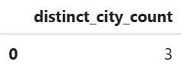
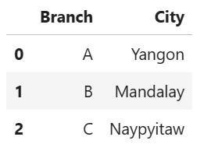
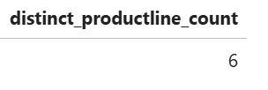
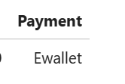
#1. What is the count of distinct cities in the dataset? SELECT count(distinct City) as distinct_city_count from amazon ; #2. For each branch, what is the corresponding city? SELECT distinct(Branch), City from amazon order by Branch; #3. What is the count of distinct product lines in the dataset? SELECT count(distinct `Product line`) as distinct_productline_count from amazon;
#4. Which payment method occurs most frequently?
WITH paymode as (SELECT Payment, count(*) as Paymode_count from amazon group by Payment)
SELECT Payment FROM paymode Where Paymode_count = (SELECT MAX(Paymode_count) FROM paymode);

Slide 7

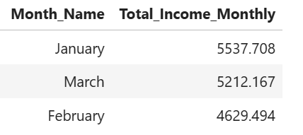
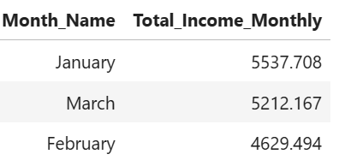
# 5. Which product line has the highest sales?
With Total_Prod_Sales as (
SELECT `Product line`, sum(Total) as Product_Sale FROM amazon group by `Product line`)
SELECT `Product line` FROM Total_Prod_Sales WHERE Product_Sale IN (SELECT MAX(Product_Sale) FROM Total_Prod_Sales);
#6. How much revenue is generated each month?
SELECT monthname as Month_Name, sum(`gross income`) as Total_Income_Monthly from amazon group by Month_Name;
#7. In which month did the cost of goods sold reach its peak?
with M_cogs as (
SELECT monthname as Month_Name, sum(cogs) as
TotalCost_OfSoldGoods from amazon group by Month_Name )
SELECT Month_Name from M_cogs WHERE TotalCost_OfSoldGoods = (SELECT MAX(TotalCost_OfSoldGoods) FROM M_cogs);

Slide 8

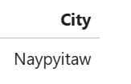

#8. Which product line generated the highest revenue?
With Prod_Wise_Rev as (
SELECT `Product line`, sum(`gross income`) as Product_Revenue FROM amazon group by `Product line`)
SELECT `Product line` FROM Prod_Wise_Rev WHERE Product_Revenue IN (SELECT MAX(Product_Revenue) FROM Prod_Wise_Rev);
#9. In which city was the highest revenue recorded?
WITH cgr as (SELECT City, sum(`gross income`) as City_Gross_Income from amazon group by City)
SELECT City from cgr where City_Gross_Income IN (SELECT max(City_Gross_Income) from cgr);
#10. Which product line incurred the highest Value Added Tax?
SELECT `Product line` FROM (
SELECT `Product line`, sum(`Tax 5%`) as Tax FROM amazon group by `Product line` order by Tax desc limit 1) as ht;

Slide 9
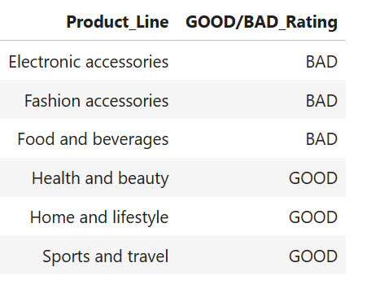

#11.For each product line, add a column indicating "Good" if its sales are above average, otherwise "Bad."
SELECT Product_Line,
Case
When prod_Avg_Sale>All_Avg_Sale THEN "GOOD"
ELSE "BAD" END AS "GOOD/BAD_Rating"
FROM(
SELECT distinct(`Product line`) as Product_Line,
avg(Total) over(partition by `Product line`) as prod_Avg_Sale,
avg(Total) over() as All_Avg_Sale from amazon ) as Sale;
#12.Identify the branch that exceeded the average number of products sold.
SELECT Branch FROM(
SELECT distinct(Branch),
avg(Quantity) over(partition by Branch) as prod_Avg_Sale,
avg(Quantity) over() as All_Prod_Avg_Sale from amazon
) as Branch_Sale WHERE prod_Avg_Sale>All_Prod_Avg_Sale;

Slide 10
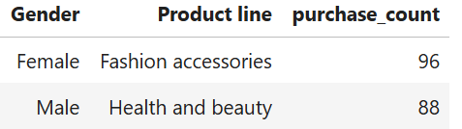
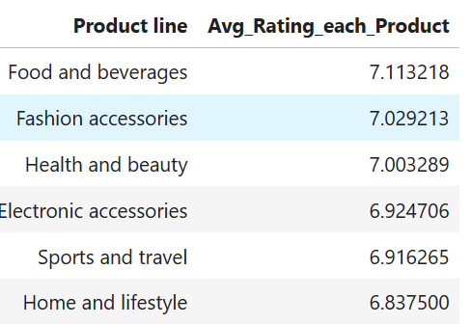
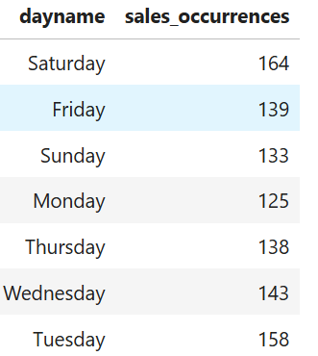
#13. Which product line is most frequently associated with each gender?
SELECT Gender, `Product line`, purchase_count
FROM (
SELECT Gender, `Product line` , COUNT(*) AS purchase_count,
RANK() OVER (PARTITION BY Gender ORDER BY COUNT(*) DESC) AS prod_rank
FROM amazon GROUP BY Gender, `Product line`
) AS gender_product_counts WHERE prod_rank = 1;
#14. Calculate the average rating for each product line.
SELECT distinct(`Product line`), avg(Rating) over(partition by `Product line`) as Avg_Rating_each_Product from amazon order by Avg_Rating_each_Product desc;
#15. Count the sales occurrences for each time of day on every weekday.
SELECT dayname, timeofday, count(*) as sales_occurrences from amazon group by dayname, timeofday order by dayname;

Slide 11

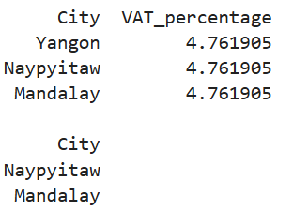

#16. Identify the customer type contributing the highest revenue.
SELECT `Customer type` FROM(
SELECT `Customer type`, sum(`gross income`) as customer_wise_revenue from amazon group by `Customer type`
order by customer_wise_revenue desc LIMIT 1) as sq1;
# 17. Determine the city with the highest VAT percentage.
SELECT City, (sum(`Tax 5%`)/sum(Total))*100 as VAT_percentage from amazon group by City;
#18. Identify the customer type with the highest VAT payments.
with customer_vat as(
SELECT `Customer type`, sum(`Tax 5%`) as customer_VAT_amount from amazon group by `Customer type`)
SELECT `Customer type` from customer_vat where customer_VAT_amount IN (SELECT MAX(customer_VAT_amount) FROM customer_vat);

Slide 12



#19. What is the count of distinct customer types in the dataset?
SELECT count(distinct(`Customer type`)) as Distinct_Customer_Types from amazon;
#20. What is the count of distinct payment methods in the dataset?
SELECT count(distinct(Payment)) as Distinct_Payment_Types from amazon;
#21. Which customer type occurs most frequently?
SELECT `Customer type` FROM amazon
GROUP BY `Customer type` HAVING COUNT(*) =
(
SELECT MAX(type_count) FROM (SELECT COUNT(*) AS type_count FROM amazon
GROUP BY `Customer type`
) AS cust_type_counts
);

Slide 13
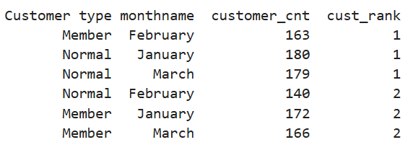
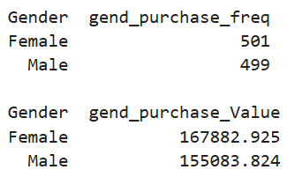
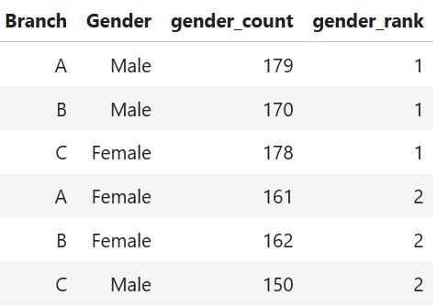
#22. Identify the customer type with the highest purchase frequency.
SELECT `Customer type`, monthname, customer_cnt, cust_rank
FROM (SELECT `Customer type`, monthname, COUNT(*) AS customer_cnt,
RANK() OVER (PARTITION BY monthname ORDER BY COUNT(*) DESC) AS cust_rank FROM amazon GROUP BY `Customer type` , monthname) AS cust_freq order by cust_rank;
#23. Determine the predominant gender among customers.
SELECT Gender, count(*) as gend_purchase_freq from amazon group by Gender;
SELECT Gender, sum(Total) as gend_purchase_Value from amazon group by Gender;
#24. Examine the distribution of genders within each branch.
SELECT Branch, Gender, gender_count, gender_rank
FROM (SELECT Branch, Gender, COUNT(*) AS gender_count,
RANK() OVER (PARTITION BY Branch ORDER BY COUNT(*) DESC) AS gender_rank
FROM amazon GROUP BY Branch, Gender) AS gender_dist order by gender_rank;

Slide 14
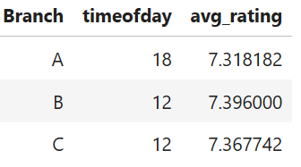
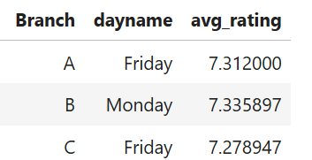
#25. Identify the time of day when customers provide the most ratings.
SELECT Branch, timeofday, avg_rating
FROM (
SELECT Branch, timeofday, AVG(Rating) AS avg_rating,
RANK() OVER (PARTITION BY Branch
ORDER BY AVG(Rating) DESC) AS rating_rank
FROM amazon GROUP BY Branch, timeofday
) AS rating_distribution WHERE rating_rank = 1;
#26. Determine the time of day with the highest customer ratings for each branch.
SELECT Branch, dayname, avg_rating
FROM (
SELECT Branch, dayname, AVG(Rating) AS avg_rating,
dense_RANK() OVER (PARTITION BY Branch
ORDER BY AVG(Rating) DESC) AS rating_rank
FROM amazon GROUP BY Branch, dayname
) AS rating_distribution WHERE rating_rank = 1;

Slide 15

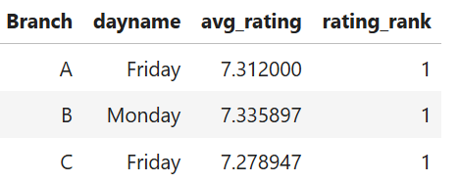
#27. Identify the day of the week with the highest average ratings.
SELECT dayname, avg_rating, rating_rank
FROM (
SELECT dayname, AVG(Rating) AS avg_rating,
RANK() OVER (ORDER BY AVG(Rating) DESC) AS rating_rank
FROM amazon GROUP BY dayname
) AS rating_distribution where rating_rank=1;
#28. Determine the day of the week with the highest average ratings for each branch.
SELECT Branch, dayname, avg_rating, rating_rank
FROM (
SELECT Branch, dayname, AVG(Rating) AS avg_rating,
DENSE_RANK() OVER (partition by Branch
ORDER BY AVG(Rating) DESC) AS rating_rank
FROM amazon
GROUP BY Branch, dayname
) AS rating_distribution WHERE rating_rank=1;

Slide 16
INSIGHTS & OUTCOME OF ANALYSIS

Slide 17
INSIGHTS :
Ewallet Payment Mode is done more frequently.
Food and Beverages Product Line has the Highest Sales and also highest Revenue.
In the Month of January more Revenue generated & in February less Revenue generated.
In Janury month total Cost of Goods reaches peaks.
City “Naypyitaw” has generated Highest Revenue.
Female more purchased with “Fashion Accessories” and Male with “Health & Beauty” product lines.
Food and beverages are highly rated & Home and LifeStyle less rated.
On Saturdays more Orders occurred and on Mondays less orders occurred.
“Member” contributing for high revenue generation.
“NORMAL” Customer type has highest purchase frequency.
Female Gender dominated with more Purchase Value.
Male Customers are more in A & B branches. Where as in C branch Female customers are more than male.

Slide 18
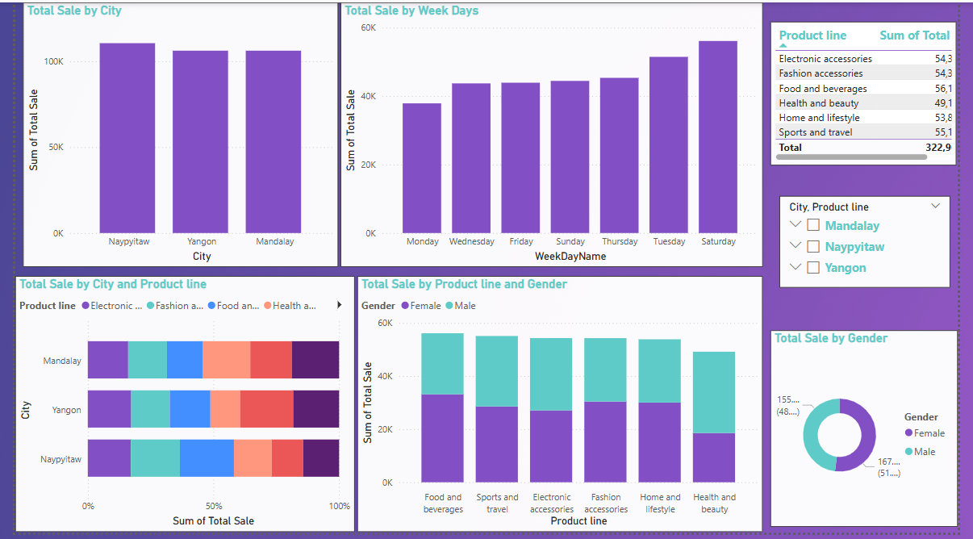
Sales Analysis Dashboard

Slide 19
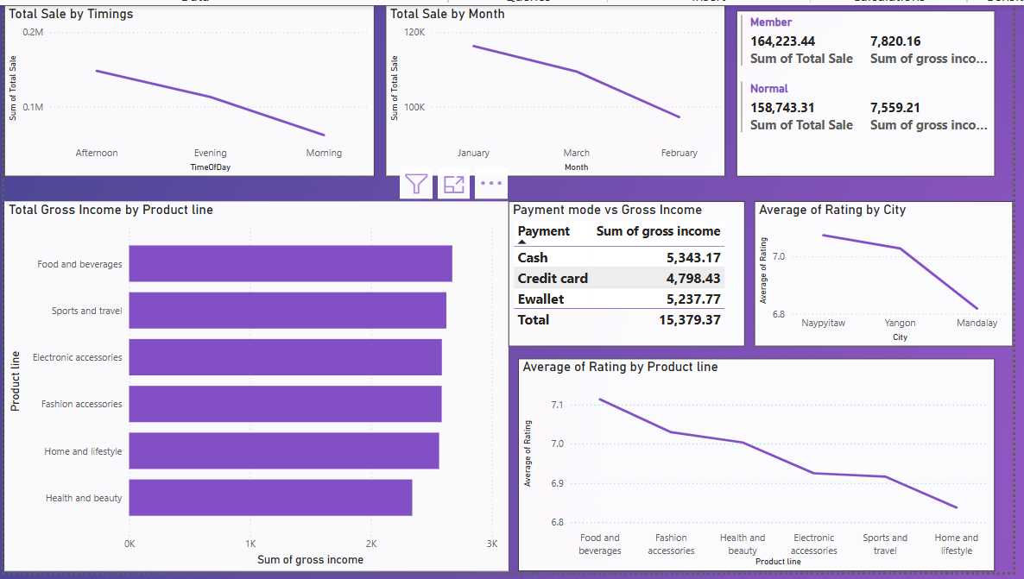
Trend Analysis Dashboard

Slide 20
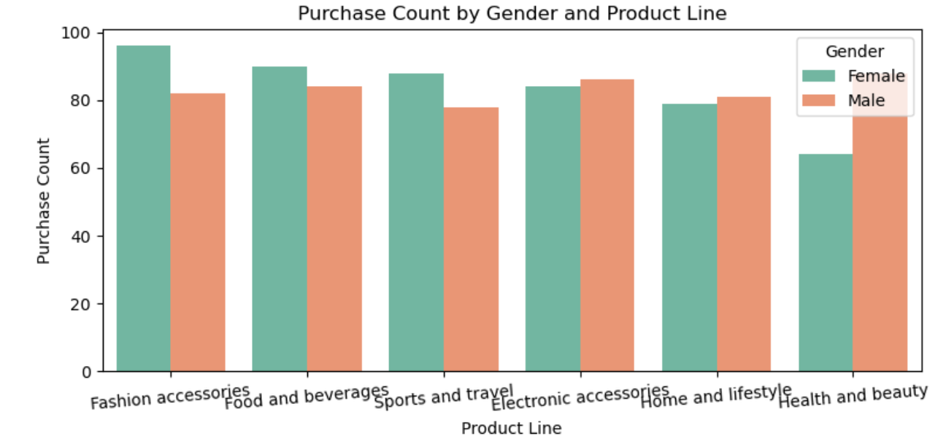
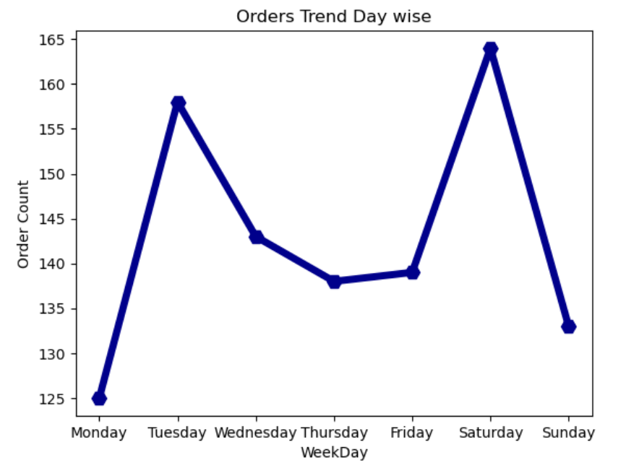
1. Product Analysis
Food and beverages are highly rated & Home and LifeStyle less rated.
Food and Beverages Product Line has the Highest Sales and also highest Revenue.
Fashion Accessories has High orders placed, Health & Beauty has Less orders placed.
We see there is a substantial difference in orders by Male & Female in this Product Lines : “Fashion Accessories” and “Health and Beauty”.
We See more orders between 13hrs to 15hrs and Less orders between 19hrs to 20hrs.

Slide 21
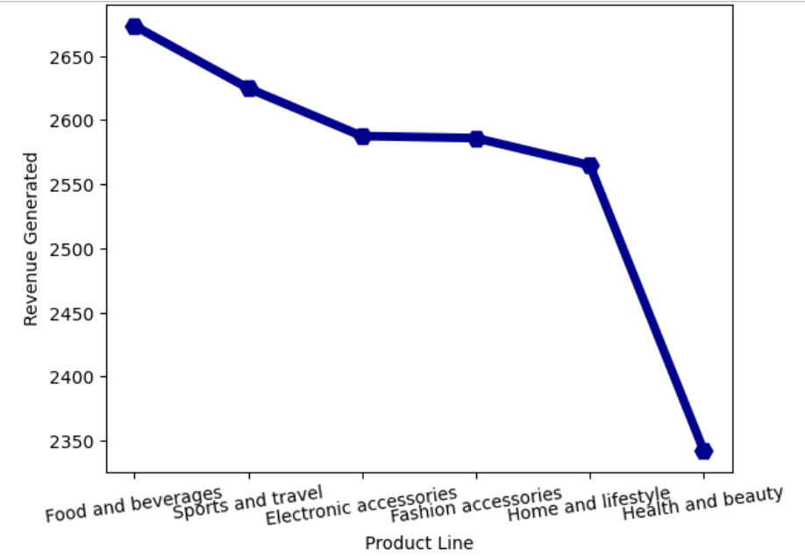
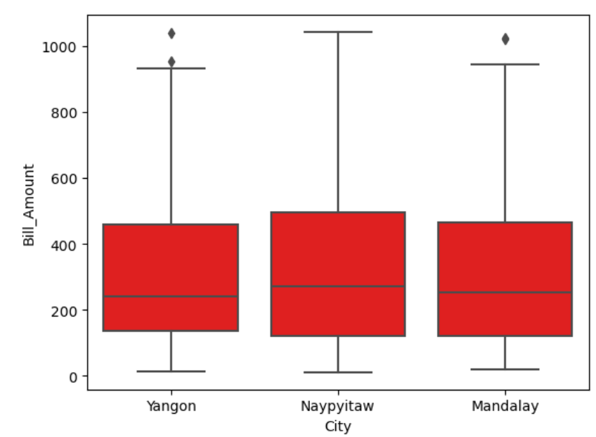
2. Sales Analysis
We see much Total Sale value happens at Naypyitaw City. Yangon & Mandalay is moderate.
Female Gender contributing good Sale compared to Male. So, need to target Male customers.
More Sale is seen on Saturdays, Less Sale on Monday & moderate in remaining days.
We see very good sale at 19, 10 & 13 hours. Less Sale at 20, 17 & 16 hours.
We See more Sales in month of January and need to improve Sales February month.

Slide 22
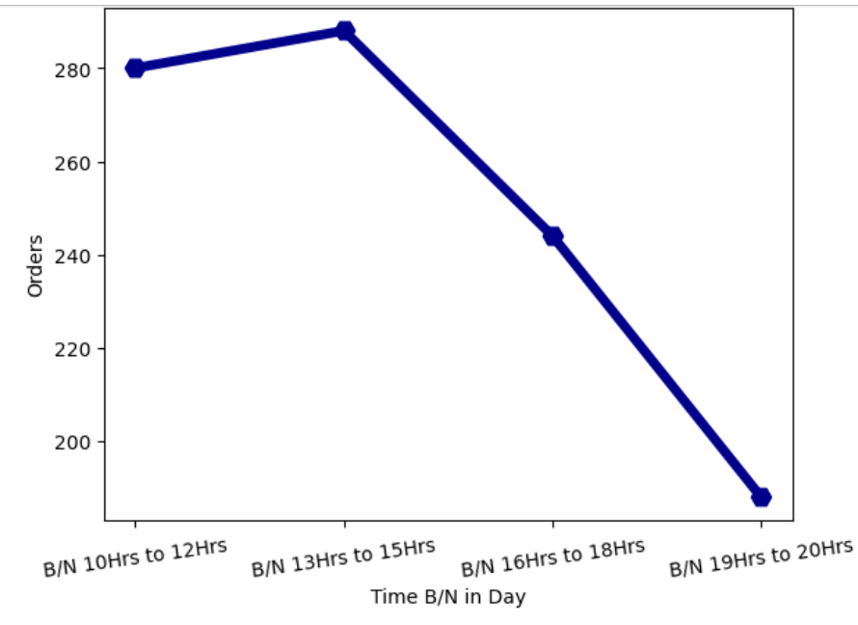
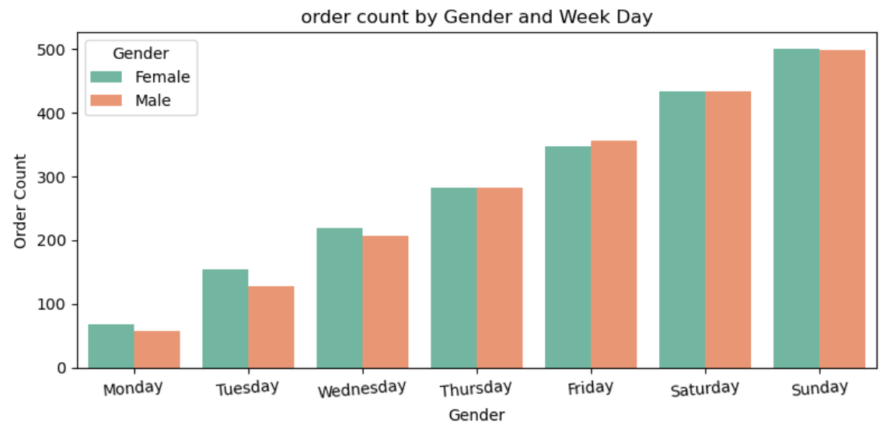
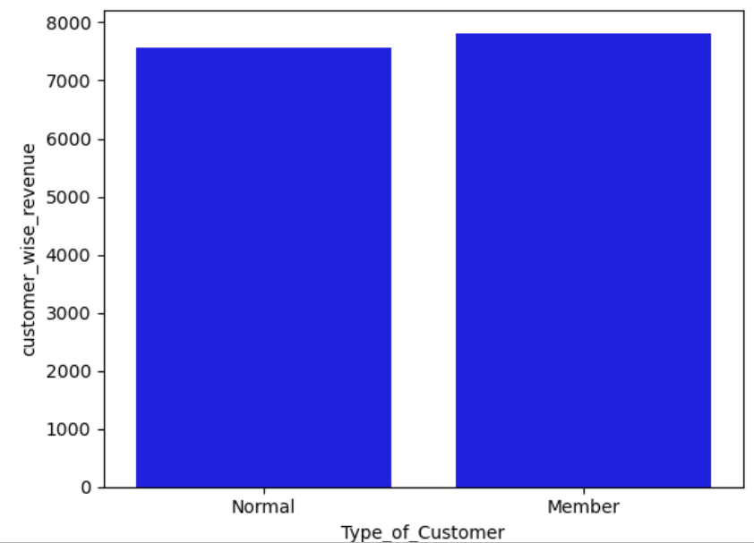
3. Customer Analysis
Female are more number of purchased with “Fashion Accessories” and Male with “Health & Beauty”.
Female Gender dominated with more Purchase Value.
Member contributes High purchase value & revenue than the
normal Customer. So, Encourage Membership to increase Sales.
Cash Payment contributed more Sale & Revenue generation.
The Mood of customers is seen in below Trends.

Slide 23
THANK YOU

