Slide 1
A Tutorial on the
Zachman Framework for
Enterprise Architecture

Slide 2
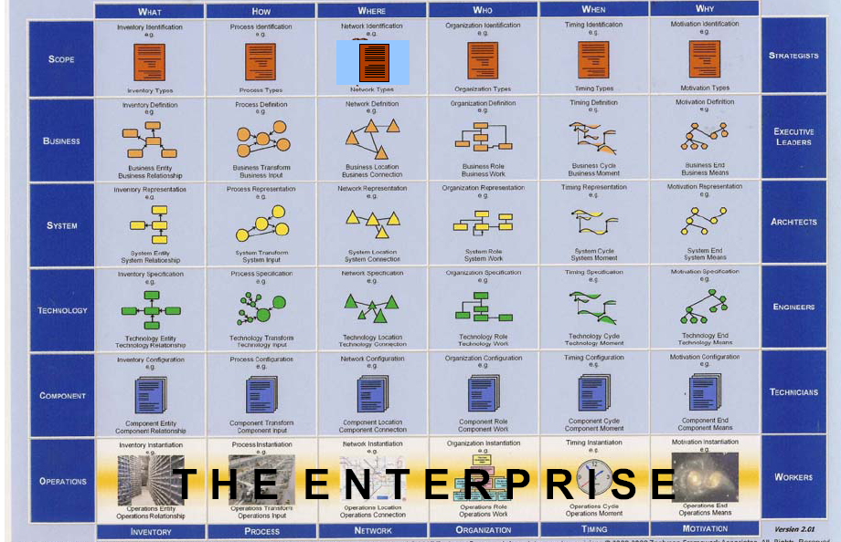
Zachman Framework

Slide 3
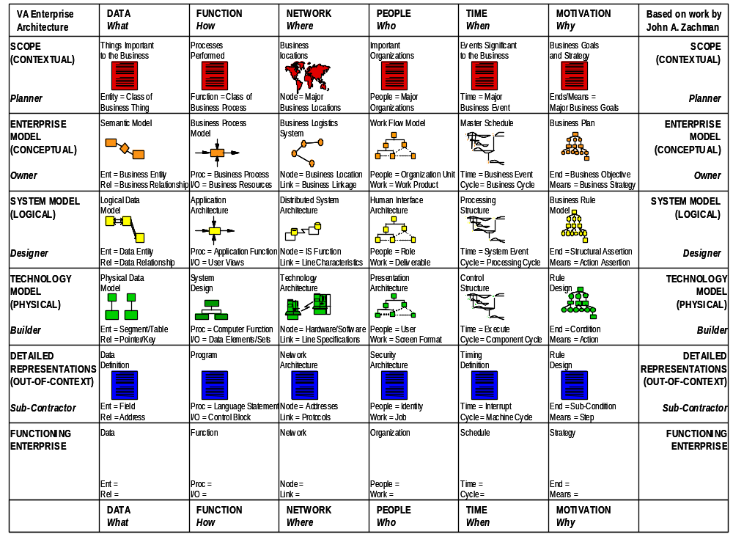
Zachman Framework

Slide 4
Zachman Framework
Row 1 – Scope
  External Requirements and Drivers
  Business Function Modeling
Row 2 – Enterprise Model
  Business Process Models
Row 3 – System Model
  Logical Models
  Requirements Definition
What
How
Where
Who
When
Why
1
Contextual
Contextual
Row 4 – Technology Model
  Physical Models
  Solution Definition and Development
2
Conceptual
Conceptual
3
Logical
Logical
Row 5 – As Built
  As Built
  Deployment
4
Physical
Physical
Row 6 – Functioning Enterprise
  Functioning Enterprise
  Evaluation
5
As Built
As Built
6
Functioning
Functioning
What
How
Where
Who
When
Why

Slide 5
Framework Rules
Basic Model = Entities and Relationships
Rule 1:
Columns have no order
Entity
Relationship
Entity
Rule 2:
Each column has a simple, basic model
What
How
Where
Who
When
Why
Contextual
Contextual
Rule 3:
Basic model of each column is unique
Conceptual
Conceptual
Rule 4:
Each row represents a distinct view
Logical
Logical
Physical
Physical
Rule 5:
Each cell is unique
As Built
As Built
Functioning
Functioning
Rule 6:
Combining the cells in one row forms a complete description from that view
What
How
Where
Who
When
Why
Notes:
Framework Rules
Zachman provided the following rules to assist the reader in understanding ISA and its application.
Rule 1: The columns have no order.
Order implies priorities and creates a bias toward one aspect at the expense of others. All columns are equally important because all are abstractions of the same enterprise.
Rule 2: Each column has a simple, basic model.
Each column represents an abstraction from the real world for convenience of description. These models include:
· Data (what), Function (how), Network (where), People (who), Time (when), and Motivation (why)
Rule 3: The basic model of each column must be unique.
The individual models may be related to one another because they are all abstractions of the same real-world enterprise, but each model represents a separate and unique concept.
Rule 4: Each row represents a distinct perspective
This rule is most easily demonstrated by the Business Model, System Model, and Technology Model rows, which represent the owner’s, architect’s, and builder’s perspectives. Each perspective is different because it deals with a different set of constraints. For example, the owner deals with usability constraints, both aesthetic and functional, and the architect deals with design constraints, the laws of physics or nature, and the builder deals with construction constraints, the state of the art in methods and technologies.
Rule 5: Each cell is unique.
Since each column has a unique basic model that makes each column unique and each row has a different perspective, each cell in the framework is unique. Zachman likens ISA to a “periodic table” for information entities, providing a classification scheme for information entities, allowing different entities to be combined to provide different views of an information system.
Because each cell is unique, different techniques and different graphic representations are appropriate for different cells. This also accounts for the large number of information systems design models and methodologies that have emerged over the years.
Rule 6: Combining the cells in one row forms a complete model.
The sum of all cells in a given row is the most complete depiction of reality from the perspective of that row. As new cells in a given row are defined each new cell description must be consistent with the perspective of that row. Each cell in a given row can be defined and is independent of any other cells in the row, yet each cell is but one abstraction of the same perspective of reality. Therefore, each cell is related to every other cell in the same row

Slide 6
Zachman Framework – Row 1
Scope/Planner’s View
Motivation/Why
  Business goals, objectives and performance
  measures related to each function
External Requirements and Drivers
Business Function Modeling
Function/How
  High-level business functions
Data/What
  High-level data classes related to each
  function
What
How
Where
Who
When
Why
1
Contextual
Contextual
People/Who
  Stakeholders related to each function
Conceptual
Conceptual
Logical
Logical
Network/Where
  VA locations related to each function
Physical
Physical
As Built
As Built
Time/When
  Cycles and events related to each
  function
Functioning
Functioning
What
How
Where
Who
When
Why

Slide 7
Zachman Framework – Row 2
Enterprise Model/Designer’s View
Motivation/Why
  Policies, procedures and standards for each
  process
Business Process Models
Business Function Allocation
Elimination of Function Overlap and Ambiguity
Function/How
  Business processes
Data/What
  Business data
What
How
Where
Who
When
Why
Contextual
Contextual
People/Who
  VA roles and responsibilities in each
  process
2
Conceptual
Conceptual
Logical
Logical
Network/Where
  VA locations related to each process
Physical
Physical
As Built
As Built
Time/When
  Events for each process and sequencing
  of integration and process improvements
Functioning
Functioning
What
How
Where
Who
When
Why

Slide 8
Zachman Framework – Row 3
System Model/Designer’s View
Motivation/Why
  VA policies, standards and procedures
  associated with a business rule model
Logical Models
Project Management
Requirements Definition
Function/How
  Logical representation of information
  systems and their relationships
Data/What
  Logical data models of data and data
  relationships underlying VA information
What
How
Where
Who
When
Why
Contextual
Contextual
People/Who
  Logical representation of access privileges
  constrained by roles and responsibilities
Conceptual
Conceptual
3
Logical
Logical
Network/Where
  Logical representation of the distributed
  system architecture for VA locations
Physical
Physical
As Built
As Built
Time/When
  Logical events and their triggered responses
  constrained by business events and their responses
Functioning
Functioning
What
How
Where
Who
When
Why

Slide 9
Zachman Framework – Row 4
Technology Model/Builder’s View
Motivation/Why
  VA business rules constrained by information
  systems standards
Physical Models
Technology Management
Solution Definition and Development
Function/How
  Specifications of applications that operate
  on particular technology platforms
Data/What
  Database management system (DBMS) type
  requirements constrained by logical data models
What
How
Where
Who
When
Why
Contextual
Contextual
People/Who
  Specification of access privileges to
  specific platforms and technologies
Conceptual
Conceptual
Logical
Logical
Network/Where
  Specification of network devices and their
  relationships within physical boundaries
4
Physical
Physical
As Built
As Built
Time/When
  Specification of triggers to respond to system
  events on specific platforms and technologies
Functioning
Functioning
What
How
Where
Who
When
Why

Slide 10
Zachman Framework – Row 5
As Built/Integrator’s View
Motivation/Why
  VA business rules constrained by specific
  technology standards
As Built
Configuration Management
Deployment
Function/How
  Programs coded to operate on specific
  technology platforms
Data/What
  Data definitions constrained by physical
  data models
What
How
Where
Who
When
Why
Contextual
Contextual
People/Who
  Access privileges coded to control access
  to specific platforms and technologies
Conceptual
Conceptual
Logical
Logical
Network/Where
  Network devices configured to conform to
  node specifications
Physical
Physical
5
As Built
As Built
Time/When
  Timing definitions coded to sequence
  activities on specific platforms and technologies
Functioning
Functioning
What
How
Where
Who
When
Why

Slide 11
Zachman Framework – Row 6
Functioning Enterprise/User’s View
Motivation/Why
  Operating characteristics of specific
  technologies constrained by standards
Functioning Enterprise
Operations Management
Evaluation
Function/How
  Functioning computer instructions
Data/What
  Data values stored in actual databases
What
How
Where
Who
When
Why
Contextual
Contextual
People/Who
  VA personnel and key stakeholders
  working within their roles and responsibilities
Conceptual
Conceptual
Logical
Logical
Network/Where
  Sending and receiving messages
Physical
Physical
Integrated
Integrated
Time/When
  Timing definitions operating to sequence
  activities
6
Functioning
Functioning
What
How
Where
Who
When
Why

Slide 12
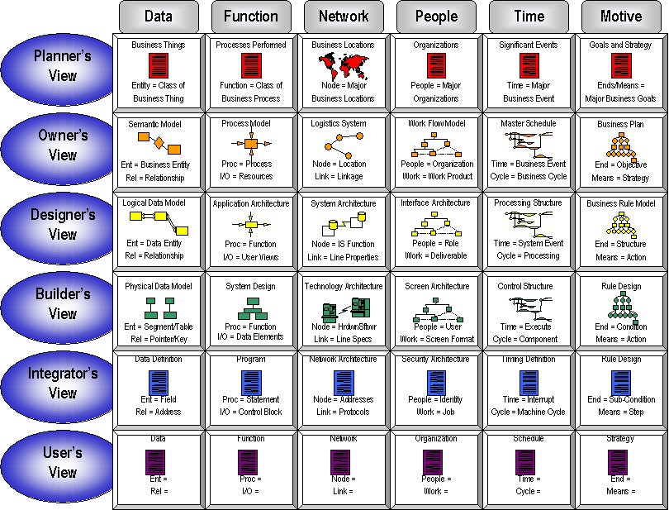
VA Zachman
Framework Portal

